Slide 1
EOForChina, Final meeting
DTU Space
Heidi Ranndal,Ole B. Andersen, and Karina Nielsen

Slide 2
Studying possible improvements of altimetry over Chinese rivers
Science collaboration.
Very fruitful and dynamic interaction and collaboration and science progress.
DTU space providing satellite data to numerous partners and interaction.
Number of joint scientific publications and presentation.
Science achievements:
  Updating the MWaPP retracker
  Implementing Fully Focused SAR (FF-SAR) processing of Sentinel-3 data.
  Studying ICESat-2 data
    ATL03 and ATL13 data for river level determination
    ATL03 data for inland water bathymetry

Slide 3
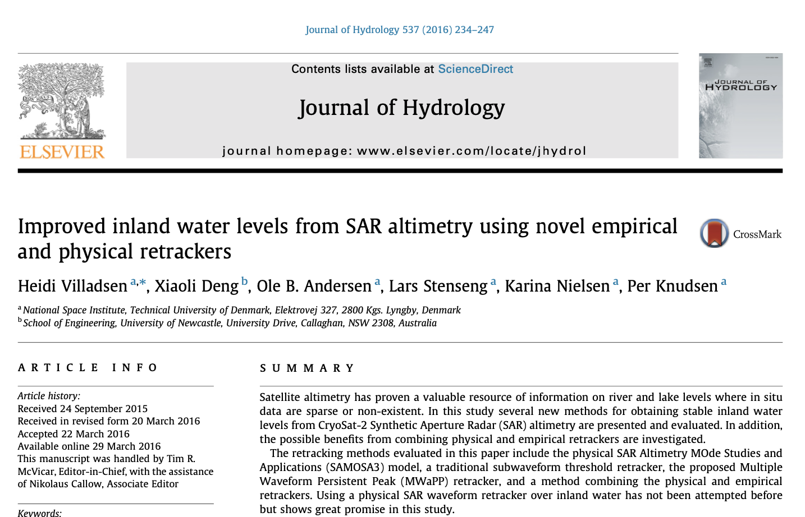
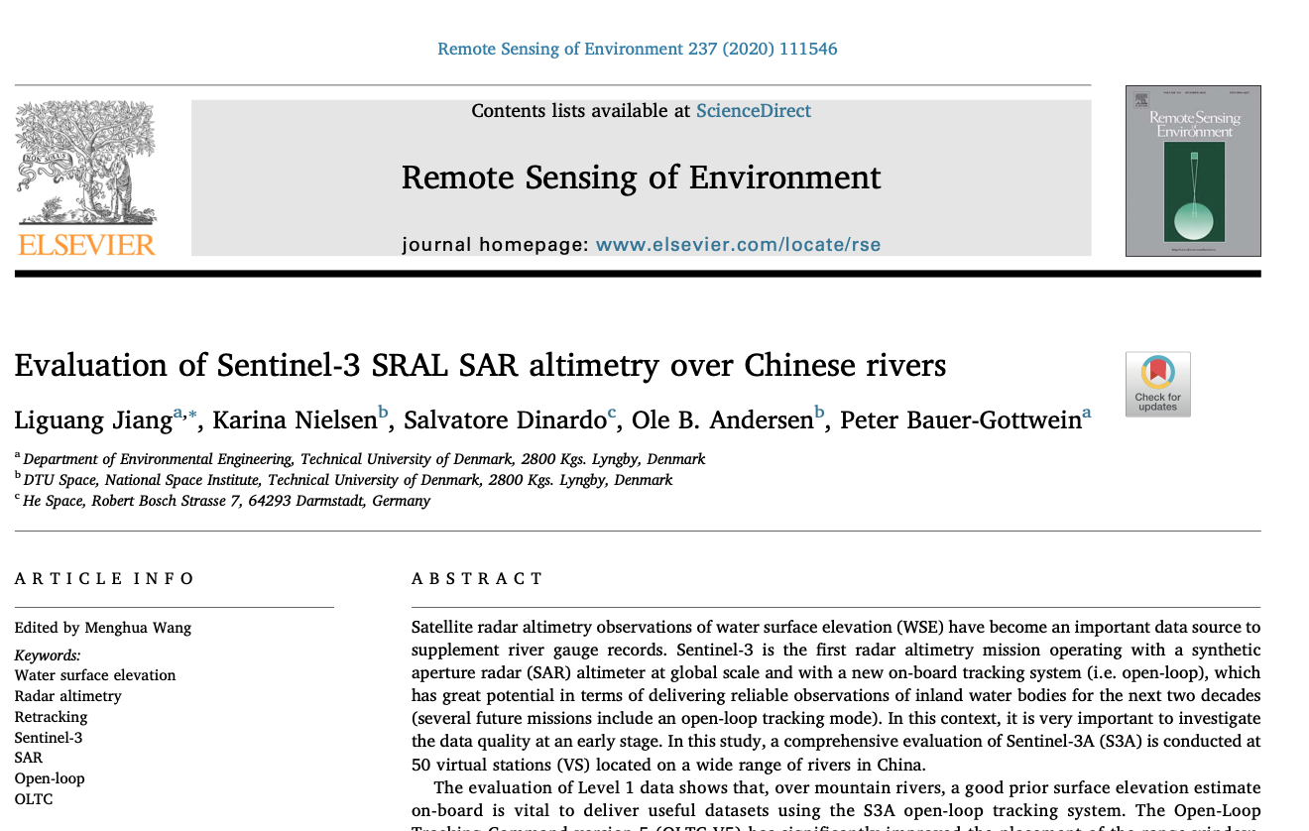
1. Updating the MWaPP retracker
Originally proposed by DTU Space in Villadsen et al. (2016)
  Finds the consistent peak in a series of waveforms retrieved over a waterbody to find the height that is common to the noisy waveforms, which should represent the water surface. Proved to be very useful over water bodies suffering from noisy waveforms.
Improvements made by DTU Environment and DTU Space in Jiang et al. (2020)
  Using a water mask (Global Surface Water Explorer occurrence value) to group waveforms over rivers
  Using the the median waveform of the group to find the common peak instead of the mean waveform.

Slide 4
1. Updating the MWaPP retracker
The suggestions in Jiang et al. (2019) were tested at several locations.
Median instead of mean: Not always the best, but in most cases.
Using a water mask to group all waveforms over a waterbody instead of using just five waveforms can be an issue over large lakes with residual geoid signals or wind effects, or for rivers running parallel to the track. I.e., in cases where we can’t expect the true elevation at nadir to be the same along the track.
All in all, as long as one takes the area into account – the suggestions in Jiang et al. improved the retracker and the changes were implemented and the MWaPP+ retracker can be applied to all SAR waveforms.

Slide 5
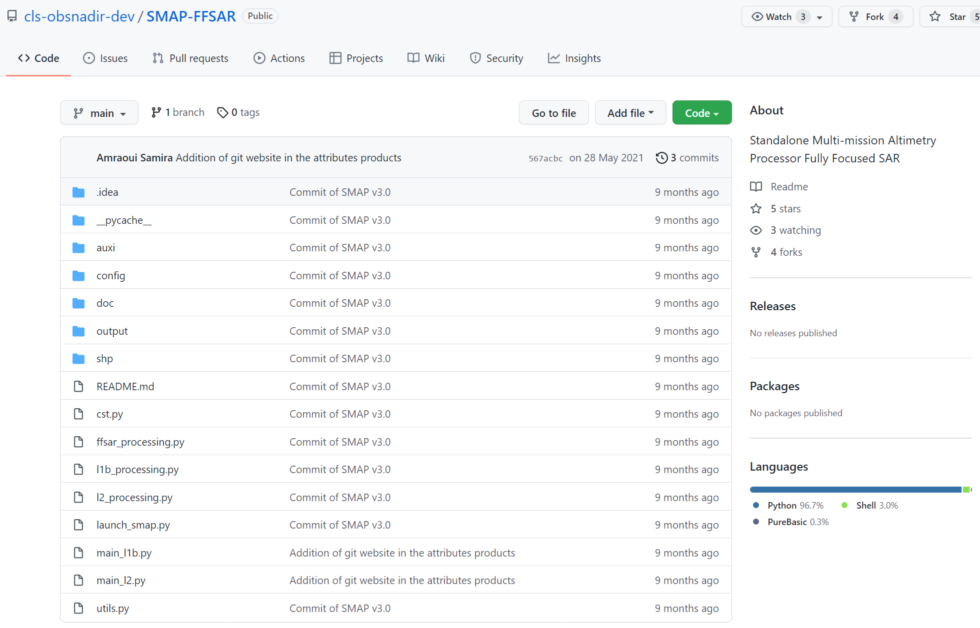
2. Fully-Focused SAR processing
Using the open source SMAP FF-SAR processor developed by CLS/ESA/CNES.
The user can determine the number of looks used to derive the surface height
Possible to increase the along-track resolution down to 50 cm.

Slide 6
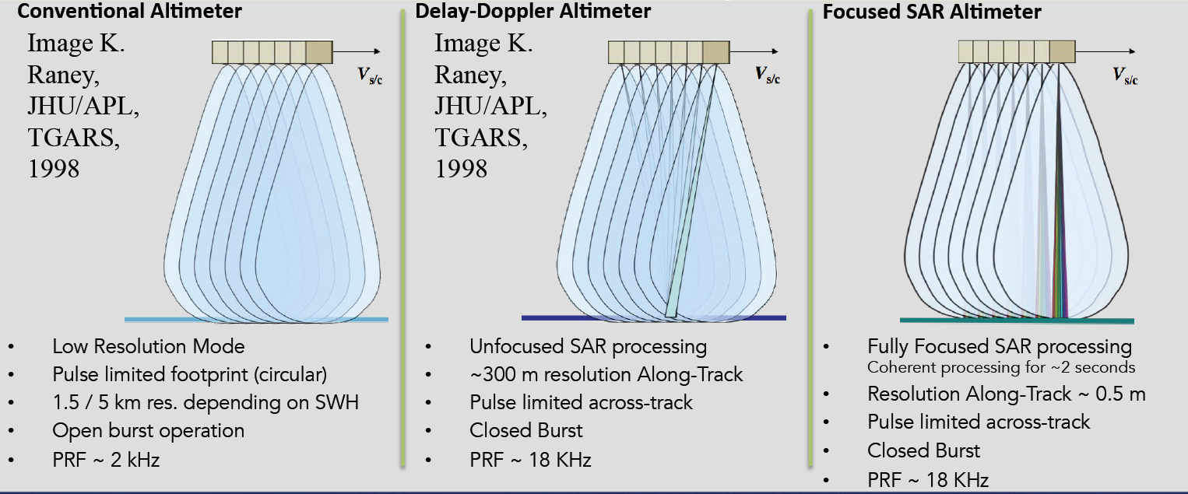
Fully Focused SAR-

Slide 7
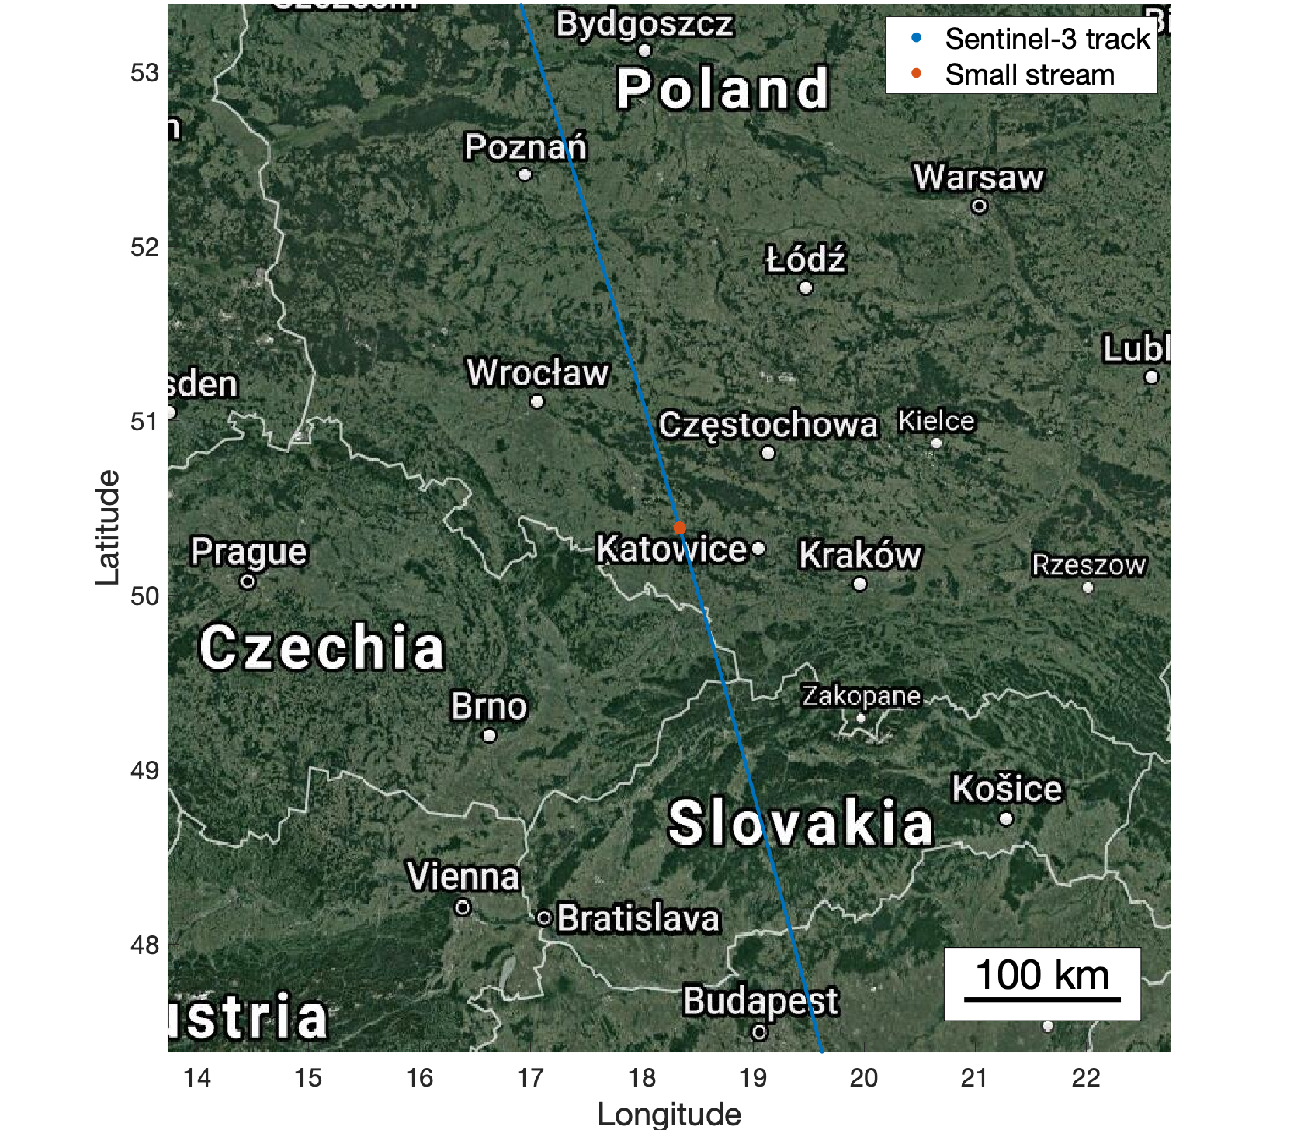
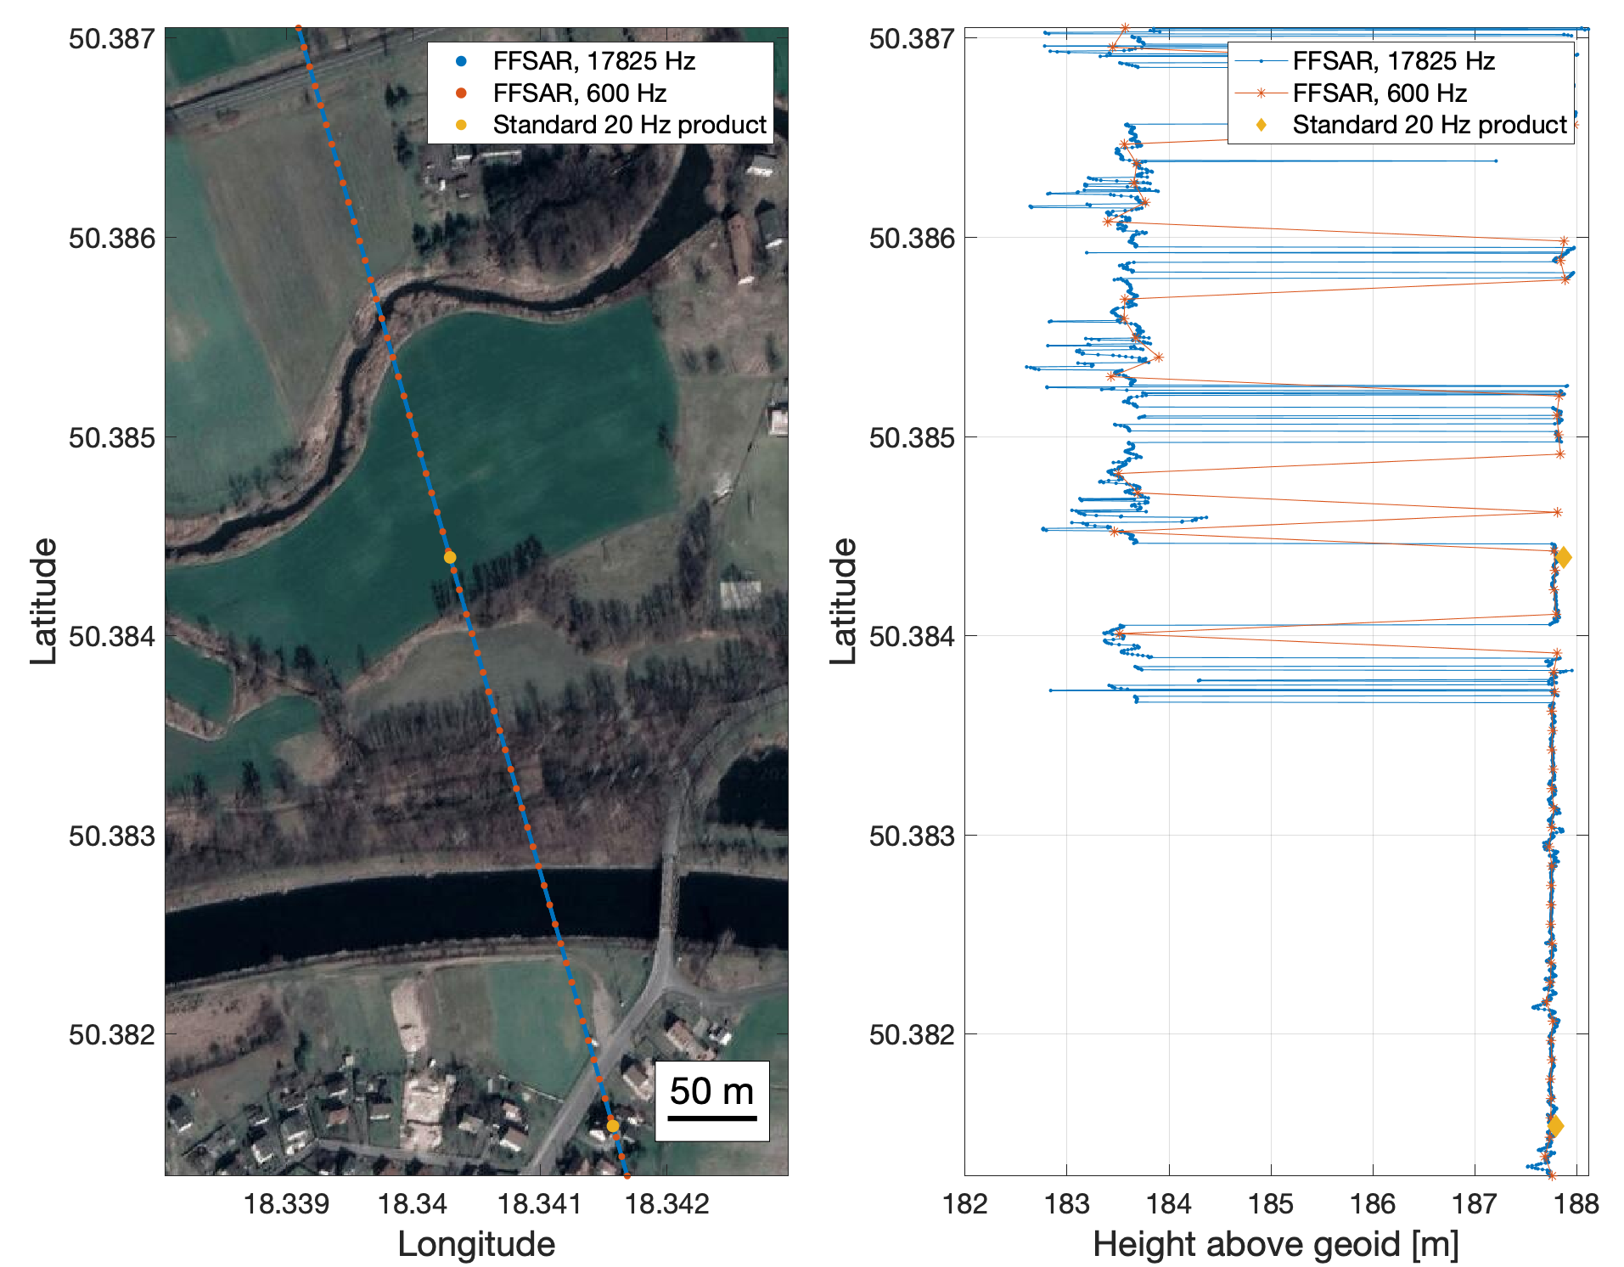
2. Fully-Focused SAR processing
Sentinel-3A, June 28th, 2018
Notes:
Eksempel på en lille å/flod i Polen, hvor FFSAR virker rigtig godt.

Slide 8
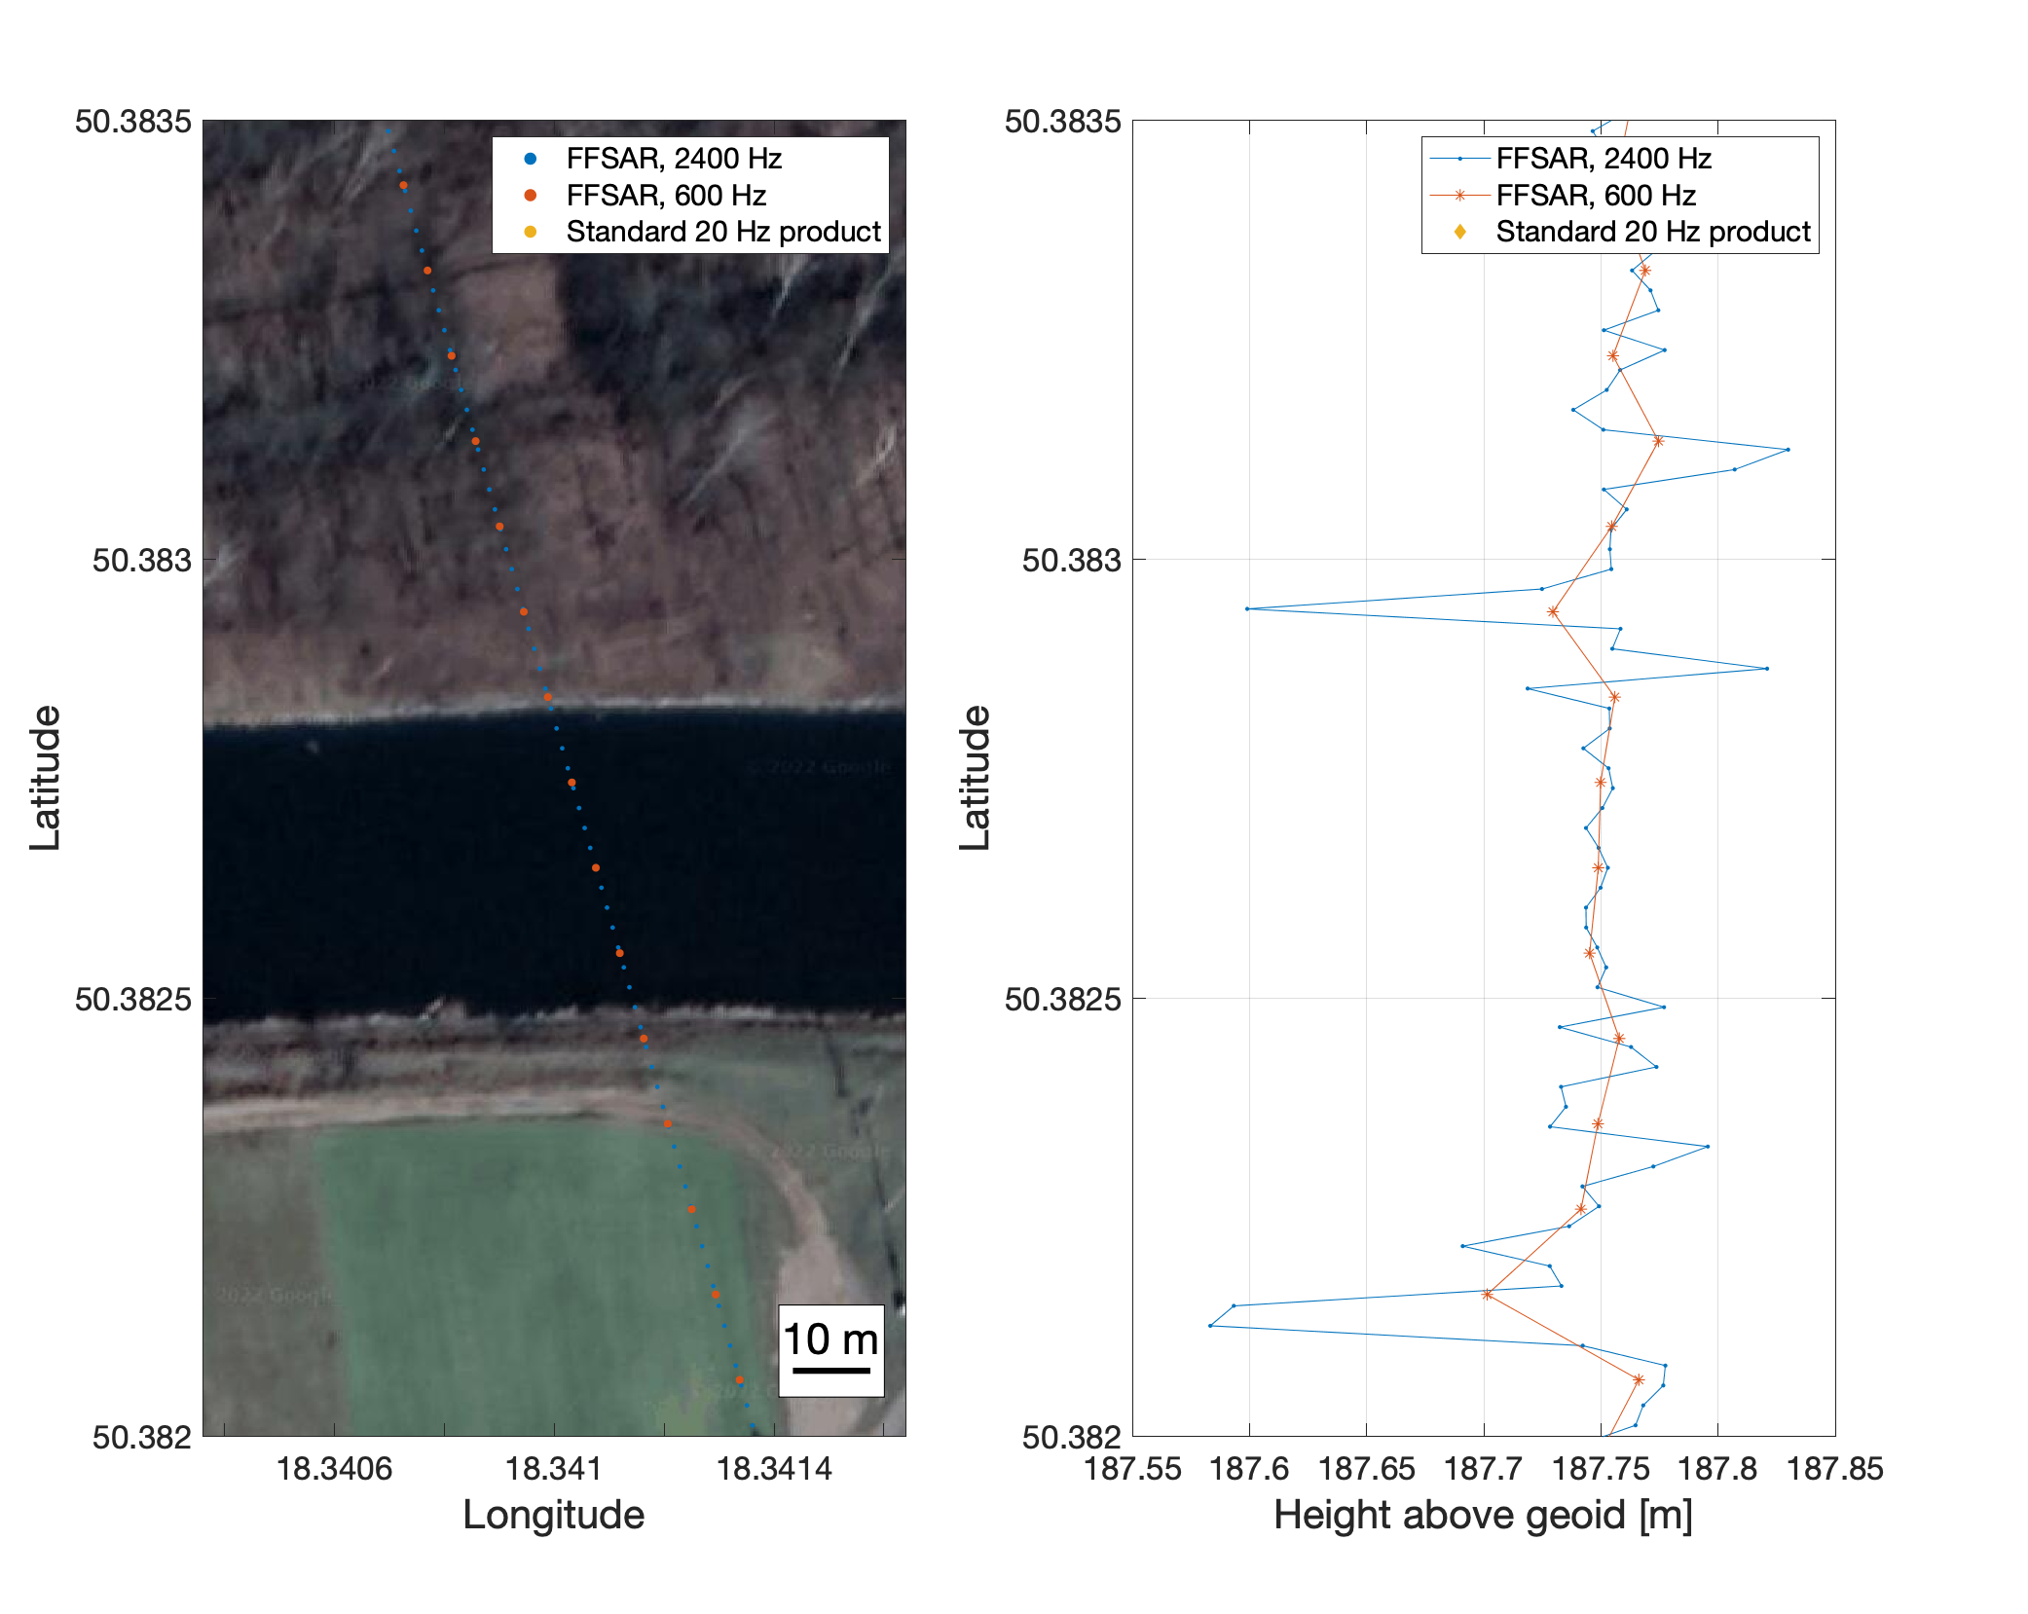
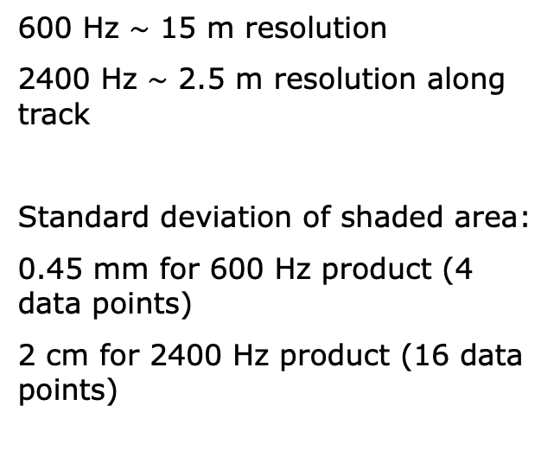
2. Fully-Focused SAR processing
600 Hz $\sim$ 15 m resolution
2400 Hz $\sim$ 2.5 m resolution along track
Standard deviation of shaded area:
0.45 mm for 600 Hz product (4 data points)
2 cm for 2400 Hz product (16 data points)
Notes:
Eksempel på en lille å/flod i Polen, hvor FFSAR virker rigtig godt. Det her er et zoom fra sidste slide.

Slide 9
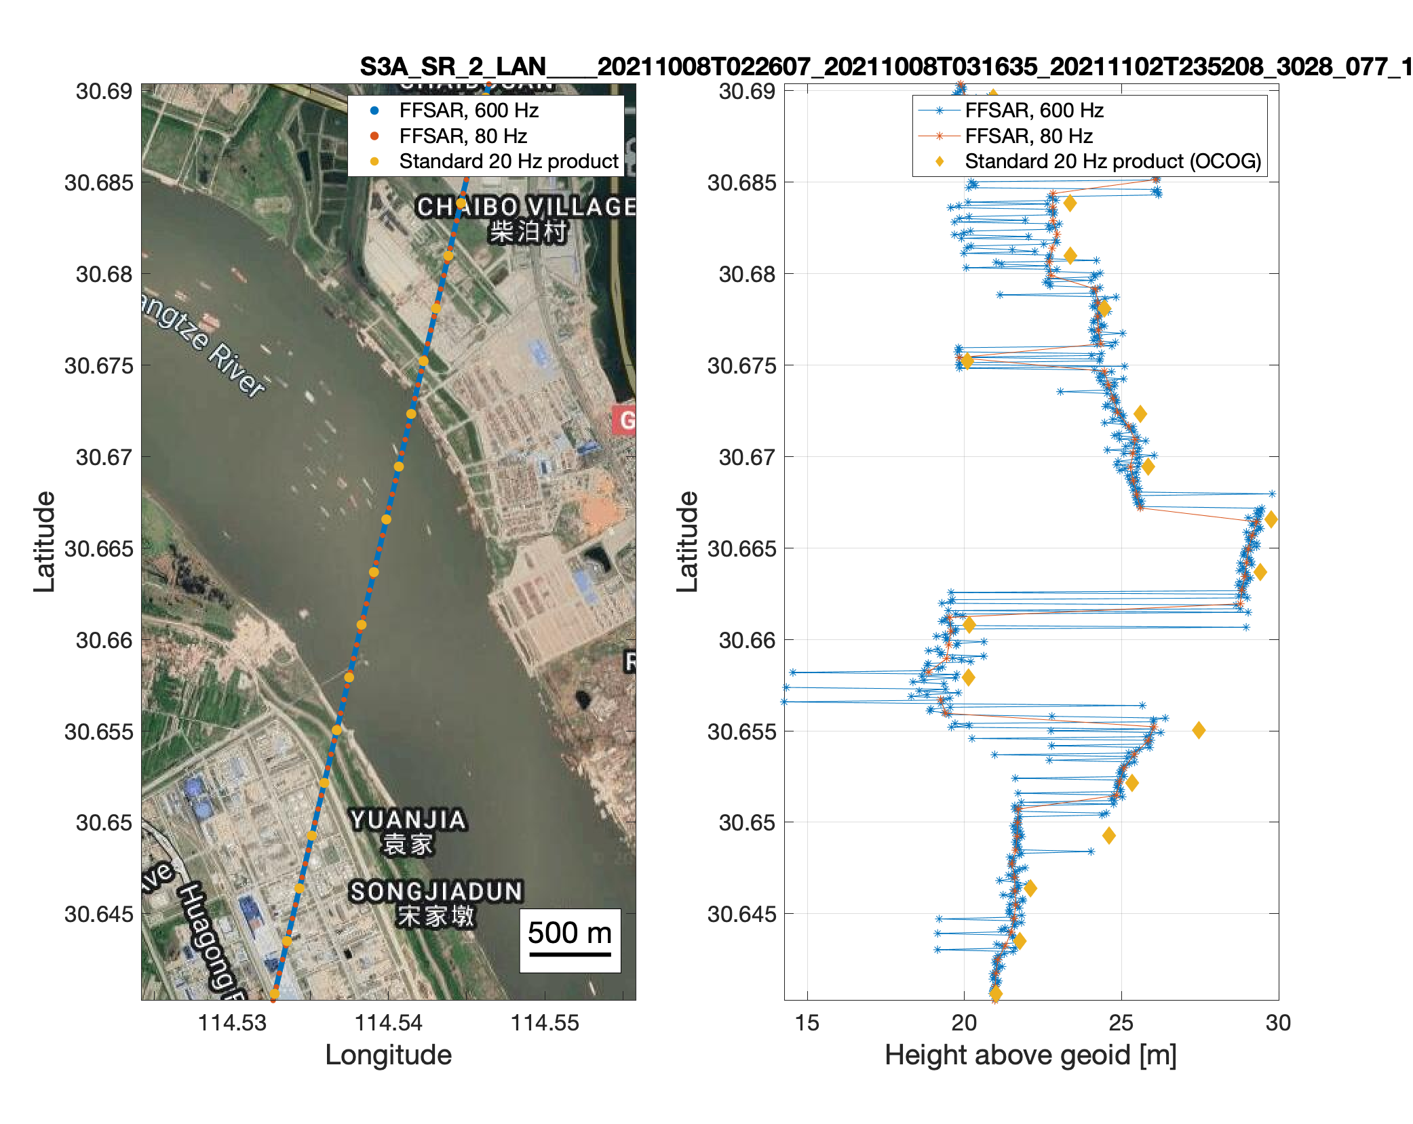
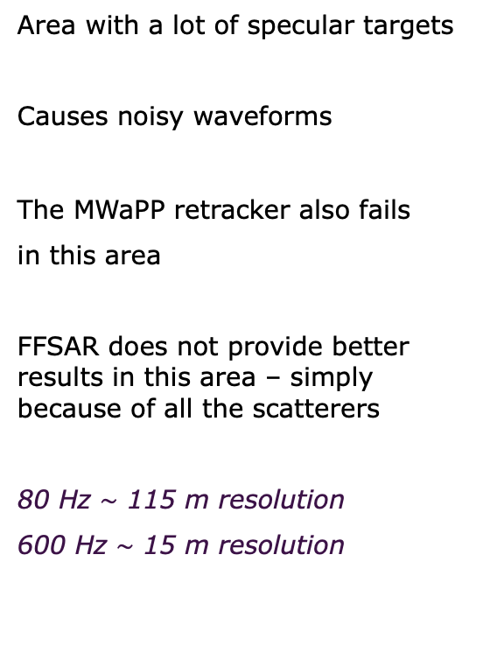
2. Fully-Focused SAR processing - Yangtze River
Area with a lot of specular targets
Causes noisy waveforms
The MWaPP retracker also fails
in this area
FFSAR does not provide better results in this area – simply because of all the scatterers
80 Hz $\sim$ 115 m resolution
600 Hz $\sim$ 15 m resolution
Notes:
Eksempel på Sentinel-3a track der krydser Yangtze nær Wuhan, hvor Peter tidligere har kigget på elendige resultater fra Sentinel-3 SAR data.

Slide 10
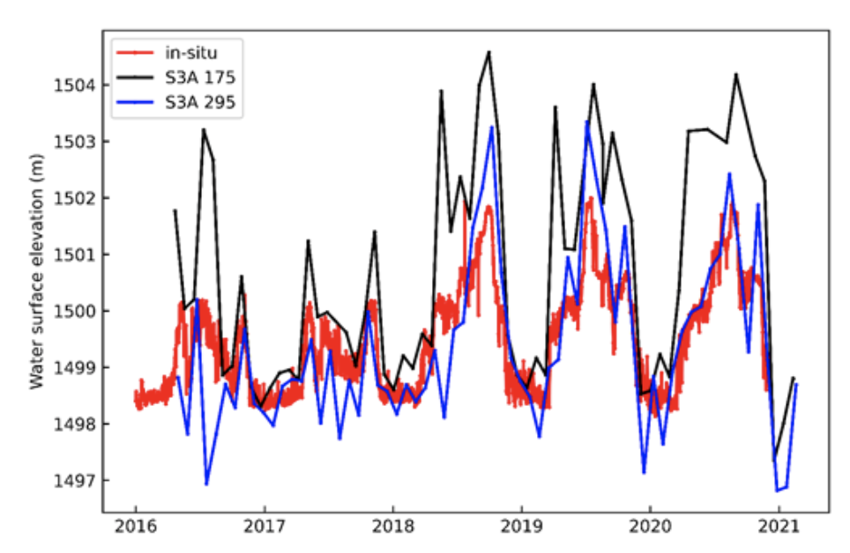
2. Fully-Focused SAR processing - Yellow River
Area with a lot of specular targets and topography within the footprint.
Angle of track wrt. river is important!
WSE from track 175 are too high compared to the in situ.
Track 295
Track 175
From Jun Liu, DTU Environment
Notes:
Det her er et sted, hvor Jun Liu fra DTU Miljø kiggede på Sentinel-3 data fra tracks 175 og 295 (se tidsserier) hvor højderne var helt ved siden af – især om sommeren for track 175. Jeg lovede at kigge på det her sted. Jeg har set på flere overflights af det her spor, og umiddelbart ser det ikke kønt ud. Men måske en hel tidsserie bedre kan vise det. Hans problem var, at 20 Hz data generelt overestimerede niveauet i floden om sommeren.

Slide 11
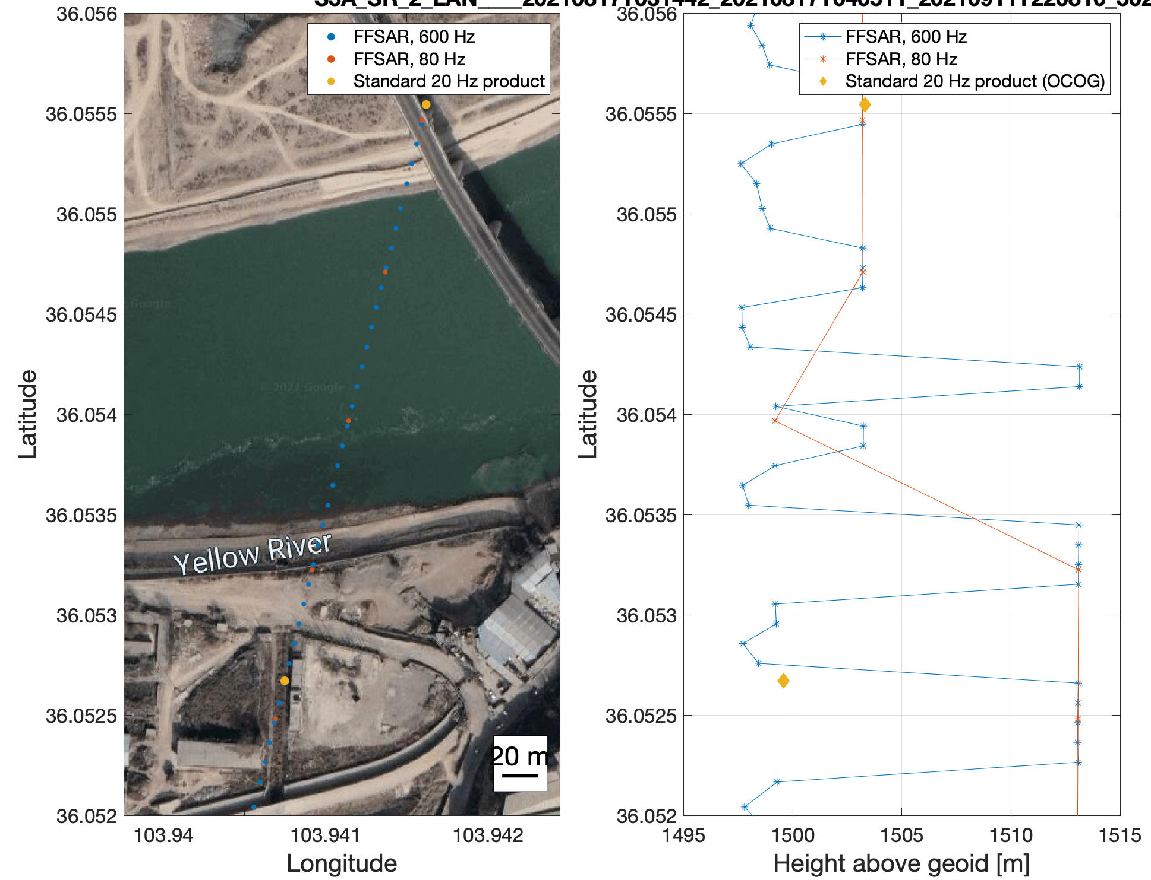
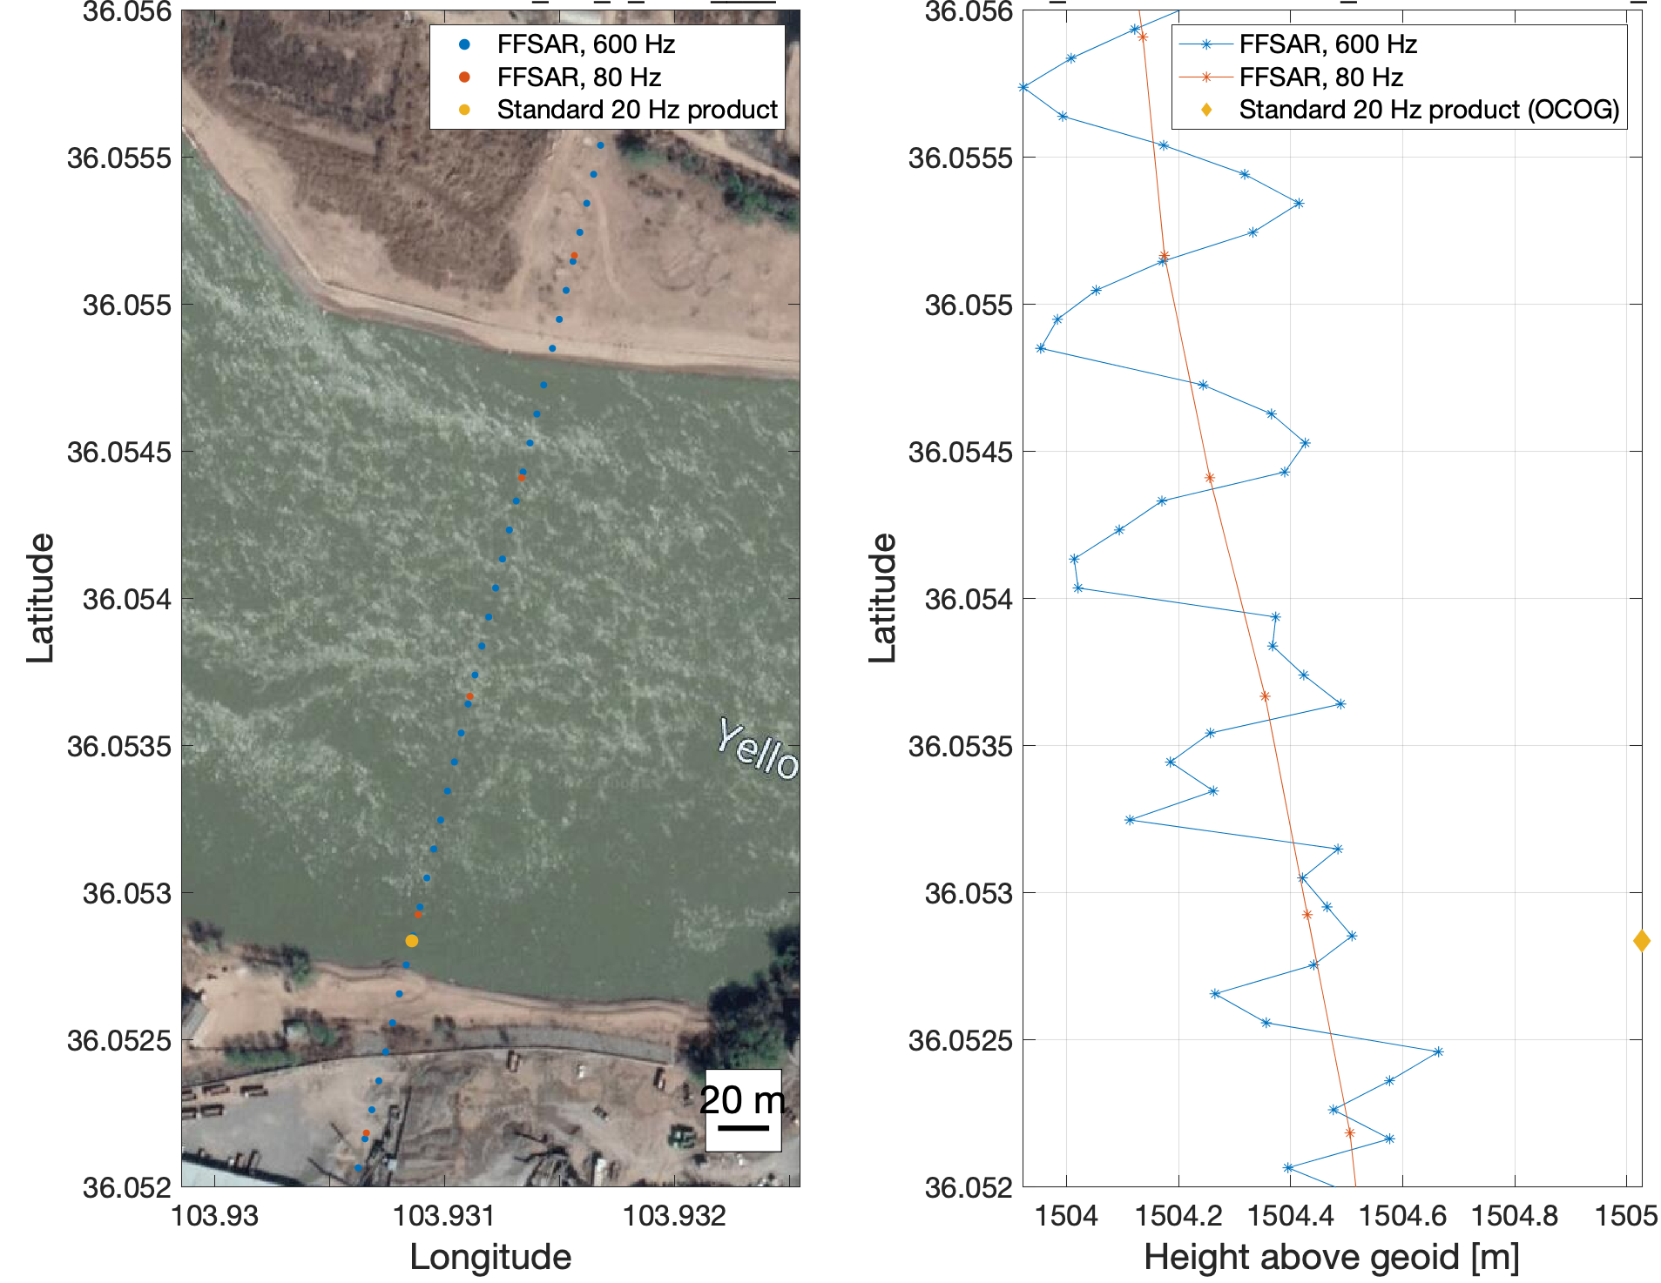
2. Fully-Focused SAR processing - Yellow River
Track 175: August 31, 2020
Track 175: August 17, 2021
INDSÆT PLOT AF AUGUST 2020 DATA!
Notes:
Jeg har set på flere overflights af det her spor, og umiddelbart ser det ikke kønt ud. Men måske en hel tidsserie bedre kan vise om det giver et bedre WSE estimat..

Slide 12
3. Studying new possibilities with ICESat-2
ICESat-2 data have been investigated for several purposes
  Obtaining precise and accurate water levels
  Retrieving information about the river banks
  The possibility of capturing bathymetry signals
3.3 km
About ICESat-2:
Laser altimeter
6 beams
Repeat period of 90 days
Is able to determine the point of reflection for every single photon with a very high precision!

Slide 13
3. New possibilities with ICESat-2
In general, ICESat-2 data are very precise.
However, elevation estimates are only availble under cloud free conditions, which make single VS time series even more sparse.
These data are from the photon data product (ATL03), but the inland water product ATL13 is sufficient almost all cases, and is computationally easier to handle.
Standard deviation of green points: 8 cm
Notes:
Eksempel er fra Han River, vest for Xiangyang, Hubei

Slide 14

3. New possibilities with ICESat-2
ICESat-2 is able to provide river elevations in areas where radar altimeters fail – like in narrow rivers in mountainous regions.
Because of the high along-track resolution of the photon data, ships on the rivers can also be detected.
$\sim$4 m

Slide 15
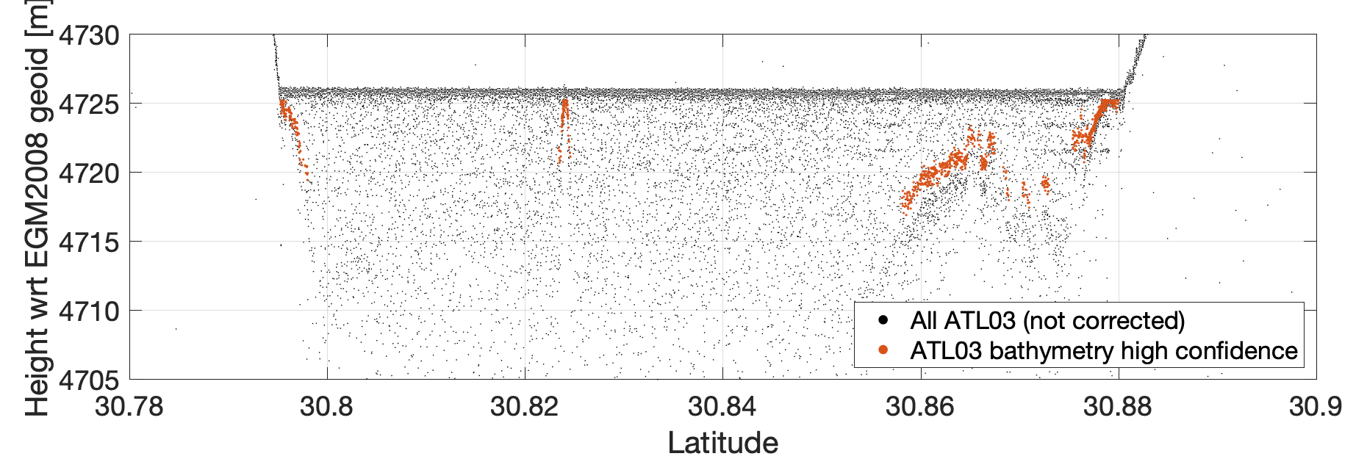
3. New possibilities with ICESat-2
ICESat-2 can also detect photons reflected beneath the water surface.
The laser can reach a depth of down to 40 m under ideal conditions.
River bathymetry was not found for any of the studied rivers, but lake bathymetry was found for Lake Namco.
Lake Namco
Raw photon data
Lake bathymetry obtained using algorithm presented in Ranndal et al. (2021)
15

Slide 16
Conclusions / outlook
Obtaining accurate river levels from satellite radar altimetry in Chinese rivers is challenging due to the size of the altimeter footprint and the high number of scatterers.
Remains difficult when using MWaPP in SAR mode, and even when using FFSAR
Combining FF-SAR processing with MWaPP retracker should be attempted?
Laser data from ICESat-2 is able to provide reliable river levels in the most challenging areas but limitation due to cloud cover.
S3 A/B and S6 NRT data is now available (S6 higher temporal and along track res).
Surface Water and Ocean Topography (SWOT mission) will be launched in late 2022.

