Slide 1
(Selected) Results from GOCE++ Dynamical Coastal Topography and tide gauge unification using altimetry and GOCE. Summary of findings and progress on GNSS reflectometry for Coastal sea level. Ole B. Andersen, P Knudsen, K. Nielsen, C. Hughes, R. Bingham, G. Woppelmann, M. Gravelle, S. Padillo, L. Fenoglio-Marc, M. Kern + S. Williams (NOC)

Slide 2
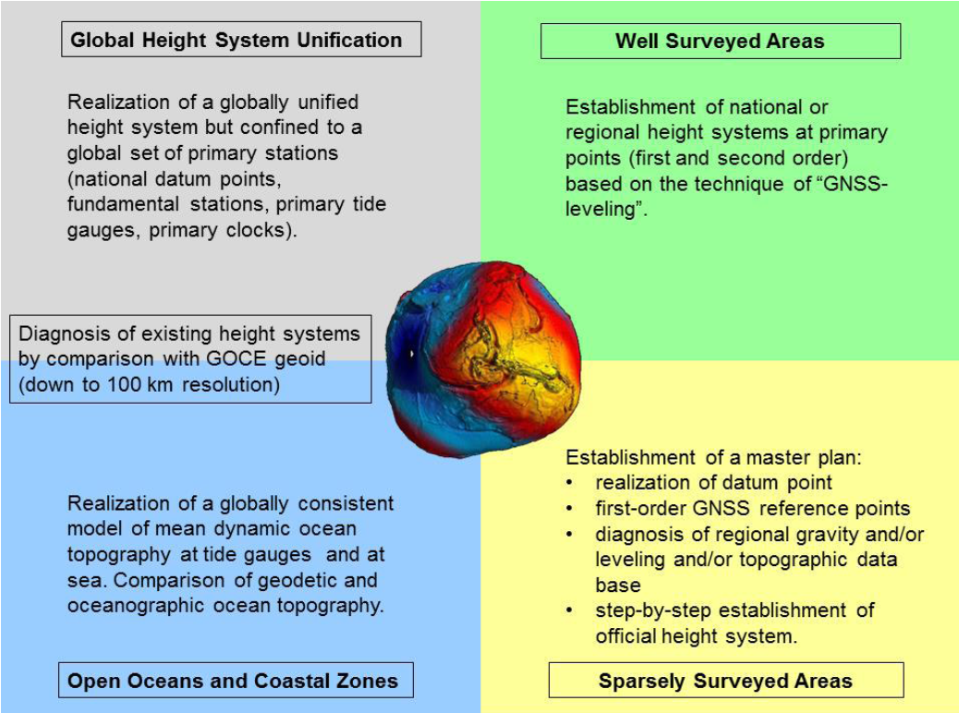
ESA (ITT) Goce + Height System Unification Roadmap (2011-2014):
2015:
ESA issued an
ITT (GOCE ++)
To focus on individual elements and impact of GOCE…
Project
extended until
early 2019
Courtesy: Gruber et al., 2014)

Slide 3
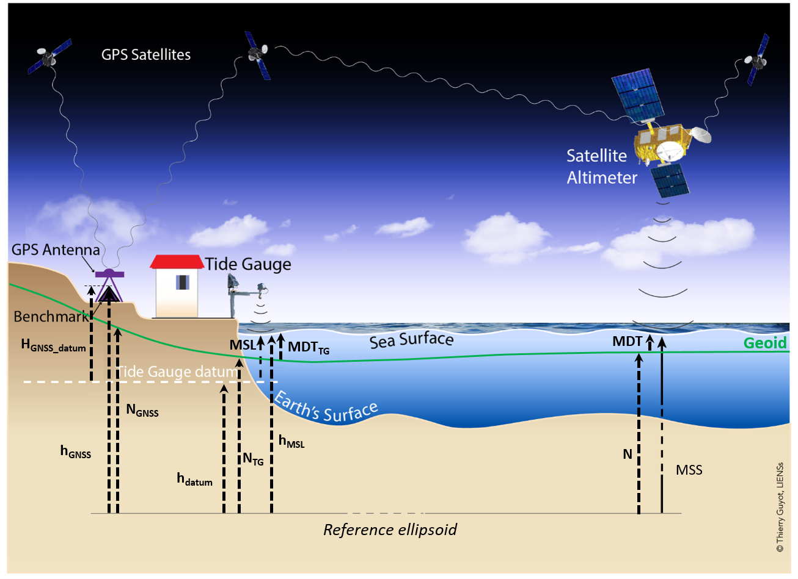

Slide 4
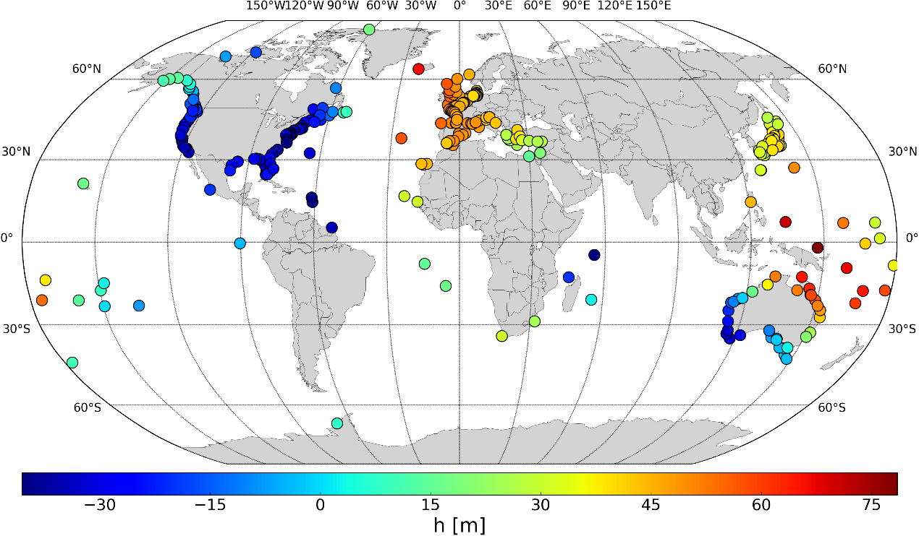
GNSS Equipped Tide gauges (SONEL)

Slide 5
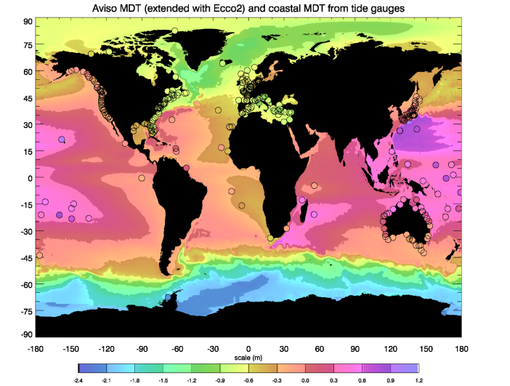

Slide 6
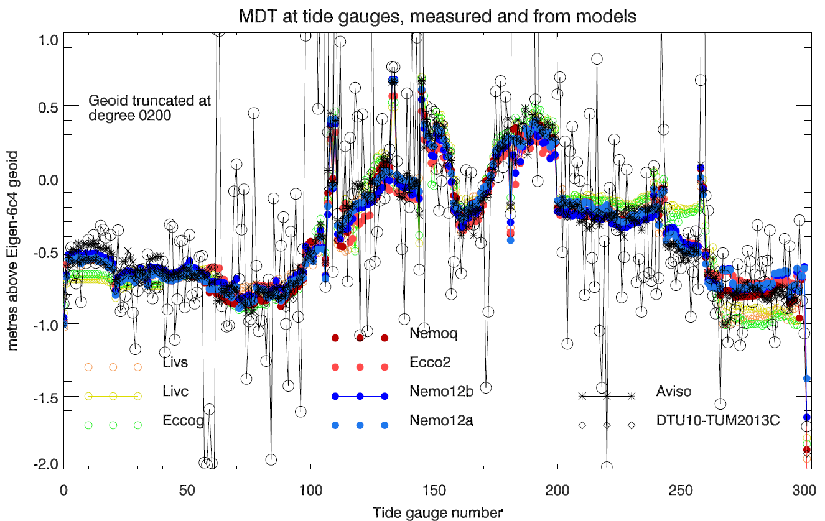
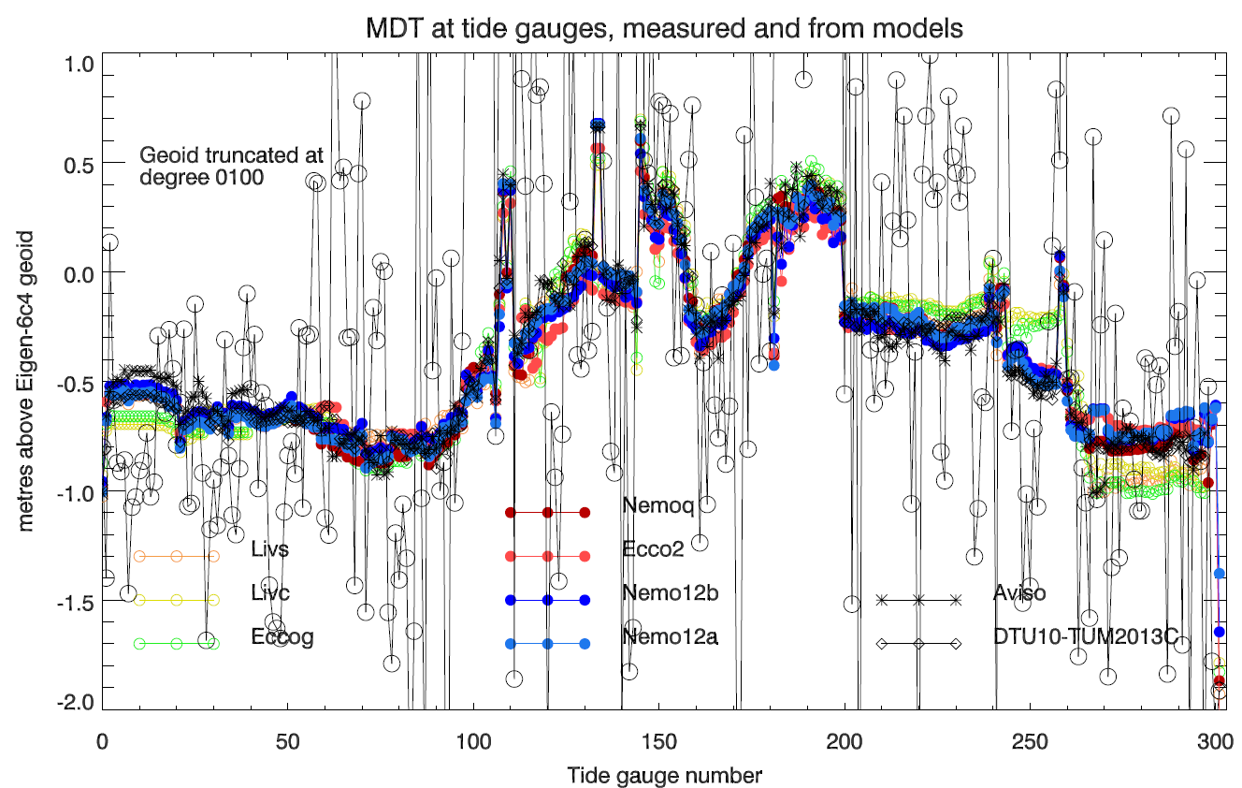
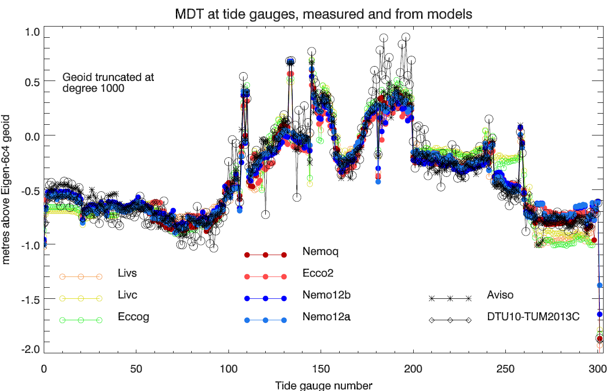
Misfit is on the order of 8-9 cm with geoids at the full resolution

Slide 7
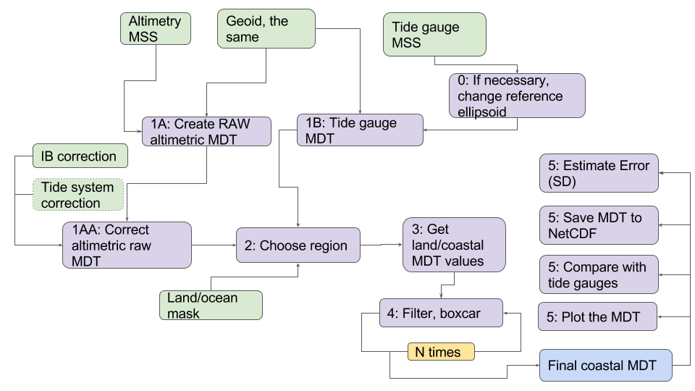
Software Architecture for creating coastal MDT
GOCE++DYCOT Coastal MDT Software Toolbox.
Command line interface written in R.
Allow filtering combining different MSS + GOCE geoids
Allows integration of MDT with TG,
Error estimation.
Available for free download from gocehsu.eu homepage

Slide 8
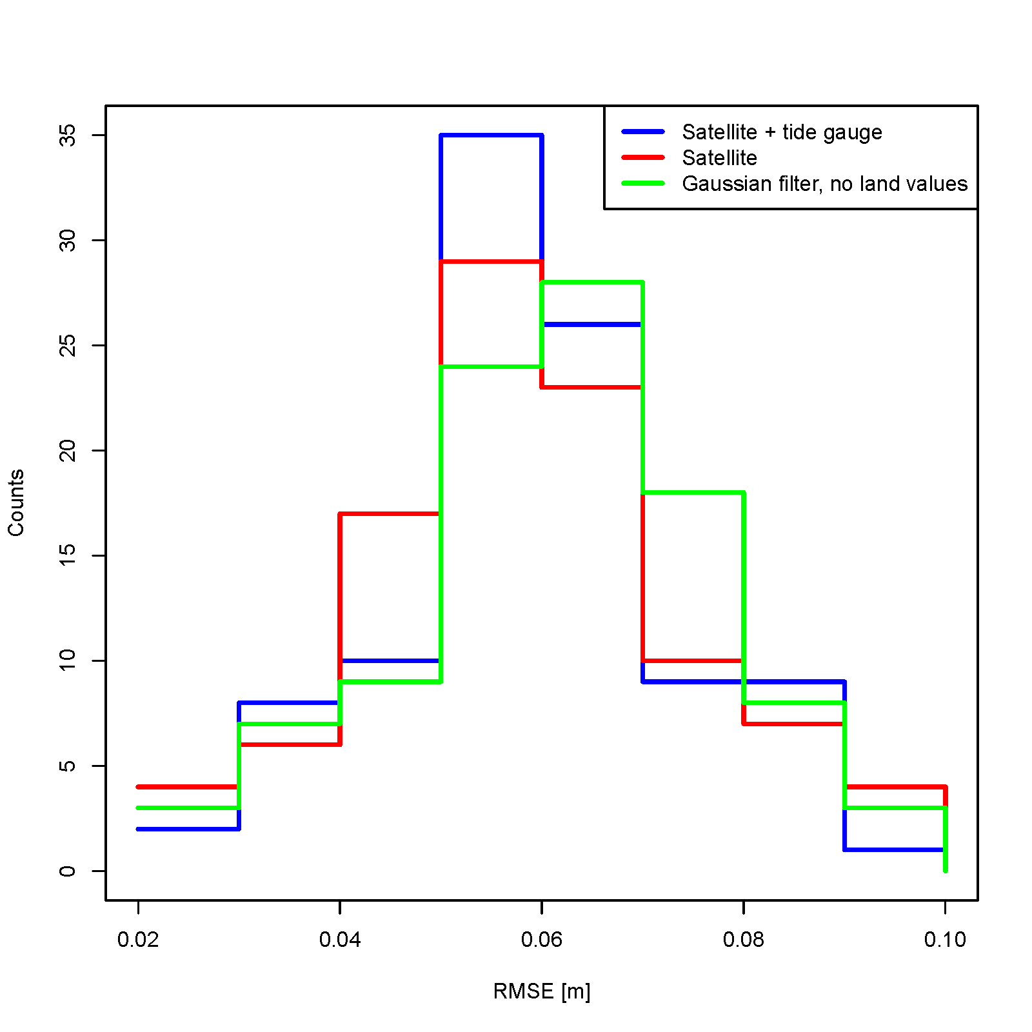
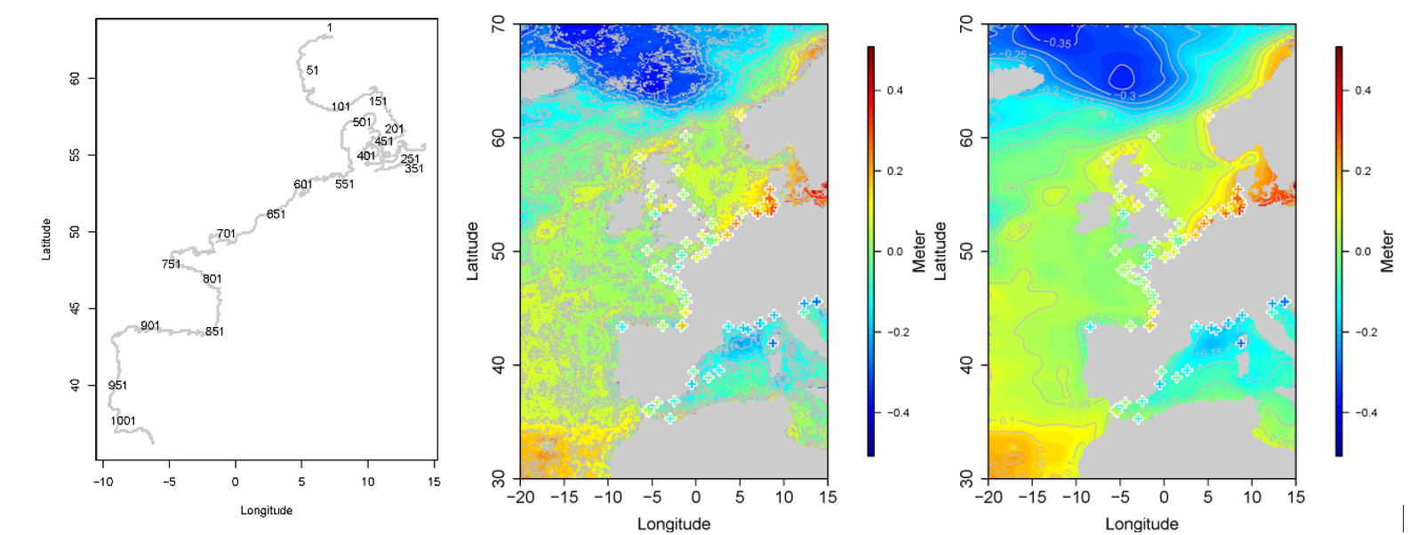
Comparison at NW European coast.
Tide gauges Raw satellite MDT, Filtered combined Sat+TG MDT
Misfit between MDT and TG of 6 cm for combined coastal MDT
Comparable for 9 cm mitfit between MDT (ECCO etd) and TG.
Difference dominated by small scale geoid errors/omissions.

Slide 9
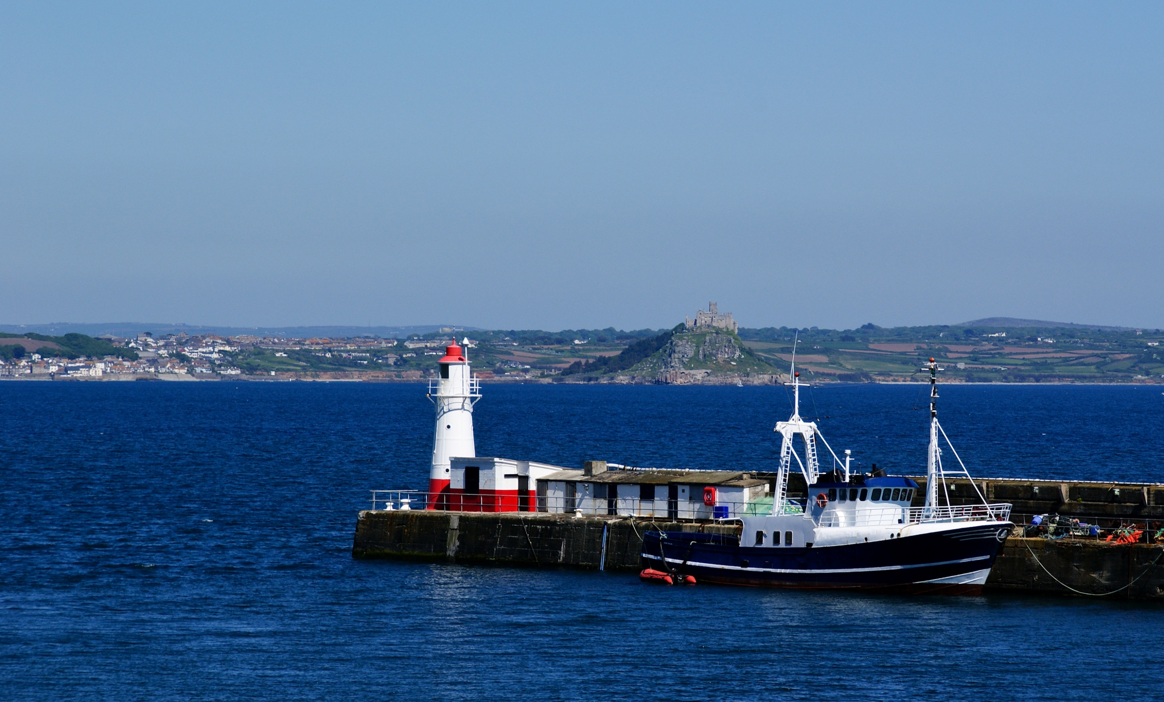
GNSS-R for coastal MDT.
Evaluation vs Sentinel-3 for coastal
sea level observations -
PROMISING BUT PRELIMINARY RESULTS

Slide 10
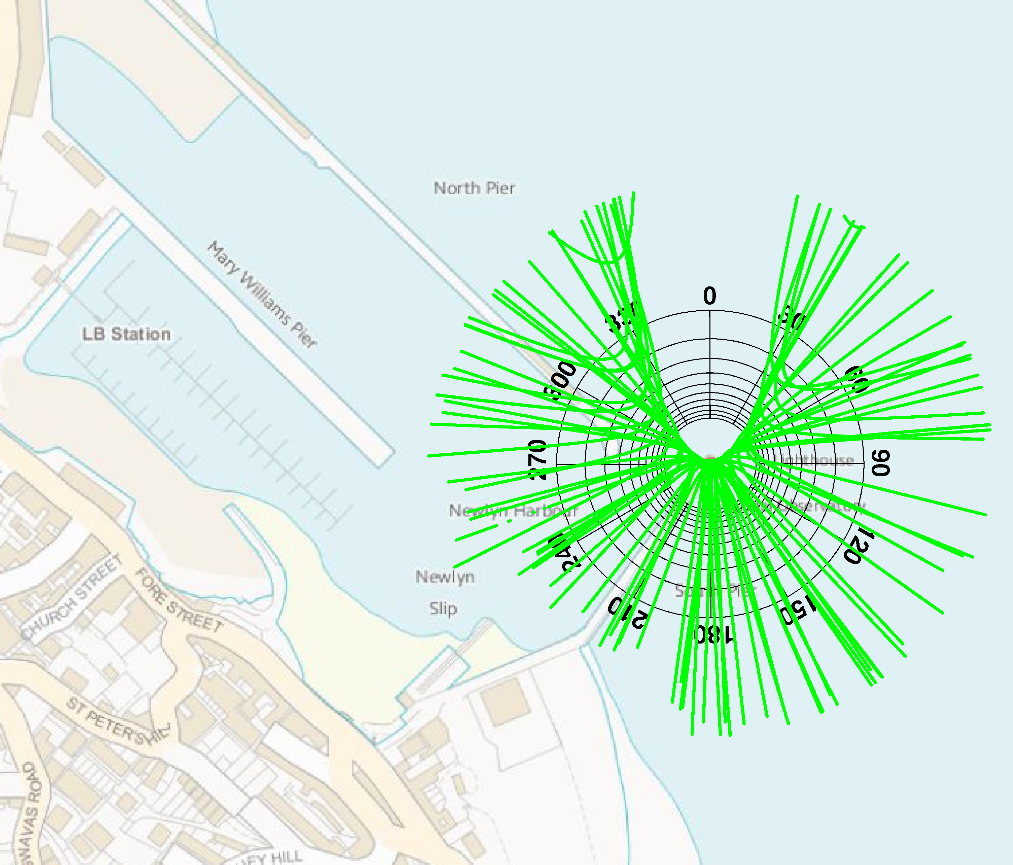
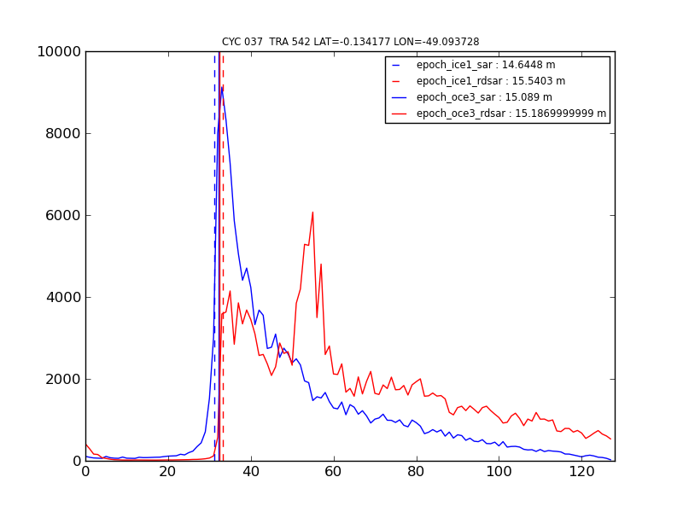
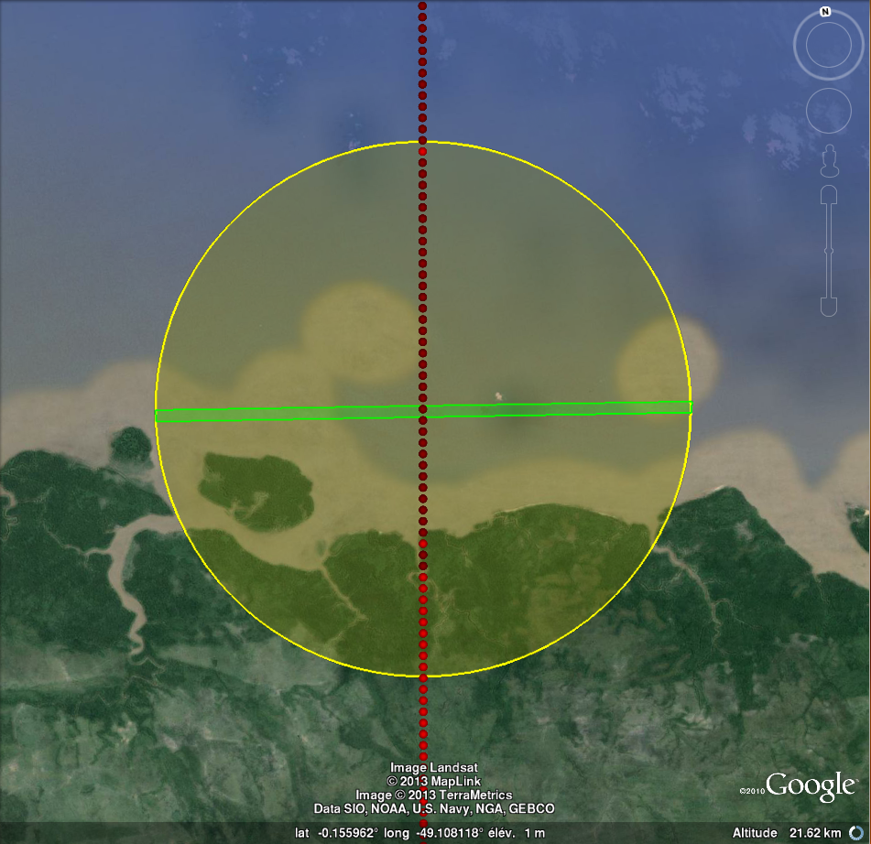

Slide 11
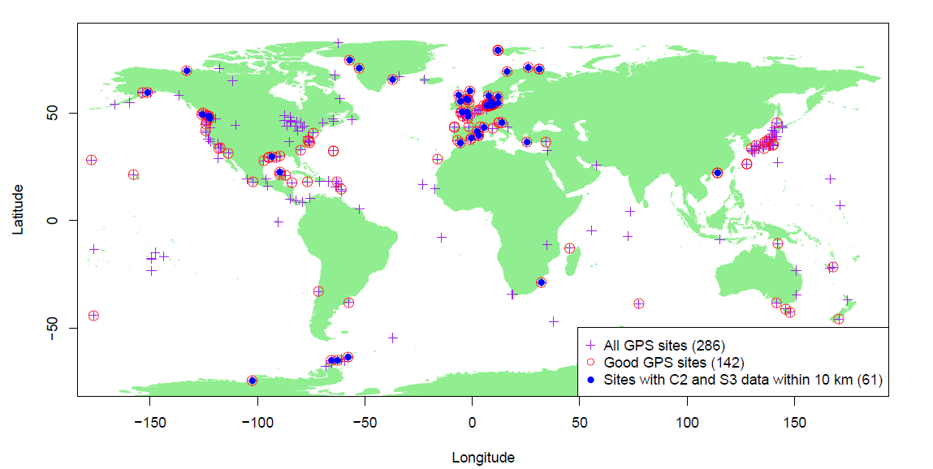
Co-located GNSS reflectrometric stations
and Sentinel-3 SAR altimetry (within 10 km)

Slide 12
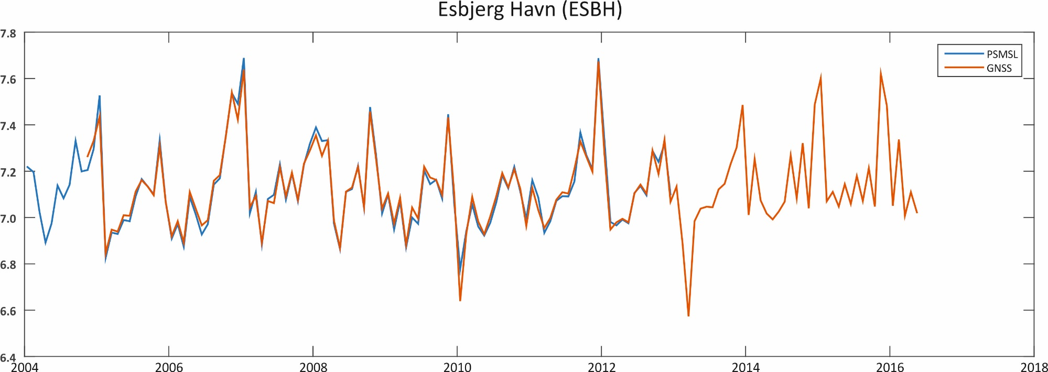
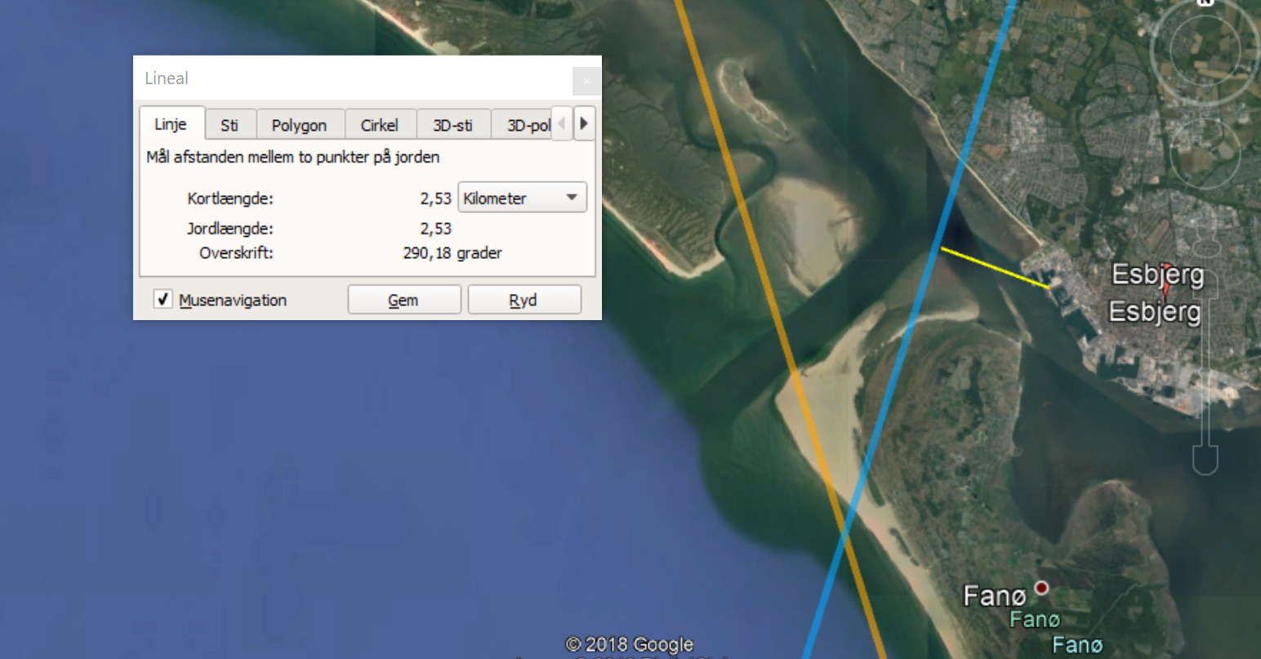
Esbjerg – North Sea coast (Denmark)
2.3 km to Sentinel-3B
Data
No S3B data available
Yet.

Slide 13
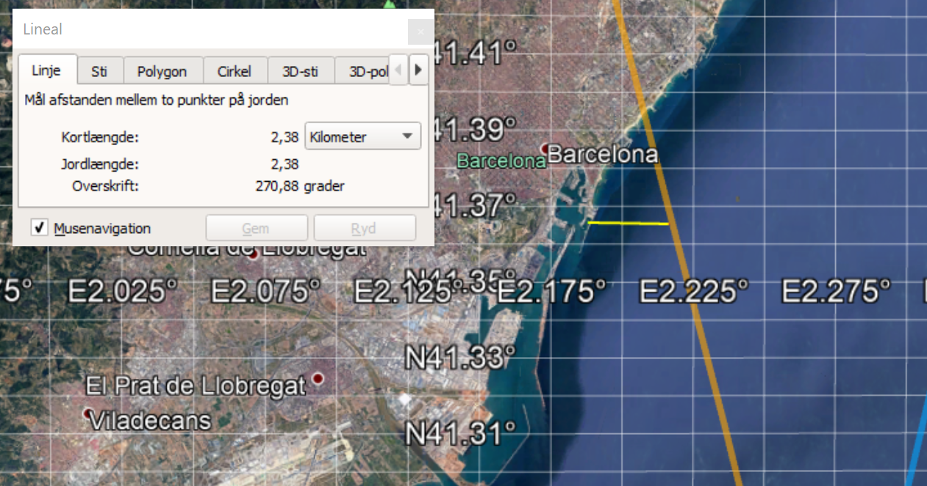
Barcelona
2.8 km between Sentinal-3A and GPS tide gauge.

Slide 14
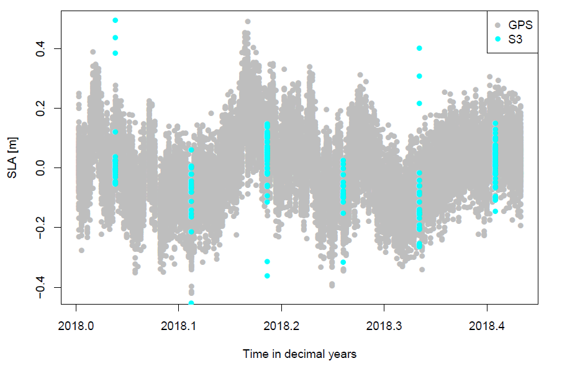
GNSS (Grey) vs Sentinel 3A (blue)
Work in progress. Still several unaccounted biases.
More to come at AGU/EGU.

Slide 15
Summary
GOCE ++ DYCOT results are appearing on gocedt.eu and paper is in press
General comparison between global MDT and TG shows 9 cm nois dominated by short wavelength geoid errors.
MDT evaluation with Tide Gauges is promising for ”geodetic approach”, and in general agreement on the 5-7 cm is found.
New extension of the project to investigate GNSS-R for coastal sea level information for possible MDT enhancement. Preliminary evaluation against Sentinel-3A in coastal regions.
More to follow.

