Slide 1
MSS for SWOT
DTU21MSS and Experimental MSS(t) for 2023
Ole B. Andersen (DTU Space)
Adili Abulaitijiang (Uni Bonn).
Shengjuin Zhang (NE University of China)
Stine Kildegaard Rose (DTU Space)
Steve Nerem (U Colorado, Boulder)
David Sandwell (Scripps)

Slide 2
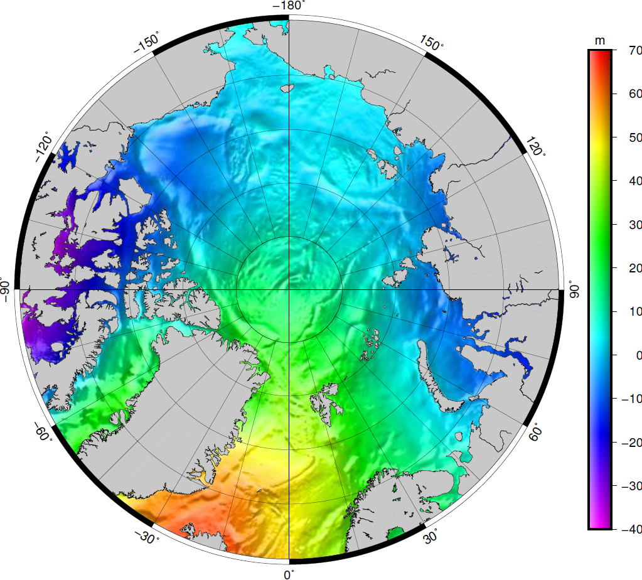
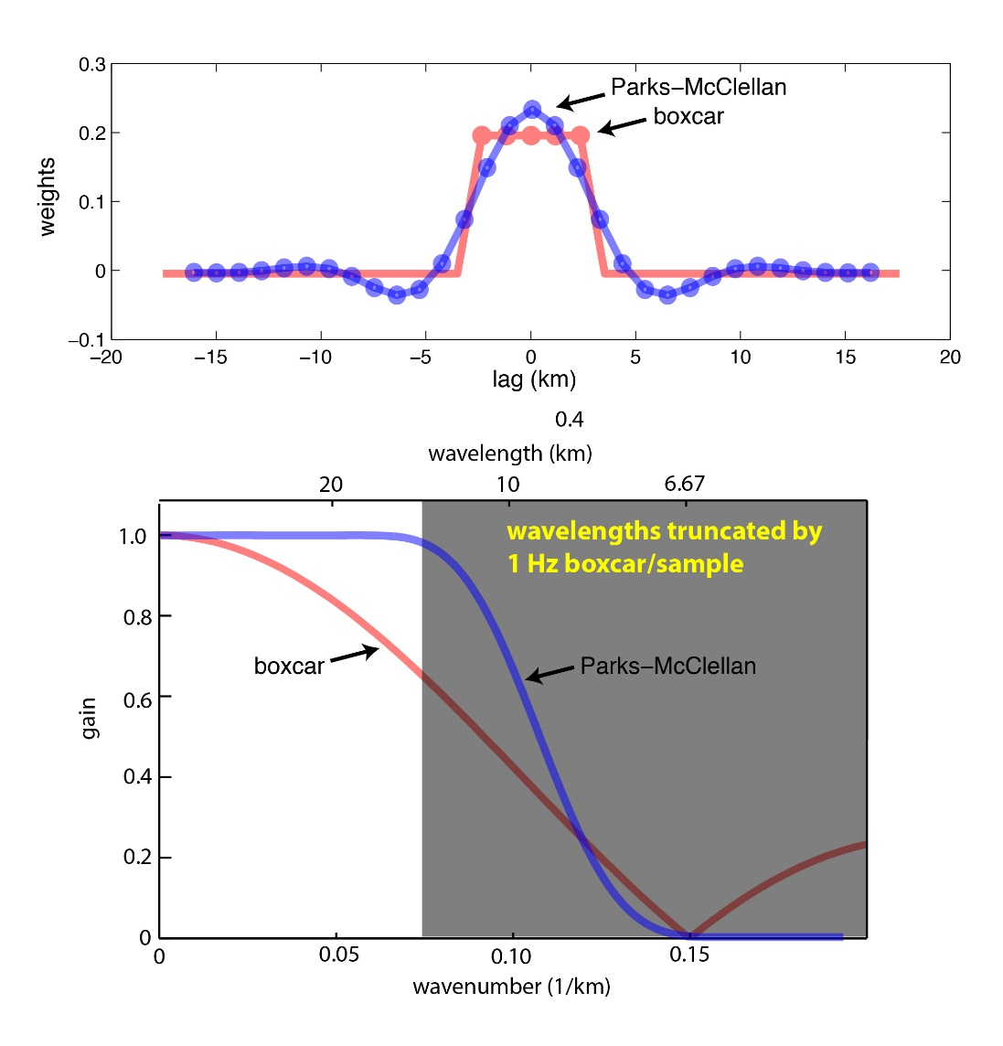
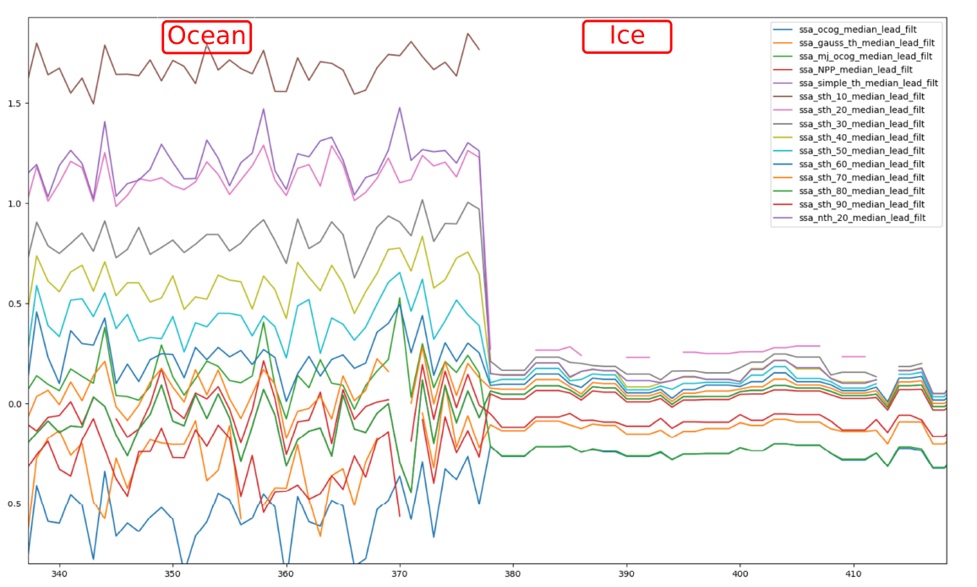
DTU21 Mean Sea Surface.
Update with respect to DTU15 and DTU18 MSS.
Ready to be delivered to SWOT for testing. Currently available on (S3A/S3B/S6)
20 Year average (1993-2012) focused on 2003.01 (Similar to previous DTU MSS)
Truly global MSS focused on accuracy and compleness between 90S and 90N.
Shorter wavelength improved through:
Two-pass altimetry for all geodetic missions (C2+SA+JA1+JA2)
Parks McClellan filtered 2Hz Sea surface height data (Limiting spectral hump in LRM)
Longer wavelength improved through:
Physical retracking of high latitude regions (C2-SAMOSA+ data using ESA GPOD)
New Sea State Bias for high latitude applied resulting in no-offset
between LRM & SAR (even into Sea Ice)
Using linear SL adjustment to fit C2 data to Jasons at high latitude.

Slide 3
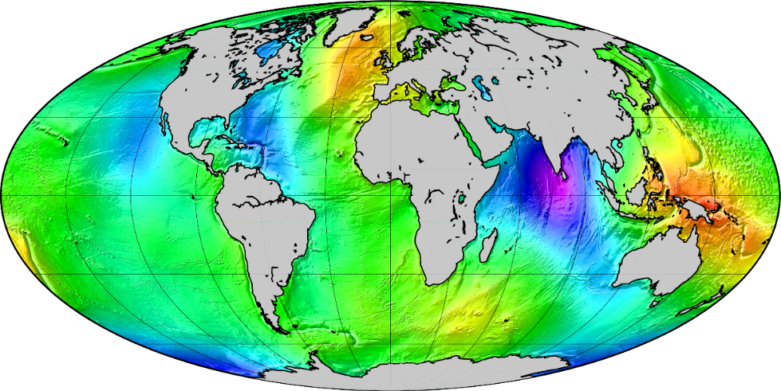
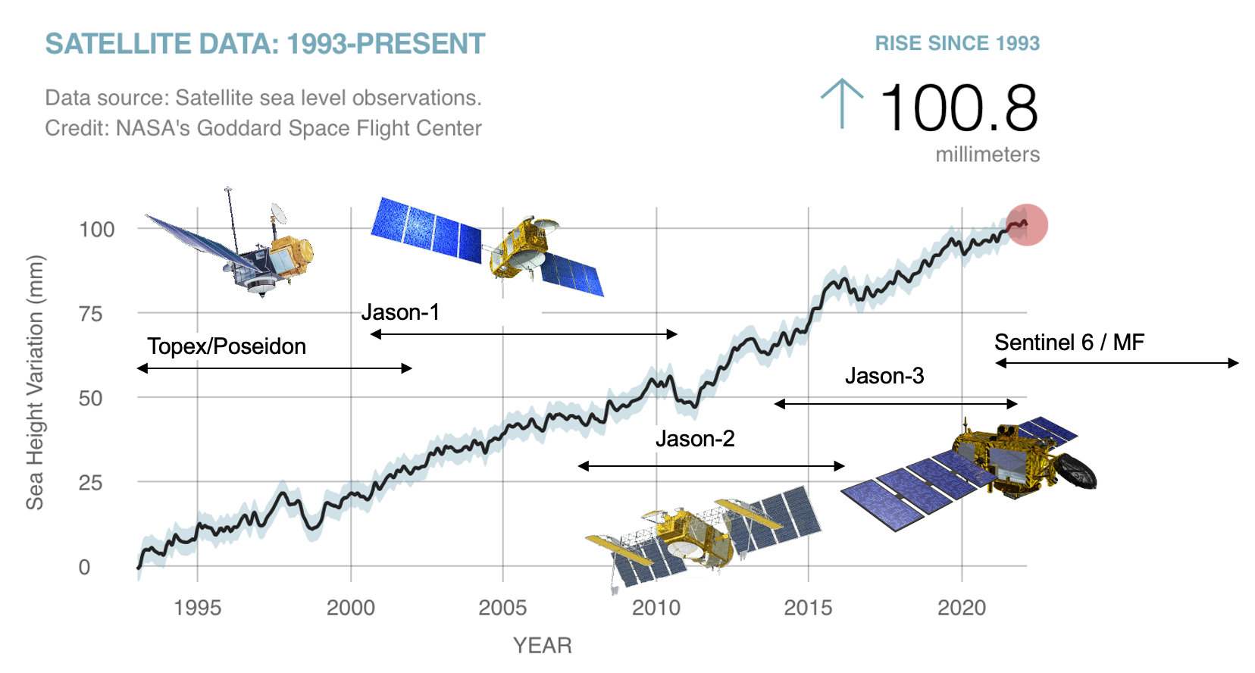
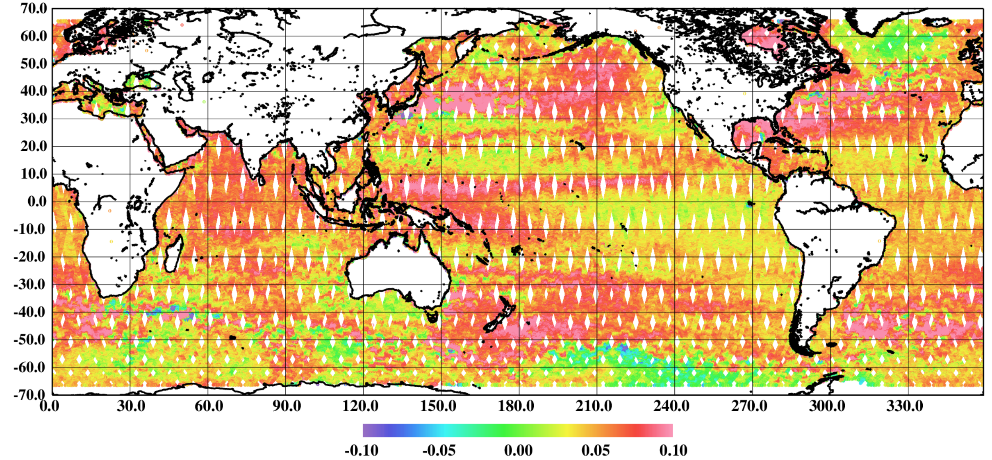
Is a mean a mean?
MSS is a fundamental reference for SWOT.
All MSS (DTU/CLS) are averaged over 20 years (1993-2012) so “center time” will be 2003.01.01
Due to GMSL trend ALL MSS becomes incresingly “outdated” with time.
S6 is biased by > 6 cm globally during 2021

Slide 4
MSS23EX(t) = MSS23E(2012)+linear SL * (t-2012)
Rate = 4 mm/year
Rate = 3 mm/year
Rate = 2 mm/year
Rate = 3.3 ± 0.4 mm/year
Acceleration = 0.1 ± 0.025 mm/year²
2023

Slide 5
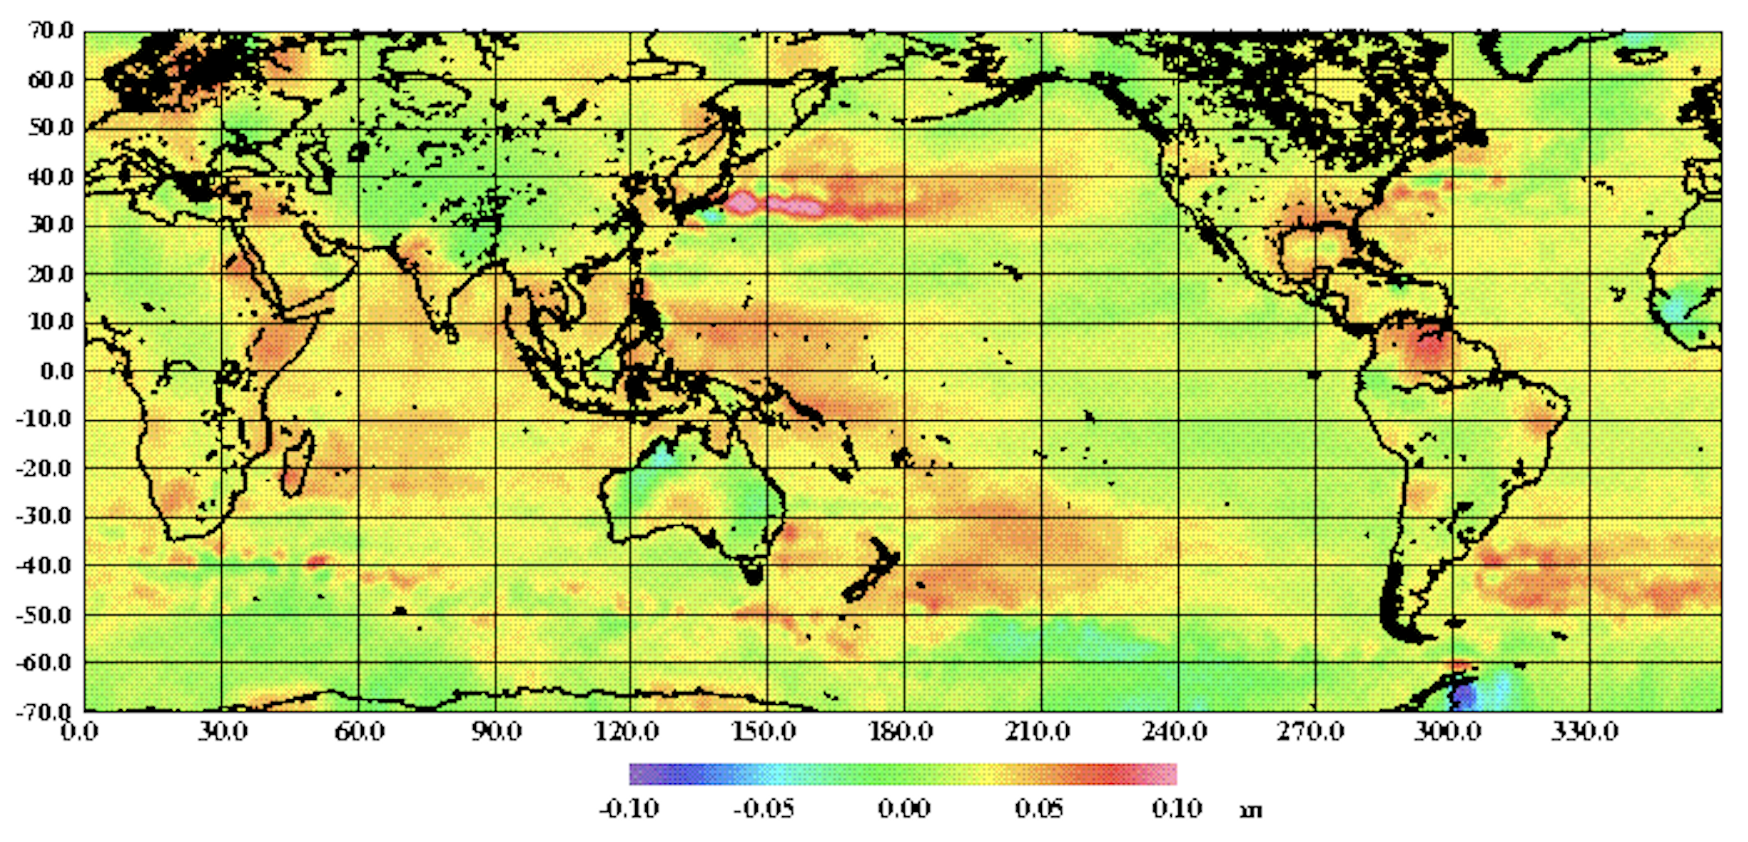
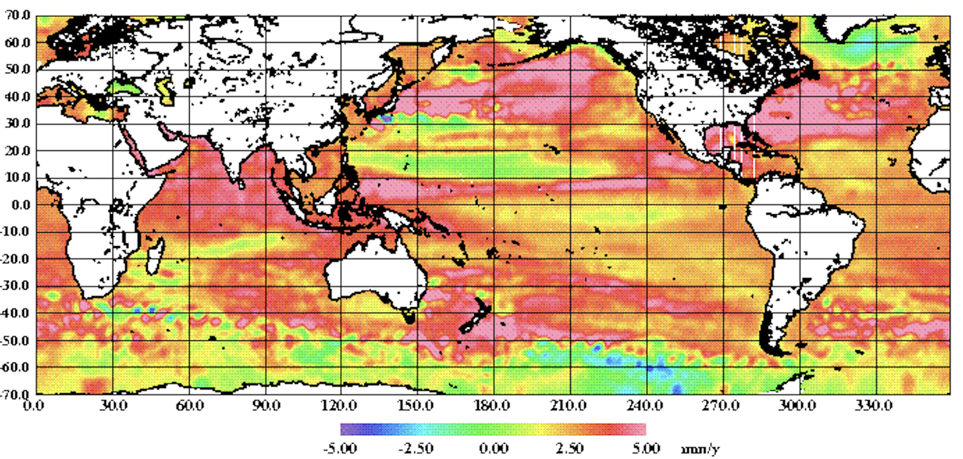
DTU23E: New MSS from 20 years of Jasons (2002-2021) center time will be 2012.01.01
Difference etween DTU23E with DTU21

Slide 6
DTU23EX is now propagated to year 2023.

Slide 7
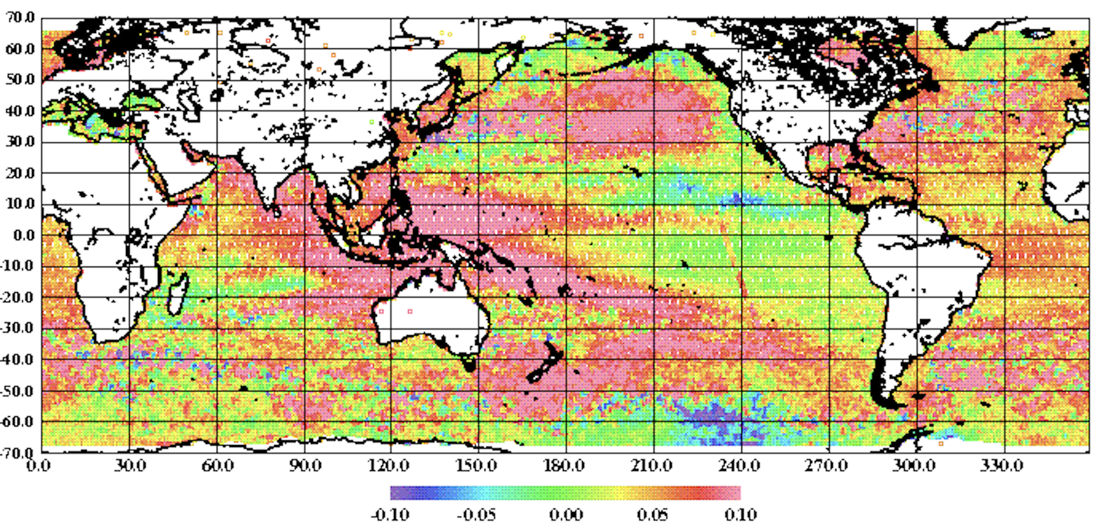
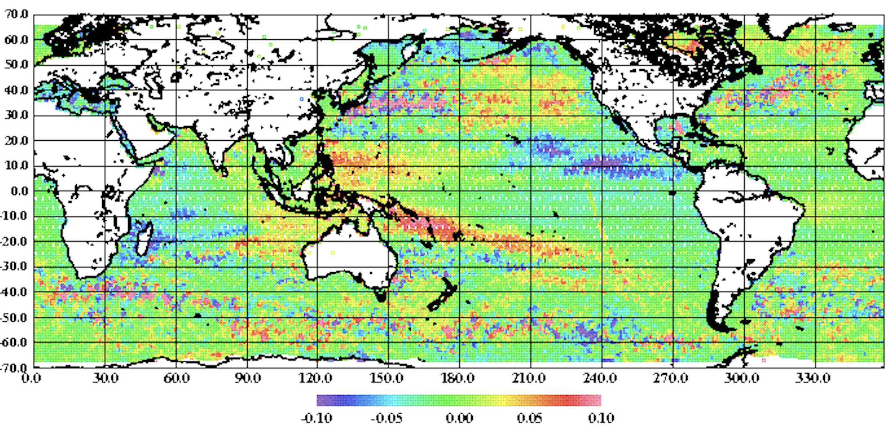
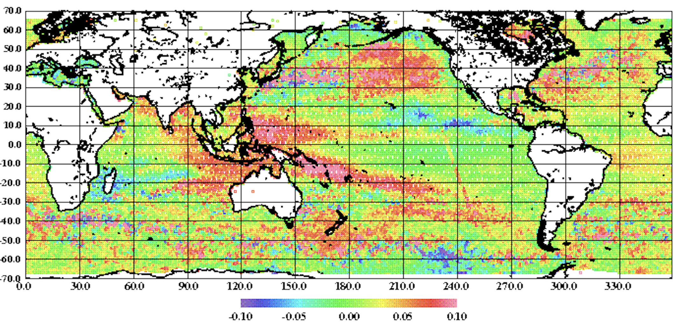
Sentinel-6 – First year average (2021.06->2022.05)
DTU21
DTU23E
DTU23EX
Values in cm | S6A Mean/Std
DTU21 CLS15 | 4.52/5.42 4.51/5.41
DTU23E (2012) | 2.11/4.77
DTU23EX (2021) | -0.4/4.28
DTU21 LinQuad | -0.3/4.76

