Slide 1
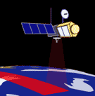
Nye Muligheder med satellite Altimetry
  Ole Baltazar Andersen, DTU Space +
  Carsten, Mai, Henriette, Louise, Adil, Stine, Heidi,
  Rene, Abbas, PerK, Trine, Tim, m. fl.
Nye muligheder:
  Længere tidsserier (næsten 30 år -> klima)
  Øget opløsning (fra 5 km til 5? meter)
  Nye sensorer (Laser)

Slide 2
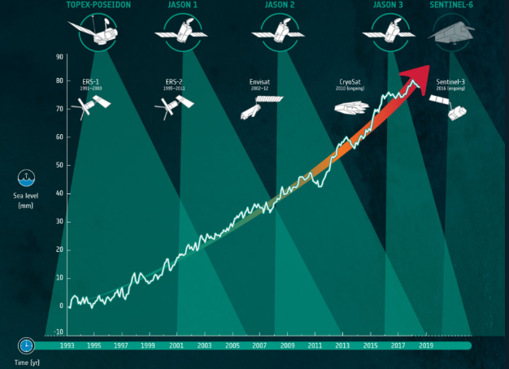
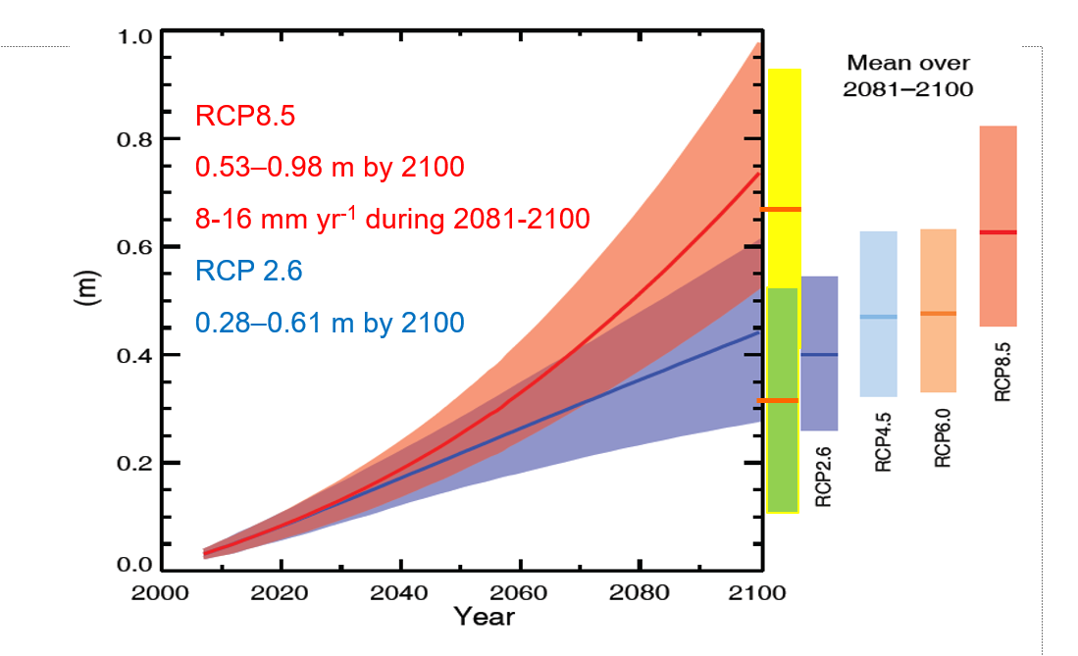
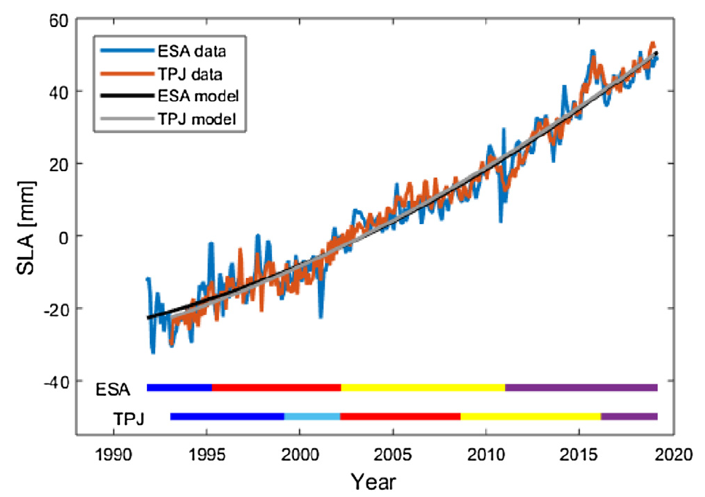
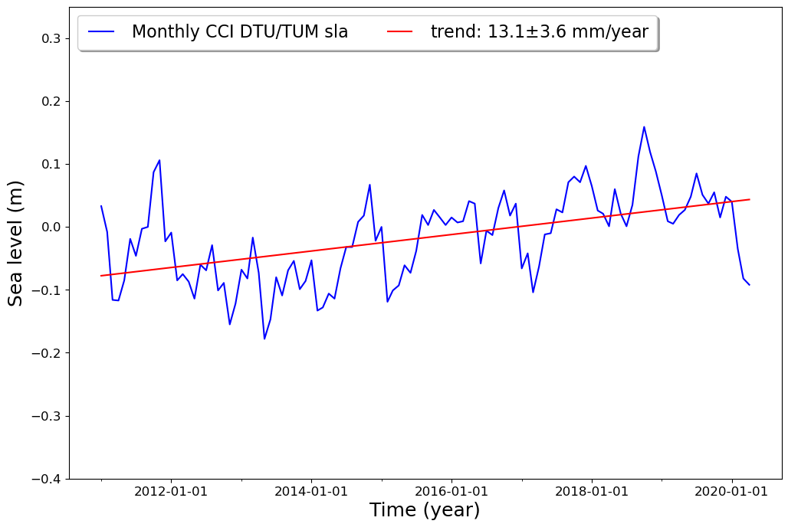
Længere tidsserier:
Globalt
Centrale Arktis
Beauford Gyre
Rose and Andersen, 2020
Weng and Andersen, 2019

Slide 3
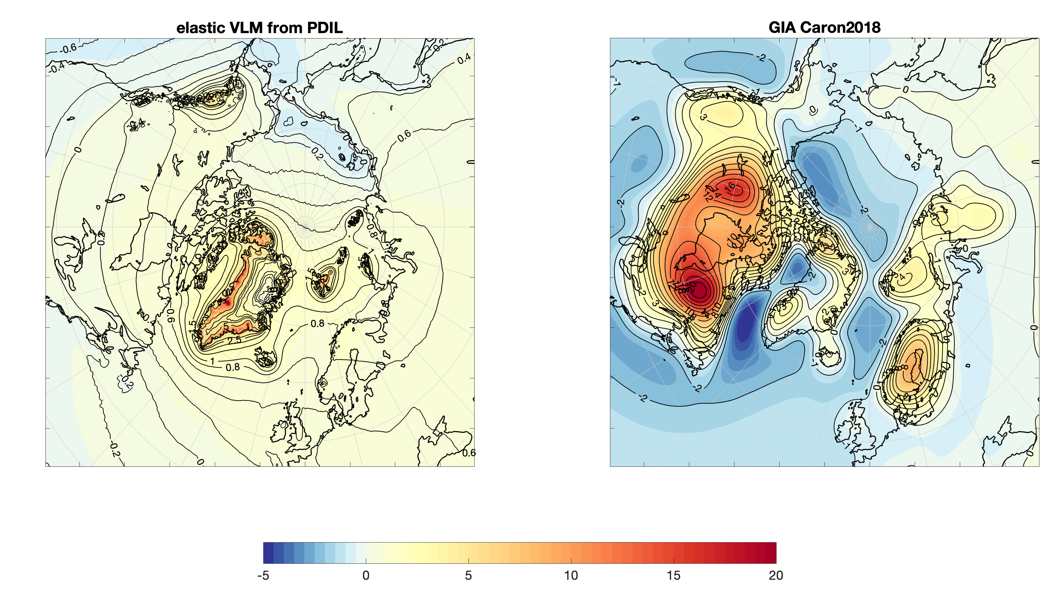
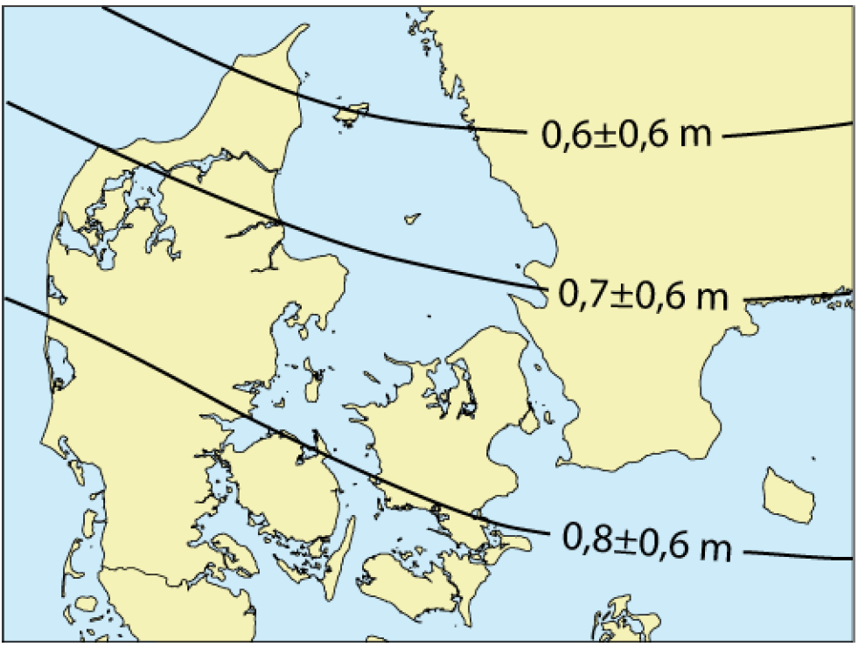
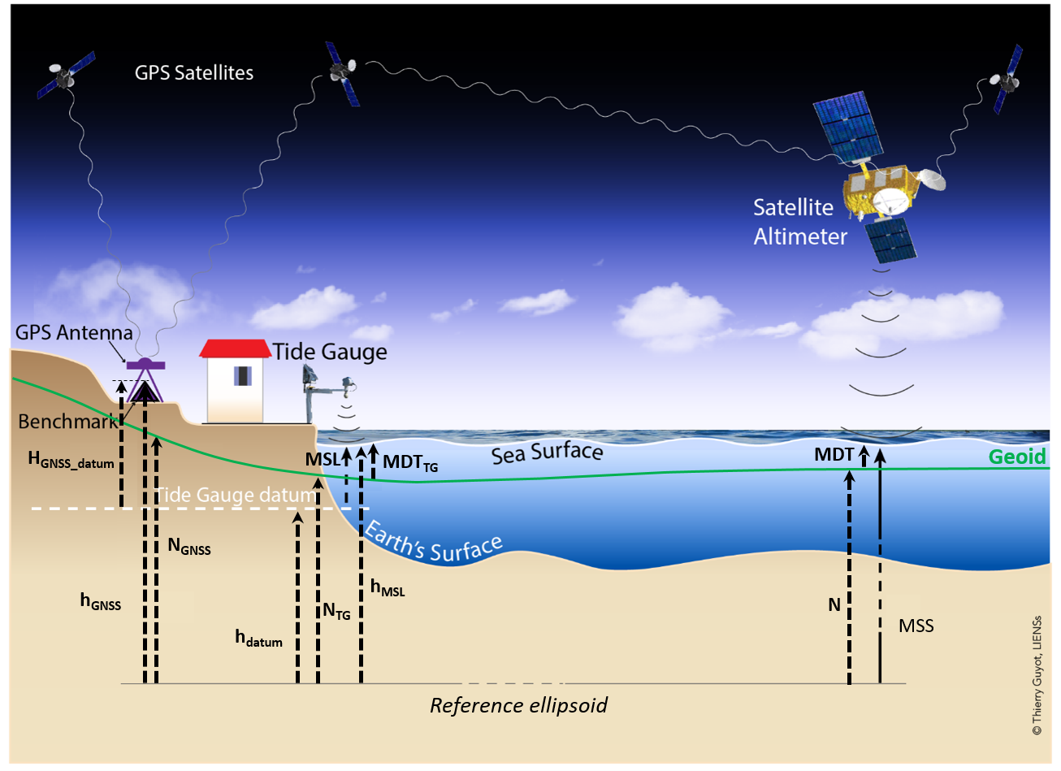
Globale relative vandsstands-ændringer
Ludwigsen et al., 2020
GEUS notat (2017)

Slide 4
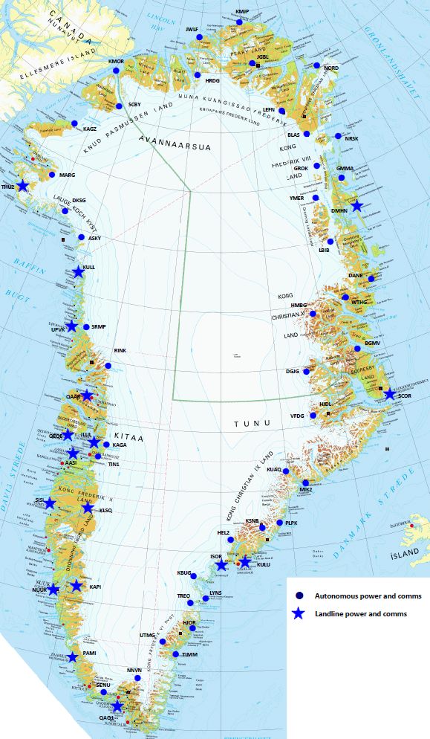
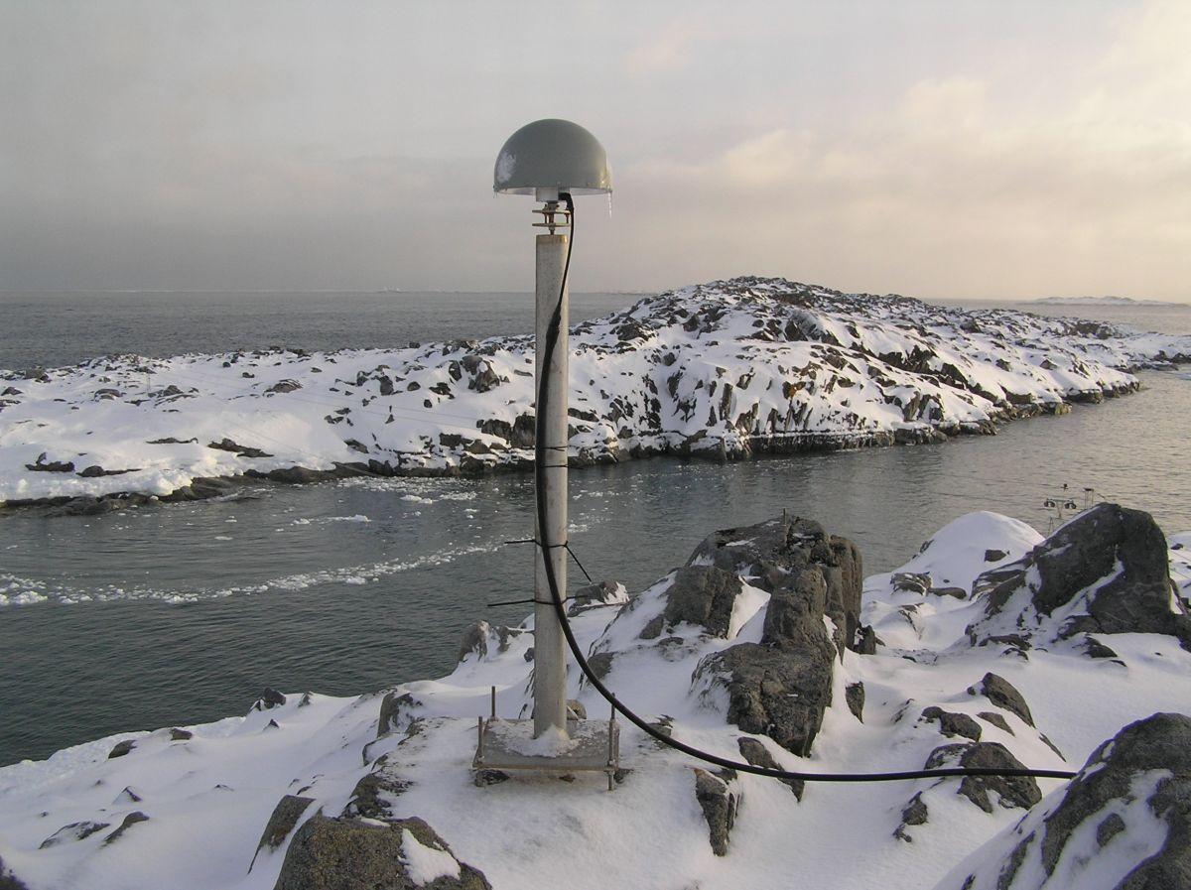
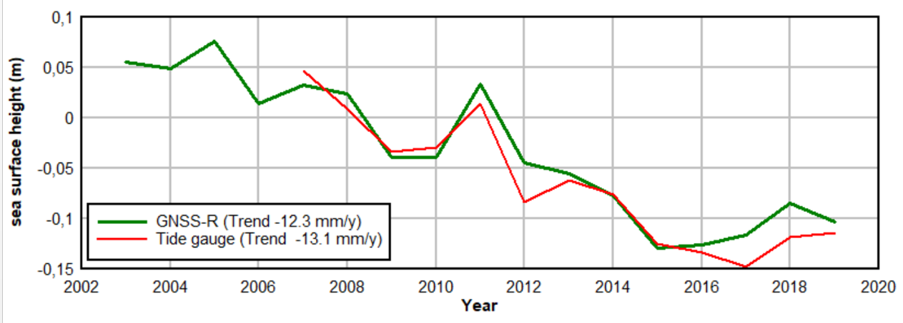
GPS + Tidevandsstationer
Fundamentale for at løse global/relative problematik
Vigtig at Tidevandsstationer udstyres med GPS
13 GNSS-R
Candidate sites
(F-B. Madsen)

Slide 5
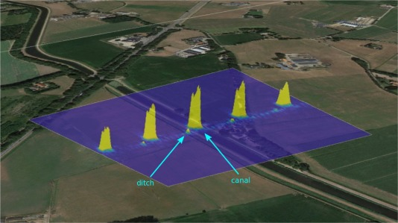
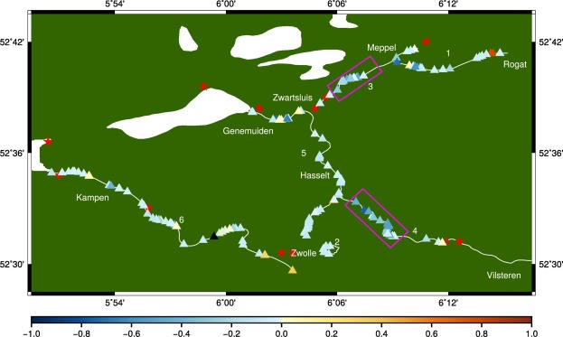
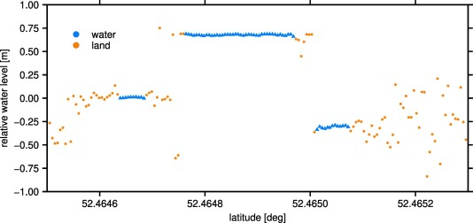
Muligheder for at øge opløsning
Ny processering (SWATH, SarIN multitarget)
Fully Focused C2 SAR to 5 meter.
Kleinherenbrink et al. 2020

Slide 6

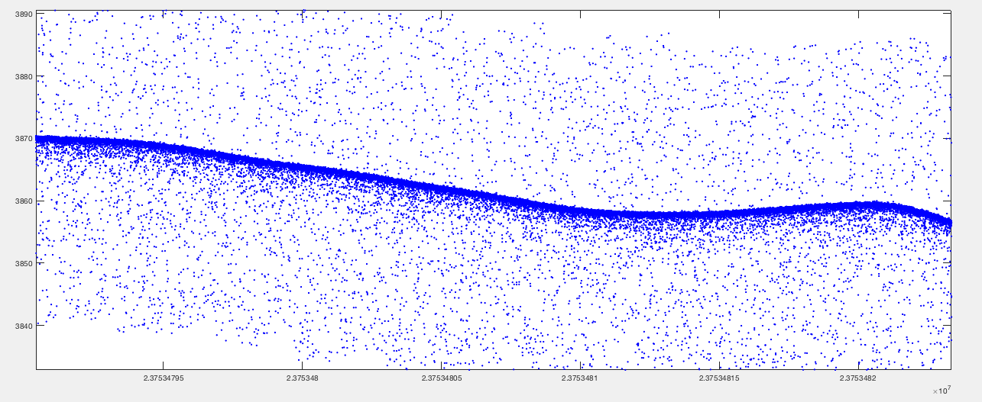

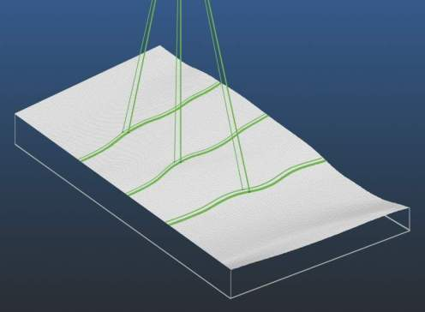
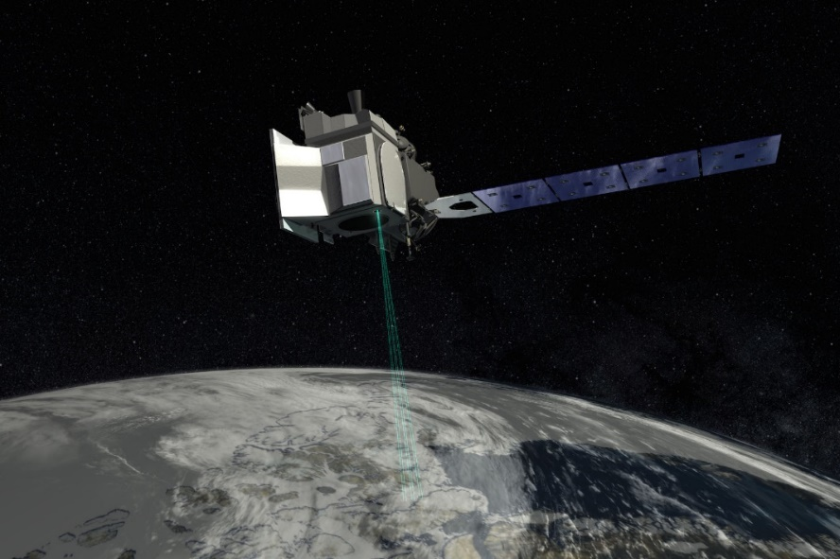
Measuring elevation, one photon at a time…
Photon-counting lidar,
launched Sep 2018
The ice sheet surface is visible as areas with a high concentration of photons
Flight direction
10.000 pulses per second - corresponds to 0.7 m between pulses at the surface.
Some photons will penetrate water, so we can observe the lake beds of (some) supra-glacial lakes, i.e. lakes on the ice sheet surface. This allows us to estimate lake water volumes.
3 km
90 m
3 km
Footprint size: 17 m

Slide 7
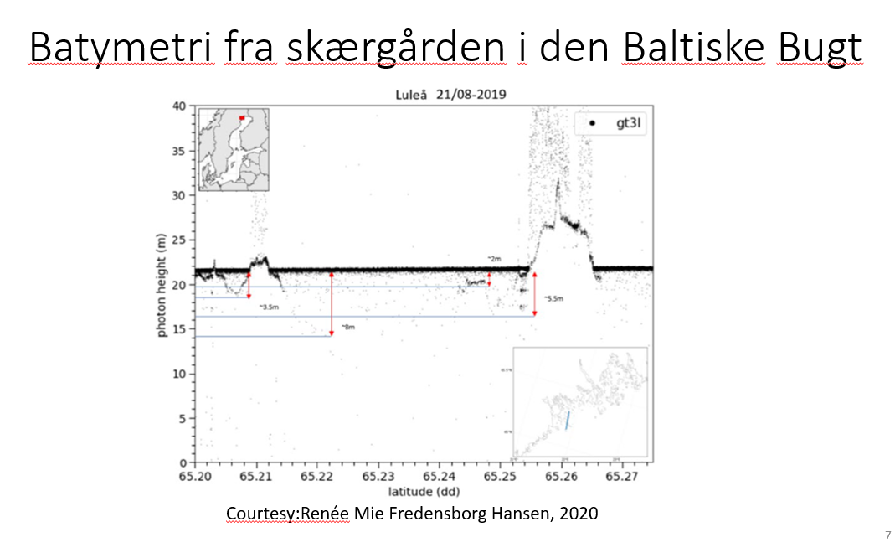
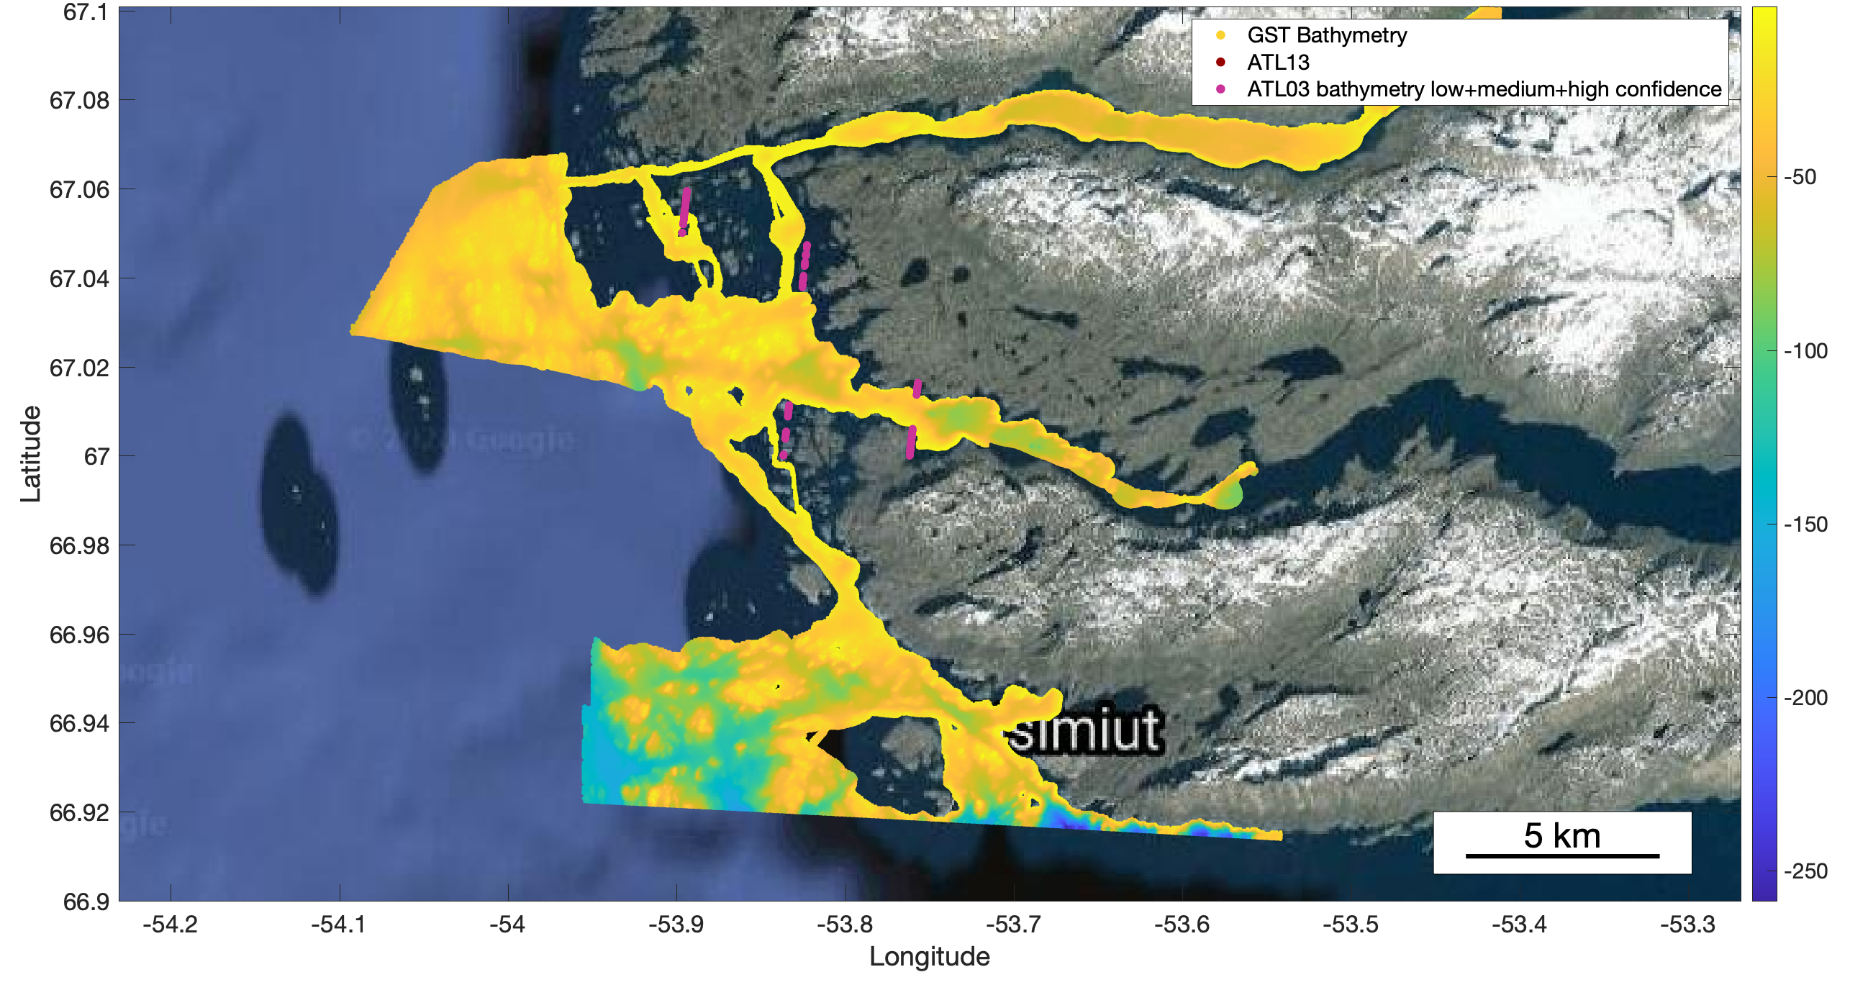
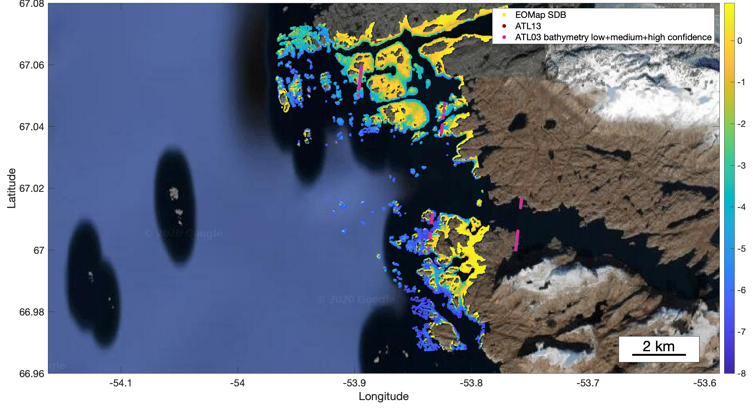
Grønlands bathymetri – Sammenligning med GST multibeam og optisk .
gt2r
gt1r
gt2r
gt2r
Ship soundings
gt1r
Depth [m]
Depths from
satellite imagery
Depth [m]
gt1r
Depth [m]

Slide 8
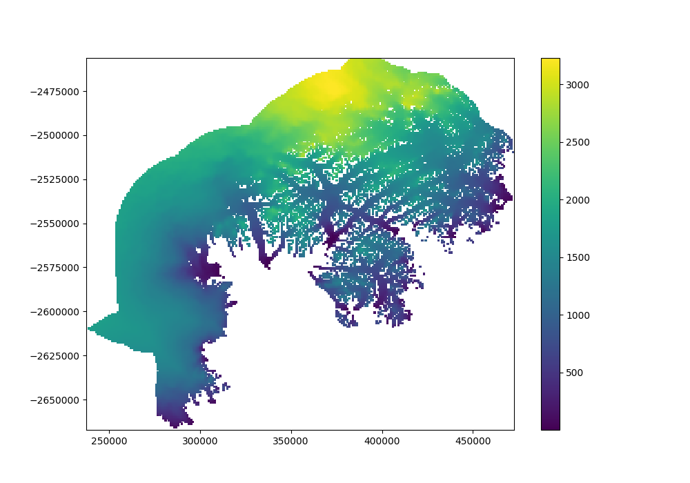
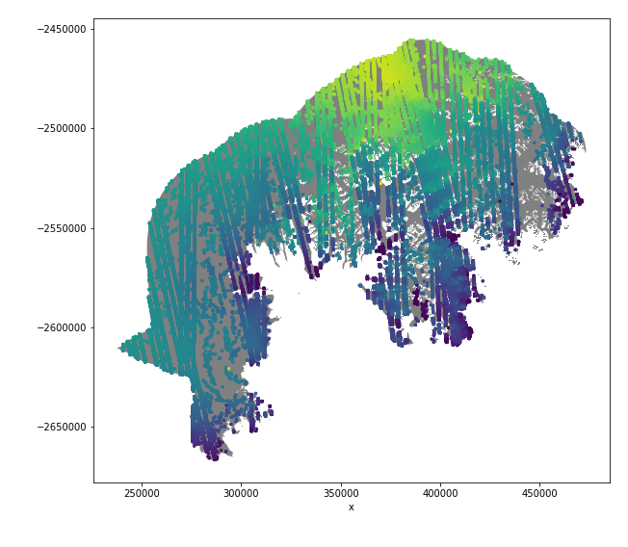
Creating high-resolution DEMs of the changing ice sheet surface
The laser will reflect from the snow surface. ICESat-2 thereby provides dense coverage of unambiguous data for surface elevations.
Creating a DEM for an area around Helheim Glacier in summer 2019:
Data coverage (Cryosat-2 and ICESat-2)
DEM (1x1km)
High-resolution elevation data along fluxgates at glacier outlets around the ice sheet margin help to constrain the annual mass loss from the Greenland ice sheet

Slide 9
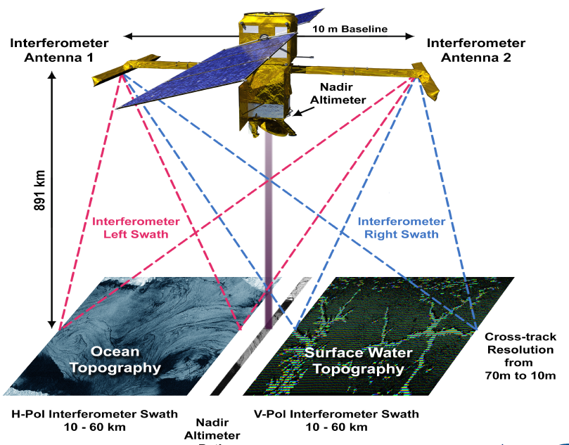
Og I 2022 kommer
SWOT
3 generations
Billeddannende
Nadir altimeter.

Slide 10



