Slide 1
Sea level observations
Climate, trend and extremes
Ole B. Andersen.
Professor, DTU Space, Denmark
2020

Slide 2
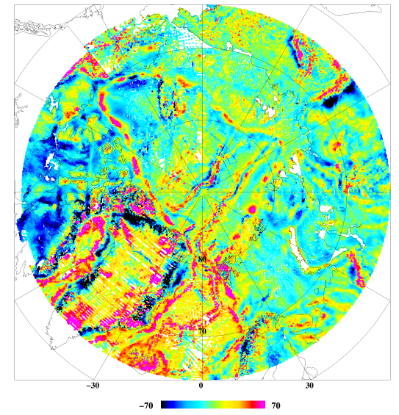
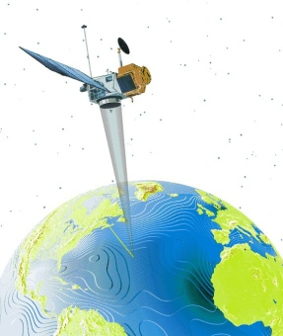
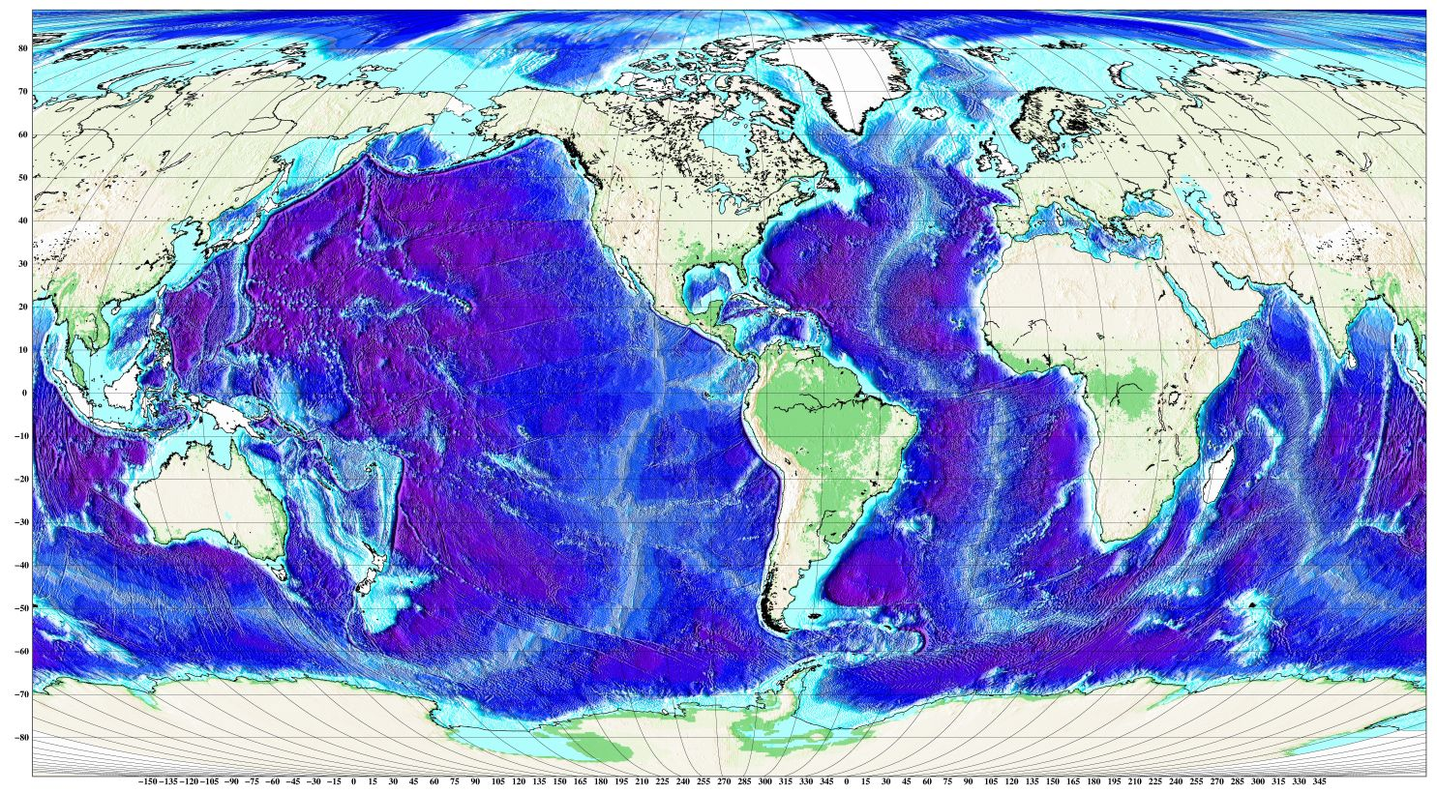
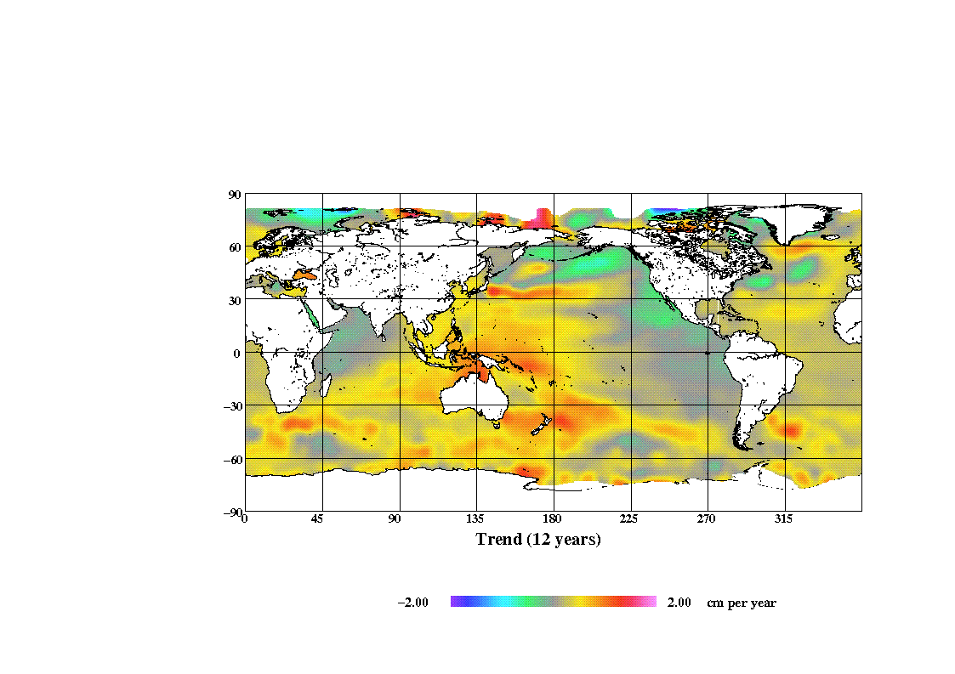
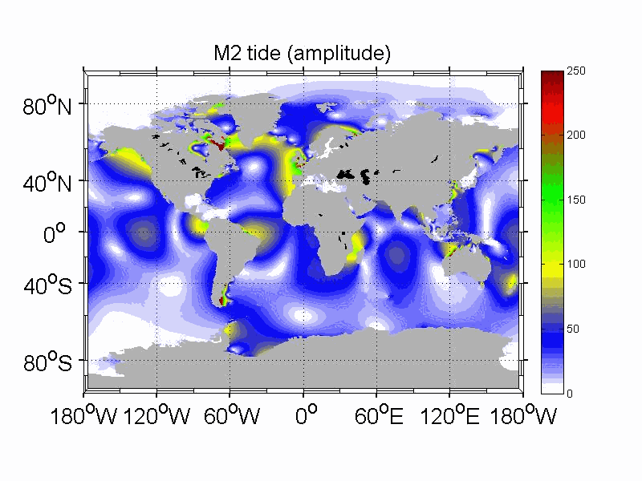
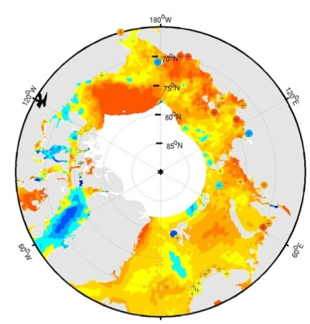
Who am I.
Gravity
Author of DTUhigh reslution
marine geophysical/geodetic maps.
  1 minute Global altimetric gravity field map
  1 minute Mean Sea Surface height
  1 minute Altimetry improved bathymetry
  Global ocean tide models.
  Global/regional/Arctic Sea level change(altimetric era).
Bathymetry
Sea Level Change

Slide 3
Overview of today
Global sea level RISE / acceleration?
How do we measure sea level.
Locally and globally
What causes sea level change
Explaining present day sea level changes
What are the impact.
TODAY we will have a number of excersizes (mainly matlab)

Slide 4
Overview of next week
Sea level EXTREMES
Sea level rise and impact…….
RCP & Sea level Projections
Sea level rise and sea level extremes:
Article Discussion:
Contributions to sea level extremes:
  Contribution from Ocean Tides
  Contribution from Winds + Waves
  Contribution from Changing currents + Sea level change.
Sea level extremes – observations:
Working with Newlyn – Annual + extreme.

Slide 5
Are you knowledgeable about
Sea Level Rise?
How much ?
Causes ?
Impacts ?
Notes:
http://sealevel.jpl.nasa.gov
http://climate.nasa.gov/SeaLevelViewer/seaLevelViewer.cfm
http://sealevel.colorado.edu/

Slide 6
Table discussion:
Are you knowledgeable about
Sea Level Rise?
How much (2050 2100)?
Causes ?
Impacts (DK; Europe)?

Slide 7
Sea level changes since …………

Slide 8
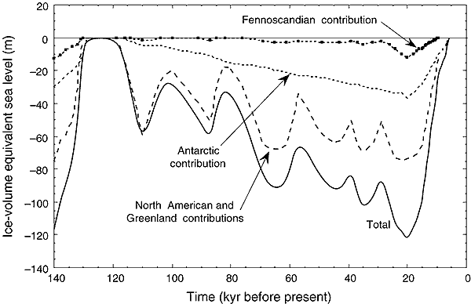
Estimates of global sea level change over the last 140,000 years (continuous line)
Contributions from the major ice sheets:
North America, including Laurentia, Cordilleran ice, and Greenland,
(ii) Northern Europe (Fennoscandia), including the Barents region,
(iii) Antarctica (Lambeck, 1999) Source: IPCC, 2001

Slide 9
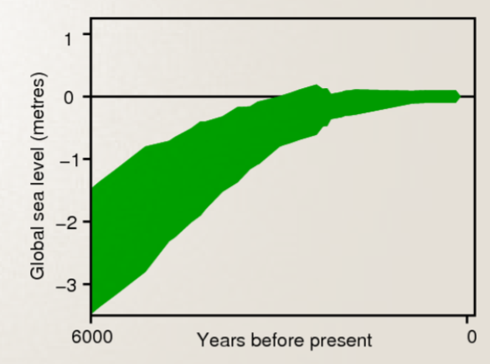
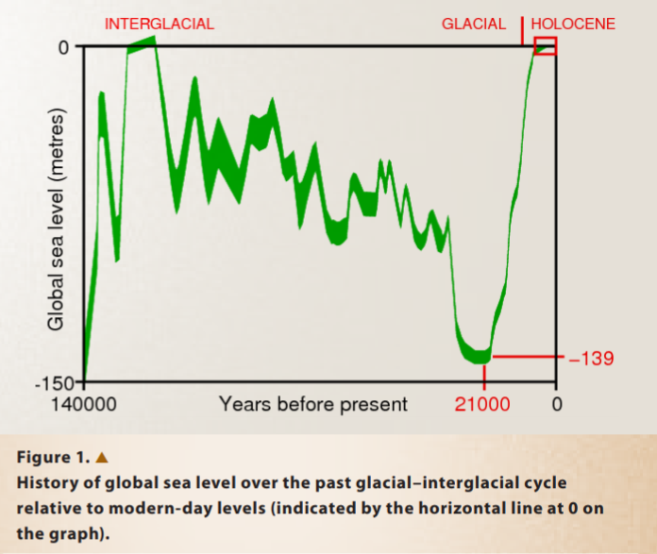

Slide 10
Sea-level rise: Historic changes
Since the Last Glacial Maximum (~20,000 years BP) MSL has risen by over 120 m
Between 15,000 and 6,000 years ago MSL rose rapidly at an average rate of 10 mm/yr.
Following last glacial period local vertical land movements are still occurring today (Actually smaller) as a result of large transfers of mass from the ice sheets to the ocean
During the last 6,000 years, global MSL variations on time-scales of a few hundred years (and longer) are likely to have been less than 0.3 to 0.5 m
During the 20th century, tide gauge data shows MSL rises in the range 1.0 to 2.0 mm/yr (larger as compared to 19th century)

Slide 11
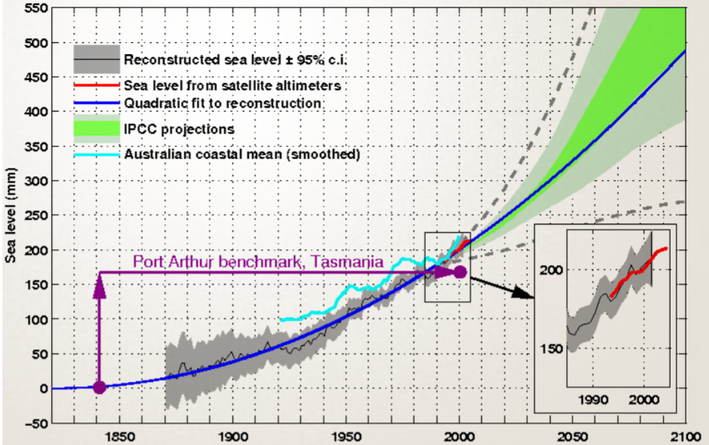
Sea level rise

Slide 12
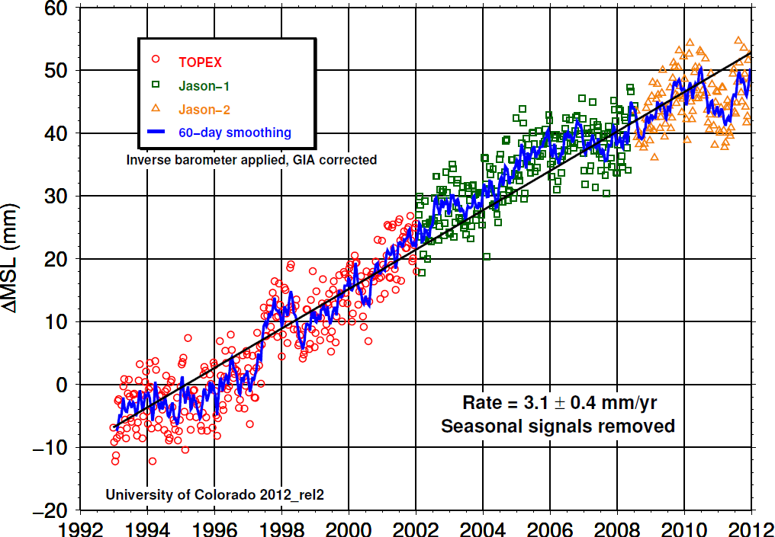
Recent sea-level rise: Global trend
Source: http://ilrs.gsfc.nasa.gov/
Notes:
GIA: glacial isostatic adjustment
Jason-2, also known as the Ocean Surface Topography Mission (OSTM), continues the oceanography program begun by the TOPEX/Poseidon and Jason-1 missions. Jason monitors global ocean circulation, discover the tie between the oceans and atmosphere, improve global climate predictions, and monitor events such as El Nio conditions and ocean eddies. The CNES, Eumetsat, NASA, and NOAA cooperative mission will carry nearly the same payload as Jason-1. The satellite's payload will include the next generation of Poseidon altimeter (Poseidon-3, with the same general characteristics as Poseidon-2, but with a lower instrumental noise and an algorithm enabling a better tracking over land and ice). The accuracy should be of about 1 cm on the altimeter as well as the orbit measurements.
Source: http://ilrs.gsfc.nasa.gov/

Slide 13
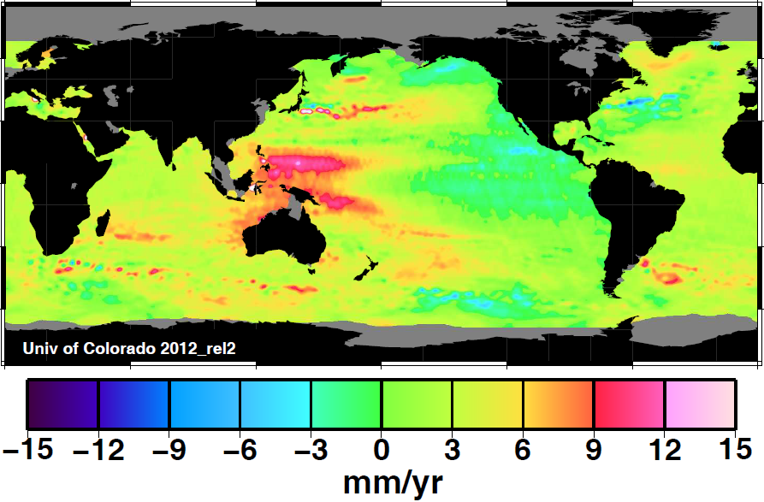
Recent sea-level rise
Local trends in sea-level (i.e. relative to local land mass)
Notes:
Local trends are calculated with a least-squares fit of 10-day, 0.25 degree resolution grids of sea level. A trend, bias, annual, and semi-annual terms are fit simultaneously. Please note that these trends have been determined for only a nineteen-year (1993 - 2012) period, and reflect the impact of decadal scale climate variability on the regional distribution of sea level rise. Additionally, local sea surface height trends and variations are a result of many factors, including (but not limited to) local crustal displacement, glacial isostatic adjustment, steric effects, and even local wind patterns. Therefore you should consider these effects in interpreting local sea surface height time series derived from our gridded data sets.

Slide 14
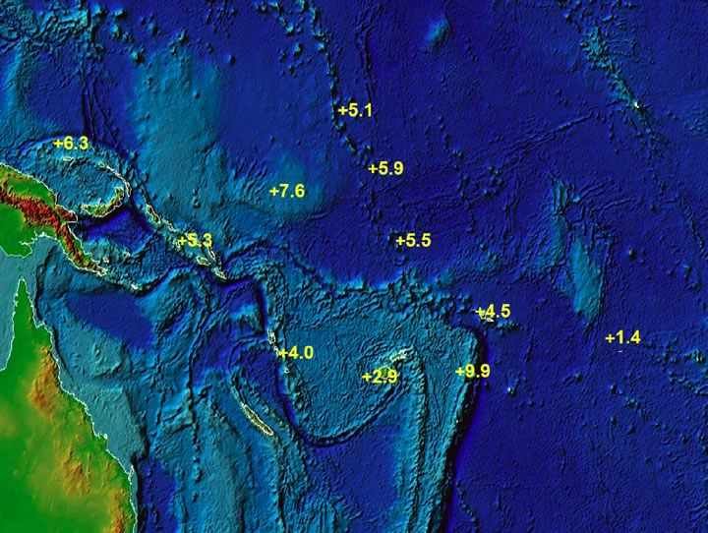
Recent Sea-Level Rise in South Pacific
(1991-2004)
Relative net sea-level trend (in mm/year) after subtracting the effects of PGR and the IB
Notes:
The South Pacific Sea Level & Climate Monitoring Project (PHASE III) SEA LEVEL DATA SUMMARY REPORT MAY 2004 - OCTOBER 2004
National Tidal Centre, Australian Bureau of Meteorology
www.bom.gov.au/fwo/IDO60102/IDO60102.2004_2.pdf
Relative net sea-level trend in mm/year after subtracting the effects of vertical movement of the platform and the inverse barometric pressure effect utilising all the data
collected since the start of the project up to the end of October 2004.

Slide 16
The Timevarying Signal in the ocean ξ(t) = T(t) + S(t) + O(t) + Z₀(t).
T= Tides (twice per day)
S = Surges (day to week)
O = Waves (seconds to hours) and currents (weeks to decades)
Z0= Long term Sea Level change (years to decades)
Normally observations X are taken at regular intervals:
t, t+∆t,t+2∆t etc
Variance of X is
We can assume signals to be statistically independent.
Hence:

Slide 17
Extremes
E(t) =
max(T(t)) + max(S(t)) + max(ΔO(t)) + Z₀(t).
Extremes of high sea-level events depend on changes in long-term average sea level as well as fluctuations around that average caused:
by tides, atmospheric pressure and storm surges AND WAVES.
Any changes in these periodic events will also have effects on the extremes of sea level experienced at the coast.
Even without any increase in weather-related events, a rise in the average sea level will mean that extreme sea levels that currently cause occasional inundation or wash-over at a given location will do so with increasing frequency in the future
causing increasingly severe impacts on coastal communities, infrastructure and habitats.

Slide 18
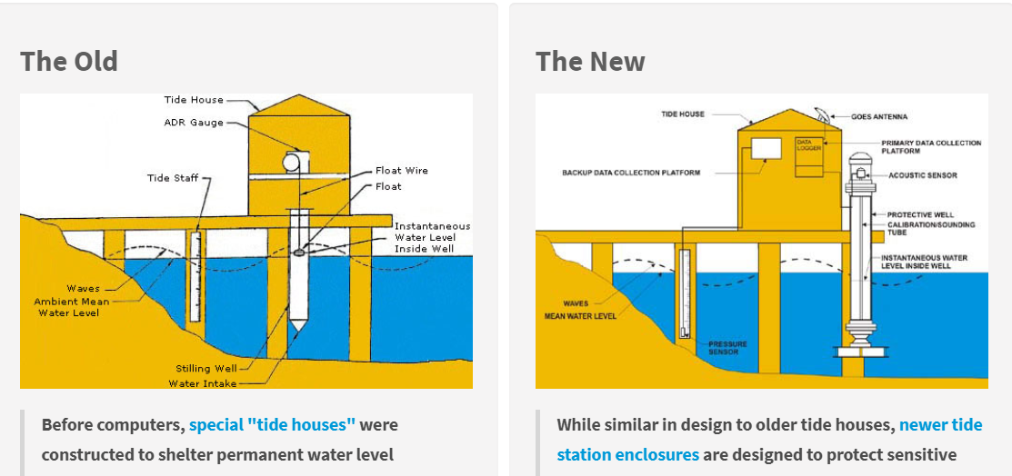
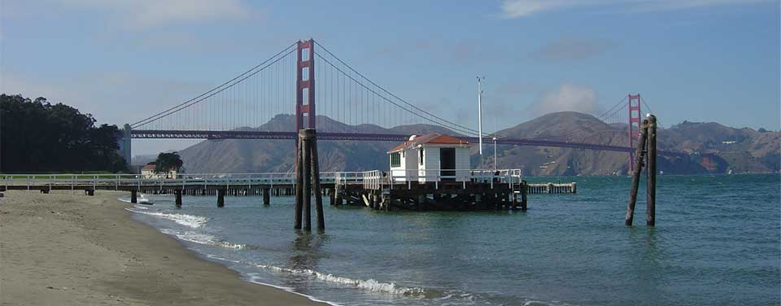
How do we measure tides + surges - Conventional
Measures in a pipe with a float (Analog)
Or with radar……..

Slide 19
How do we measure tides + surges - Conventional
Many locations

Slide 20
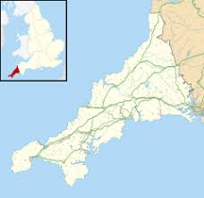
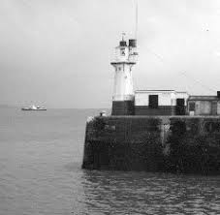
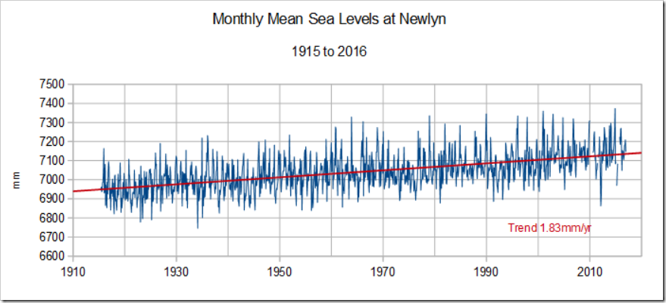
The Newlyn tide gauge
Data (decimal years, height (mm), dummy

Slide 21
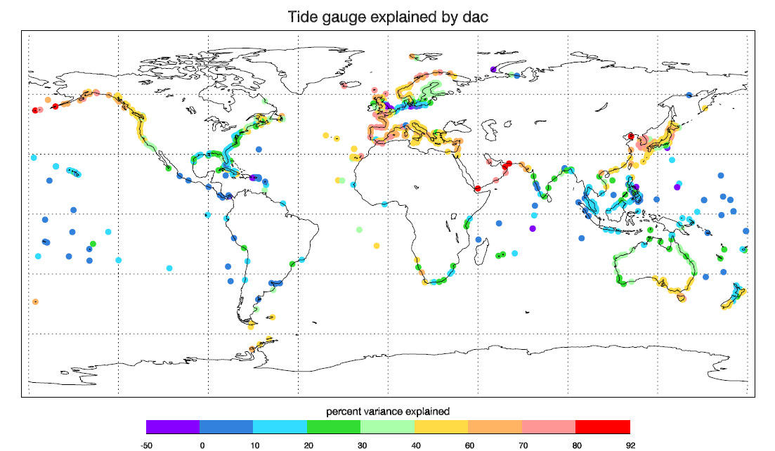
All over the world for 100 years ”or only at coast”

Slide 22
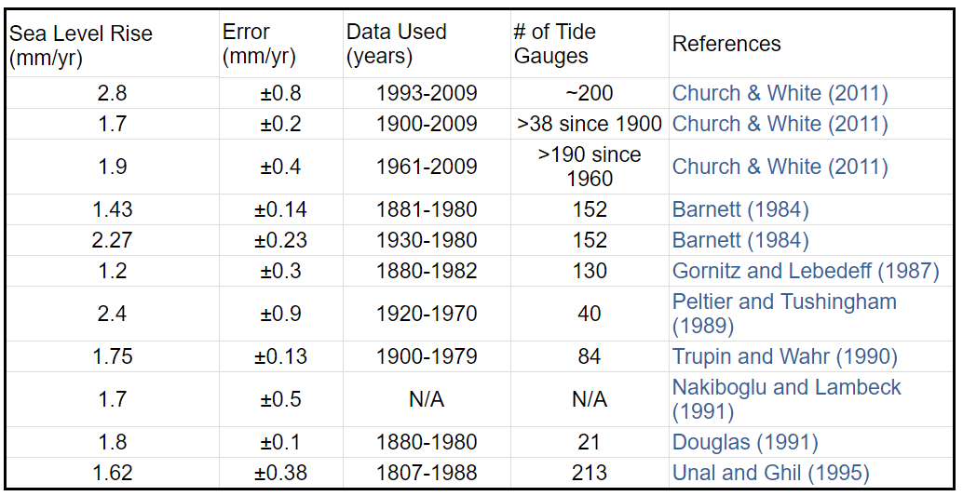
Sea level rise from tide gauges

Slide 23
Sea level change since Pleistoscene

Slide 24
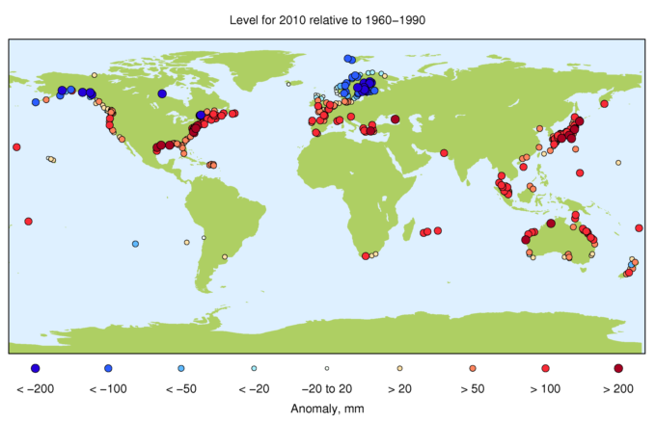
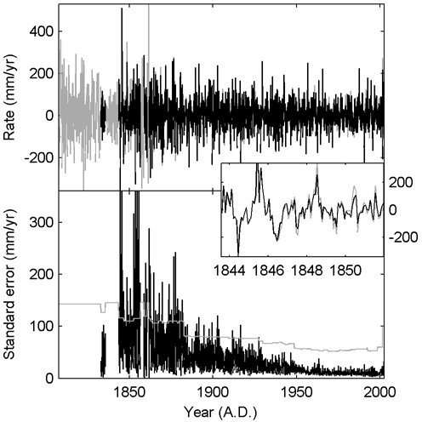
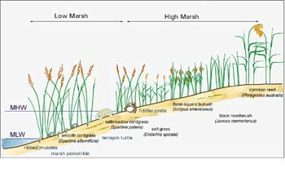
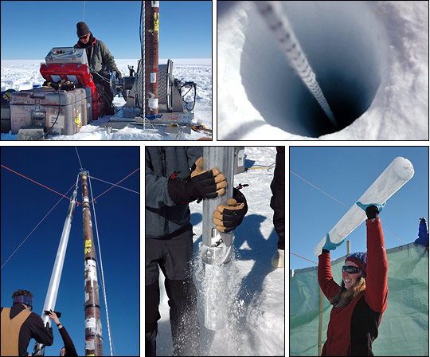
Importance of TG
Climate changes observations:
Tide gauges
Marsh
Ice cores
Climate Models
Sea Level reconstruction:

Slide 25
Exersize 1 DIY sea level trend.
The Cph/Stok/Newlyn/Manilla tide gauge – all > 100 years.
Format is (time (decimal years), ssh (in mm + 7000 mm offset)
Study long term sea level change
Create sea level trend over 100 years and most recent 30 years.
Investigate trend
Method:
Use Polyfit routine or the preferred \ operator :
ssh = Newlyn sea surface height (100 observations).
time = time (in years);
You create a prediction model of same time length (100) as you vector of ssh
e = [ones time];
In Matlab you can use the backslash operator which create the LSQ fit.
res = e\ssh’ , res(1) = b, res(2) = a (next page)
Create linear model sshLinear = time*res(2) + res(1)
Removing trend is then residual = ssh-sshLinear

Slide 26

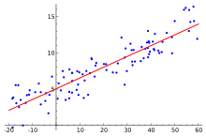
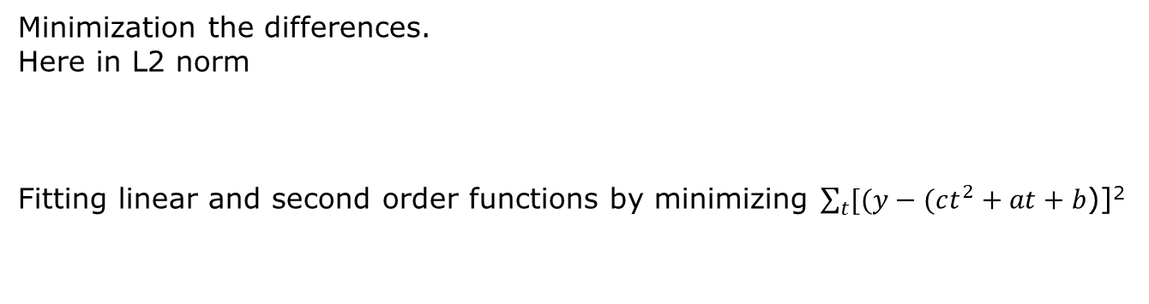
Linear Trend estimation
Tide Gauge annual series (ssh(t)=y)
Minimization the differences.
Here in L2 norm
Fitting linear and second order functions by minimizing $\sum_{t}{[(y−(ct^{2}}+at+b$)]²

Slide 27
What did you learn from This.
Sea level trend changes slowly (dependent on averaging period)
Sea level trend has changed lately.
A number of 1.8 mm/year is very reasonable for 100 years but not for recently……..
We observe very large variations.
HOWEVER WHAT THEY MEASURE IS WHAT PEOPLE WiLL EXPERIENCE LOCALLY

Slide 29
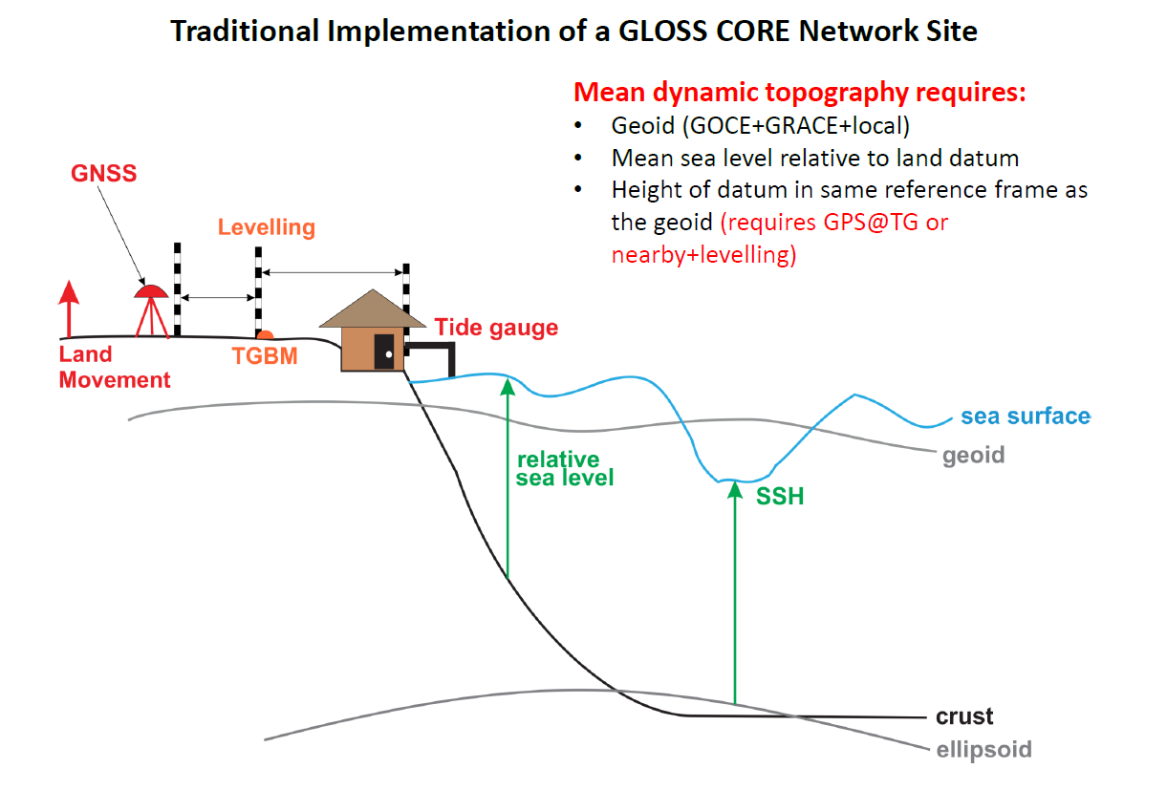
Tide gauge measure RELATIVE SEA LEVEL

Slide 30
Factors affecting LOCAL RELATIVE sea surface high observations
Eustatic – changes of total sea water mass
Steric – Thermal expansion of water volume
Local Ground movements:
Isostatic –> Vertical movement of land
Hydrological –> Vertical movement of land
Tectonic –> Horizontal +Vertical movement
Geophysics -> Sediment compaction

Slide 31
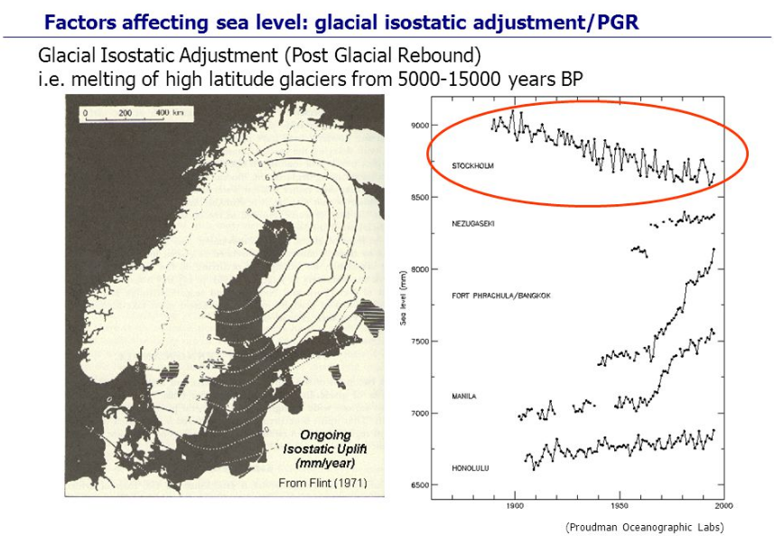
TIDE GAUGE

Slide 32
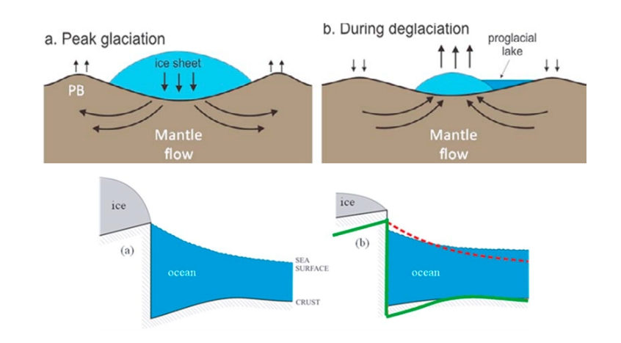
VLM = Post Glacial Rebound + Elastic

Slide 33
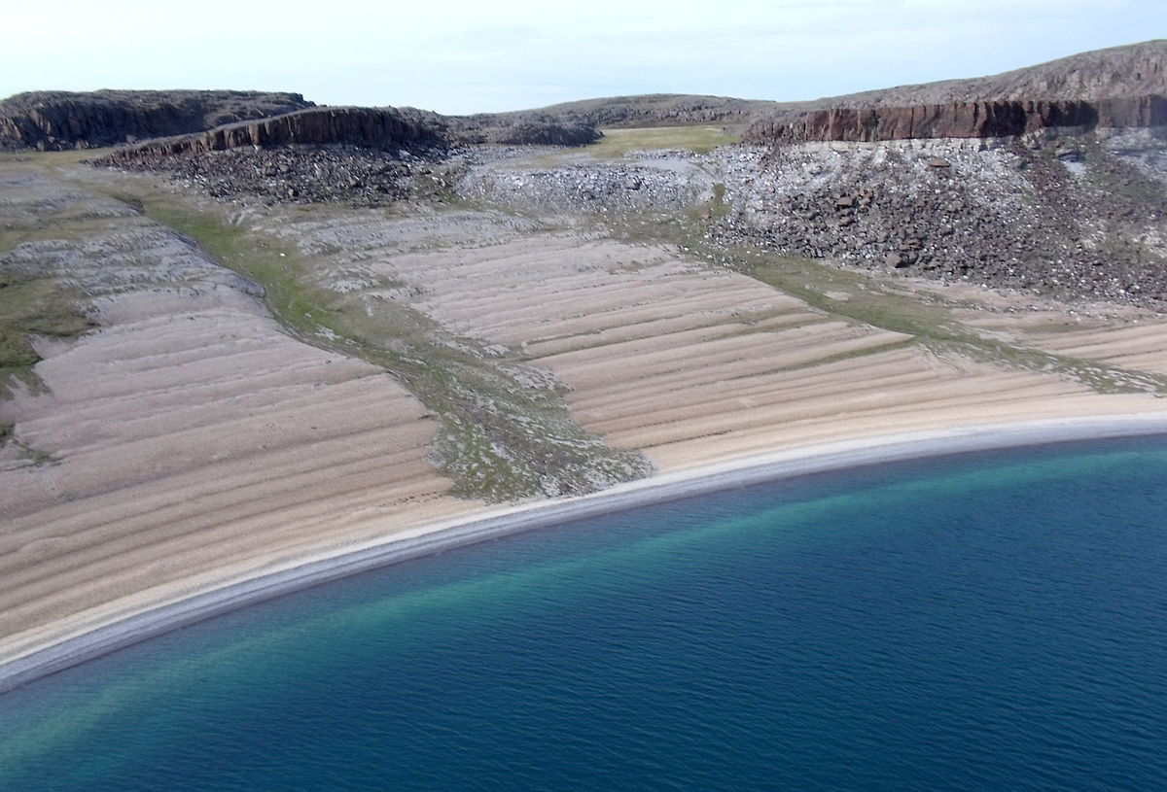
Scandinavia: Coastline change with time……

Slide 34
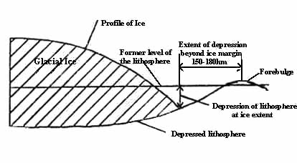
Glacial/interglacial isostatic adjustment
(PGR: Post Glacial Rebound)
The weight applied to the crust is dispersed throughout the lithosphere
The lithosphere is so rigid that the weight is transferred across the crust resulting in a peripheral depression and “forebulge”
Around the periphery of the ice sheet margin up to a distance of 150-180 km, depression (>100m) occurs without ice loading
This area can record relative sea level change without the complexity of glacial erosion or deposition
The lateral displacement of mantle material from below the centre of ice sheet loading results in the formation of an area of slight uplift (10 - 20 m) beyond the peripheral depression (the forebulge).

Slide 35
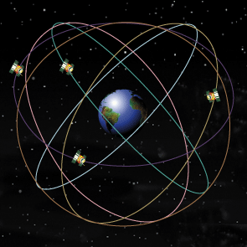
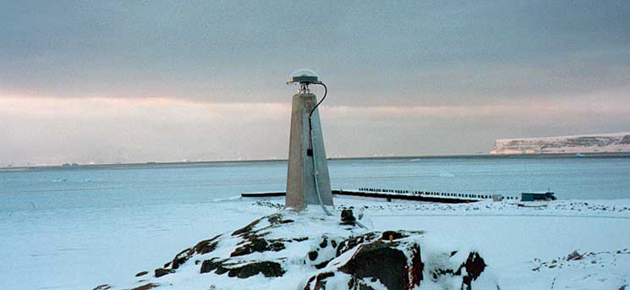
Measuring PGR using GPS.

Slide 36
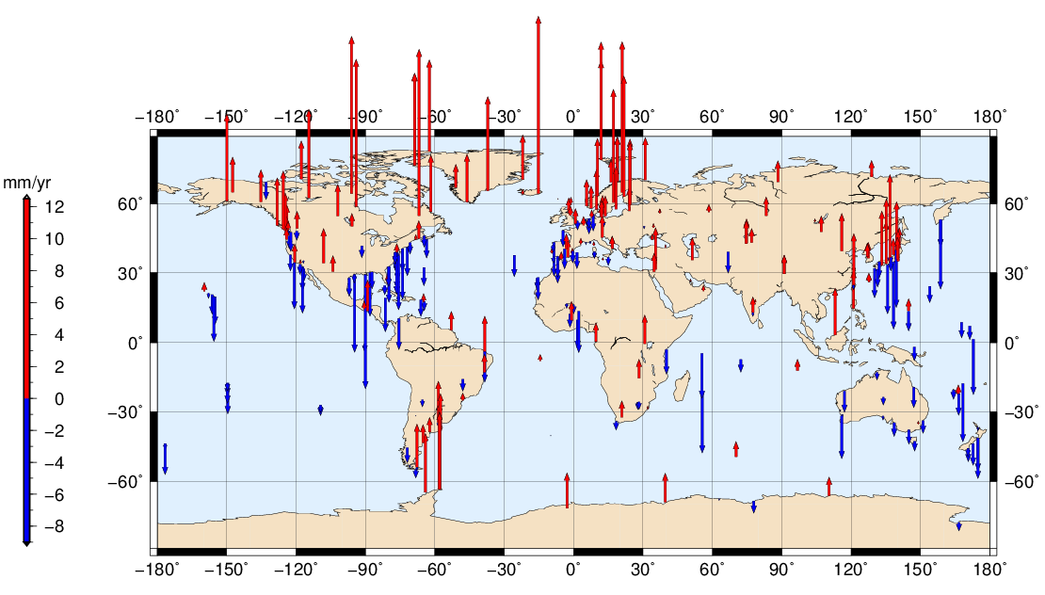
Crustal movements from GPS
Tide gauge will see opporsite we can use This to correct the TG….

Slide 37
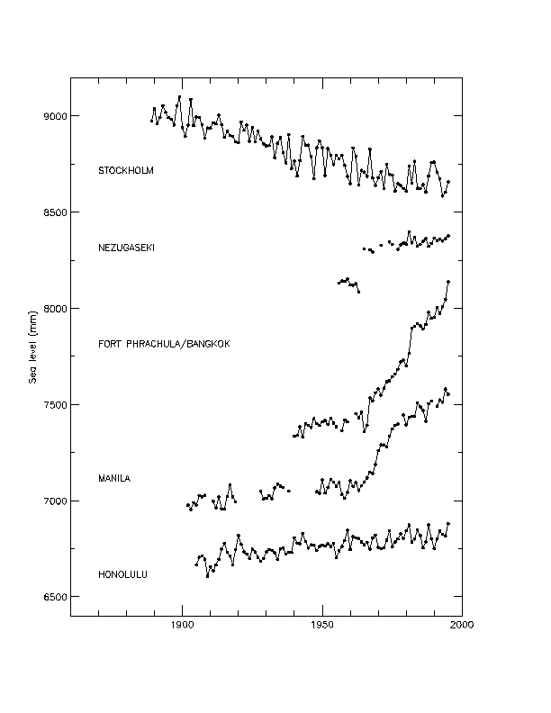
hydrology
Fort Phrachula Bangkok, Thailand (sea level rise due to increased groundwater extraction since about 1960)
Manila, Philippines (recent deposit from river discharges and reclamation works)
(courtesy of Proudman Oceanographic Lab)
Notes:
Reclamation: 矯正

Slide 38
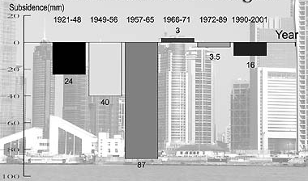

Slide 39
Tectonics
TIDE GAUGE

Slide 40
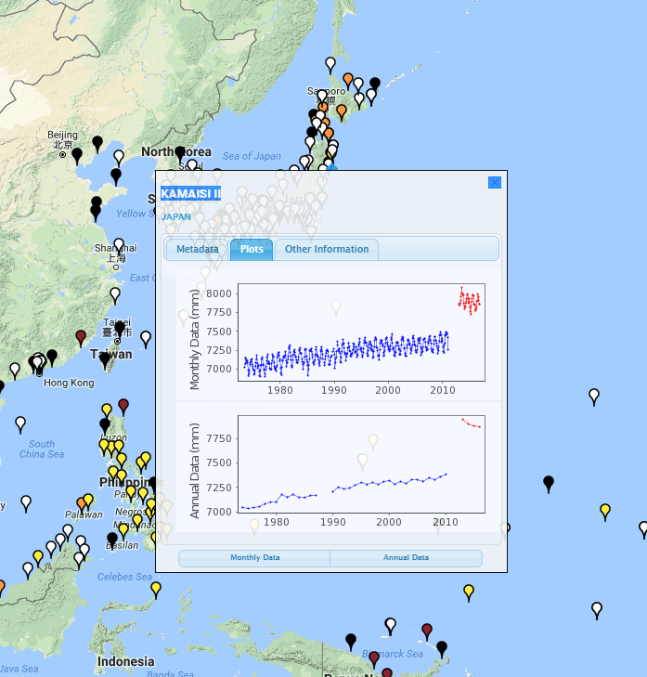
Tide gauge
Problems…

Slide 41
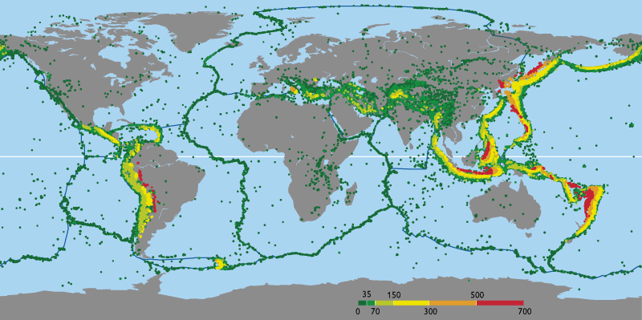
Earthquakes zones.

Slide 42
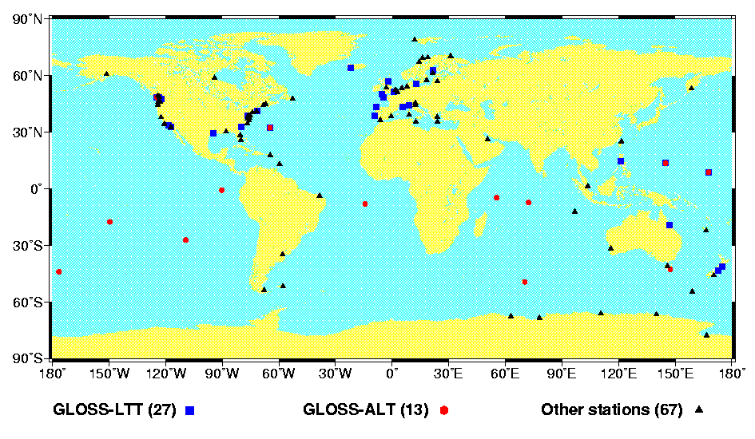
So a number of Tidegauges are influenced

Slide 43
Sea level rise from tide gauges

Slide 44
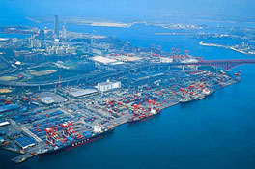
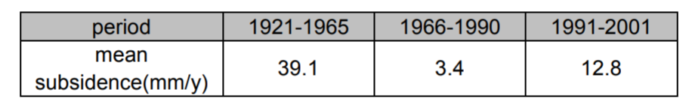
Pros and cons of Tide gauges vs Satellites
Pros of TG
  Very long time series - some > 100 years.
  Very high temporal sampling
  They measure relative sea level (Where people live)
Cons of TG.
  Fixed to the Ground.
  Far from global
  Some times problems with outtages,pgr and earthquakes……..
  Post Glacial Rebound not very good understood.
  Hydrology…BIG CITIES WANT LOT OF DRINKING WATER -> Subsidence (like a sponge)

Slide 45
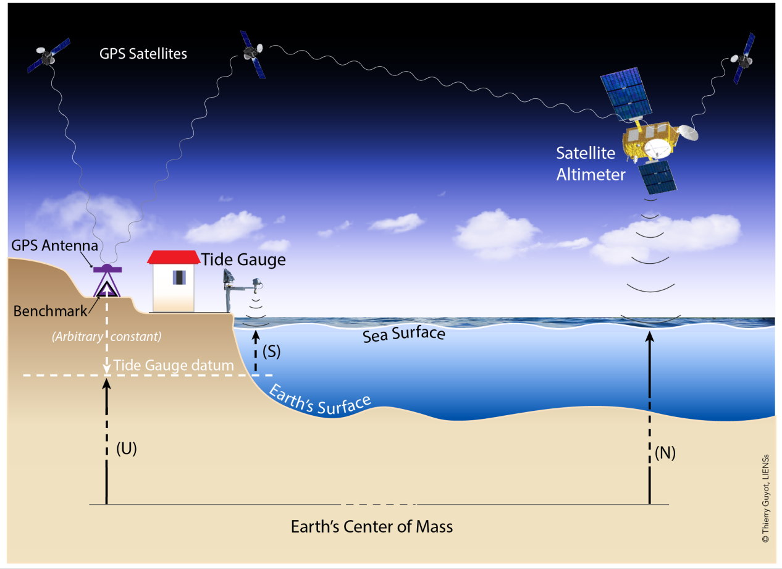
A better way to measure Z0 long-term sea level changes

Slide 46
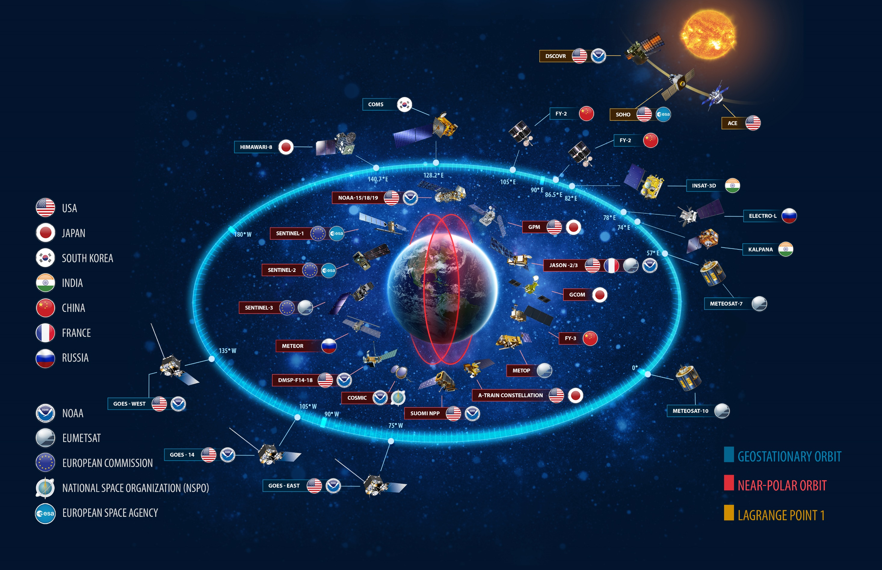

Slide 47


Slide 48
Moving from TG to Satellites
(ABSOLUT SEA LEVEL CHANGES = CLIMATE)

Slide 49
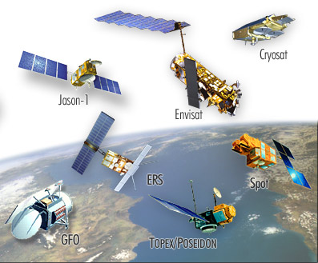

Satellite Altimetry

Slide 50
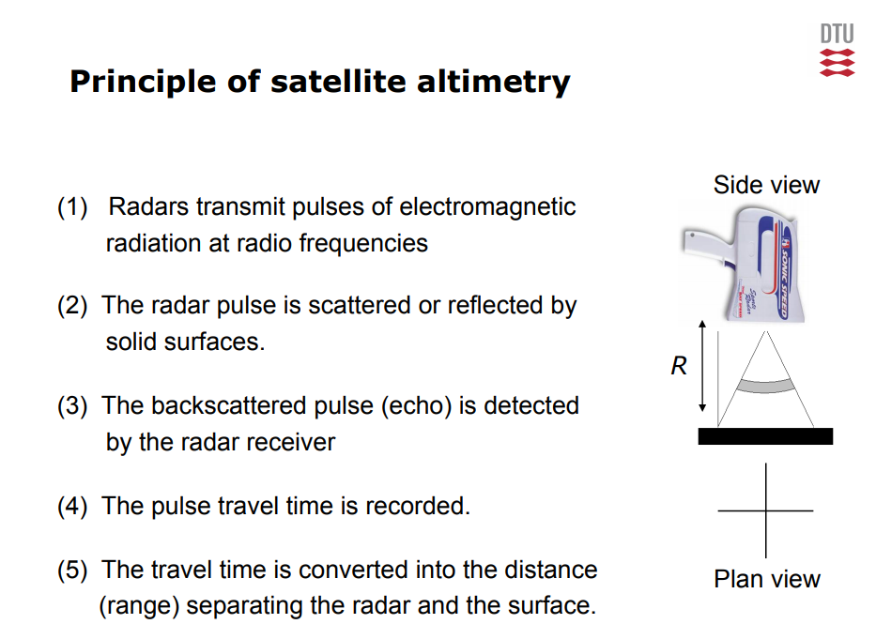

Slide 51
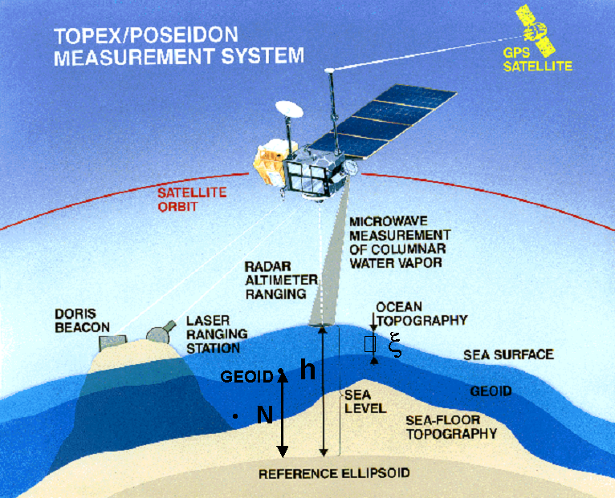
Altimetric Observations
Accurate radar (or laser) ranging to the sea surface is
Based on accurate time-determination d = t * c / 2
Where c must be adjusted slighly for propagation through ionosphere and troposphere.
SSH = Height_{sat} – Range
Height_{sat} Is determinde using
GPS or DORIS/Laser ranging
Relative to the reference ellipsoid
Ellipsoid is ”best” mathematical
model of the Earth Shape (WGS84).

Slide 52
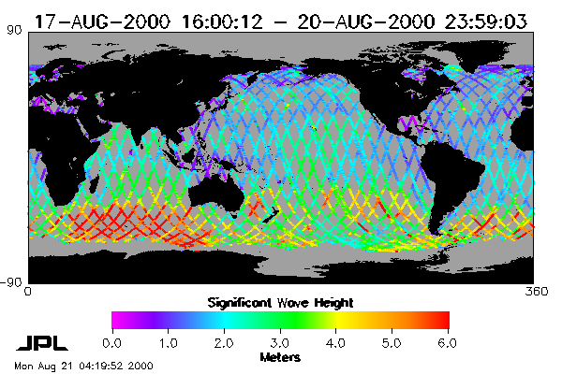
Orbit Parameters
The coverage of the sea surface depends on the orbit parameters (inclination of the orbit plane and repeat period).
JASON - 10 Days
 | Satellite | Repeat Period | Track spacing | Inclination Coverage
Repeating (ERM) | ESA ERS 1+2/ENVISAT/S-3 | 30 days | 95 km | 98° (+/-82°)
 | JASON 1-2-3 | 10 days | 315 km | 66.5°

Slide 53
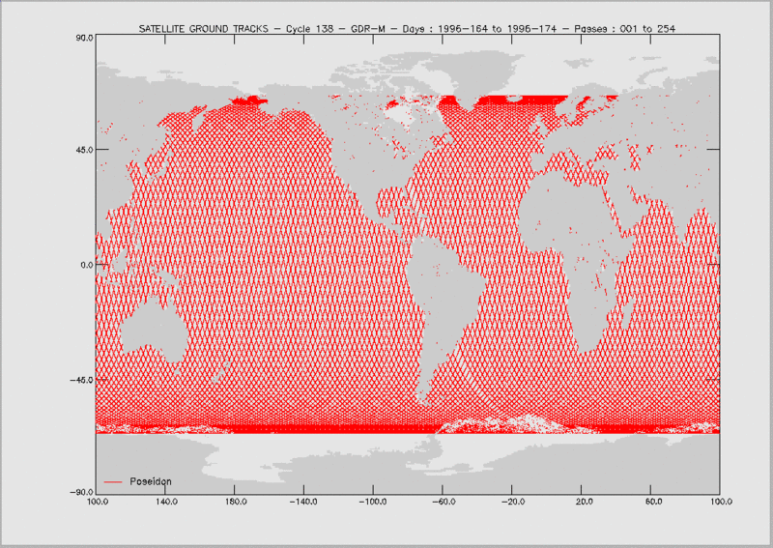

Slide 54
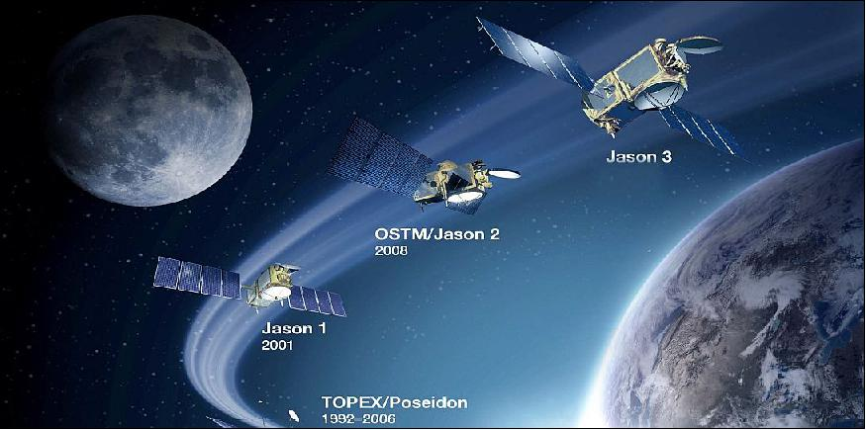
Sea level trend (accuracy)
Delicate cal/val+tandem formation flight ensures cm-ACCURACY
If we want to monitor that sea level is increasing

Slide 55
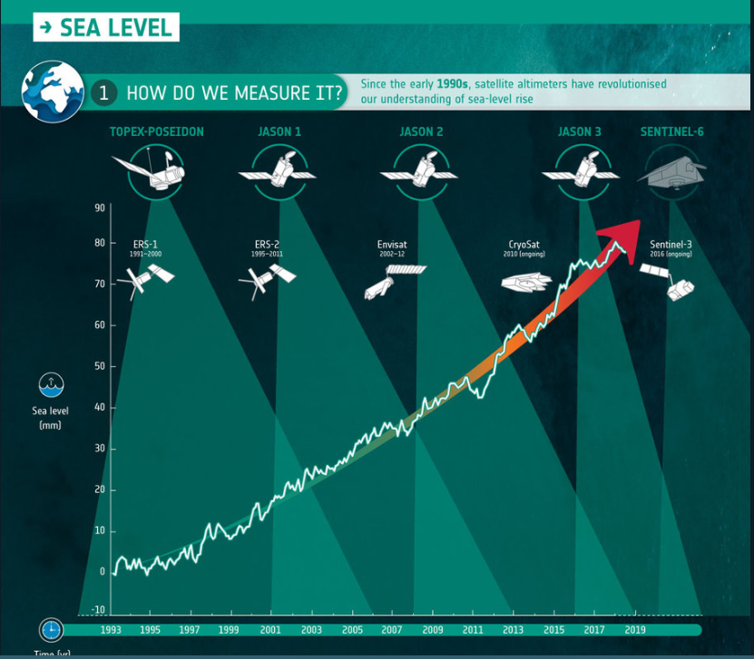

Slide 56
Make it easy and use gridded monthly sea level from satellite altimetry.

Slide 57




Montly grid of (ξ(t)
Time
(1993-2015)
Latitude N
(-66 -> 66)
Time
(1993-2015)
Longitude M (0-360)
Creating a 1D averaged time series
$$f\left(t\right)=\frac{1}{N∗M}\sum_{m=1}^{M}{}\sum_{n=1}^{N}{\left({\frac{ssh(n,m,t}{area=1}}\right)}$$

Slide 58

Linear Trend estimation
Minimization the differences.
Here in L2 norm
Fitting higher order functions by minimizing $\sum_{t}{[(y−(ct^{2}}+at+b$)]²

Slide 59





Slide 60

Global sea level change
3.3 mm/y +/- 0.45 mm (20 years)
Notes:
The raw GMSL record from satellite altimetry. Let’s review the recent acceleration estimate from Nerem et al., (2018)

Slide 61

Satellite can nearly meet climatic change study requirements…….
The fundamental importance of sea level changes is that it is a direct measure of the HEAT CONTENT of the ocean (integration of all the heat we put into the ocean).

Slide 62

DTU 2018 sea level acceleration estimates used European satellite (ERS1/2, Envisat+Cryosat)
3.52 mm/y + 0.068 mm/y²
Can we validate it ???

Slide 63


Slide 64

Satellite reveals the spatial pattern of linear sea level change

Slide 65
Lets try it out…….
Use data from 319 month (1991.5 -2018.8)
67 Latitude cells.
120 longitude cells
Latitude N
(-66 -> 66)
Longitude M (0-360)

Slide 66

Spatial Analysis
Latitude N
(-66 -> 66)
Analyse each individual (n,m)
time series estimating a trend
For each point in the global grid of N*M pixels
Trend(n,m) =
Longitude M (0-360)
Globally or Creating a 1D averaged time series
$$f\left(t\right)=\frac{1}{N∗M}\sum_{m=1}^{M}{}\sum_{n=1}^{N}{\left({\frac{ssh(n,m,t}{area=1}}\right)}$$

Slide 67
Exersize 2
Create present day sea level change from satellite altimetry.
YOU CAN CHOOSE YOUR LEVEL.
Either (globally average or averaged of the global model).
ssh = Global averaged sea surface height (319 observations).
time = time (in years);
You create a prediction model of same time length (319) as you vector of ssh
e = [ones time ]; e = [ones time time**2];
In Matlab you can use the backslash operator which create the LSQ fit.
res = e\ssh’ , res(1) = b, res(2) = a (next page)
Create linear model sshLinear = time*res(2) + res(1)
Create t2 timeseries from 1993-2100) and enter in equation.

Slide 68

Acccelerating sea level change
3.2 mm/y + 0.08 mm/y²
Error in T/P was found by Watson (2017) & Nerem (2018).
We new something was wrong since 2004 but could not proved it
Notes:
The raw GMSL record from satellite altimetry. Let’s review the recent acceleration estimate from Nerem et al., (2018)

Slide 69
DTU 2018 sea level acceleration estimates used European satellite (ERS1/2, Envisat+Cryosat)
3.52 mm/y + 0.068 mm/y²
Can we validate what we are seing???

Slide 70

Importance to Future sea level rise
Projections of 21st-century GMSLR under
Different RCPs from the IPCC 5th Assessment Report
RCP8.5
0.53–0.98 m by 2100
8-16 mm yr⁻¹ during 2081-2100
RCP 2.6
0.28–0.61 m by 2100

Slide 71
Are you knowledgeable about
Sea Level Rise?
How much ?
Causes ?
Impacts ?
Its important to study the causes, as this might be the way we can progress physical models
Notes:
http://sealevel.jpl.nasa.gov
http://climate.nasa.gov/SeaLevelViewer/seaLevelViewer.cfm
http://sealevel.colorado.edu/

Slide 72

Satellite altimetry and Climate
What changes sea level
Adding water (Eustatic)
Heating water (Steric)
Changing the shape (Isostatic)

Slide 73

The water System

Slide 74
Contributing factors to Sea Level Rise
Δh (t) = X (t) + g (t) + G (t) + A (t) + I (t) + p (t) + s (t)
X - thermal expansion (steric rise)
g - loss of mass of glaciers and ice caps (eustatic rise)
G - loss of mass of the Greenland ice sheet due to current climate change (eustatic rise)
A - loss of mass of the Antarctic ice sheet due to current climate change (eustatic rise)
I - loss of mass of the Greenland and Antarctic ice sheets due to the ongoing adjustment to past climate change (eustatic rise)
p - runoff from thawing of permafrost (eustatic rise)
s - deposition of sediment on the ocean floor

Slide 75
Factors affecting sea level rise: Eustatic changes
Eustatic changes = volumetric (mass) changes
Comes from….Glaciers, ice-caps or ice-sheets:
Gain mass by accumulation of snow (snowfall and deposition by wind-drift), which is gradually transformed to ice.
Lose mass (ablation) mainly by melting at the surface or base with subsequent runoff or evaporation of the melt water
Net accumulation occurs at higher altitude
The mass balance for an individual body of ice is usually expressed as the rate of change of the equivalent volume of liquid water, in m³/yr; the mass balance is zero for a steady state
Permafrost is great big unknow right now.
Thawing permafrost might become large contributor in the future.

Slide 76
Factors affecting sea level rise: Steric rise
As oceans warm, density decreases and thus even at constant mass the volume of the ocean increases
Thermal expansion (or steric sea level rise) occurs at all ocean temperatures (albeit small in the deep ocean)
Water at higher temperature or under greater pressure (at greater depth) expands more for a given heat input. Therefore, the global average expansion is affected by the distribution of heat within the ocean
Haline-expansion:
Salinity changes within the ocean also have a significant impact on the local density and thus local sea level, but have little effect on global average sea level change
The rate of climate change depends strongly on the rate at which heat is removed from the ocean surface layers into the ocean interior – if heat is taken up more readily, climate change is retarded but sea level rises more rapidly

Slide 77



Smaller effect: Changing the shape (isostatic)
Earthquakes & Post Glacial Rebound changes the shape.

Slide 78


Eustatic Sea Level Rise
(Mass changes)
We need to launch a scale in Space to measure mass changes
Mass on earth will affect satellites differently due to their difference in r to the mass element (Newtons 2 law.

Slide 79


Gravity and satellite orbits
Two spacecrafts making one scale
GRACE–400 km

Slide 80

Observations are TIME differences:

Slide 81


GRACE Formation Flying Satellites
  KBR+USO Ranging (JPL/SSL/APL)
ACC SuperSTAR Accelerometer (ONERA)
SCA Star Cameras (DTU)
GPS Receiver (JPL)
Satellite (JPL/Astrium)
Launcher (DLR/Eurockot)
Operations (DLR/GSOC)
Science (CSR/JPL/GFZ
In essence.
The two satellites become the scale
And you use orbit pertubation
As measurements.
There aint no moving parts in satellite

Slide 82

Orbit
Launched: March 17, 2002
Initial Altitude: 500 km
Inclination: 89 deg
Eccentricity: ~0.001
Distance: ~220 km
Nominal Mission : 5 years
Non-Repeat Ground Track, Earth Pointed, 3-Axis Stable
2005 GRACE 1-2 Orbit Switch
Mission Lifetime
5 Years
Extended to 9 Years
But its still working (2016)
Future
GRACE-Follow On

Slide 83

GRACE measurement technique
The two satellites act like a very big scale because of
ORBIT pertubation……
Orbit pertubation/ranging is measured by KBR ranging
Accuracy currently 2 Micrometer
1/100 thickness of a hair
Better than diameter of blood cell
Delivers 10-Day / Monthly gravity field
From 2002 Onwards
Study gravity field changes with time
Limit in resolution 400 km

Slide 84


Slide 85







Gravitational Mass Variations | Grace – Challenges
2002
Integrated temporal variations of (AOHIS) :
  Atmosphere (A)
  Ocean (O)
  Hydrosphere (H)
  Cryosphere (I)
  Geosphere (S)
2016
Equivalent Water Thicknesses (EWT)

Slide 86
Whats fantastic about GRACE is that it can measure how
gravity is changing because our planet is changing.

Slide 87





GRACE “a scale in space”
Weights the ice-caps
Glaciers
Greenland
Contribute 0.51 mm/year
Antarctica
From Khan et al.
Contribute 0.8 mm/year
Contribute 0.35 mm/year

Slide 88

Eustatic contribution to sea level rise (roughly 50%)
Continental ice from ice-caps is missing

Slide 89

Steric Changes
T0 = 0ºC and S0 = 35 psu. (practical salinity unit)

Slide 90


If you are to use spaceborne
Data you must assume a relation between depth and temperature to perform the integration

Slide 91


There’s a better way.
Since 2004 you can get temperature as a function of depth.

Slide 92

The revolution of ARGO

Slide 93


ARGO floats……

Slide 94
Now we can perform the integration but only for the period 2005-2017

Slide 95
Eustatic contribution to sea level rise (roughly 50%)

Slide 96

Eustatic or steric?
ρ = 1028 kg/m3
Δρ = 28 kg/m³
δh_{s} = 0.05 mm/yr
Salinity induced rise:
δh_{eustatic} = (ρ/Δρ)δh_{s} = 36.7 δh_{s}= 1.8 mm/yr
Assuming global ocean covers an area of 3.6 ×10⁸ km²
This eustatic change would require an ice melt volume of 650 km³/year
Source: Ocean Freshening, Sea Level Rising, Walter Munk, Science 27 June 2003 300: 2041-2043

Slide 97

Greenland from GRACE

Slide 98


What can altimetry, GRACE, and Argo tell us?
The sea level budget may be expressed as height changes from the main components of sea level change:
∆SSH = ∆SH + ∆OM
SSH = sea surface height, SH = steric height, OM = ocean mass
Argo measures temperature and salinity short of the abyssal ocean (roughly 44 to 75% of Argo profiles are from 2000m).
∆SH = ∆SH_{(0–2000m)} + ∆SH_{(2000m–∞)}
We can estimate a residual from observations:
∆SL_{residual} = ∆SSH – ∆SH_{(0–2000m)} – ∆OM
∆SL_{residual} = ∆SH_{(2000m–∞)} + Error

Slide 99

Global sea level budgets
Global sea level budgets can be closed within the estimated errors
What do regional sea level budgets tell us?

Slide 100

Future sea level rise.
Can we just extrapolate steric+eusteric?
We have to be very careful because the earth is dynamic and elastic.
Melting Greenland West Antarctica

Slide 101


Slide 102
summarizing
Importance to investigate sea level rise (incl spatial pattern).
Important to understand future extremems.
Importance to

Slide 103
Are you knowledgeable about
Sea Level Rise?
How much ?
Causes ?
Impacts ?
Notes:
http://sealevel.jpl.nasa.gov
http://climate.nasa.gov/SeaLevelViewer/seaLevelViewer.cfm
http://sealevel.colorado.edu/

Slide 104

Cliff erosion
suspect?
Source: Tyndall Centre for Climate Change Research

Slide 105

Coastal erosion and accretion
1 cm rise in MSL erodes
approx 1m horizontally of beach
SLR has a profound effect on the rate of sedimentation
Varying of sedimentation rates
-> changing vegetation zones
e.g. growth/shrinkage of marshes (high tide water level regions)
Storm surges force large quantities of shore-face sediments through inlets -> create tidal deltas/barriers
River flow (Florida must pump water)
1m
0.01
Notes:
Movement of sediment from tidal region to beneath near-shore waters
Change to rate of sedimentation due to change in weight of overlying water column
Wetlands/salt marshes – high tide water level regions
e.g. mangrove ecosystems: provide natural protection against storm surges/hurricanes;
sedimentary traps: stabilise coastlines;
home to commercially exploited fish
-in danger of being overcome by rising sea-levels (natural rate of mangrove rise:~2/3 mm yr-1)

Slide 106

Bruun Rule (One of the processes affecting sandy beaches)
R = G(L/H)S
  H = B + h*
  R = shoreline recession due to a sea-level rise S
  h* = depth at the offshore boundary
  B = appropriate land elevation
  L = active profile width between boundaries
  G = inverse of the overfill ratio
Source: Nicholls, 1998
Notes:
Assessing erosion involves using the Bruun Rule for straight areas of coastline. The assumption is that the profile conserves its average or equilibrium shape relative to sea level. Using appropriate boundary conditions, the profile shape defines all the information necessary to predict the response to sea level rise. To maintain the profile shape the upper part of the profile erodes and the lower part of the profile accretes, translating the shoreline landward.
Source: Nicholls, 1998.
R = G(L/H)S
where: H = B + h*
R = shoreline recession due to a sea-level
rise S
h* = depth at the offshore boundary
B = appropriate land elevation
L = active profile width between boundaries
G = inverse of the overfill ratio

Slide 107

Vulnerable coastal/island regions

Slide 108


Vulnerable populated regions
Mega Coastal Cities:
Populations >8 million
(over 50% of US population (110 million) live in coastal areas
(over 40% in Europe
Highly populated Delta regions
http://www.survas.mdx.ac.uk

Slide 109


People close to the coast

Slide 110
Increased salinity in estuaries
Saltwater will penetrate farther inland and upstream in estuaries (i.e. estuarine salt wedge)
Higher salinity impairs both surface water and groundwater water supply
Saltwater intrusion would also harm ecosystems:
  aquatic plants and animals e.g. salt marshes, mangroves
  Higher salinity has been found to decrease seed germination
  Flooded agricultural land takes a long time to recover
Decline of coastal commercial fisheries
e.g. Salinity intrusion has already been cited as primary reason for reduced oyster harvests in Delaware and Chesapeake Bays in the USA
Notes:
Impair:損害,減少,削弱
Germination:發芽,萌芽
Oyster:牡蠣,蠔,沈默者

Slide 111
Mitigation

Slide 112

Amager Faelled is at 1 meter below sea level.
However Ørestaden is planned for 1 meters sea level rise

Slide 113

Dikes

Slide 114

Dikes, Levees and Floodwalls.
New Orleans (Katarina, Levee failure)

Slide 115

Dike protection.

Slide 116

The Guardian 2020

