Slide 1
Sea level extreme and projections surges, tides and waves
Ole B. Andersen.
DTU Space, Denmark
2020

Slide 2
Overview of this week (extremes)
Sea level rise and impact…….
Climate Models and sea level Projections
Sea level rise and sea level extremes:
Article Discussion:
Contributions to sea level extremes:
  Contribution from Ocean Tides
  Contribution from Winds + Waves
  Contribution from Changing currents + Sea level change.
Sea level extremes – observations:
Working with Newlyn – Annual + extreme. (might skip)
Impacts

Slide 3
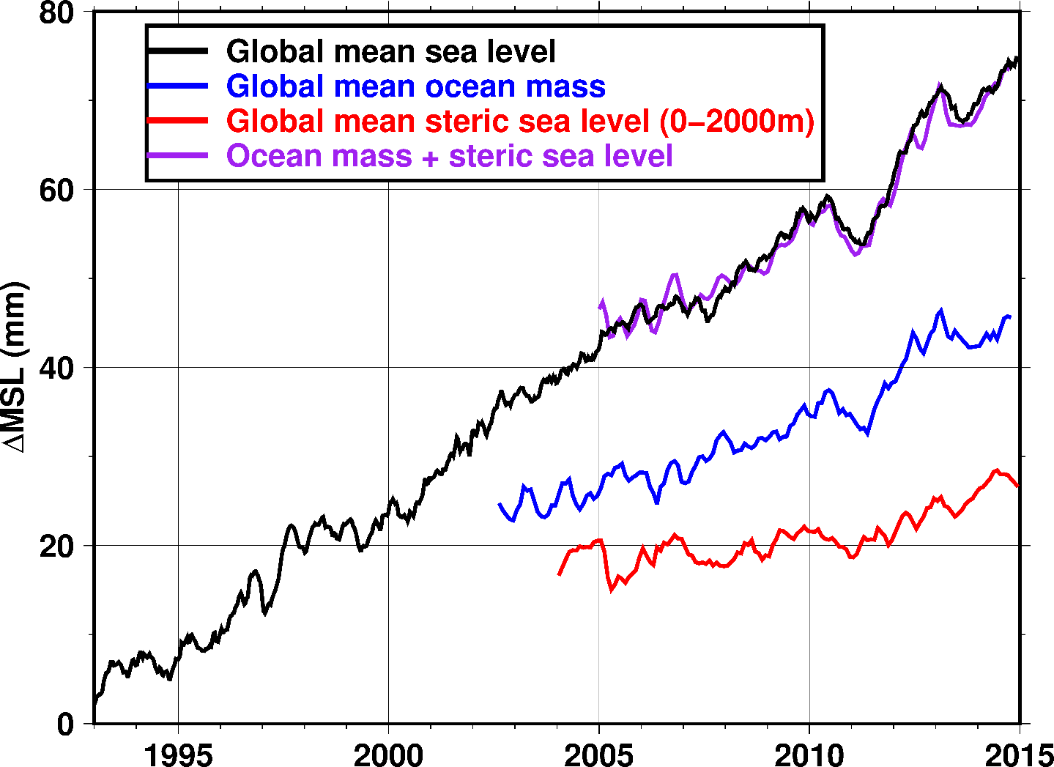
Observed Sea level rise EXPLAINED
ξ(t) = Z₀(t) + T(t) + S(t) + ΔO(t).
Global sea level rise explained by
Eustatic (Add)
And Steric (heat)

Slide 4

Climate models and SL projections

Slide 5
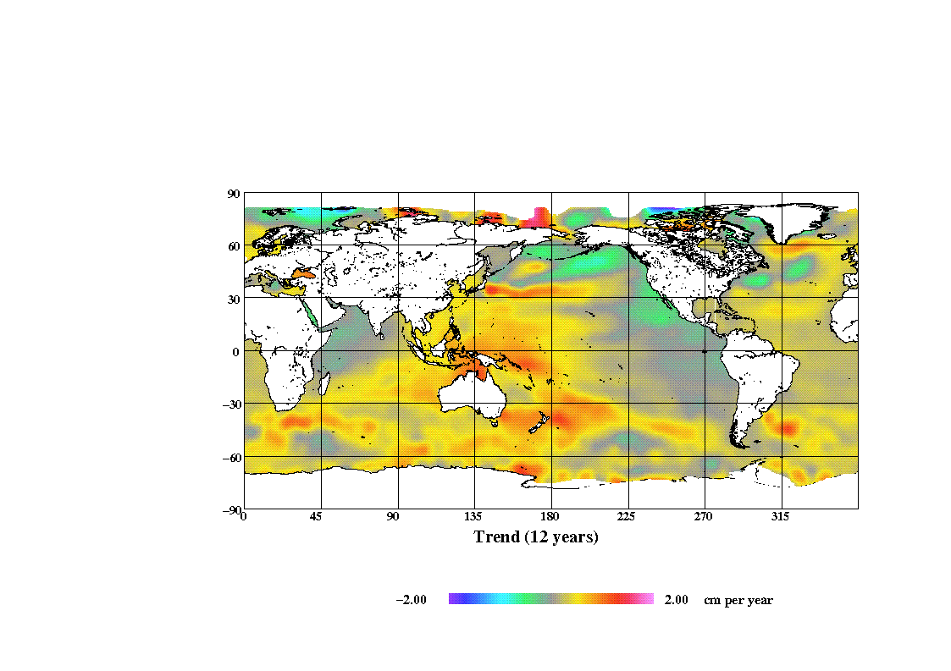
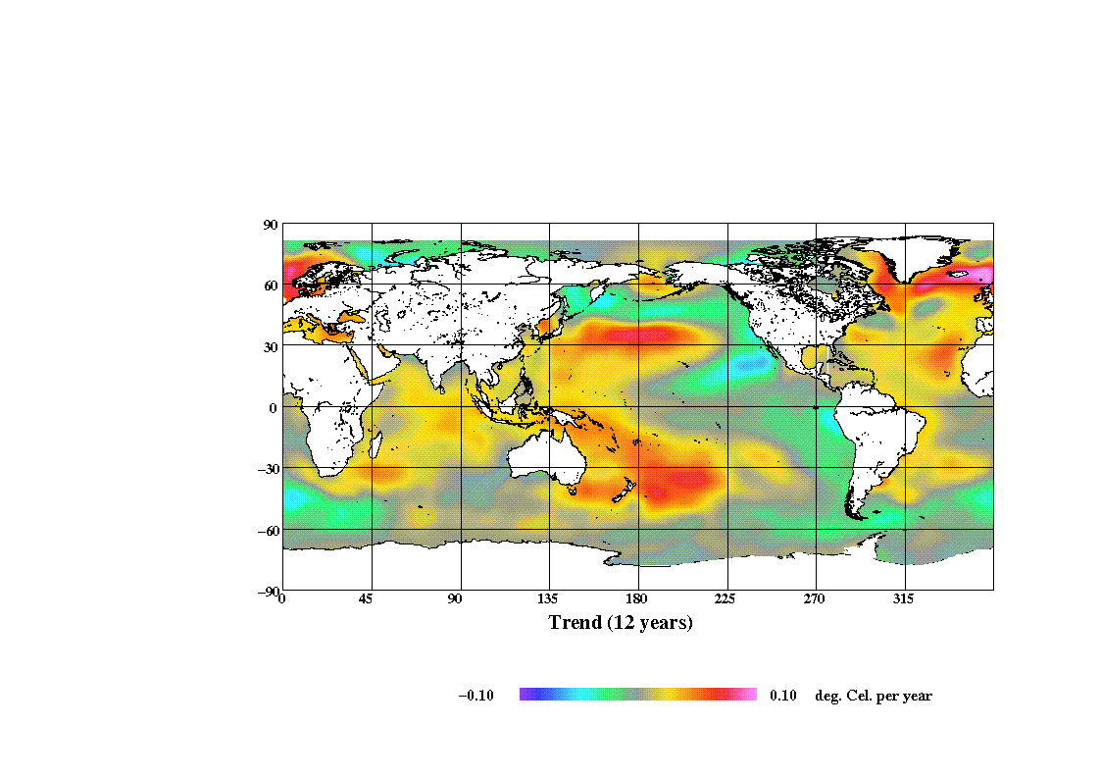
12 Years Sea Level
Change (1993-2004)
12 Years Sea Surface
Temperature change.

Slide 6
Projections of Sea level.
Semi Empirical model could be:
A physical model for sea surface height changes could be tempeture
This holds to good approximation for temperature and sea-level changes during the 20th century, with a proportionality constant of 3.4 millimeters/year per °C.
We use this to go forward in time: -> Semi empirical model
We know that from Greenland melting
600 gTons result in 0.5 mm water.
We could add Antarctica and Continental glacier models from models.
Vupti we have SEMI EMPIRICAL SEA LEVEL PROJECTION.

Slide 7
Different flavours
Empirical (not even a climate model but just projection).
Semi Empirical (physical scaled by proxy factors).
AO-GCM (atmosphere ocean global climate models - Coupled)
EMIC models (intermediate complexity - Coupled)

Slide 8
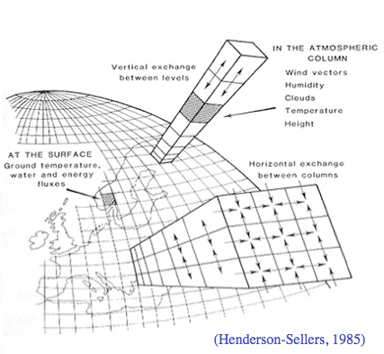
Climate models (Coupled)

Slide 9
Climate models

Slide 10
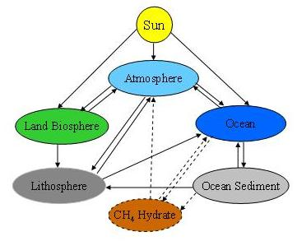
EMIC = Earth-System Models of Intermediate Complexity

Slide 11
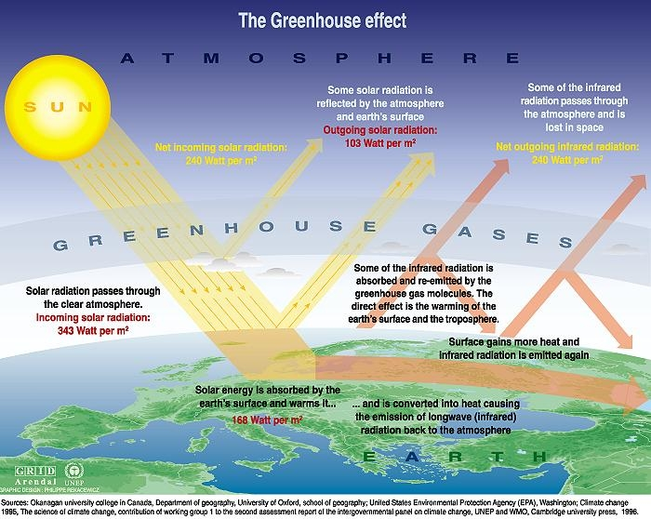
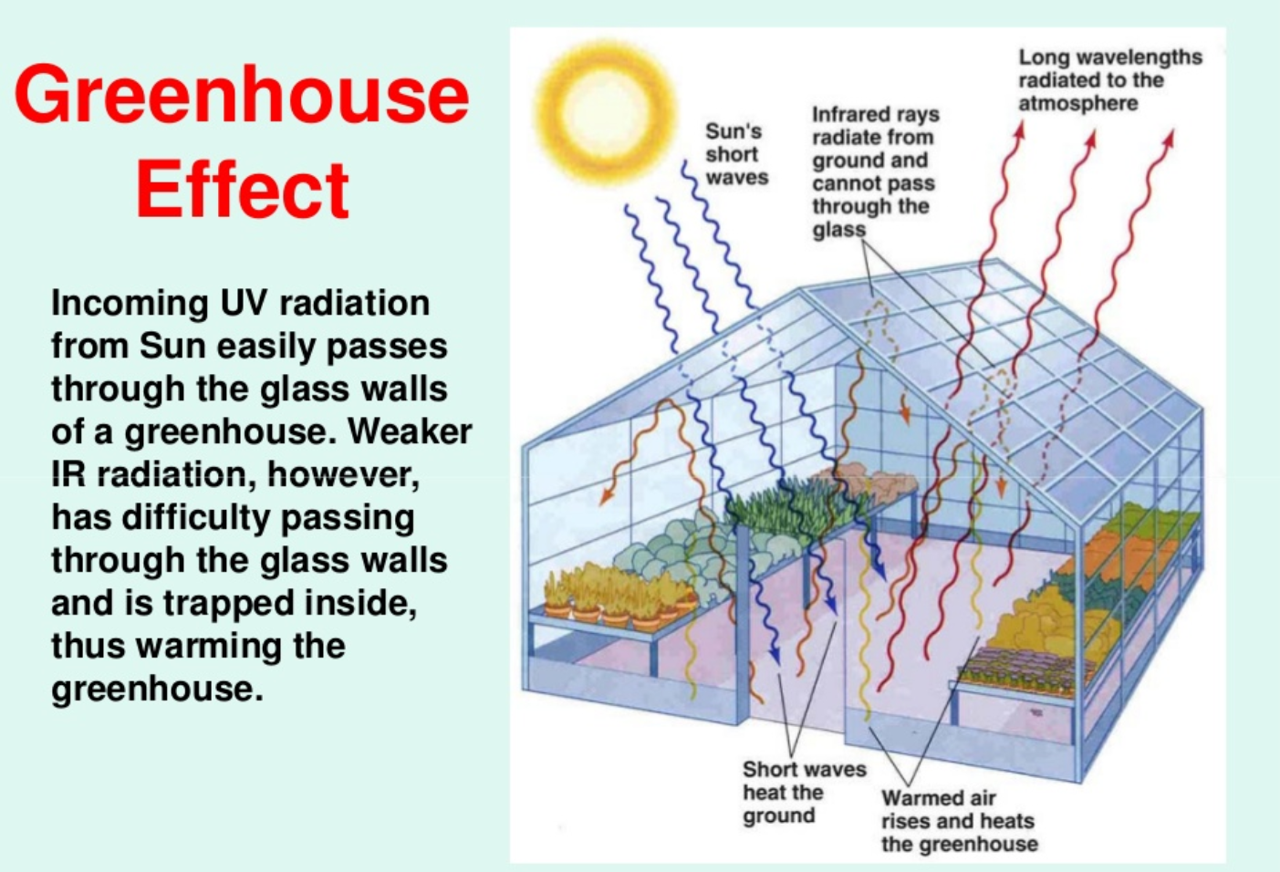

Slide 12
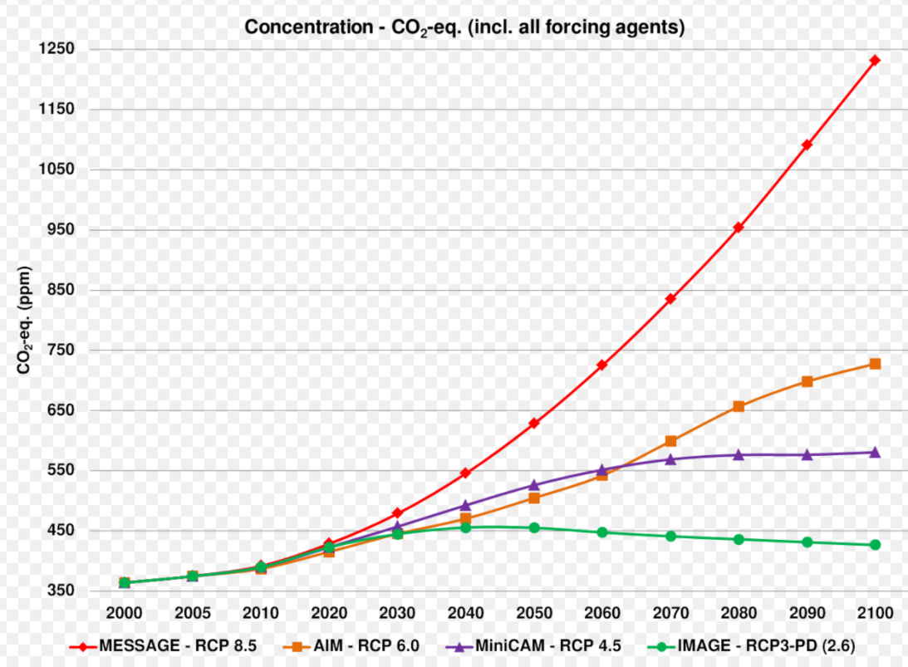
RCP – Representative Concentration pathways.
Radiative forcing values in year 2100 relative to pre-industraial values (+2-6 +4.5 +6 and +8.5 W/m2. RCP 4.5 and RCP 8.5 gives like global mean temperature increase of 2-3.6 or 3.2-5.4 in year 2081-2100. RCP 8.5 is Business as usual.

Slide 13
IPCC Intergovermental panel of climate change projections.
”Coupled models”
Intercomparison phase (CMIPS)
Coupled model includes atmosphere – versus normal ocean model
Also models are run for different RCP forcing.
6 normal Global models used:
  ACCESS1.0 (CSIRO)
  ACCESS1.3 (CSIRO-BOM),
  CSIRO-Mk3.6.0 (CSIRO-QCCCE Australia),
  EC-EARTH (EC-EARTH consortium)
  GFDL-ESM2G, and
  GFDL-ESM2M (NOAA Geophysical Fluid Dynamics Laboratory, USA).
  BUT THERE ARE ALSO OTHER MODELS (NOT SO CONSERVATIVE)

Slide 14
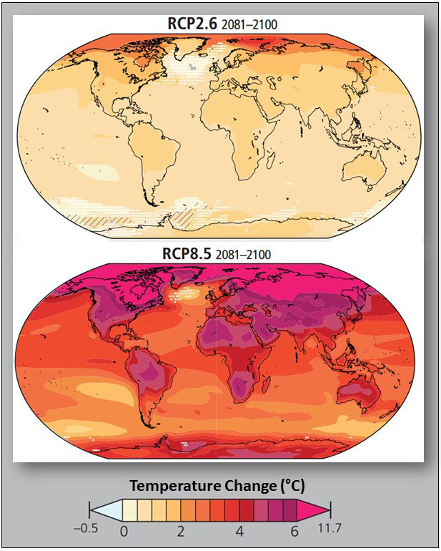
2100 Projections
Sea surface temperature
Change will give 15 cm
Sea level rise due to
Steric expansion in upper
2000 meters.

Slide 15
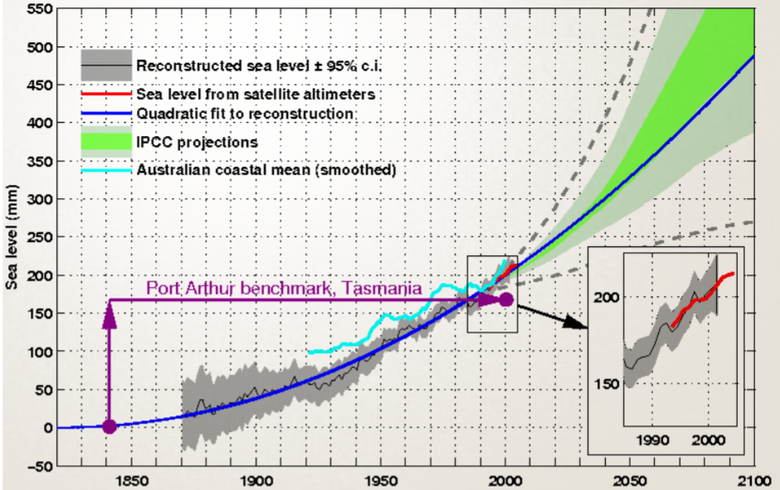
Sea level projections

Slide 16
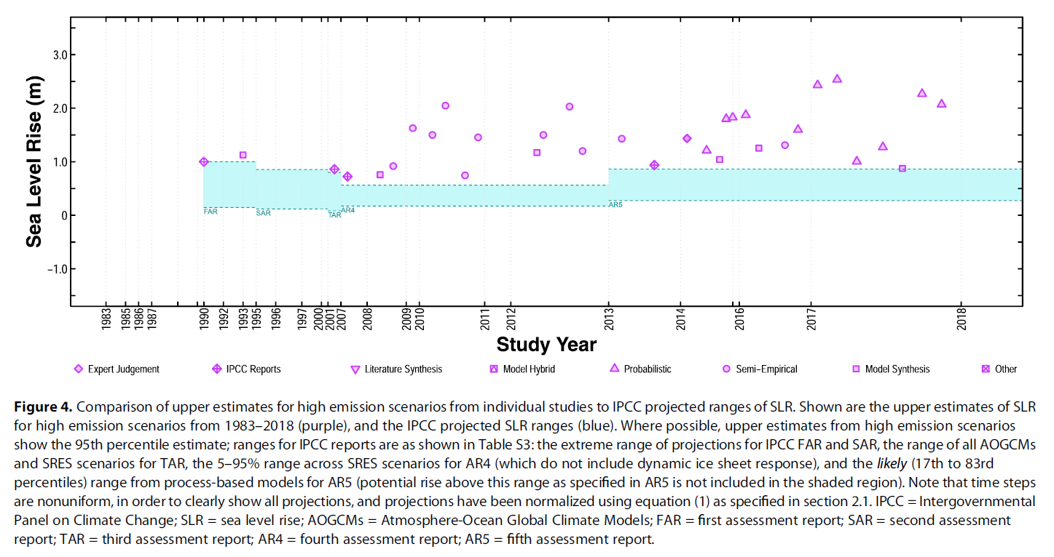

Slide 17
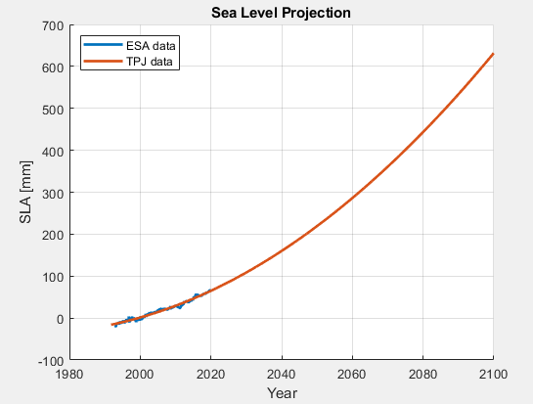
Excersize 1 – Empirical SL projection…
Create your own Sea level projections into 2100
Load TPJ_mean.mat
Time: t_TPJ=(1993+1/24:1/12:2020)‘ -time_now (=2020) <- Shift origin
p_TPJ=polyfit(t_TPJ,TPJ_mean,2);
Projection (first set time into future:
t_future=(1993+1/24:1/12:2100)’-time_now;
Multiply t_future x p_TPJ to get sea level projection
1) linear: B x t_future + C
2) Quadratic A x t_future**2 + B x t_future + C

Slide 18
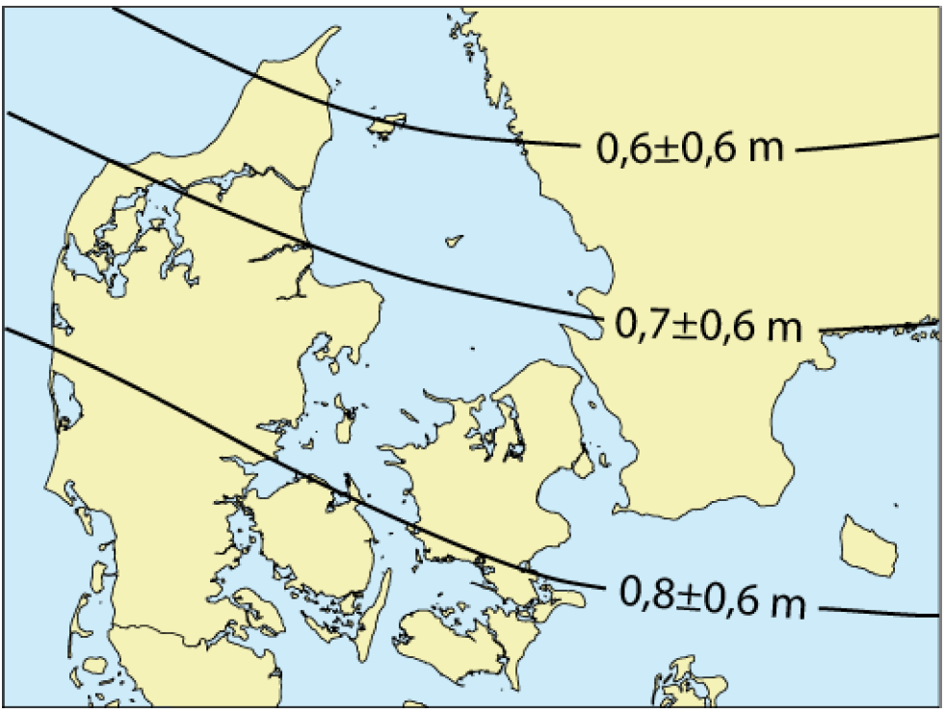
Denmark in year 2100
DMI model (notice uncertainty)

Slide 19
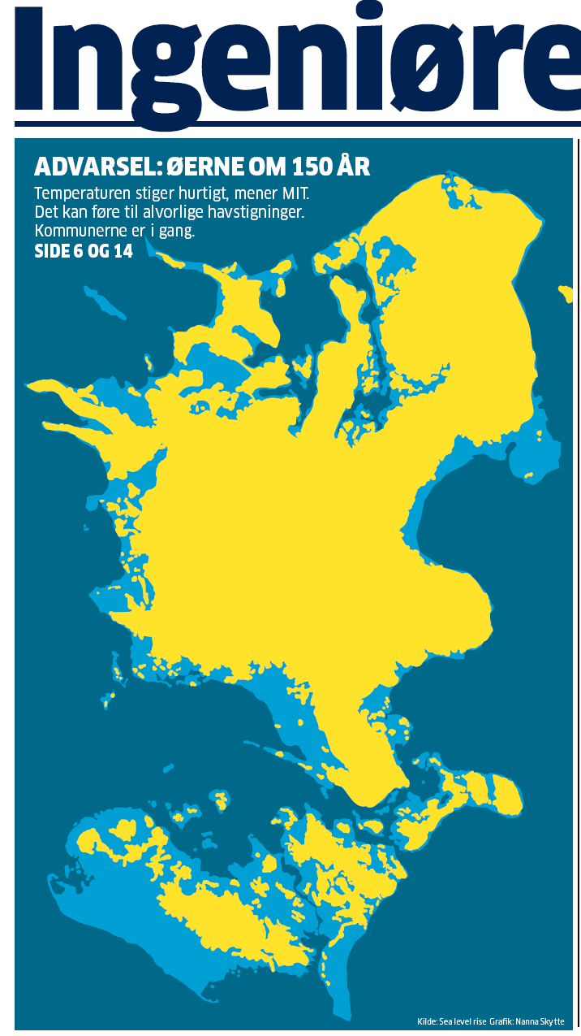

Slide 20
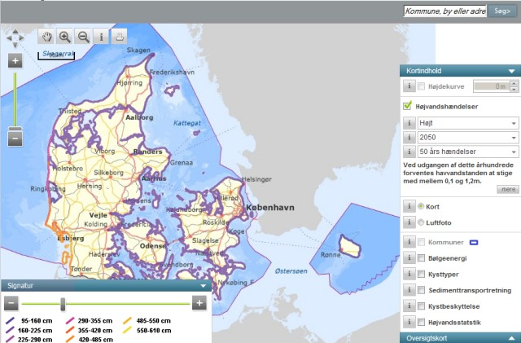

Slide 21
Break.

Slide 22
Extremes along Europe’s coast.
E(t) = max(T(t)) + max(S(t)) + max(Δ O(t)) + Z₀(t).
Changes in Z₀(t) is given as relative SL(model)
Article by Vousdoukas et al. AGU journal open access:
Interesting as it is a detailed view of extreme sea level in the future.
Before we discuss – let me introduce usage of nested model…….

Slide 23
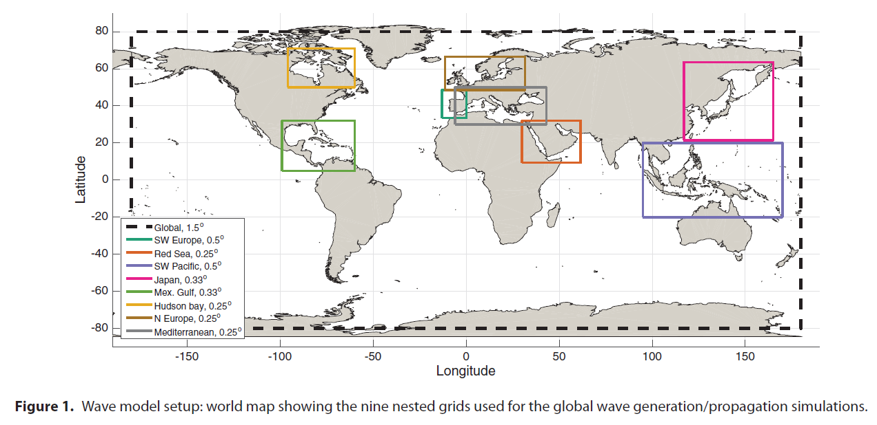
Vousdukas et al. 2017.
Nested models vs Global models

Slide 24
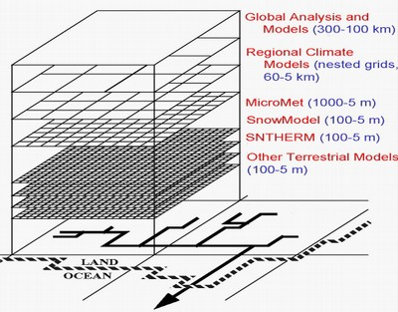

Slide 25
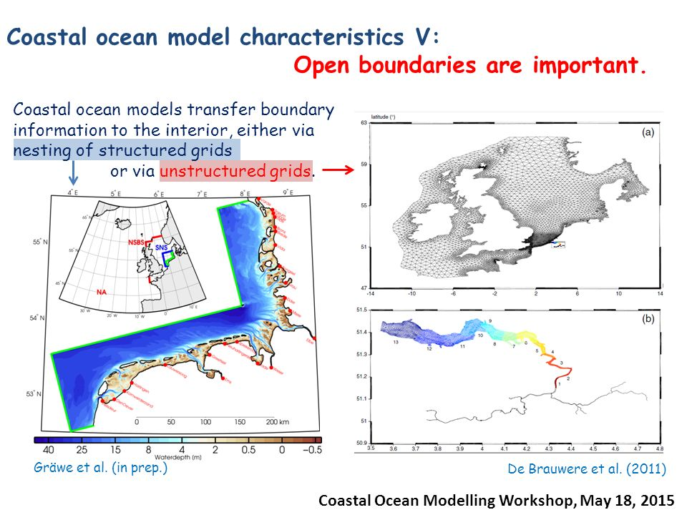

Slide 26
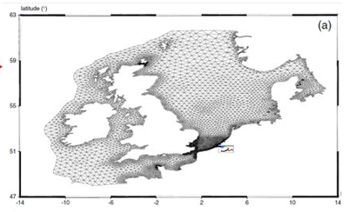
What is Vousdoukas is trying to say is:
Predicting future extreme sea levels (ESL) has large REGIONAL VARIATION.
Local effects will create local variations in ESL.
Sea level rise if frequently not the largest component

Slide 27
Sea Level Extremes –
Group discusssion / presentation
Group 1: Figure 2 + Figure 3 (findings).
Group 2: Figure 5 (Contribution of weather extremes) + Figure 6
Group 3: Figure 8 + Table 1 (Evolution of a 100 year extreme)
Group 4: Figure 9 + Table 2 (Return period of present day 100 year extreme)

Slide 28
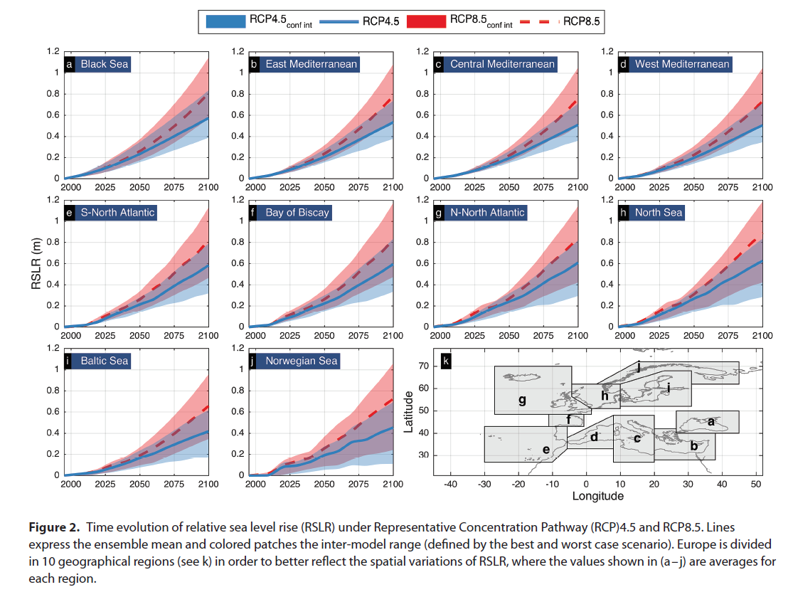

Slide 29
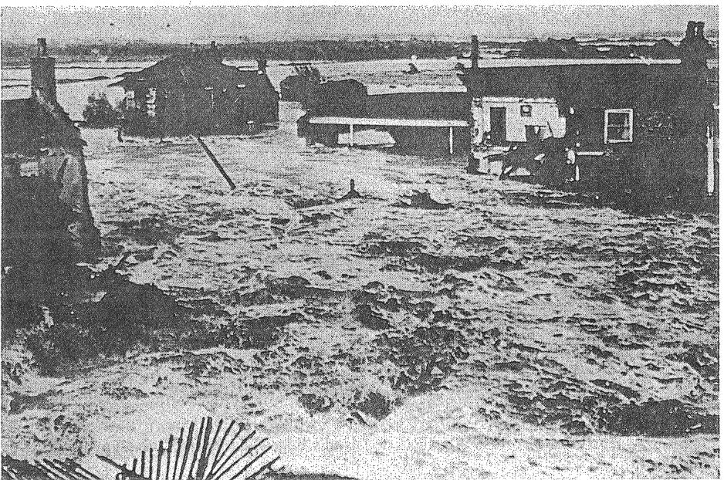
Tide and Storm Surges Extremes
ξ(t) = Z₀(t) + T(t) + S(t) + O(t).
T(t) is a (mathematical) function of the sun and moon.
S(t ) = (”random”) function of Pressure and Wind.
Low atmospheric pressure create high water level.
Wind forces the water to pile up along the coast.

Slide 30
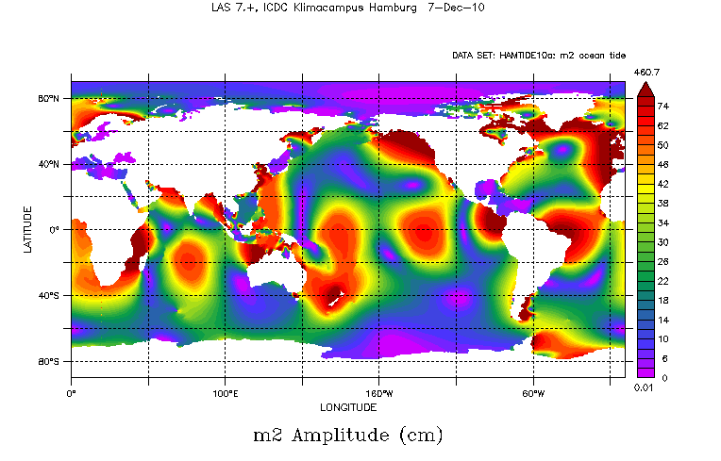
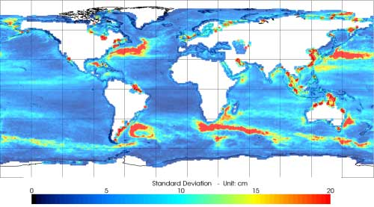
Standard
Deviation of Tides and Other time varying signals

Slide 31
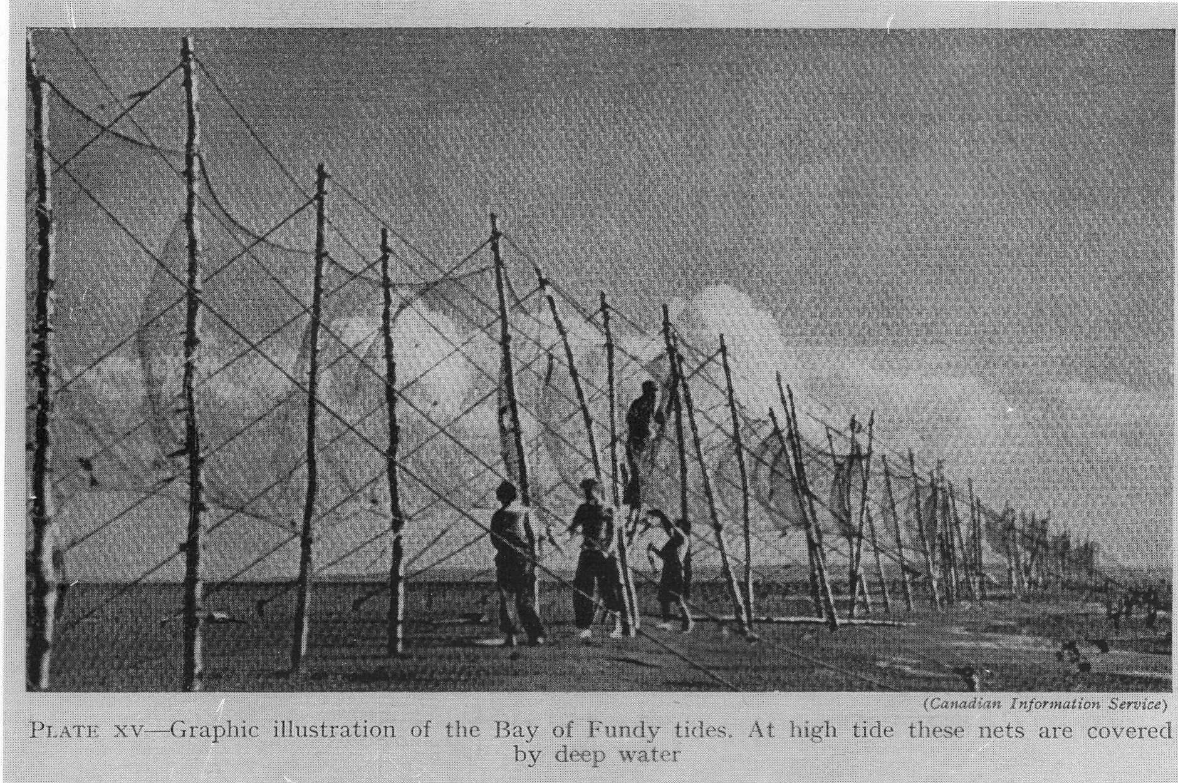
Tides T(t) are LARGEST AT THE COAST.
Some countries have a profound interest in tidal research.

Slide 32
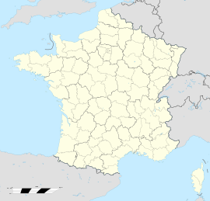

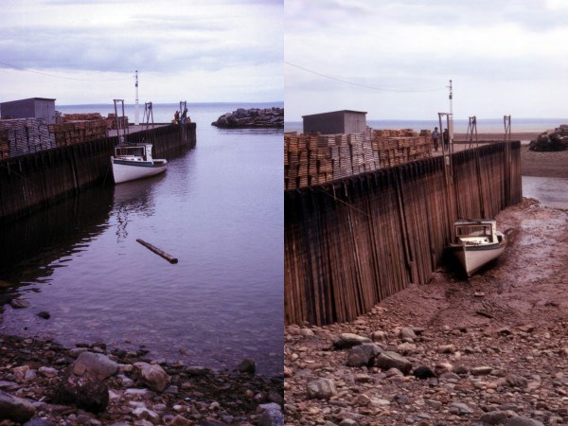

Tides are fun:

Slide 33
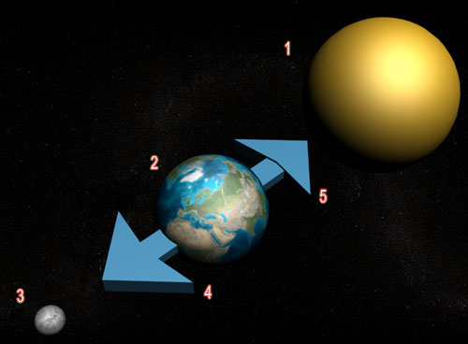

Slide 34
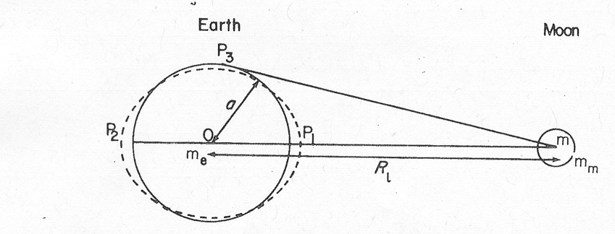
Tidal Forces.
Force =
Difference (P₁-O) is the Tide producing force =

Slide 35
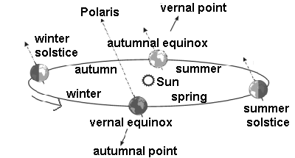
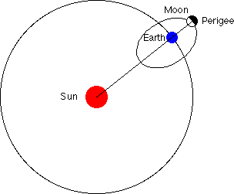
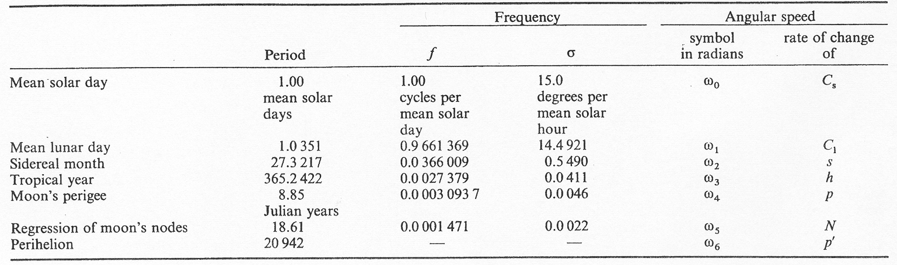
Basic Frequencies
The angular speed can be described using a series of predefined frequencies
The I’s are small integer (Doodson numbers).

Slide 36

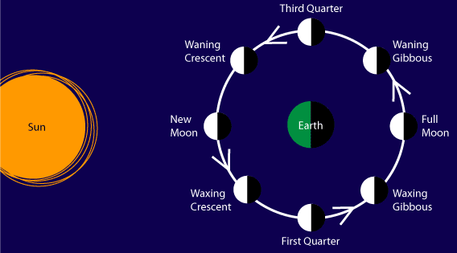
Look into the sky and observe……….

Slide 37
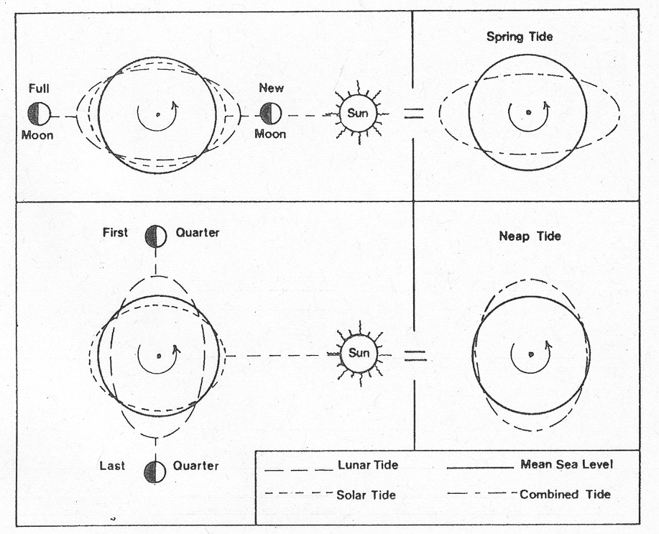
Tidal Pattern - Spring / Neap tides

Slide 38
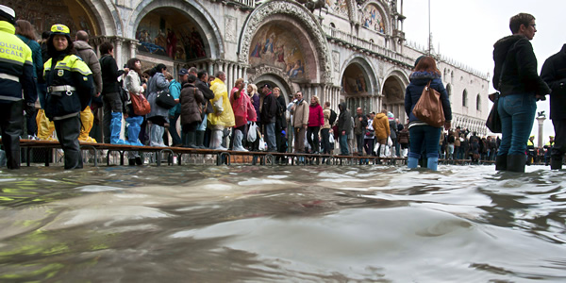
“Acqua Alta”

Slide 39
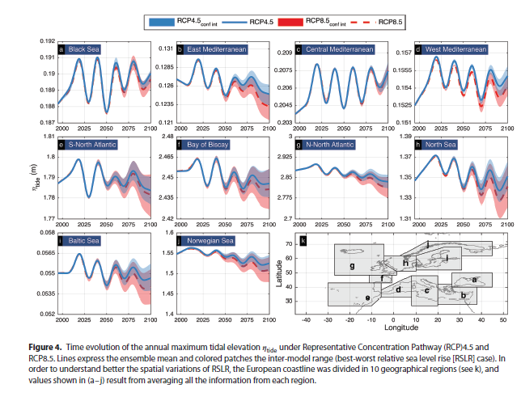
Projection -> Tides in year 2100 will get smaller

Slide 40
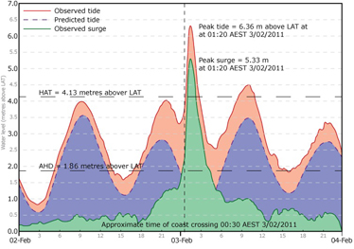
Queensland sea level during Surge

Slide 41
Tides and Storm Surges
ξ(t) = Z₀(t) + T(t) + S(t) + O(t).
The astronomical tides are modified by the weather to greater or lesser extent.
If severe weather couples with high tides storm surges occur.
S(t ) = function of Pressure and Wind.
Low atmospheric pressure create high water level.
Meteorological effects are greatest in winter.
Let se an example……..

Slide 42
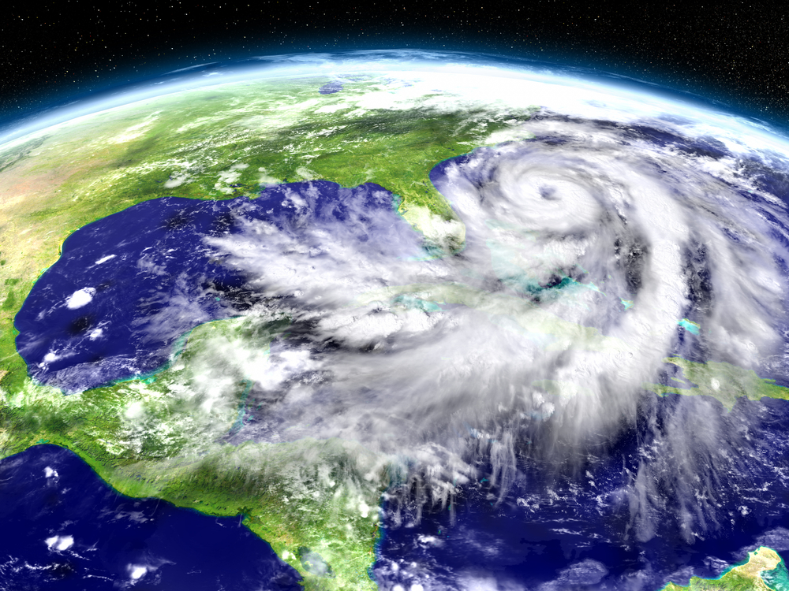
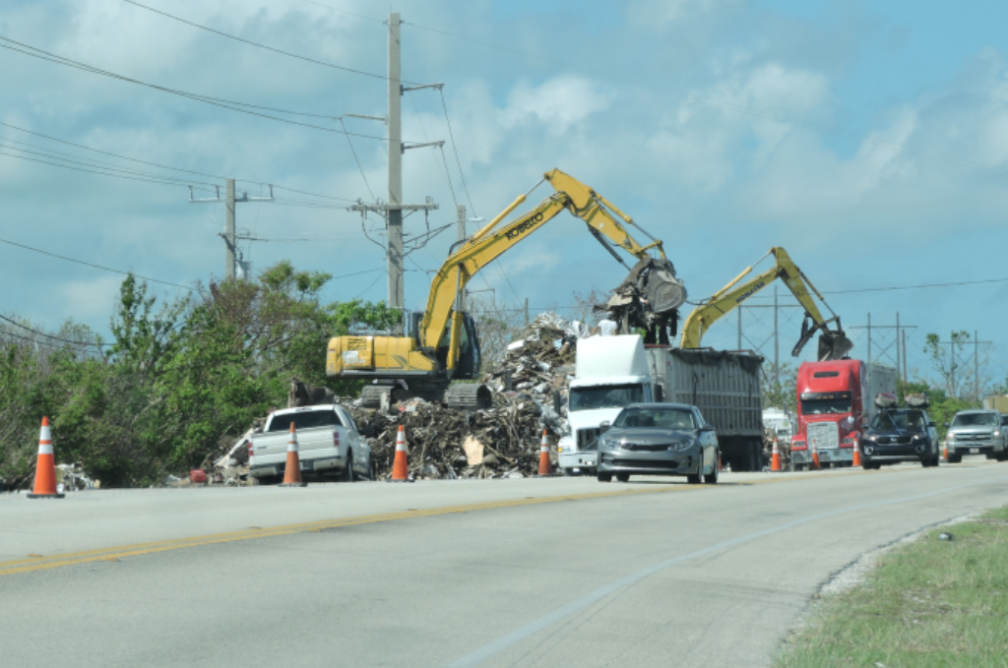
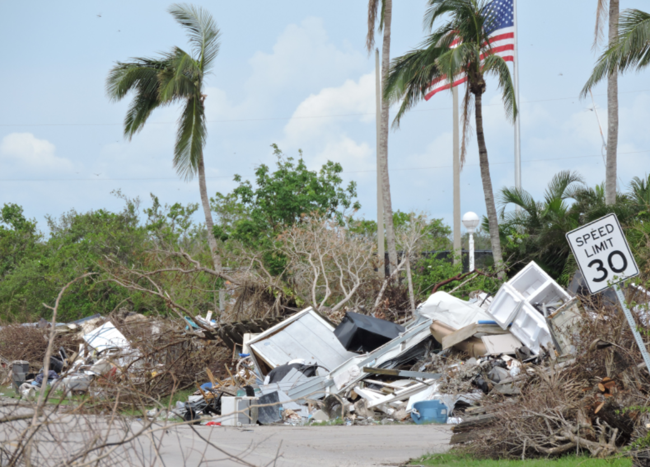
Storm surges
Storm surges are well known globally.
Storms surges = Hurricanes (USA)
Hurricanes = Cyclones (i.e., Australia)
Cyclones = Typhones (Japan)
My Holiday in Key West
Florida Oct 2017

Slide 43
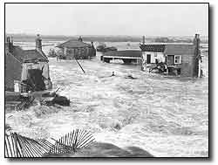
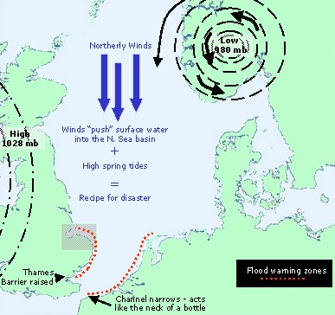
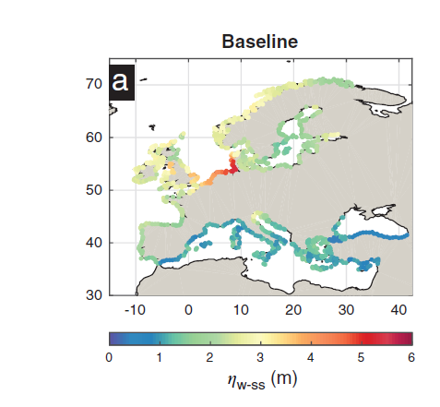
storm surges
A deep centre of low pressure
situated over Scandinavia
produces northerly winds
Wind stress forces surface
waters into the “bottle-neck”
of the English Channel
Flow is restricted by the Straits of Dover and sea levels rise along the adjacent coasts of East Anglia and the Netherlands
4. Other key ingredients include high Spring tides and on-shore winds

Slide 44
Inverted barometer (IB) effect
The inverse response of sea level to changes in atmospheric pressure =>
A static reduction of 1-mb in atmospheric pressure will cause a stationary rise of 1-cm in sea level . Why winter is worse……….
980mb
1000mb
20cm
Lower Atmospheric Pressure
Notes:
IB (mm) = 9.948 * ( 1013.3 - P )

Slide 45
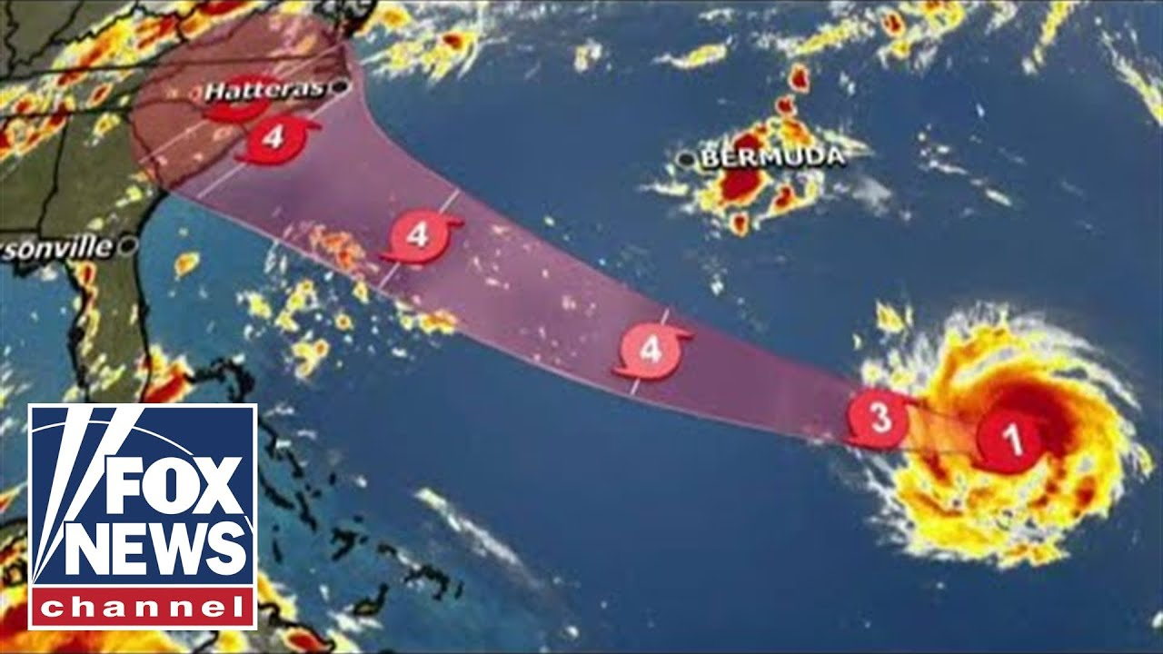
Storm event. Hurricane Florence 10 Sep 2018.

Slide 46
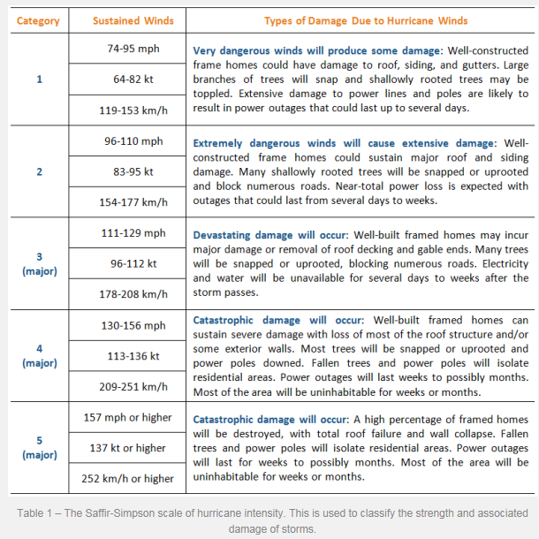
If it has been calculated based on past hurricane records that a Category 5 hurricane has a return period of 100 years, this essentially means that there is a 1 in 100 chance (1%) that this will occur in any single year.
a return period of 100 years does not mean that we can’t get two ‘100 year hurricanes’ in two or three consecutive years.

Slide 47
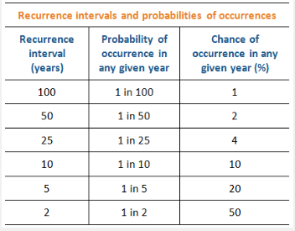
Quantifying storms (easy)
Return periods and Events
Return period P = (n+1)/m
n length of record (100 years),
m = number of recorded incidents or events.
A 100 year event is measured once is 100 years
– this has 1 percent change that it MIGHT occur during any year.
Similarlay a 50 year event or a signal with a return period period of 50 years
– this has 2 percent change that it MIGHT occur during any year.

Slide 48
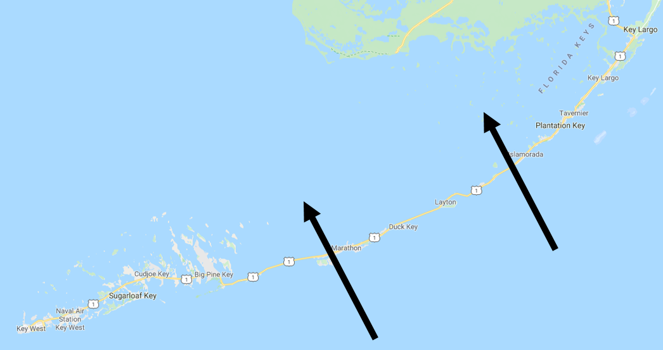
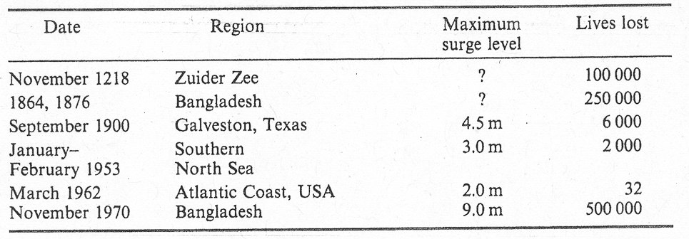
Quantify Storm Surges is not so easy – its not the same damage .
A list of some of the largest storm surges, and the
Impact on human population. Forecasting and ”knowledge”
Should diminish the loss of lives in the future.

Slide 49
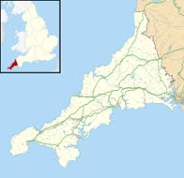
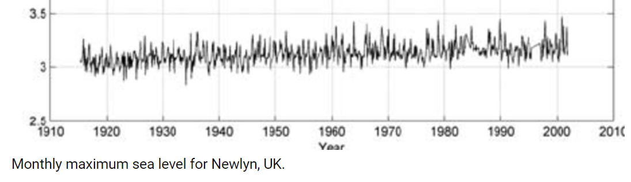
Derive statistics from tide gauge.
Annual maxima (Newlyn 84 years)

Slide 50
Derive statistics from tide gauge records.
Probability of sea level z being exceeded in a year is P(z).
Probability of no exceedance is (1-P(z))
In Two years the Probability of no exceedance is (1-P(z))²
Risk of reaching level z in such period is then 1-(1-P(z))²
Risk in a period T is then.
Risk = 1-(1-P(z))^{T}
This is frequently used when constructing off-shore structures.
Bridges / wind mills / oil rigs / dikes etc etc.

Slide 51
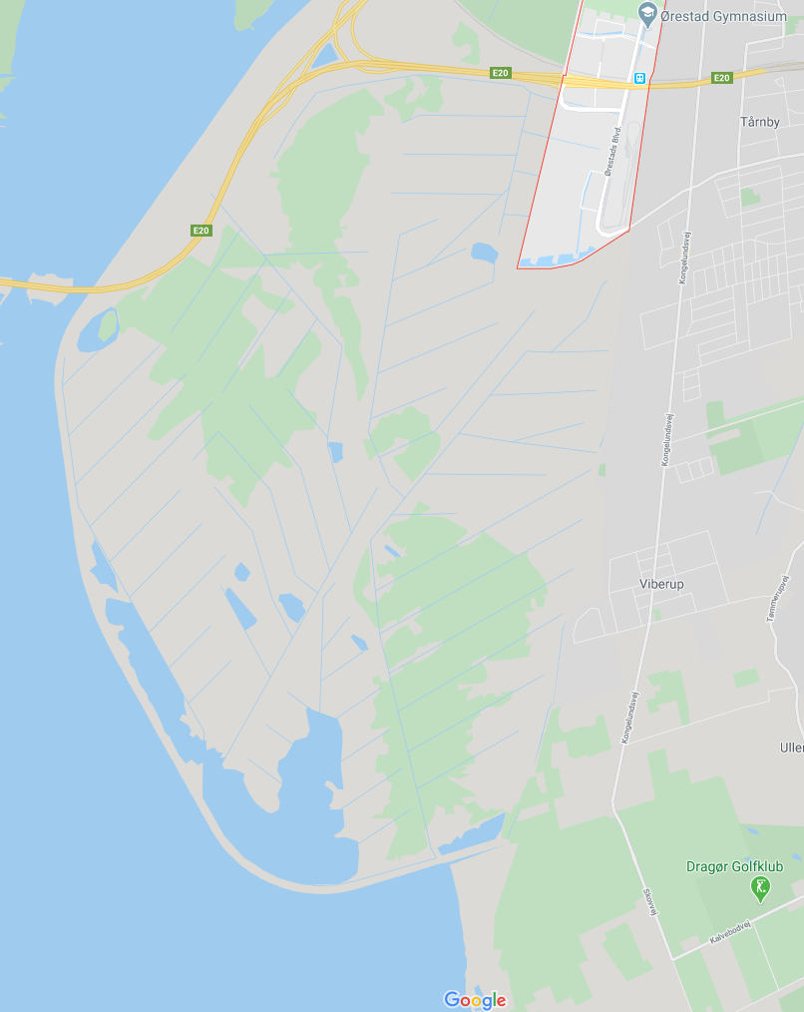


If you create a structure for a 100 year event or an event z with a probability of P(z) = 0.01
then the Risk (R) will be 0.62 of encountering this event during the first 100 years.
Similar statistics to rolling a dice and not wanting a 6’er……

Slide 52
The “best” we can do.
Annual Exceedance at Newlyn
Determine the value of P(z) can be done using the annual exceedance probability at a tide gauge like Newlyn because extreme weather event tend to have a preference to happened during winter

Slide 53

28 times the annual water level exceeded 3 meters.
In 84 years this is one out of 3 years or a return period of 3 years.

Slide 54

Fairly equal to a Gaussian distribution

Slide 55

Showing figure in another way.
3 meters has return period of 3 years

Slide 56
Including sea level rise

Slide 57

Including 20 cm sea level rise.
3.2 m
A 3 meter was a 30 year event but becomes nearly annual event

Slide 58

With increasing sea level return period decreases
For places with small tides MORE EXTREME.
100 year event for Aabenraa becomes 10 year event with 25 cm sea level rise.

Slide 59

Fits with Vous

Slide 60




Stormsurge BODIL
2013 December Storm Surge Bodil/Xavier was captured by Cryosat-2. Caused 2 meter surge (largest on record) in Kattegat and severe flood damage in Denmark. Bodil was a 1000 Year event
Though sampling is not ”perfect” the Cryosat-2 occational observations are
Extremely valuable for coastal research and safety.

Slide 61

Maybe there is something we dont know
Modifying statistics ??????

Slide 62
Question / discussion (time permitting) :
How can we even talk about an 100 or 1000 year event
It is VERY VERY DIFFICULT.
AND SEA LEVEL IS SLOWLY CHANGING STATISTICS
Best guess is “the larger the event – the more in-frequent it is”
Some kind of extrapolation (qualified guessing) must be used

Slide 63

Increased waves in future projections……
E(t) = max(T(t)) + max(S(t)) + ΔO(t) + Z₀(t).
Under RCP we will encounter greater surges
And we will expect greater significant and actual wave height
The actual water level will/might be increased as the
Surge Level SSL has an added wave component.
Hs is significant wave height (DELFT NL surge model)

Slide 64


Waves

Slide 65

Waves …………

Slide 66

Significant wave height
(10% of time this is exceeded by Extreme WH)

Slide 67

North Sea - Winter vs Summer

Slide 68

Dramatic Changes ”tipping point” ξ(t) = Z₀(t) + T(t) + S(t) + ΔO(t).
Mainly contribution from Z, but also some from O(t)

Slide 69

Currents might change ΔO (t)???

Slide 70

Extreme water level
E(t) = max(T(t)) + max(S(t)) + Δ O(t) + Z₀(t).
Changes in Z₀(t) + Δ O(t) from Models

Slide 71

Total extreme sea level (incl Tides)

Slide 72
Are you knowledgeable about
Sea Level Rise?
How much ?
Causes ?
Impacts ?
Increased Flooding is covered.
Other effects:
Notes:
http://sealevel.jpl.nasa.gov
http://climate.nasa.gov/SeaLevelViewer/seaLevelViewer.cfm
http://sealevel.colorado.edu/

Slide 73

Cliff erosion
suspect?
Source: Tyndall Centre for Climate Change Research

Slide 74

Coastal erosion and accretion
1 cm rise in MSL erodes
approx 1m horizontally of beach
SLR has a profound effect on the rate of sedimentation
Varying of sedimentation rates
-> changing vegetation zones
e.g. growth/shrinkage of marshes (high tide water level regions)
Storm surges force large quantities of shore-face sediments through inlets -> create tidal deltas/barriers
River flow (Florida must pump water)
1m
0.01
Notes:
Movement of sediment from tidal region to beneath near-shore waters
Change to rate of sedimentation due to change in weight of overlying water column
Wetlands/salt marshes – high tide water level regions
e.g. mangrove ecosystems: provide natural protection against storm surges/hurricanes;
sedimentary traps: stabilise coastlines;
home to commercially exploited fish
-in danger of being overcome by rising sea-levels (natural rate of mangrove rise:~2/3 mm yr-1)

Slide 75

Bruun Rule (One of the processes affecting sandy beaches)
R = G(L/H)S
  H = B + h*
  R = shoreline recession due to a sea-level rise S
  h* = depth at the offshore boundary
  B = appropriate land elevation
  L = active profile width between boundaries
  G = inverse of the overfill ratio
Source: Nicholls, 1998
Notes:
Assessing erosion involves using the Bruun Rule for straight areas of coastline. The assumption is that the profile conserves its average or equilibrium shape relative to sea level. Using appropriate boundary conditions, the profile shape defines all the information necessary to predict the response to sea level rise. To maintain the profile shape the upper part of the profile erodes and the lower part of the profile accretes, translating the shoreline landward.
Source: Nicholls, 1998.
R = G(L/H)S
where: H = B + h*
R = shoreline recession due to a sea-level
rise S
h* = depth at the offshore boundary
B = appropriate land elevation
L = active profile width between boundaries
G = inverse of the overfill ratio

Slide 76

Vulnerable coastal/island regions

Slide 77


Vulnerable populated regions
Mega Coastal Cities:
Populations >8 million
(over 50% of US population (110 million) live in coastal areas
(over 40% in Europe
Highly populated Delta regions -> Migration
http://www.survas.mdx.ac.uk

Slide 78


People close to the coast

Slide 79
Increased salinity in estuaries
Saltwater will penetrate farther inland and upstream in estuaries (i.e. estuarine salt wedge)
Higher salinity impairs both surface water and groundwater water supply
Saltwater intrusion would also harm ecosystems:
  aquatic plants and animals e.g. salt marshes, mangroves
  Higher salinity has been found to decrease seed germination
  Flooded agricultural land takes a long time to recover
Decline of coastal commercial fisheries
e.g. Salinity intrusion has already been cited as primary reason for reduced oyster harvests in Delaware and Chesapeake Bays in the USA
Notes:
Impair:損害,減少,削弱
Germination:發芽,萌芽
Oyster:牡蠣,蠔,沈默者

Slide 80
Mitigation

Slide 81

Amager Faelled is at 1 meter below sea level.
However Ørestaden is planned for 1 meters sea level rise

Slide 82

Dikes

Slide 83

Dikes, Levees and Floodwalls.
New Orleans (Katarina, Levee failure)

Slide 84

Dike protection.

Slide 85

The Guardian 2020

Slide 86
Thanks.

