Slide 1

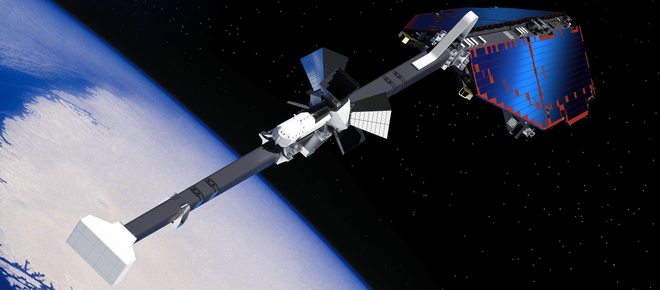
Division of Geomagnetism, DTU Space
Christopher Finlay
cfinlay@space.dtu.dk

Slide 2


Slide 3
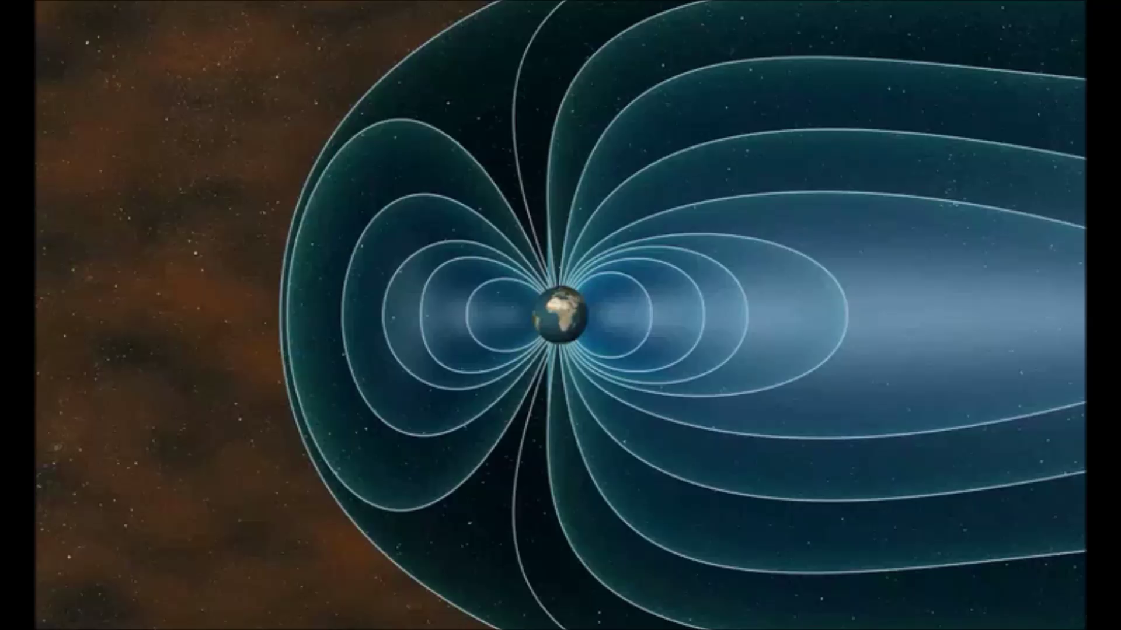
Field sources

Slide 4
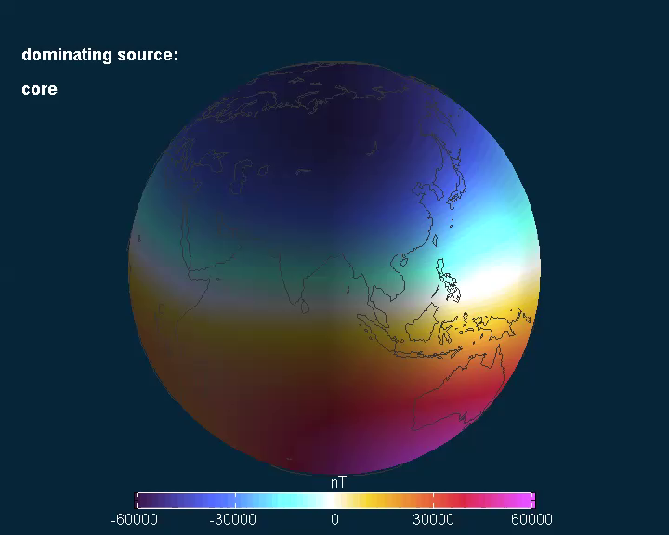

Slide 5
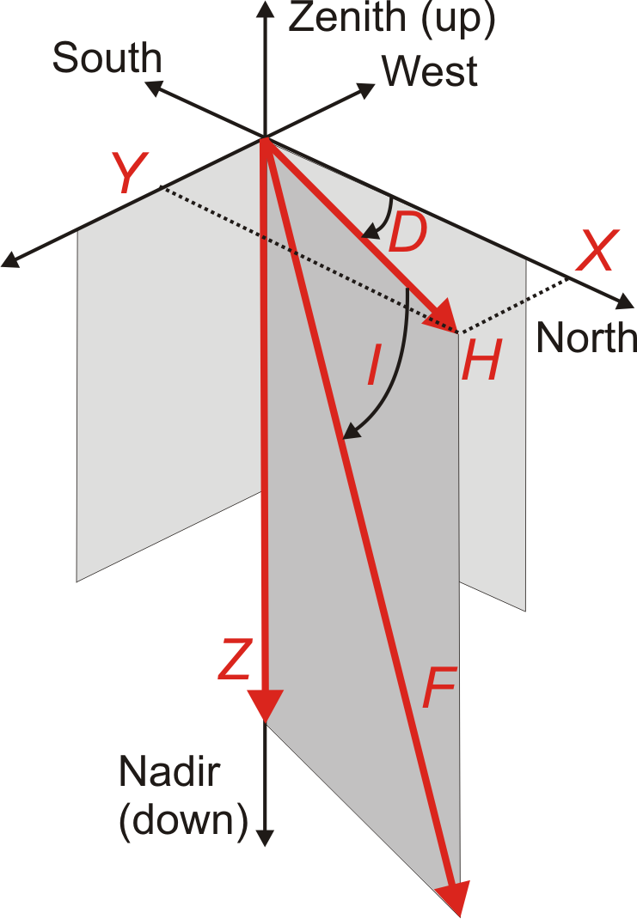
Geomagnetic field vector
Declination D: ’azimuth’
Inclination I: ’dip’
Field strength ’F’

Slide 6
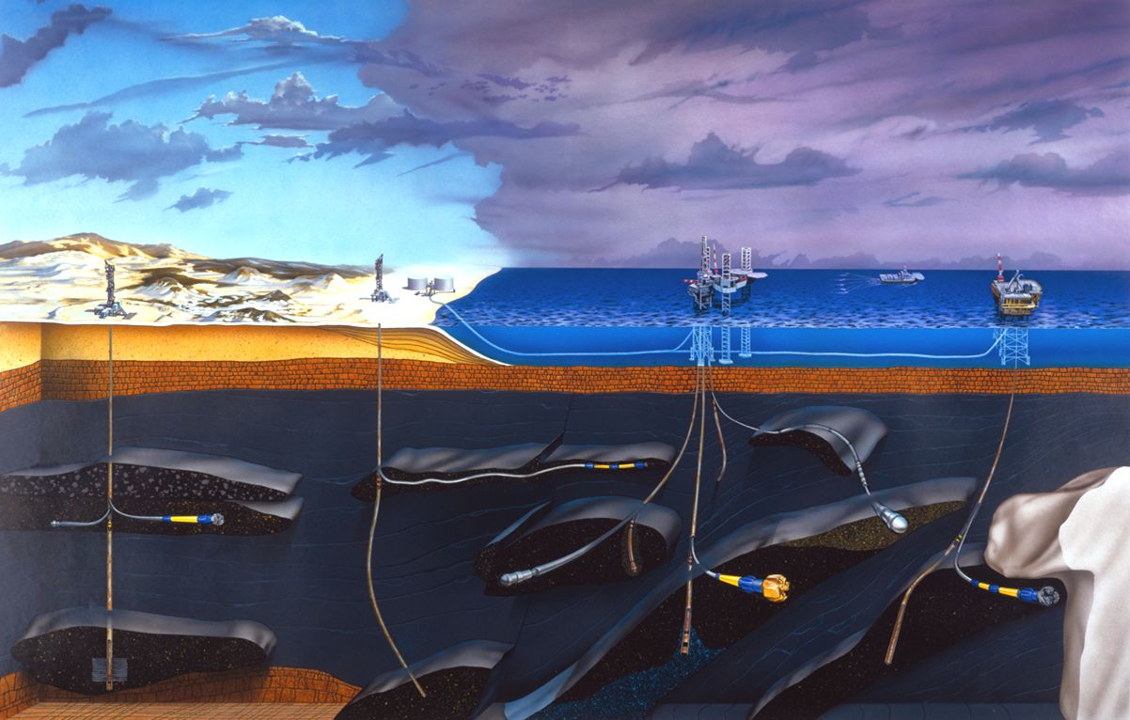
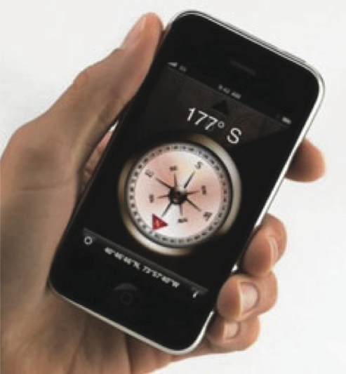
Applications:
Providing directional information

Slide 7
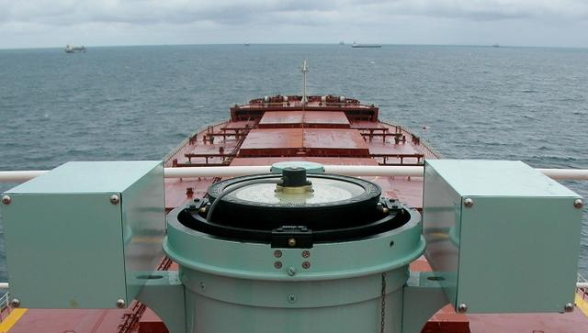
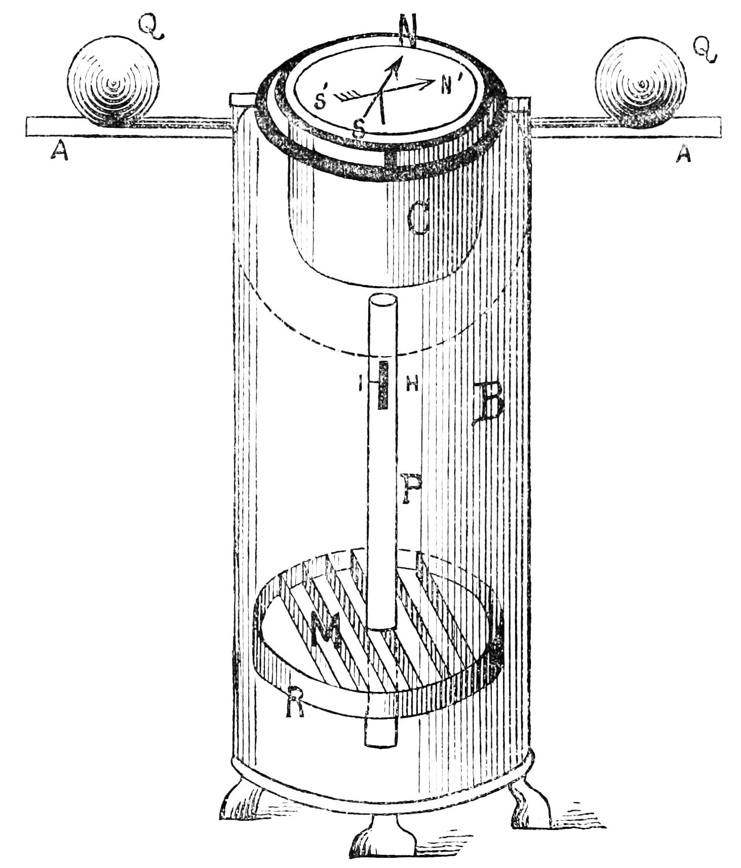
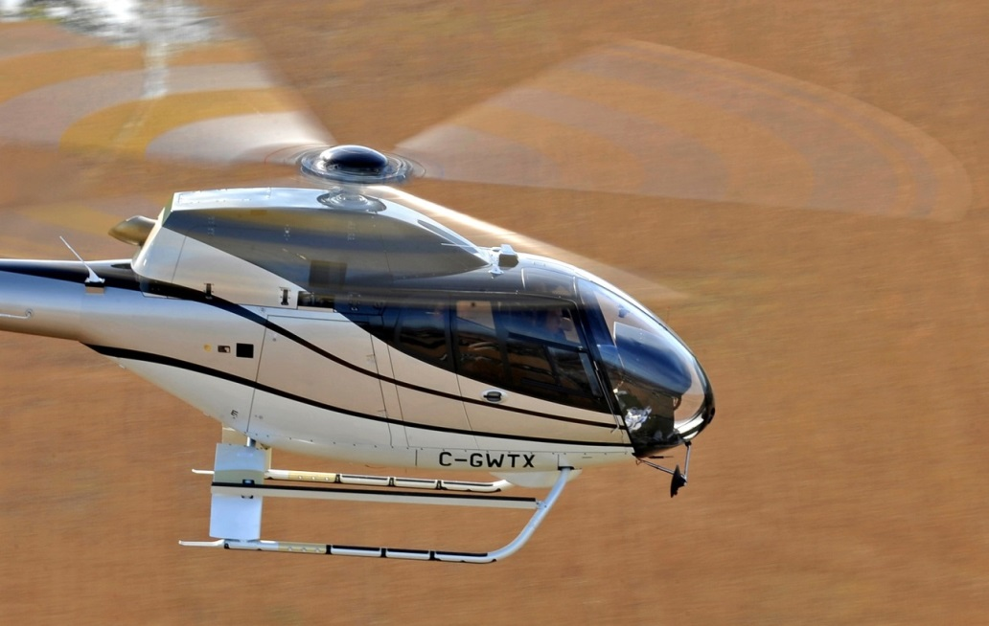
Autopilot & compass compensation in the marine…
… and aeronautical domain
Absolute orientation applications require:
(i) measured field direction
AND
(ii) a geomagnetic reference model
Notes:
Observeratory scientists kicks in because : knows about models and expected declination, knows about instruments, knows about the magnetic environment.
Model is ok for navigating, but oftten not sufficient for compensating

Slide 8
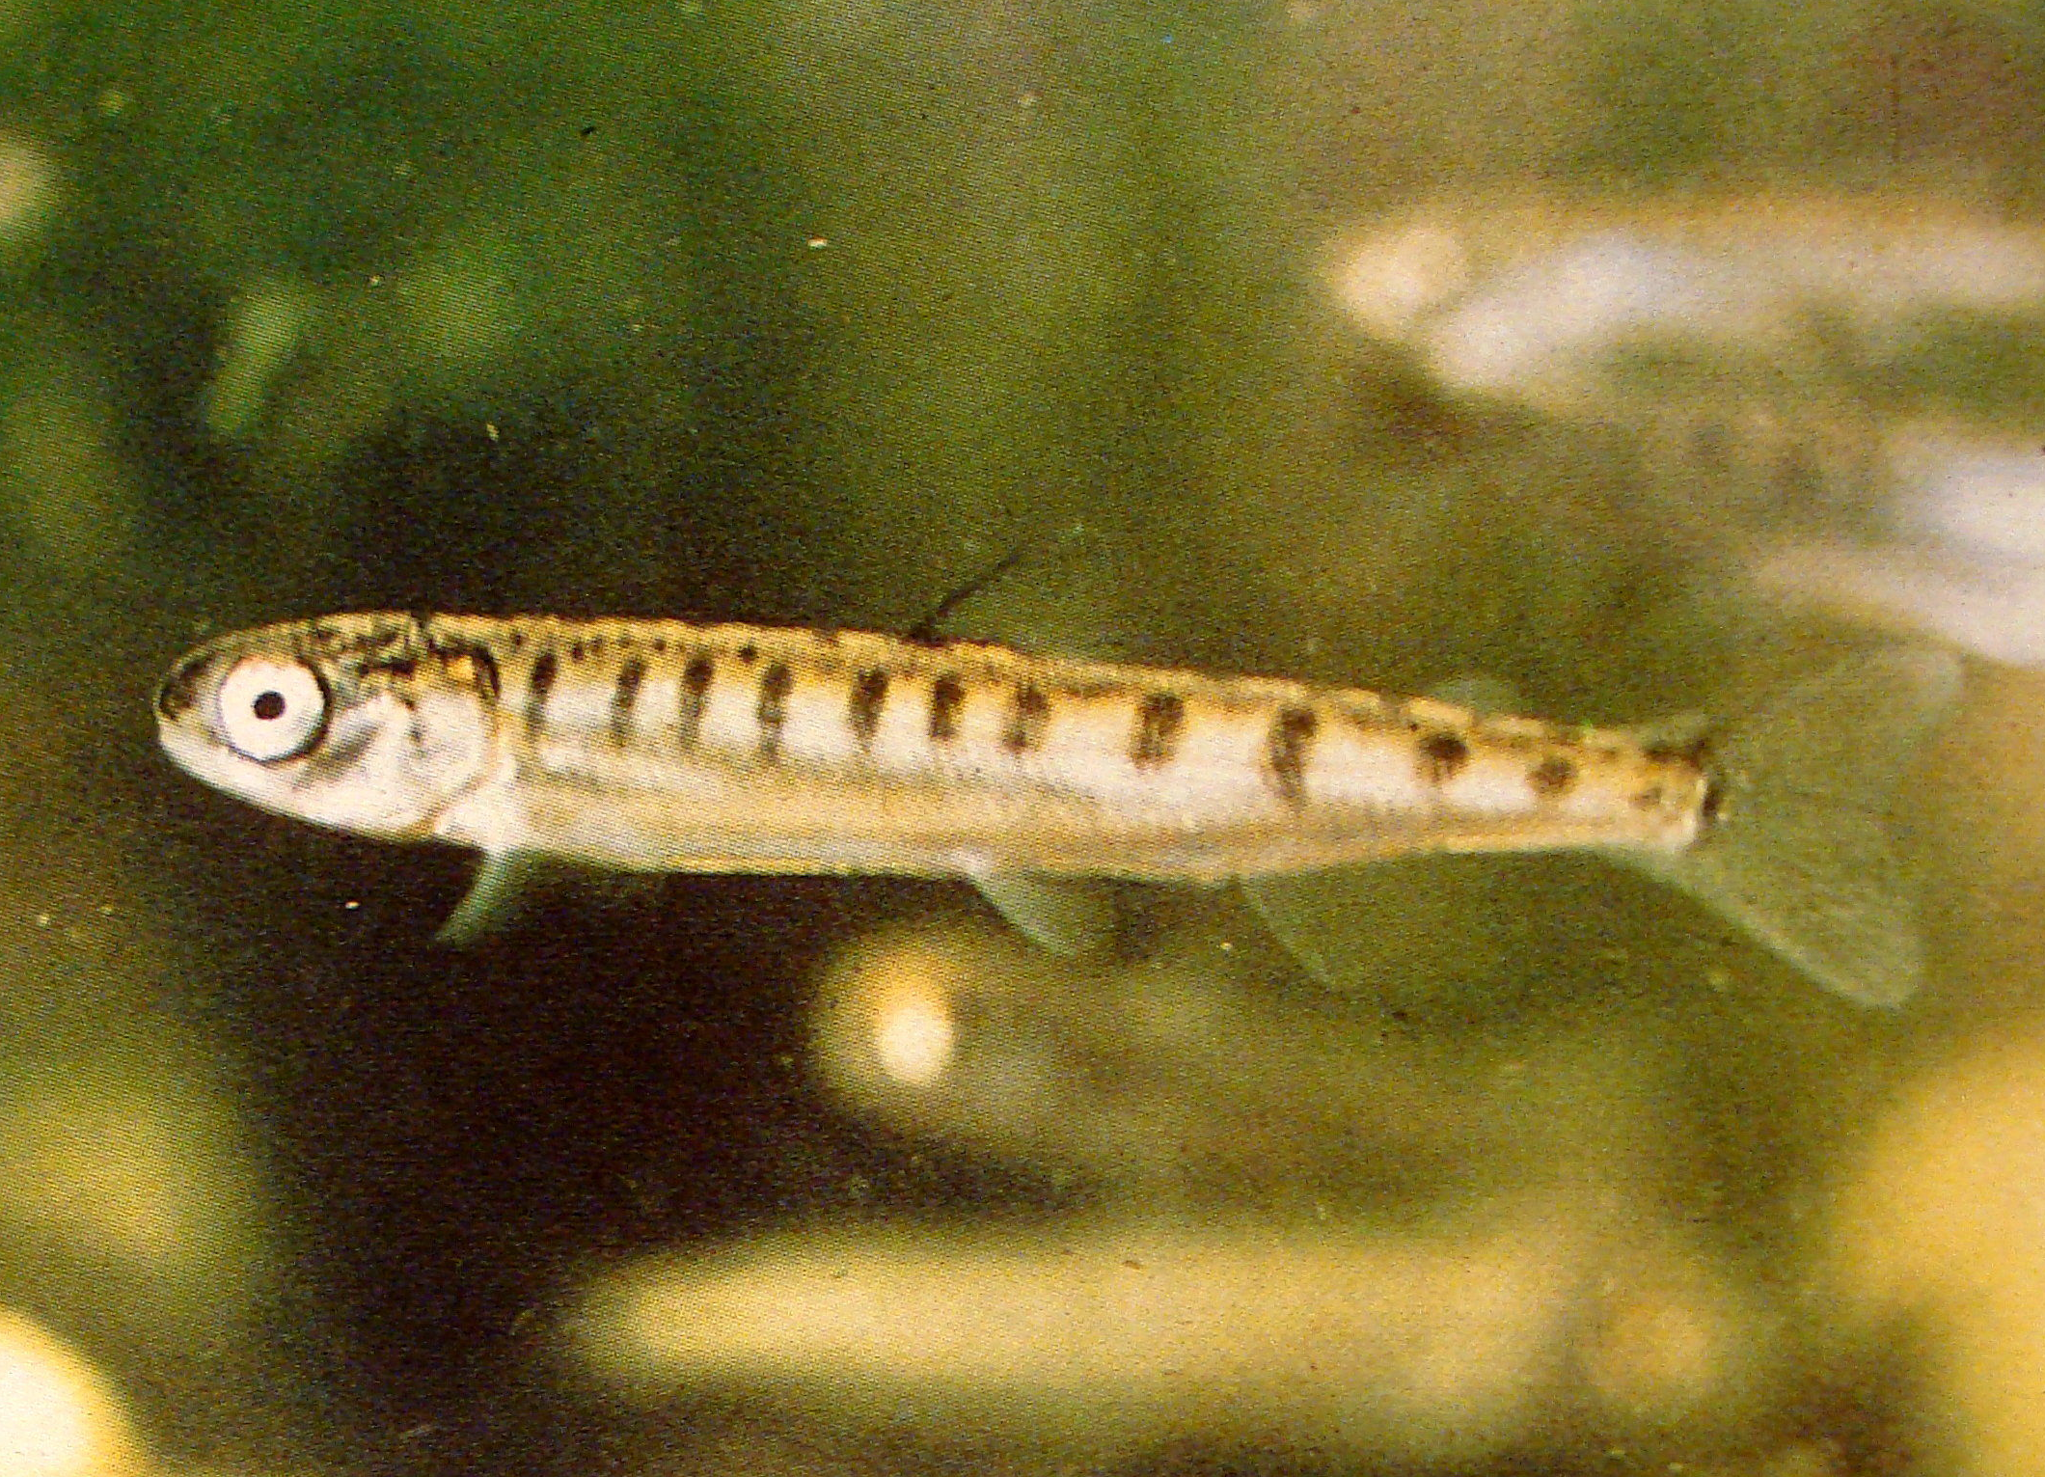
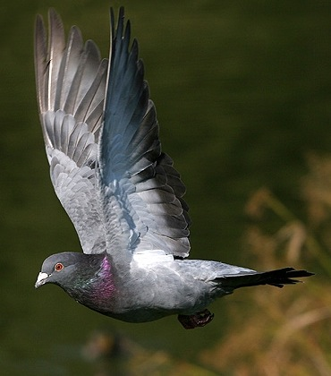
Animal orientation and navigation
Many species across all major phyla appear sensitive to magnetic fields.
(e.g. butterflies, salmon, lobsters, sea turtles, migratory birds, bats, the mole rat, mice)
Orientation
Local navigation
Migration
Triggers to locate food and breeding grounds
Use spatial variations in field inclination and intensity
A magneto-sensing protein complex has recently been discovered in pigeons: (Qin et al., 2015)
Controversial, still much debated…

Slide 9
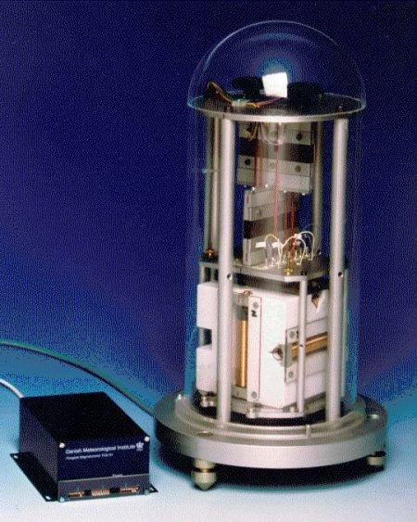
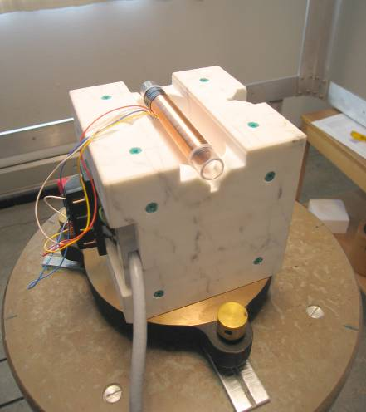
Measuring the field:
DTU’s 3 –axis Fluxgate Magnetometer
Solid marble cube
Suspended system for stability
Fluxgate sensor in glass tube surrounded by copper wire coil
Sensor angles are accurately measured in Helmholtz coil system

Slide 10
Ground-based geomagnetic observatories
magnetic observatory
magnetic observatory using DTU instrument
Danish observatory / variometer station

Slide 11
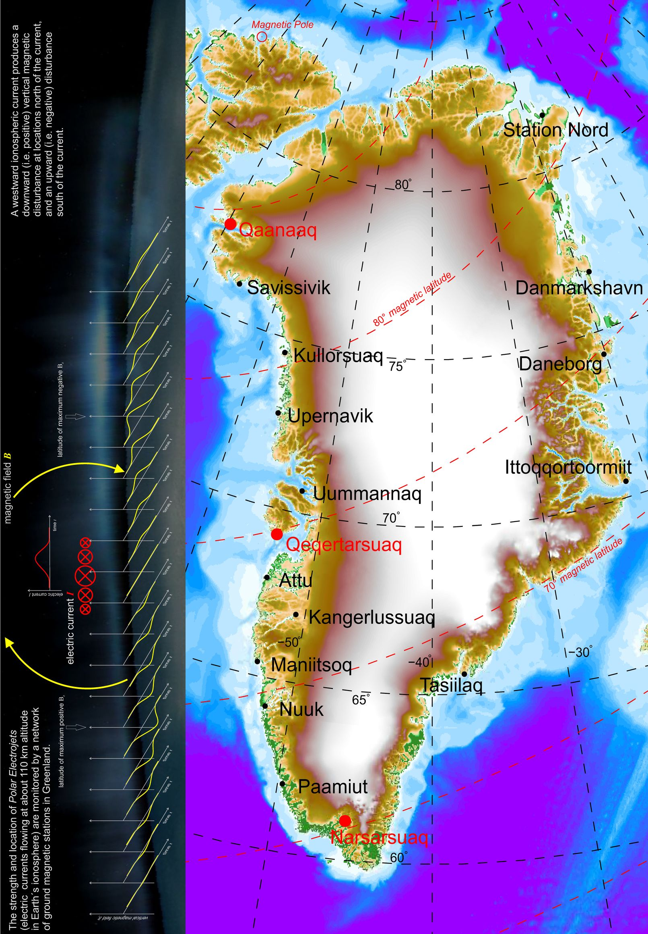
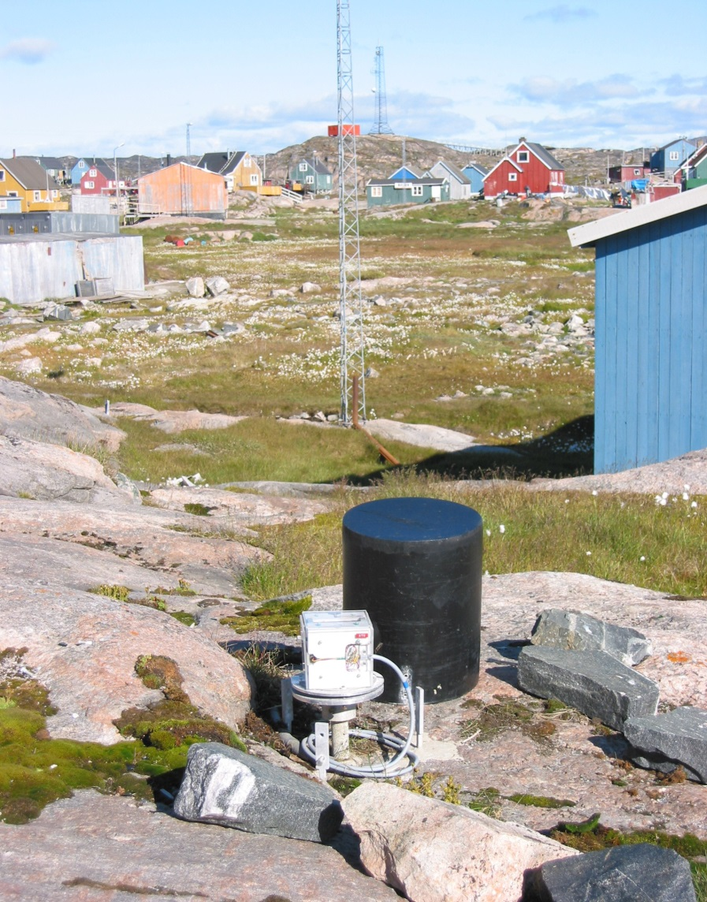
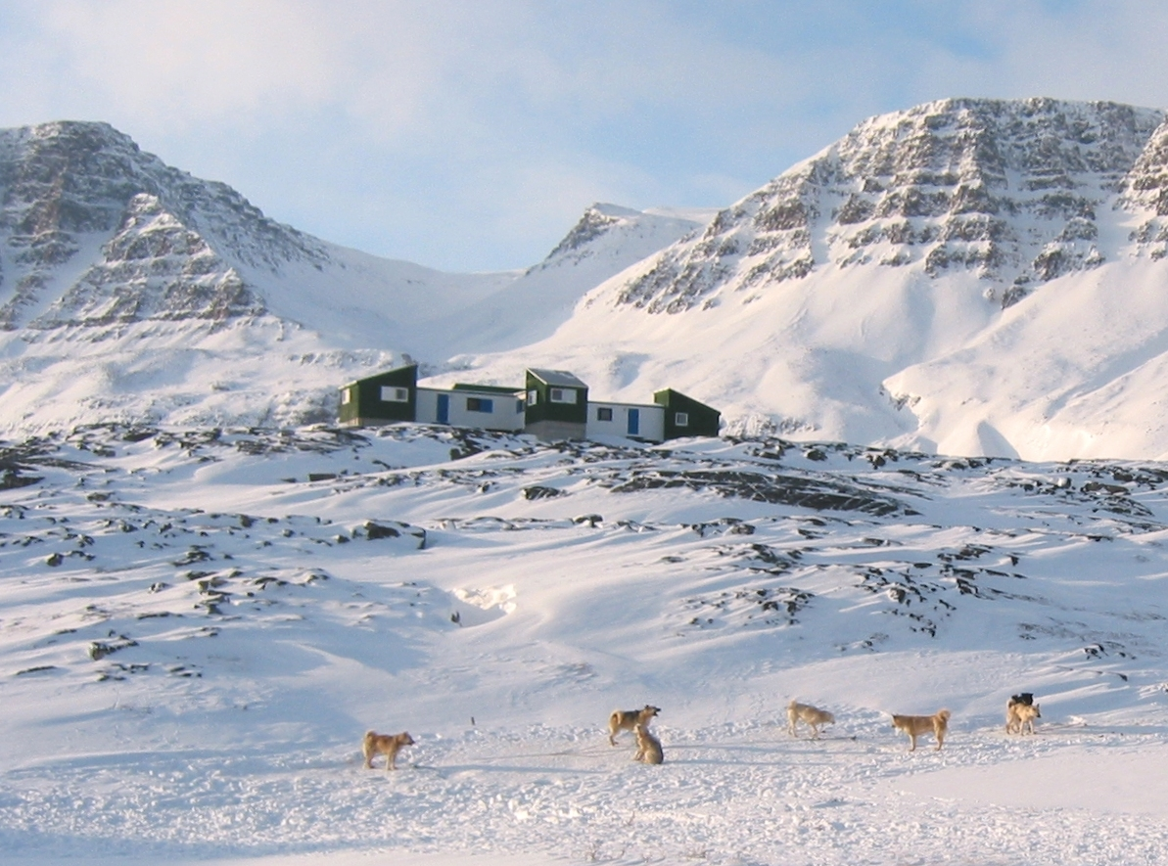
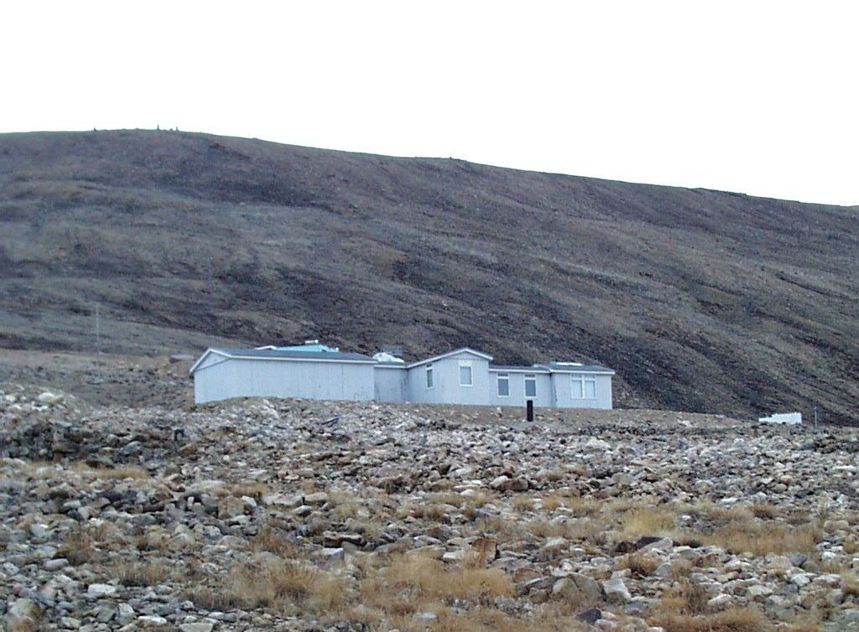
DTU Space’s magnetic
stations in Greenland
17 Magnetic Stations,
3 of which are Magnetic Observatories
Attu
Magnetic Observatory:
continuous long-term monitoring of the absolute value of Earth’s magnetic field
Qaanaaq: since 1956
Qeqertarsuaq: since 1926
Narsarsuaq: since 1983
Qaanaaq
Qeqertarsuaq
Magnetic Variometer Station:
Measurements of rapid fluctuations,
no absolute baseline (no thermal control)

Slide 12
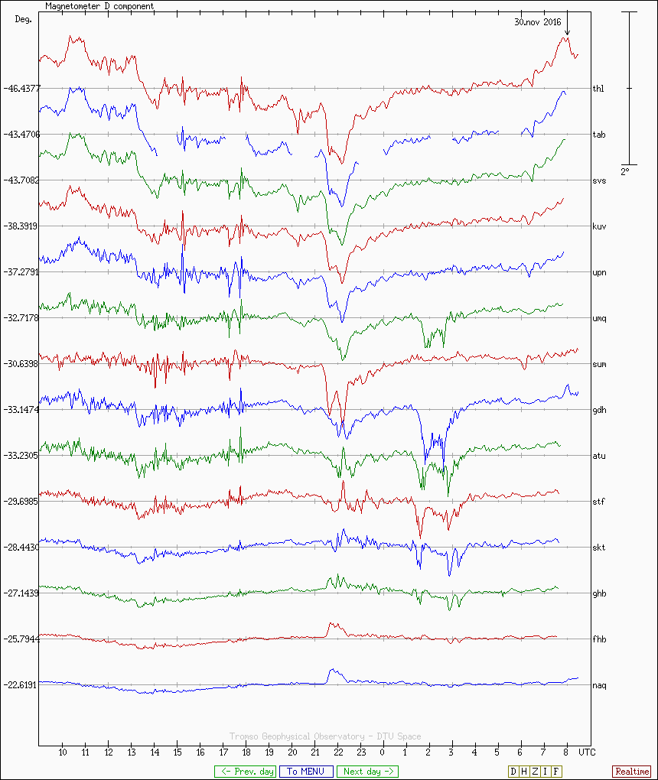
Real-Time Data of all Stations available online (today!)
2°
Qaanaaq
Qeqertarsuaq
Narsarsuaq

Slide 13
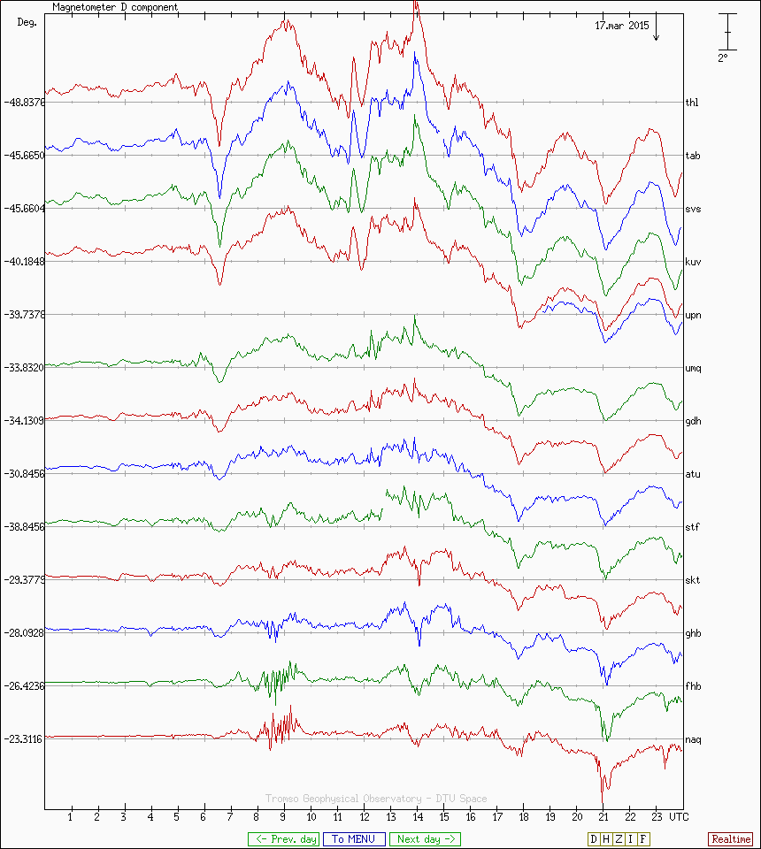
Real-Time Data of all Stations online available (storm)
2°
Qaanaaq
Qeqertarsuaq
Narsarsuaq

Slide 14
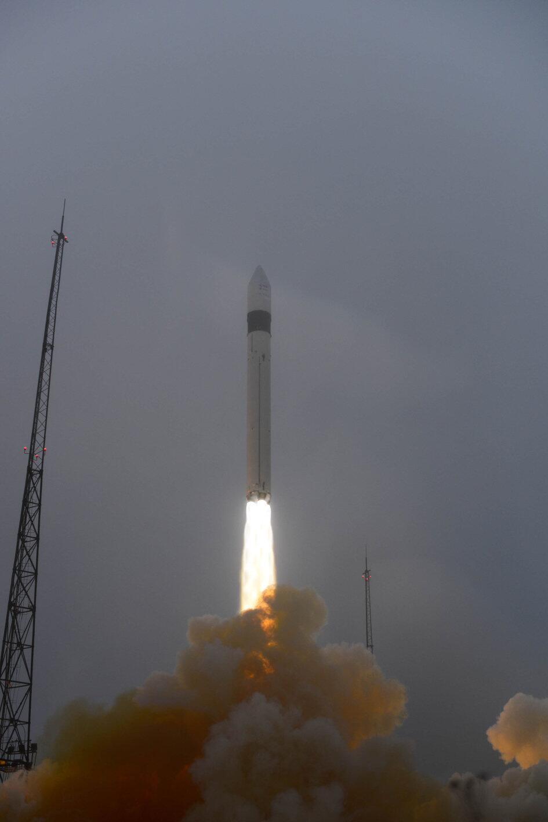
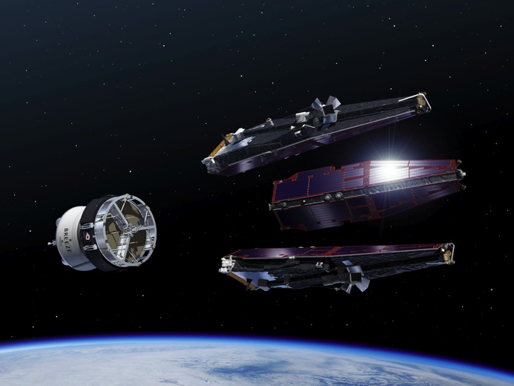
Space observations: ESA’s Swarm mission
Satellite trio launched from Plesetsk, Russia, 22nd November 2013.

Slide 15
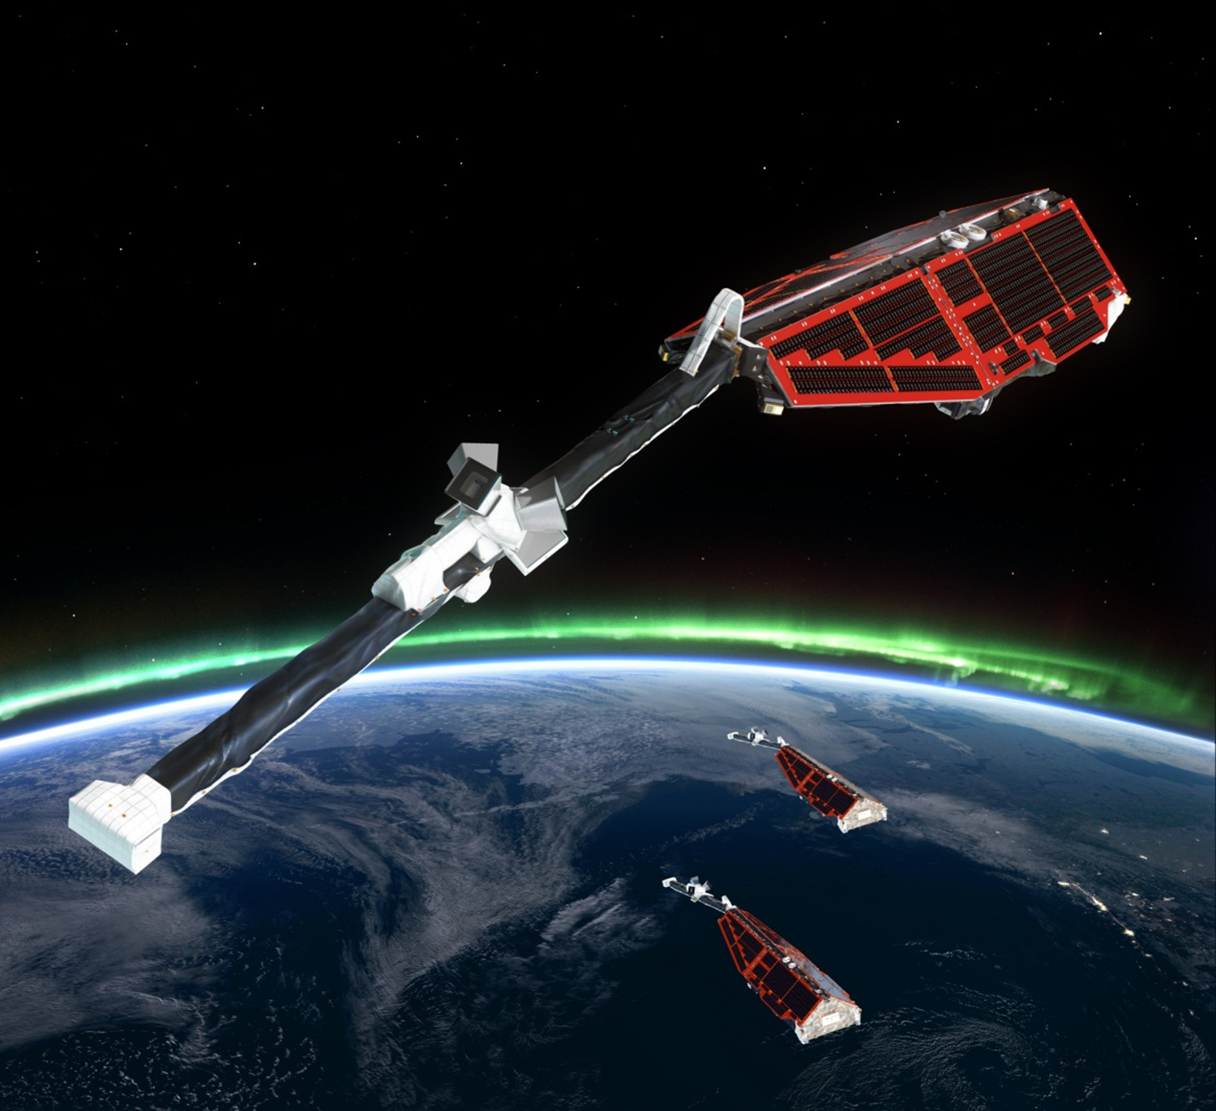
ESA Earth explorer mission: Swarm
Three identical satellites:
two side-by-side in low orbit (~ 450 km)
one in higher orbit (~ 510 km)

Slide 16
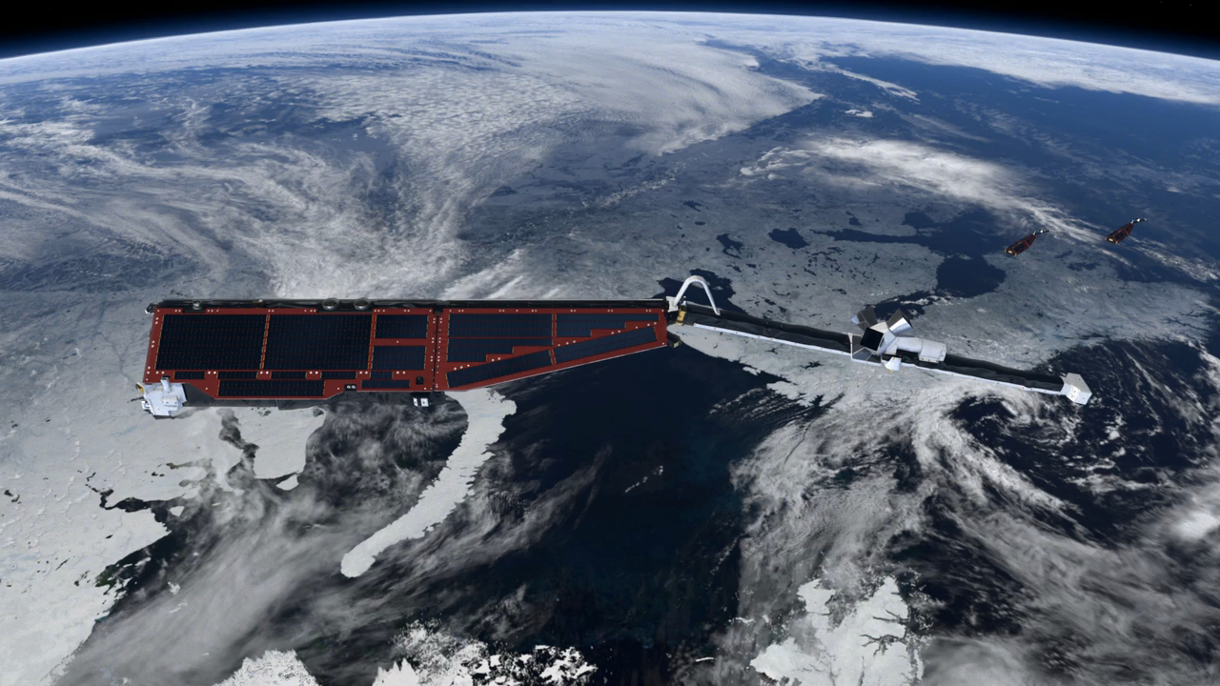
ESA’s Swarm mission: satellites in orbit

Slide 17
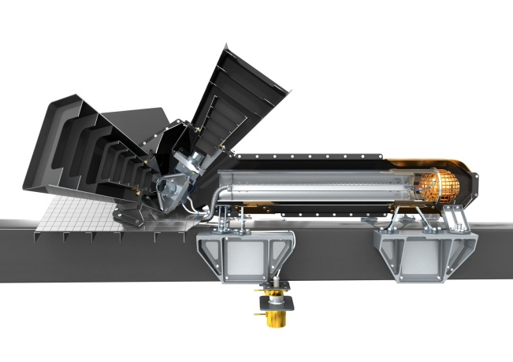
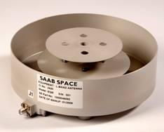
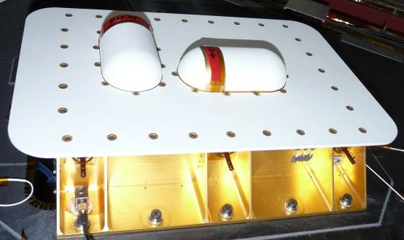
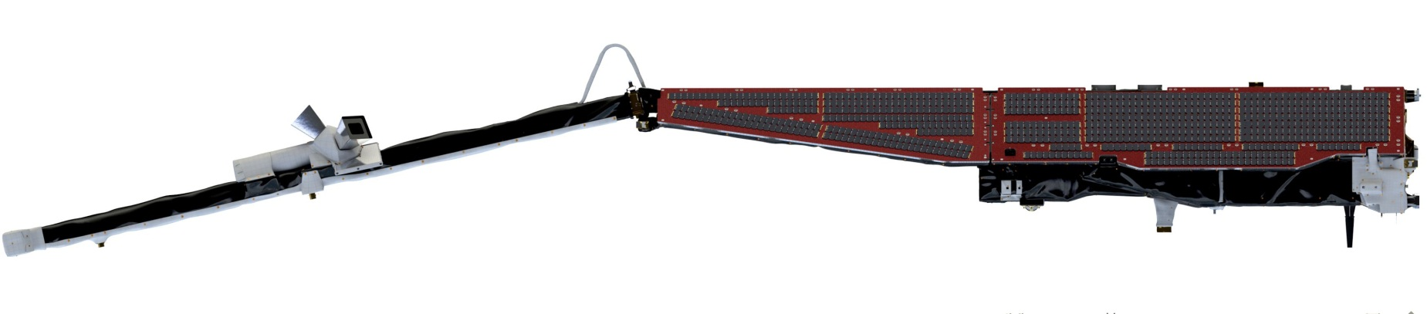
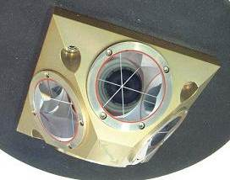
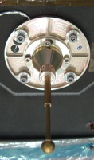
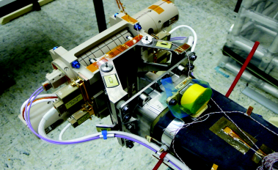
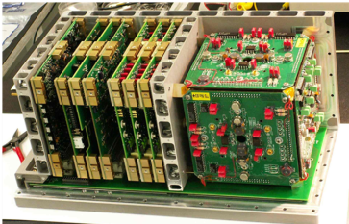
Swarm Payload
Star trackers
Vector
magnetometer
GPS antenna
3D-ion imager
Time, position and ionospheric sounding
Plasma parameters
and electric field
Flight direction
Magnetic field
Laser reflector
Thermospheric density and winds
Langmuir probe
Absolute scalar
magnetometer
3D-accelerometer
Notes:
Here we look a bit closer at the instruments on board of each Swarm satellite.
The main instrument is the vector field magnetometer, which makes high-precision measurements of the magnitude and direction of the magnetic field.
The orientation of the vector is determined by the star tracker assembly, which provides attitude data.
The VFM and star tracker assembly are mounted on a ultra-stable structure, called an optical bench, in order to align them perfectly.
At the end of the boom, you find the absolute scalar magnetometer. It measures the strength of the magnetic field with greater accuracy than any other magnetometer launched into space.
The sensitivity of the Advanced Scalar Magnetometer with its laser technology is a few tenths of a pT. This compares to measuring a distance of 6 km with a3mm accuracy.
It is needed to calibrate the vector field magnetometer. It is placed at the end of the boom to have as little as possible influence of any magnetic disturbance due to electrical units on the body.
On top you see the GPS antenna and laser reflector to precisely determine the orbit to a few cm-level and validate it.
The accelerometer is inside the satellite and measures non-gravitational accelerations providing information about the air drag and wind around the satellite.
The electric field instrument comprises the Langmuir probe and the 3D thermal ion imager. This set of instruments measures plasma density, drift and velocity in high resolution to characterise the electric field.
The Langmuir probe provides measurements of electron density, electron temperature and electric potential of the satellite.

Slide 18
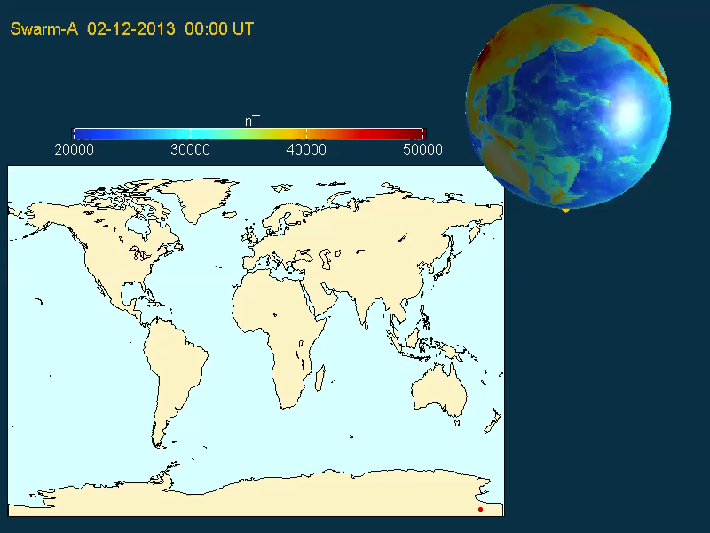

Slide 19
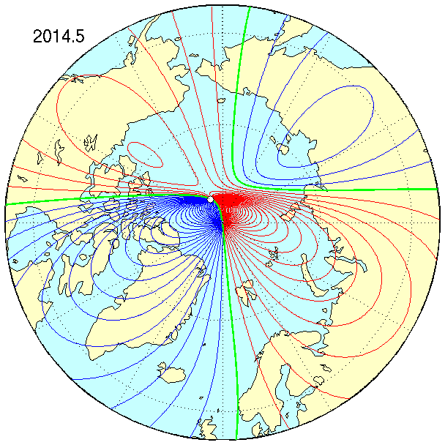
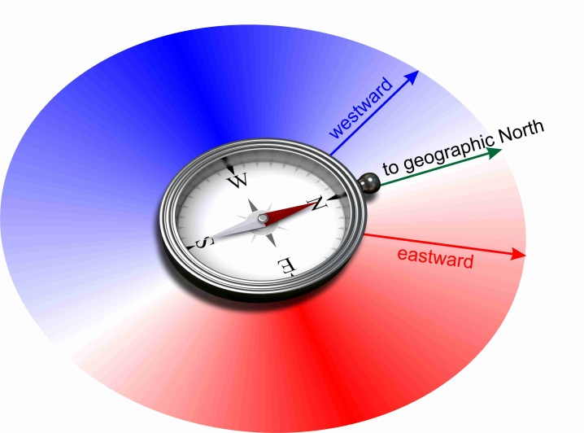
DTU Global Geomagnetic Reference model
Compass points in direction
eastward / westward
of geographic pole
Compass points towards geographic pole

Slide 20
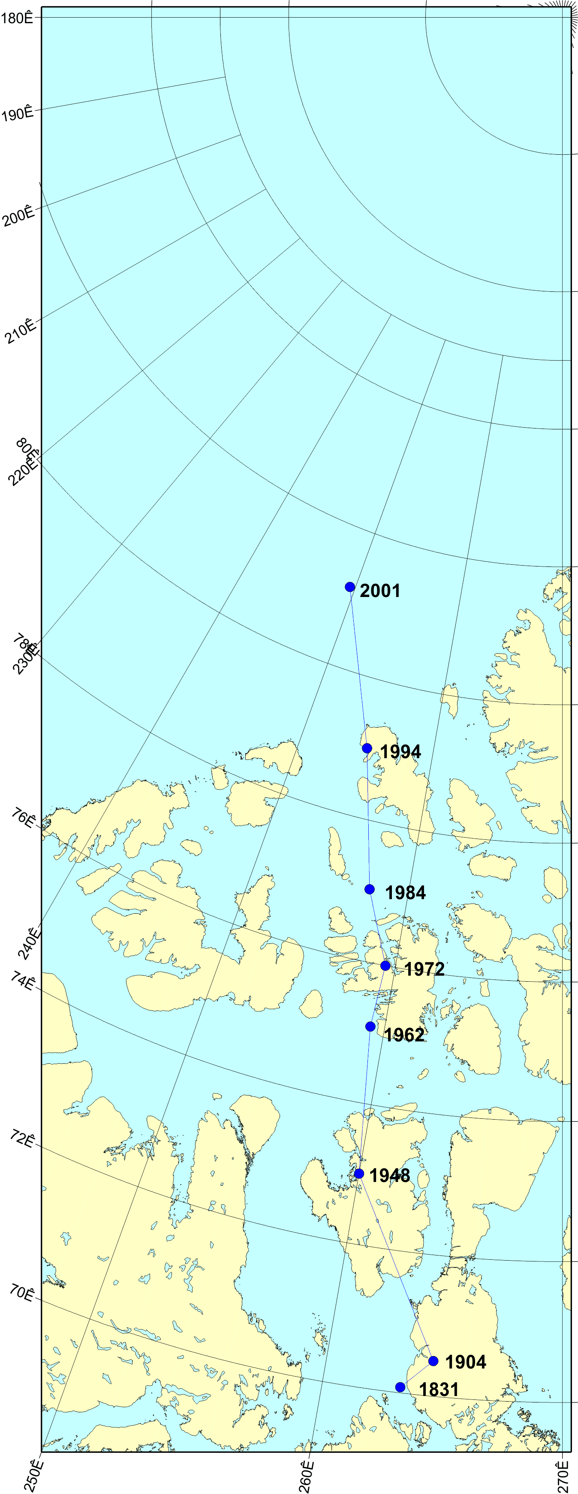
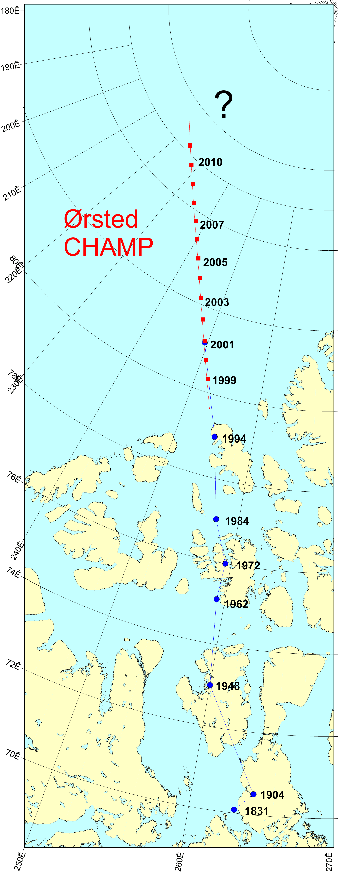
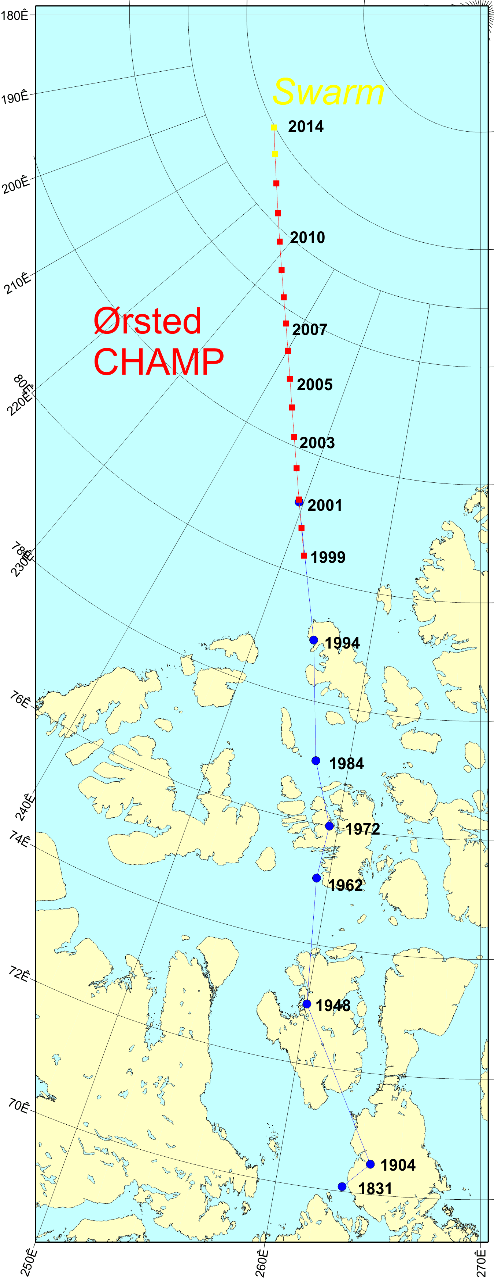
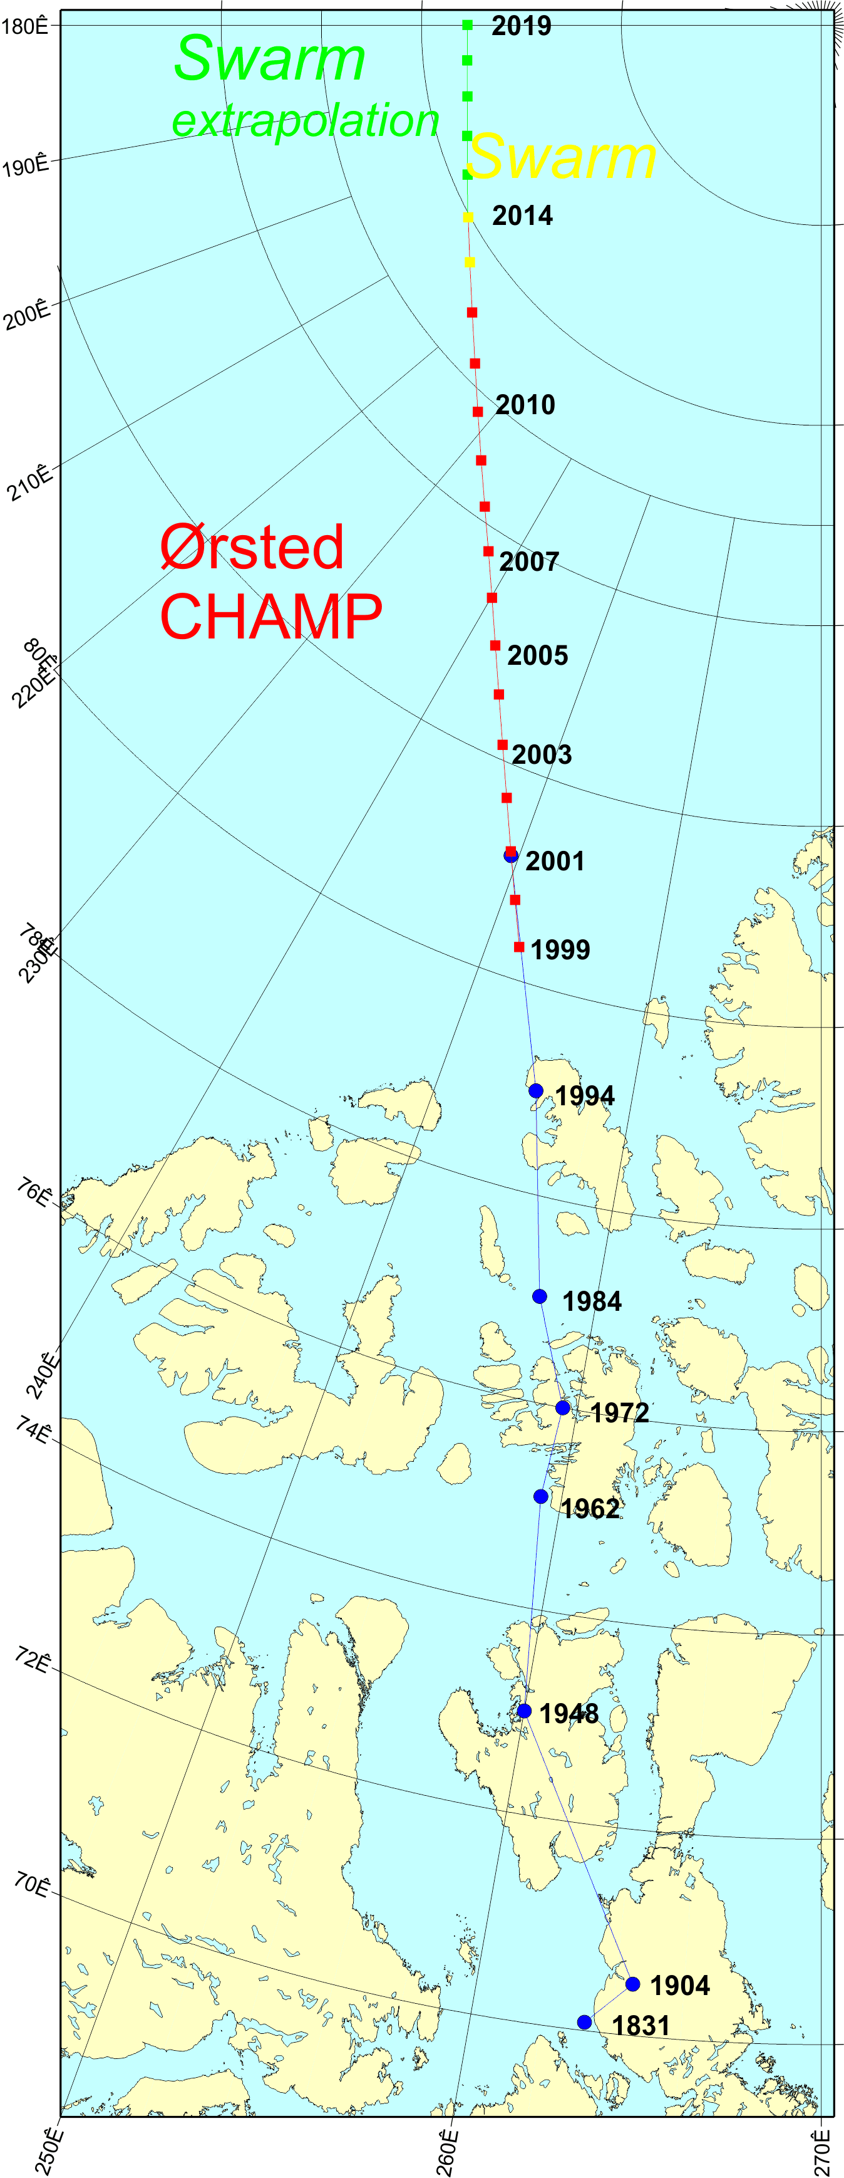
Recent Movements of the magnetic North Pole
Ground expeditions
1831 James Clark Ross
1904 Roald Amundsen
Previous satellites
Ørsted
CHAMP
Swarm

Slide 21
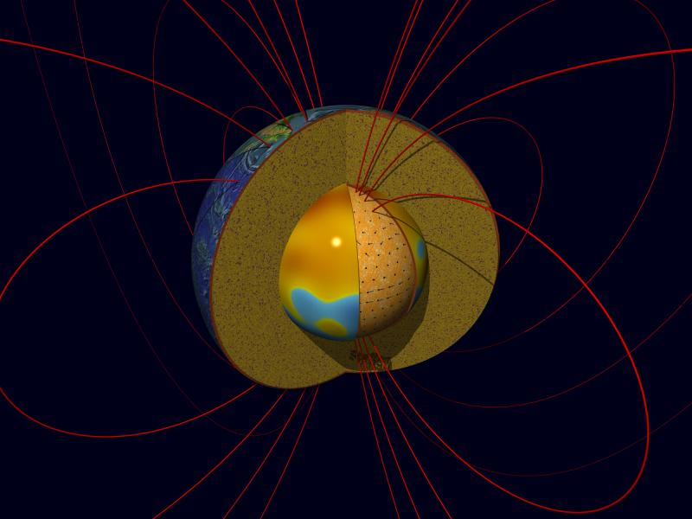
Origin of the Earth’s magnetic field and pole movements?
Motions of liquid iron in the outer core……

Slide 22
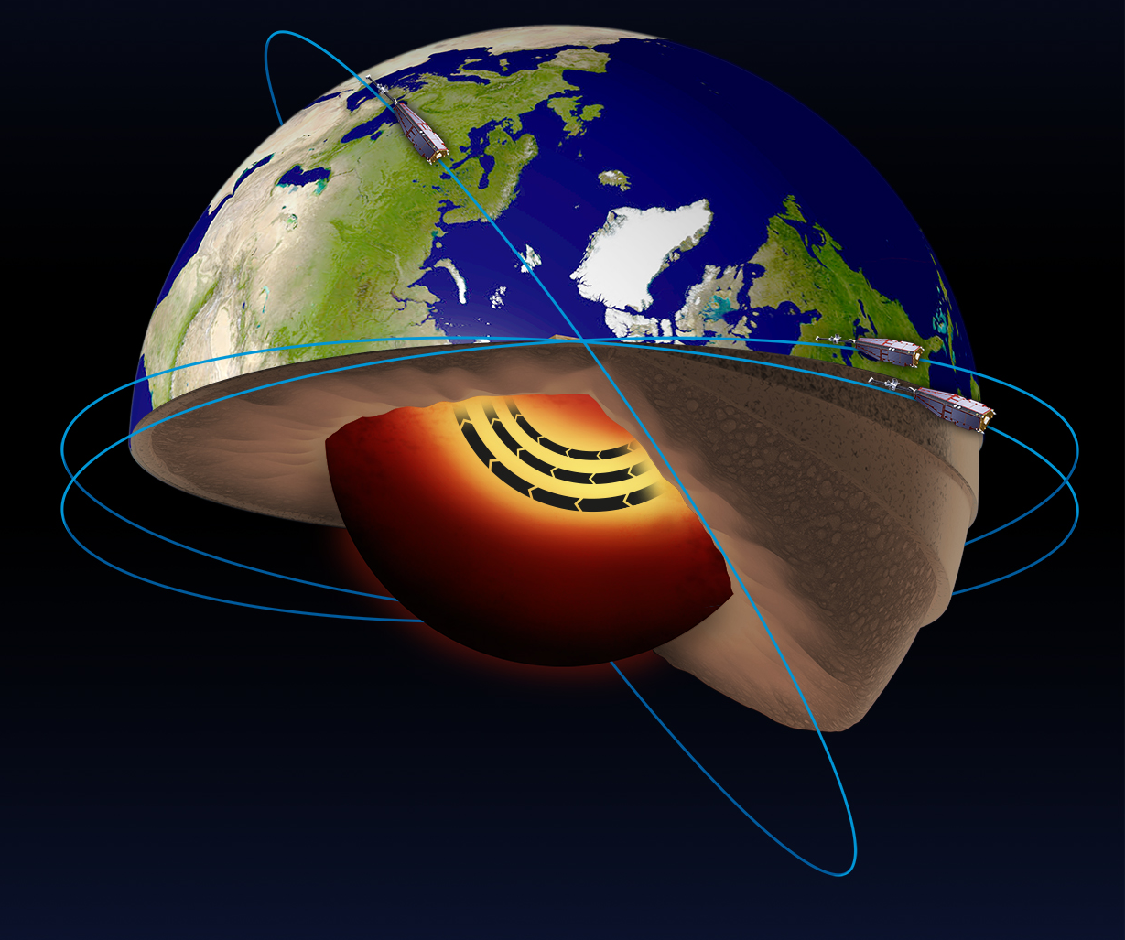
Mapping the liquid metal flows in Earth’s core
Recently discovered an accelerating jet at high latitudes in Earth’s core

Slide 23
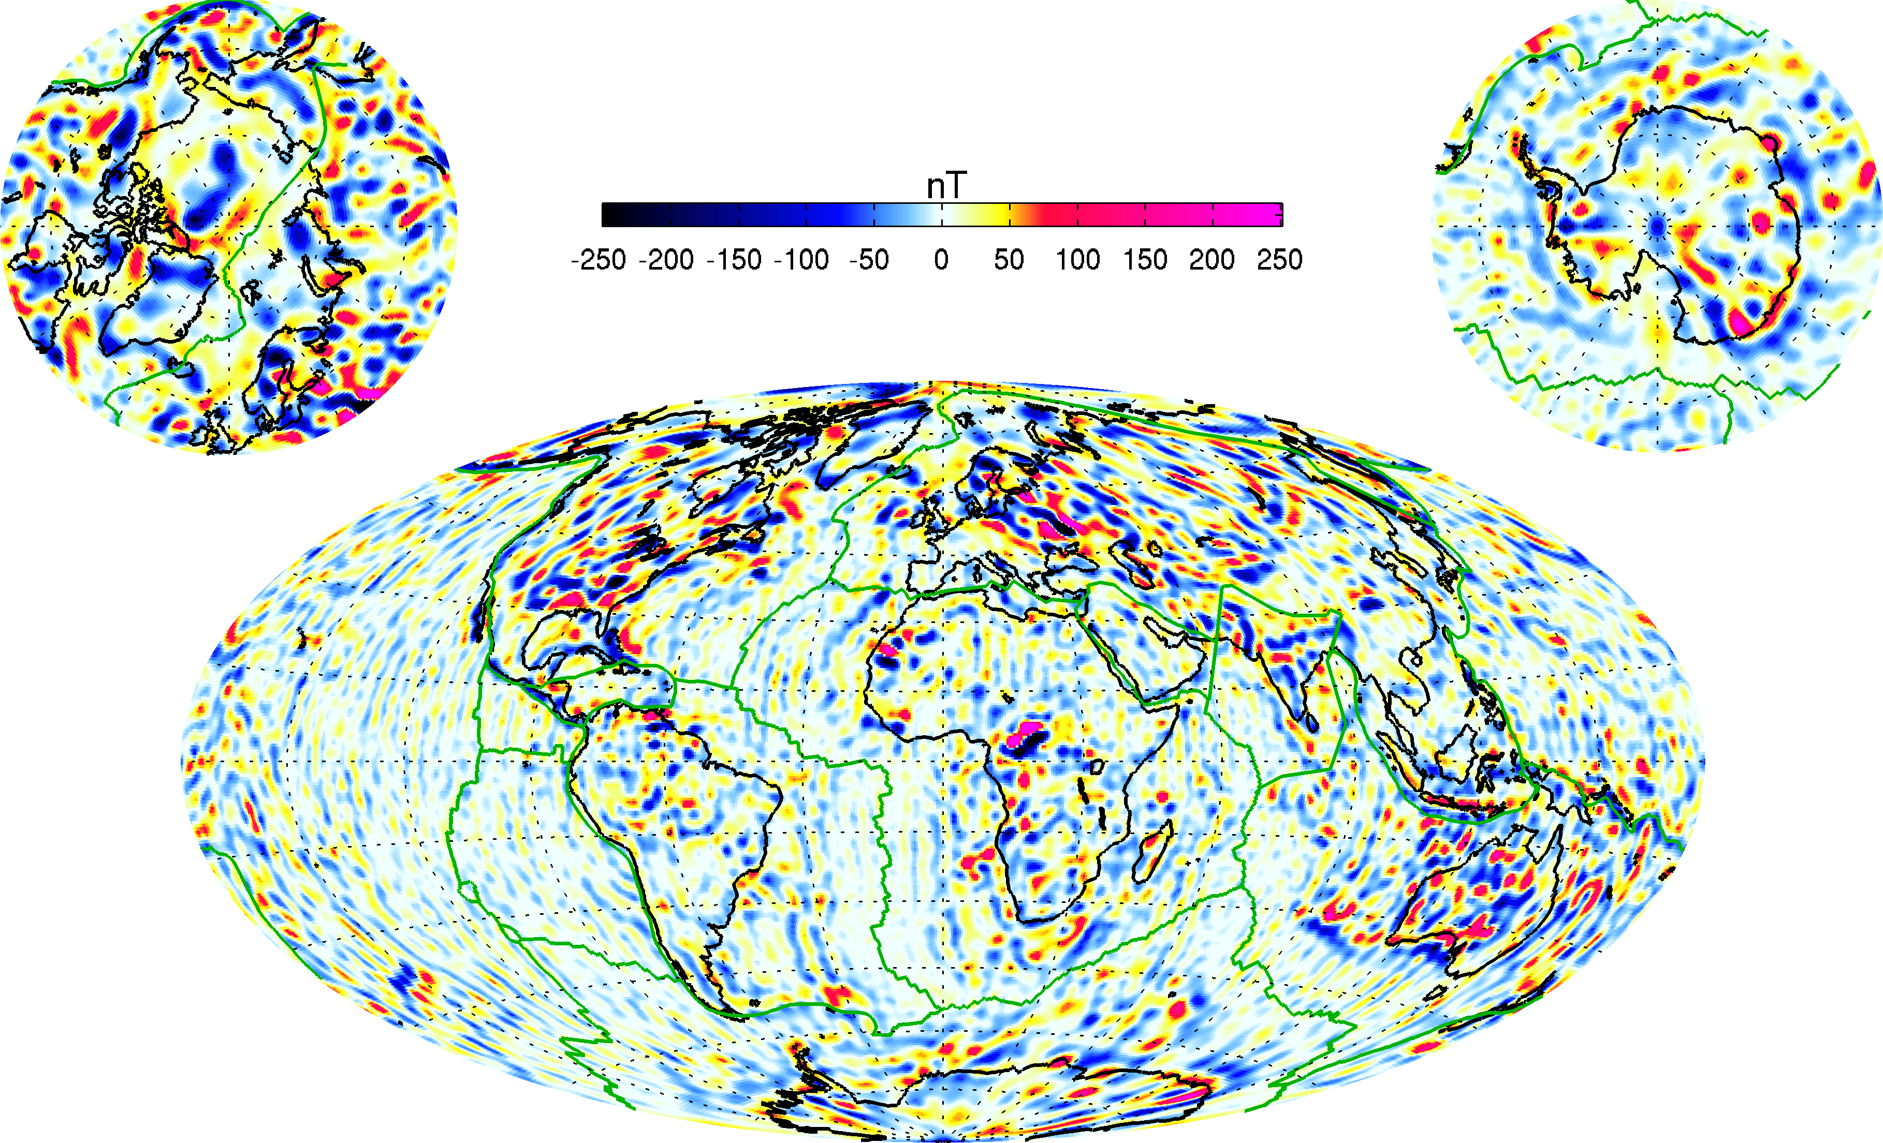
Mapping the large-scale crust
[Courtesy of
PhD Student
Livia Kother]
Much more to come as Swarm descends from 450 down to 300km and below!

Slide 24
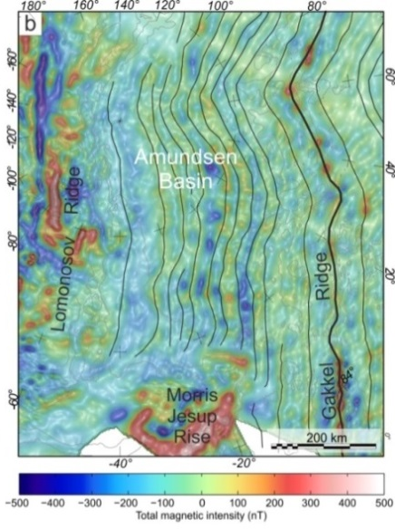
On regional/local scales with airborne data:
from geophysical data to geology

Slide 25
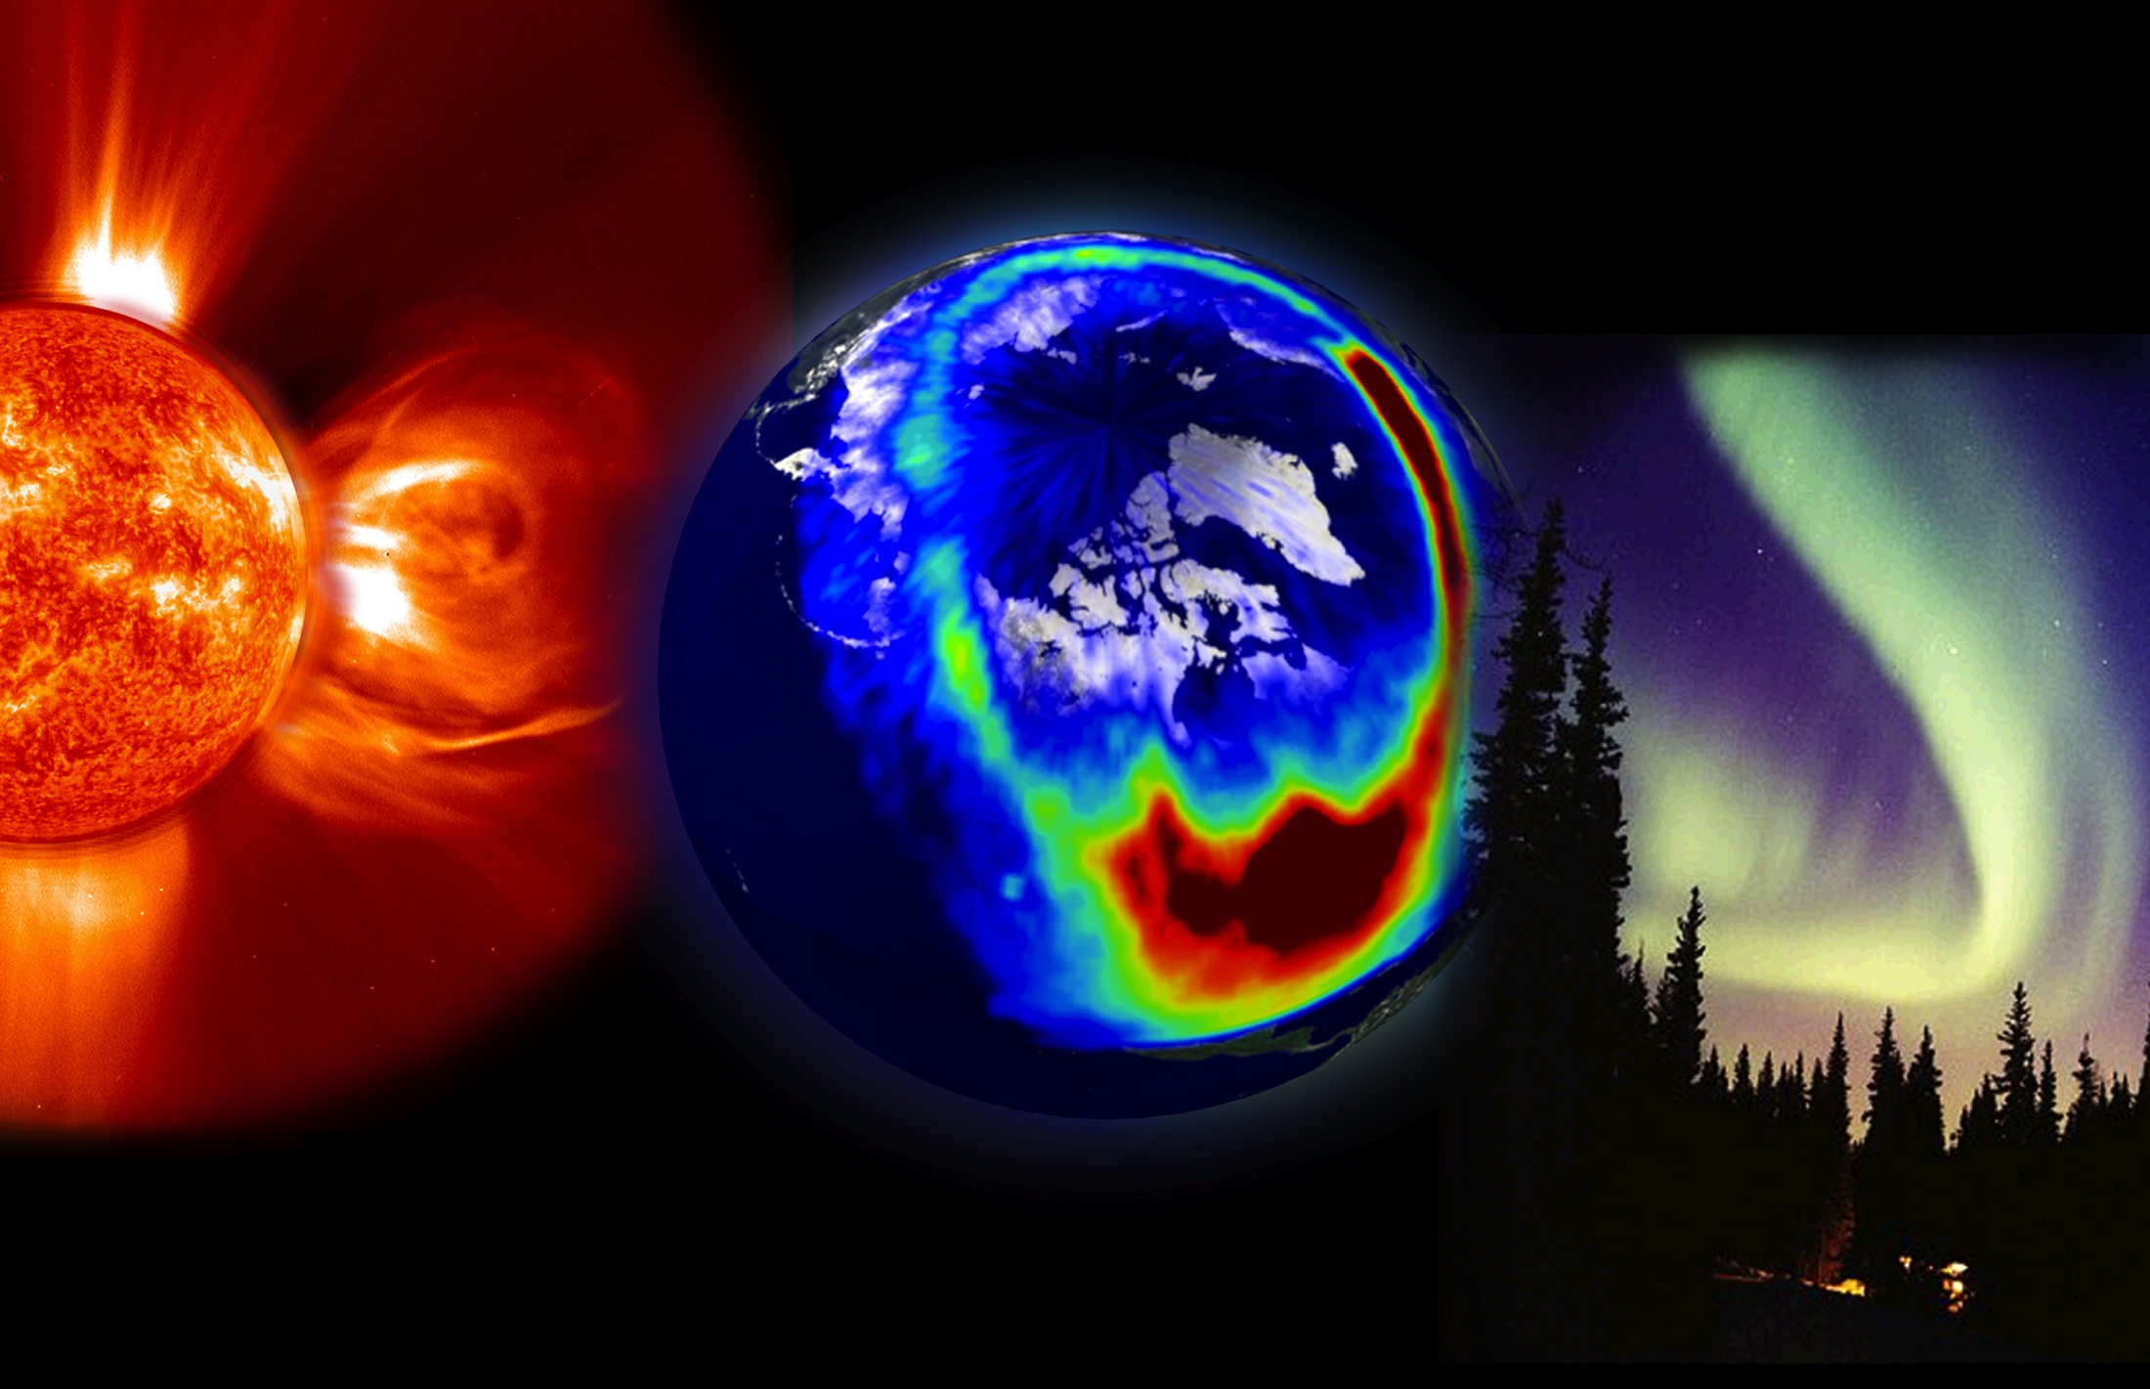
Monitoring dynamic ‘space weather’ in the polar regions
credit: NASA/GSFC/SDO

Slide 26
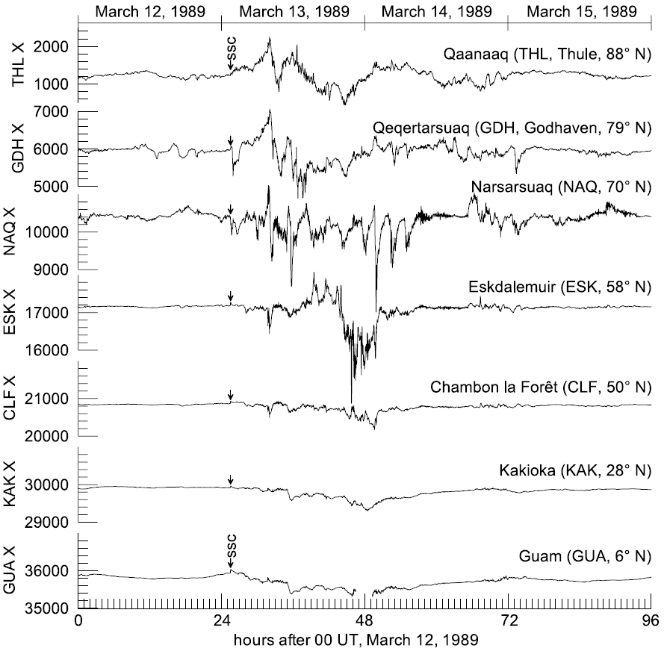
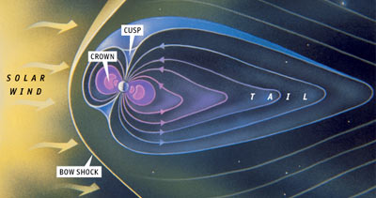
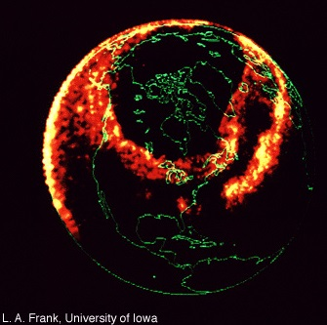
Ionospheric and magnetospheric effects
of geomagnetic storms
Figure: Matzka et al. (2010)
Image: Dynamics Explorer UV
Notes:
Ground induced currents

Slide 27
Summary
DTU plays a leading role in ESA’s Swarm satellite mission, now carrying out high resolution global survey of the Earth’s magnetic field
Build ground magnetometers and operate a unique chain of stations in Greenland
Produce world-class, open access, geomagnetic reference models used for navigation and in scientific applications
Studies of Earth’s core, crust and ionosphere

