Slide 1
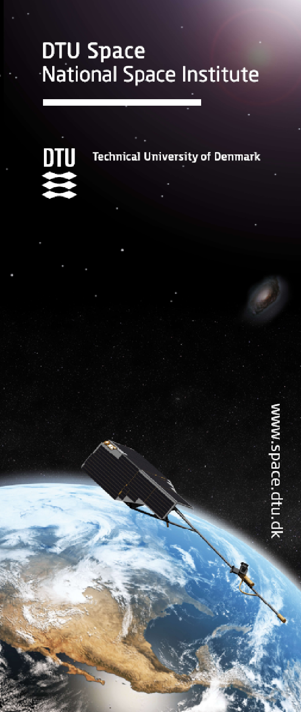


Dual frequency airborne radar altimetry for sea ice and land ice observations
Sine M. Hvidegaard, Henriette Skourup,
Sebastian B. Simonsen, Rene Forsberg, Louise Sandberg Sørensen, Veit Helm, Alex Coccia, Karlus Macedo, Tânia Casal, and Malcolm Davidson
www.space.dtu.dk
Notes:
1

Slide 2
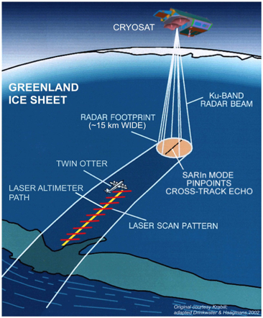

ESA/DTU Space airborne campaigns
CryoVEx
Experiment goals:
  Validation of satellite altimetry missions, especially CryoSat-2 but also Sentinel-3, SARAL/AltiKa
  Cross-calibration of ICESat-2 and CryoSat-2
  Continuation of timeseries for specific sites
  Proof-of-concept for new technologies and preparation for future missions

Slide 3
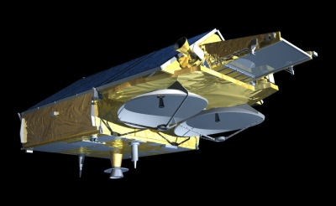
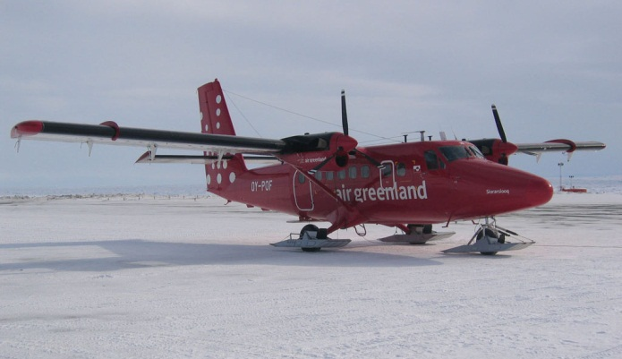
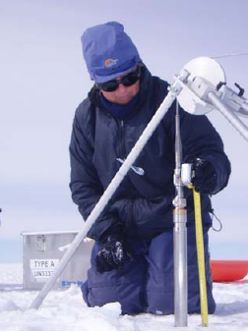
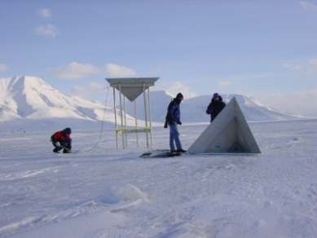
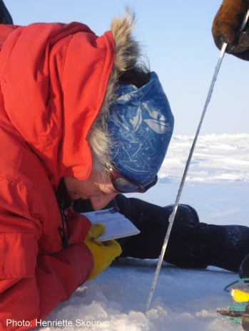
CryoVEx validation concept
Global
Regional
Local

Slide 4
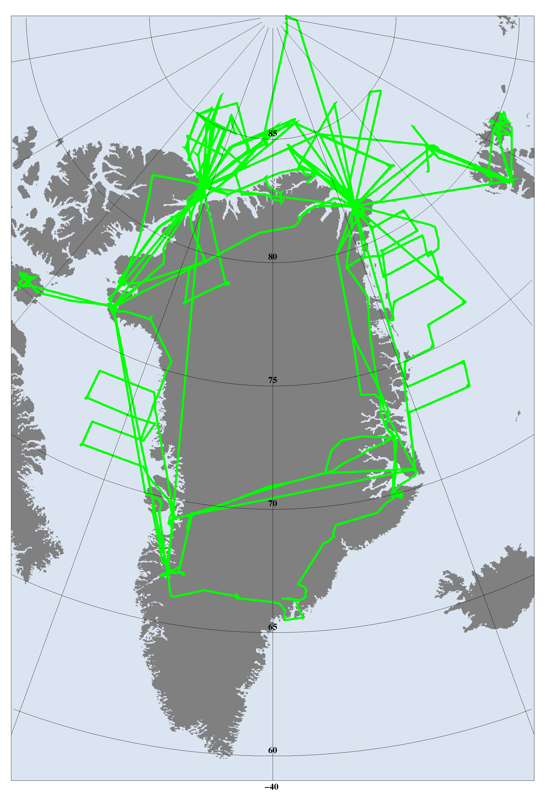
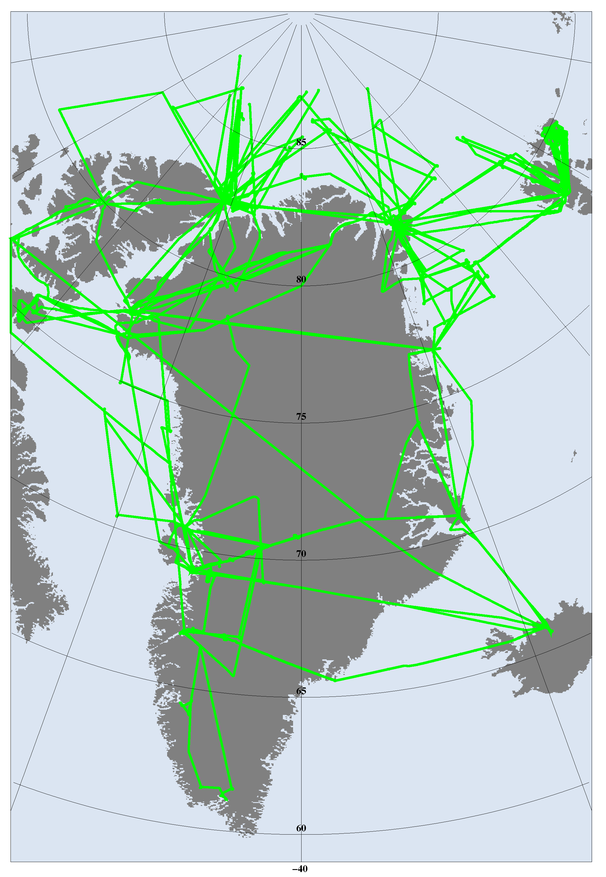
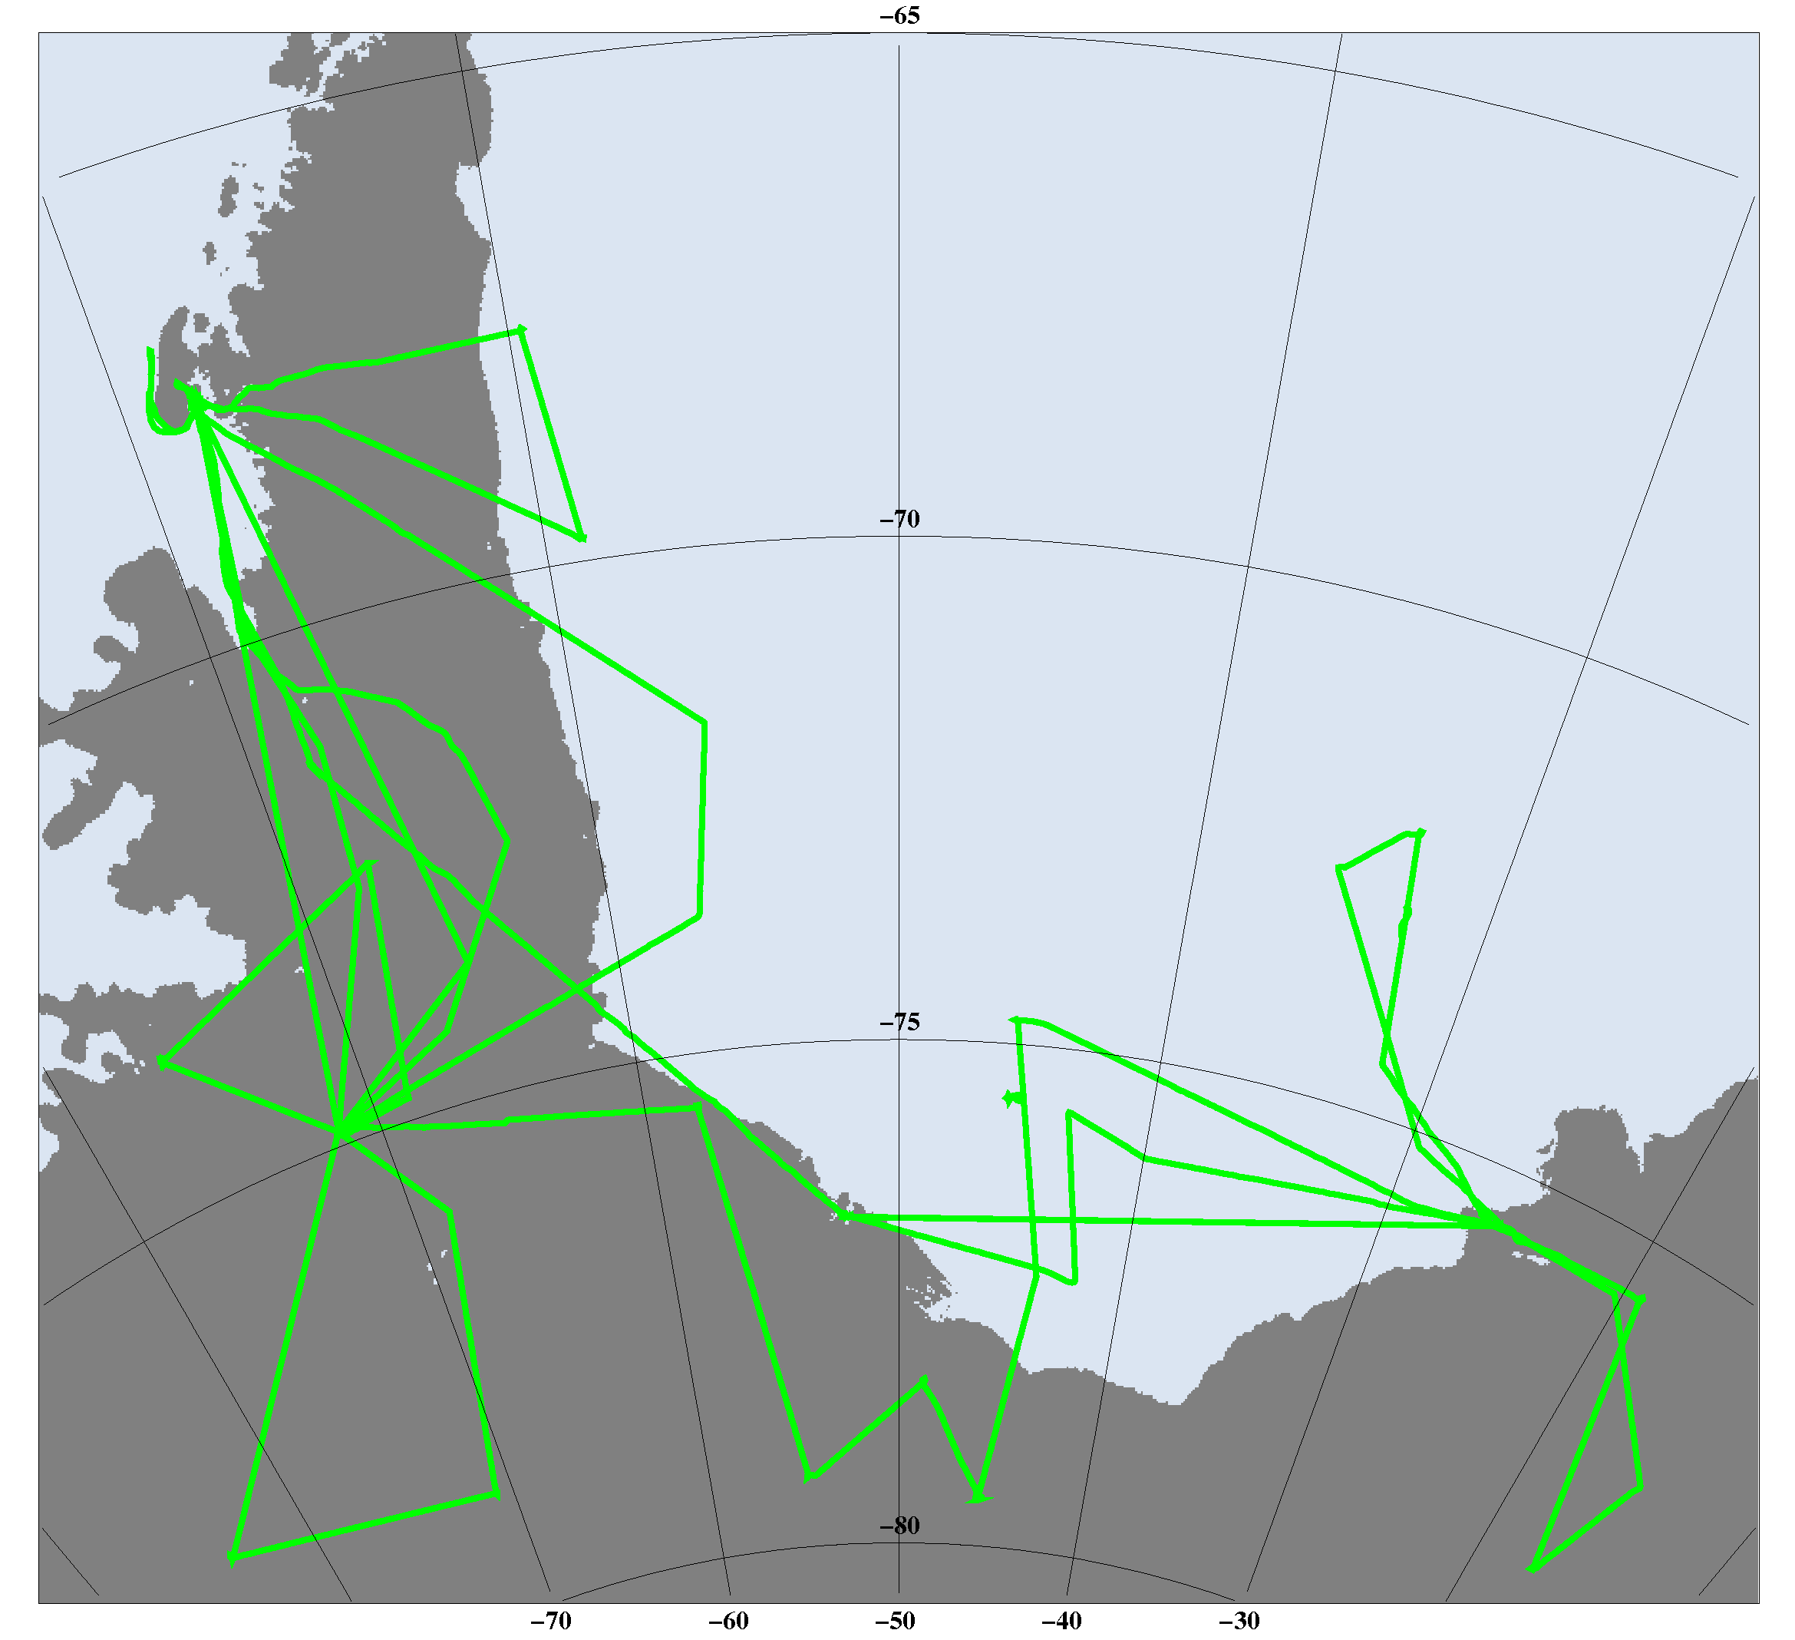
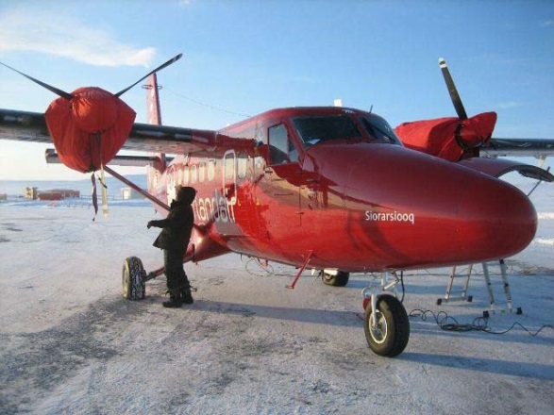
ESA/DTU Space campaigns 2003->
2003‐08
2011‐2017
2017‐18
Notes:
10 Arctic campaigns
1 Antarctic campaign

Slide 5
ESA/DTU Space airborne campaigns
Timeline
  2003 -> Pre-launch validation experiments for CryoSat mission (ALS + D2P – Kansas radar)
  2005/06 Certification of ASIRAS (Airborne Ku-radar)
  2011 First validation of CS-2
  2016 First campaign(Fall) with Ku/Ka radar (ASIRAS and KAREN)
  2017 Arctic (Spring) campaign with Ku/Ka altimetry
  2017/18 First Antarctic campaign with Ku/Ka altimetry
  2019 Arctic (Spring) campaign with Ku/Ka altimetry
  2019 Arctic(Late Summer) campaign
  2020 Arctic(Spring) campaign - MOSAiC

Slide 6
ESA/DTU Space airborne campaigns
Timeline
  2003 -> Pre-launch validation experiments for CryoSat mission (ALS + D2P – Kansas radar)
  2005/06 Certification of ASIRAS (Airborne Ku-radar)
  2011 First validation of CS-2
  2016 First campaign(Fall) with Ku/Ka radar (ASIRAS and KAREN)
  2017 Arctic (Spring) campaign with Ku/Ka altimetry
  2017/18 First Antarctic campaign with Ku/Ka altimetry
  2019 Arctic (Spring) campaign with Ku/Ka altimetry
  2019 Arctic(Late Summer) campaign
  2020 Arctic(Spring) campaign - MOSAiC

Slide 7
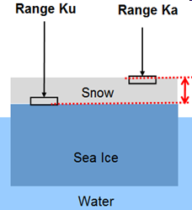
Dual-frequency radars and laser
NIR laser

Slide 8
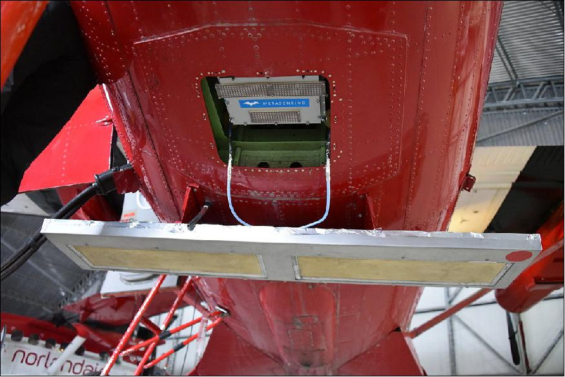
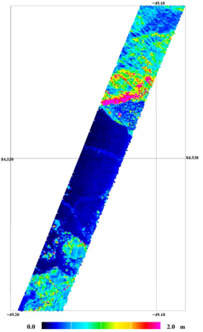
Instrument setup
ASIRAS Radar (ESA/RST):
  Ku-band (13.5 GHz)
  Footprint area: 10m x 3m
  Range resolution: 0.1098m
KAREN Radar (MetaSensing):
  Ka-band (34.525 GHz)
  Footprint area: 12m (20m) x 5m
  Range resolution: 0.1650m
NIR Laser scanner (Riegl):
Resolution: 1mx1m
Swath-width: 300m

Slide 9
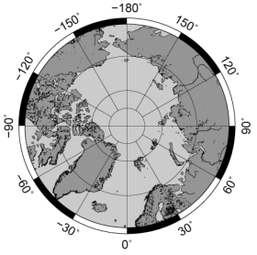
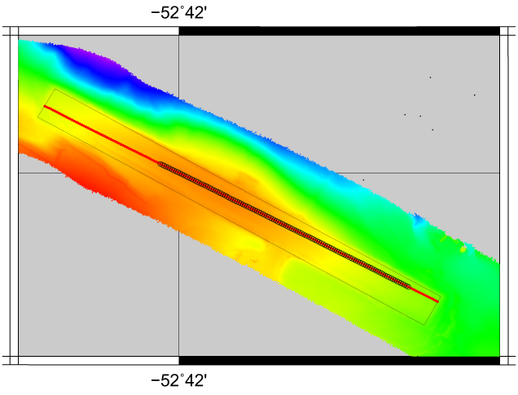
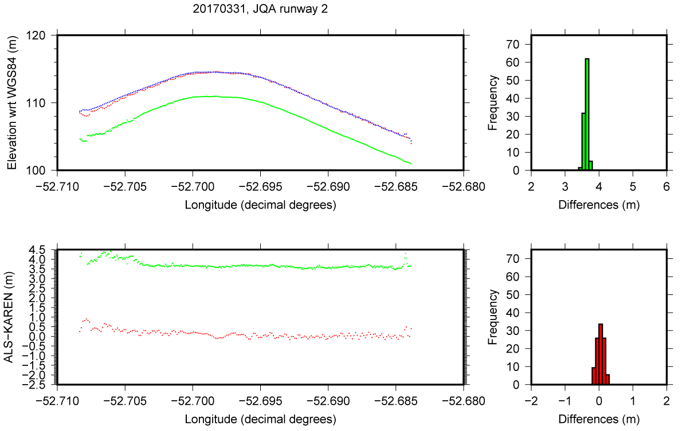
Vertical alignment
Qaarsut, 20170331
To get absolute heights need for performing an internal calibration between instruments at a known surface
Loss in cables
Re-tracker dependent
Profile | # points | OCOG |  | TRMFA 50%
 |  | Off-set (m) | Std (m) | Off-set (m) | Std (m) | Roll (%)
ASIRAS | 218 | 3.64 | 0.06 | 3.83 | 0.04 | 47
KAREN | 95 | 0.03 | 0.10 | 0.08 | 0.12 | 47

Slide 10
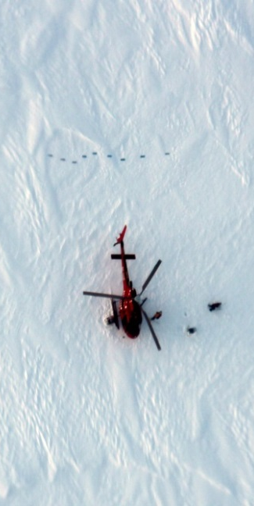
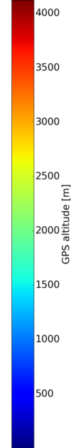

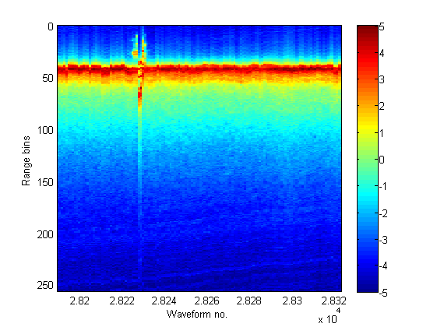
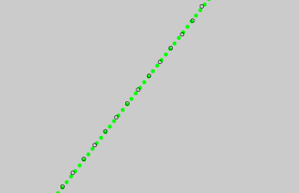
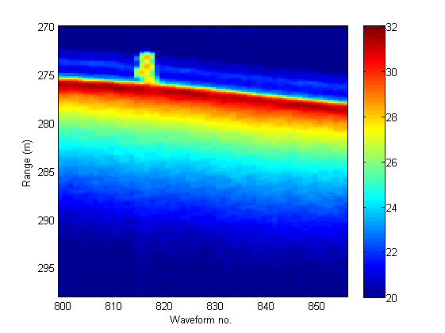
Horizontal alignment
Leverarms between the ASIRAS and KAREN reference points 2016:
dx=+0.33m, dy=-0.02m, dz=+0.255m
20161027 at EGIG T1
ASIRAS Green
KAREN Black
Flight direction
dx=0.24m

Slide 11
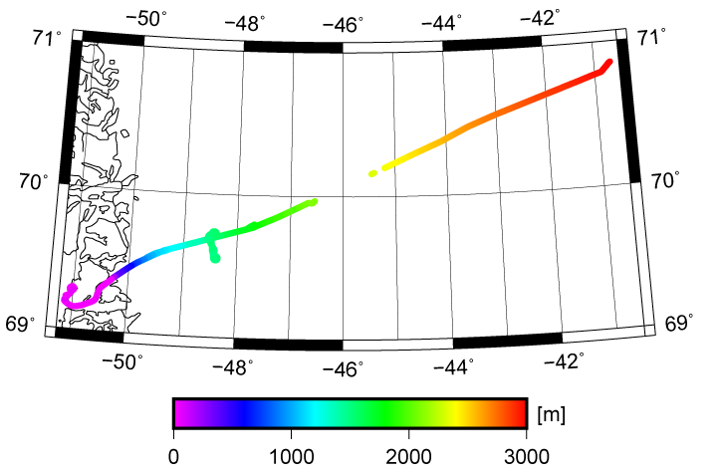

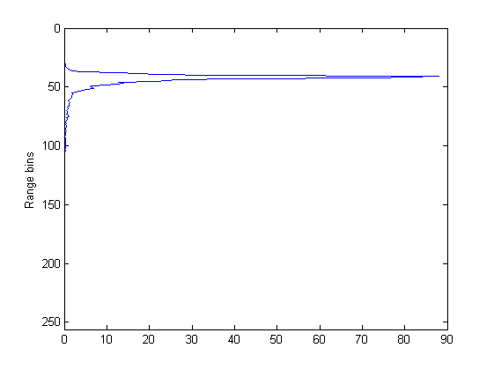
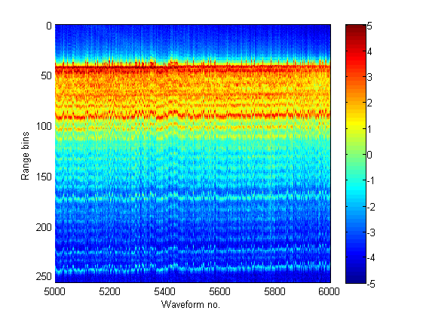
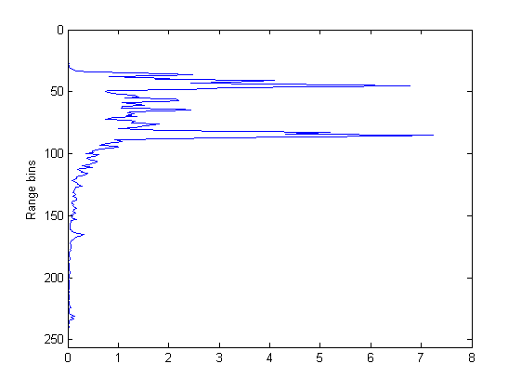
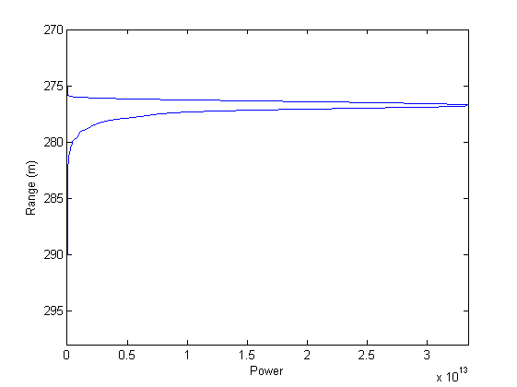
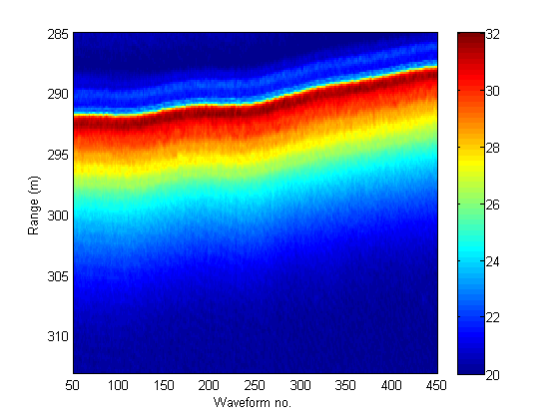
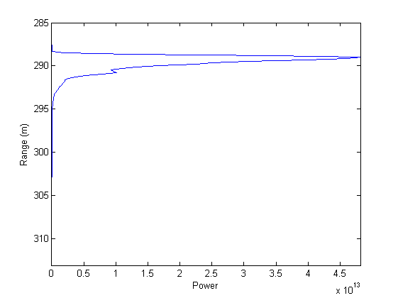
EGIG line ASIRAS and KAREN
October 2016
Percolation zone
Dry snow zone
ASIRAS
10 m
Range resolution: 0.1098m​
KAREN
10 m
Range resolution: 0.1650m
10 m

Slide 12
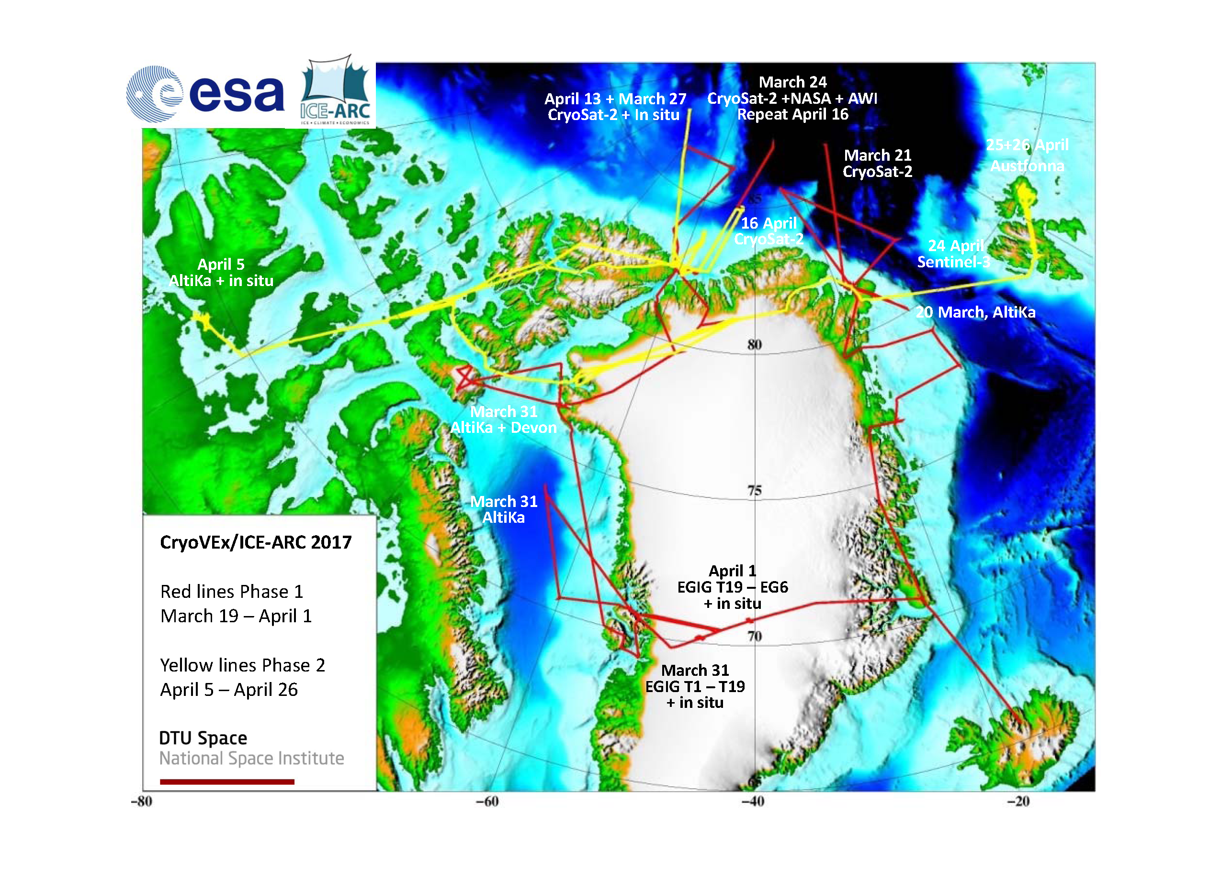

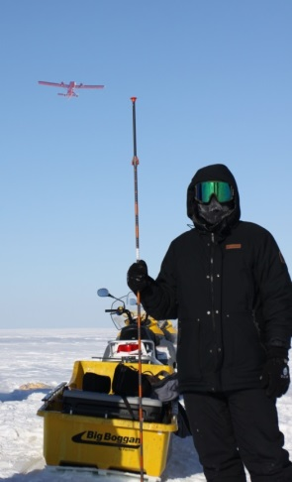
CryoVEx campaign 2017
Impact of snow density and stratigraphy on ka and Ku-band radar altimetry, measured on the EGIG line of the Greenland Ice Sheet
B6.07: ESA Campaigns Poster Session
Thursday, May 16, 2019, 5:20 PM - 7:00 PM
Cambridge Bay
SnowExp

Slide 13
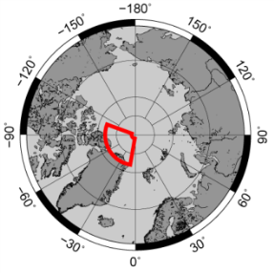
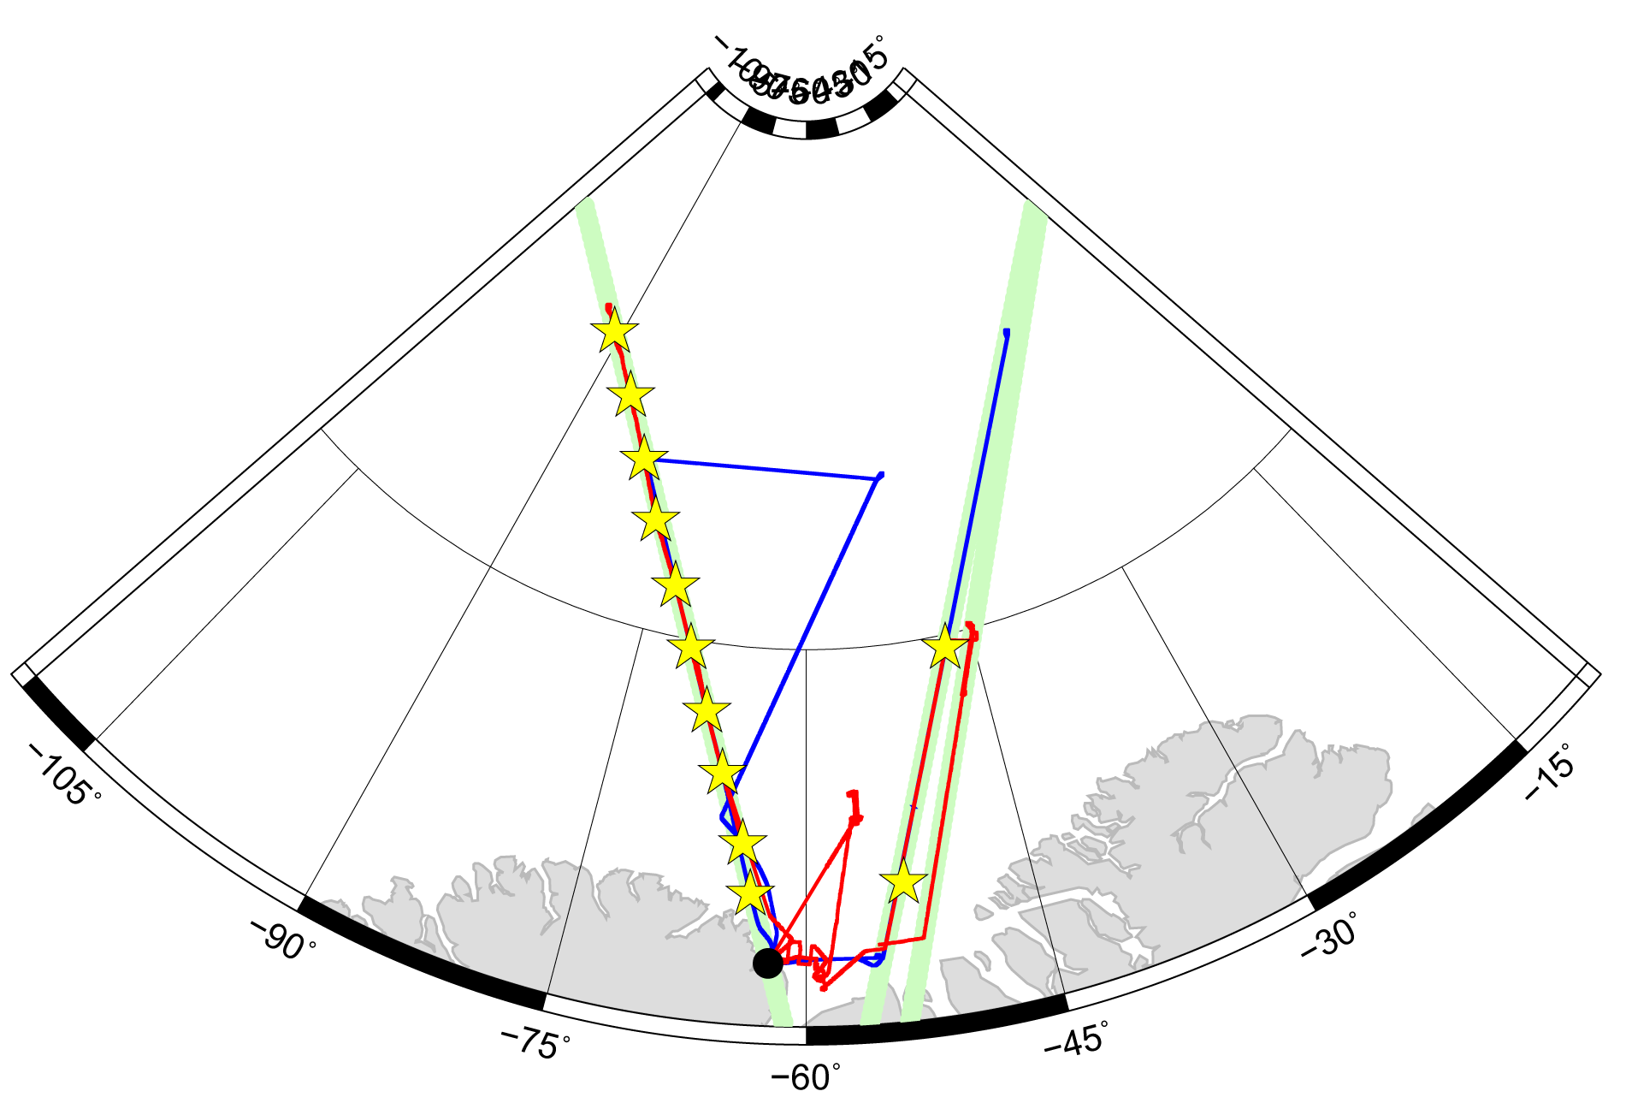
CryoVEx campaign 2017
Phase 1 blue
Phase 2 red
In-situ sites
NE-track:
March 24
CS2 orbit # 36892
ESA CryoVEx (ALS, ASIRAS, KAREN)
AWI Polar-5 (EM sounder)
NASA OIB (ATM, snow depth radar)
NASA JPL GLISTIN (Topographic interferometer (ka))
April 16
ESA CryoVEx (ALS, KAREN)
NW-track:
March 27
ESA CryoVEx (ALS, ASIRAS, KAREN)
April 11-18
In Situ measurements
April 12
CS2 orbit # 37159
NASA OIB (ATM, snow depth)
April 13
ESA CryoVEx (ALS, KAREN)
Notes:
10 NW line

Slide 14
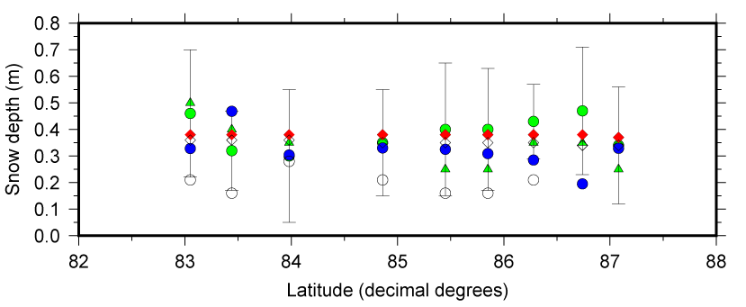
CryoVEx 2017 snow depth
In situ mean (April 11-18) Warren 99 (March)
In situ mode Warren 99 (April)
NASA OIB qlooks (April 12)
KAREN-ASIRAS TRMFA 50% (March 27)

Slide 15
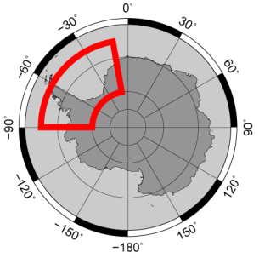
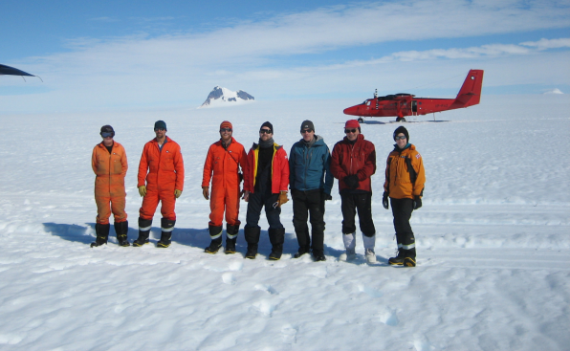
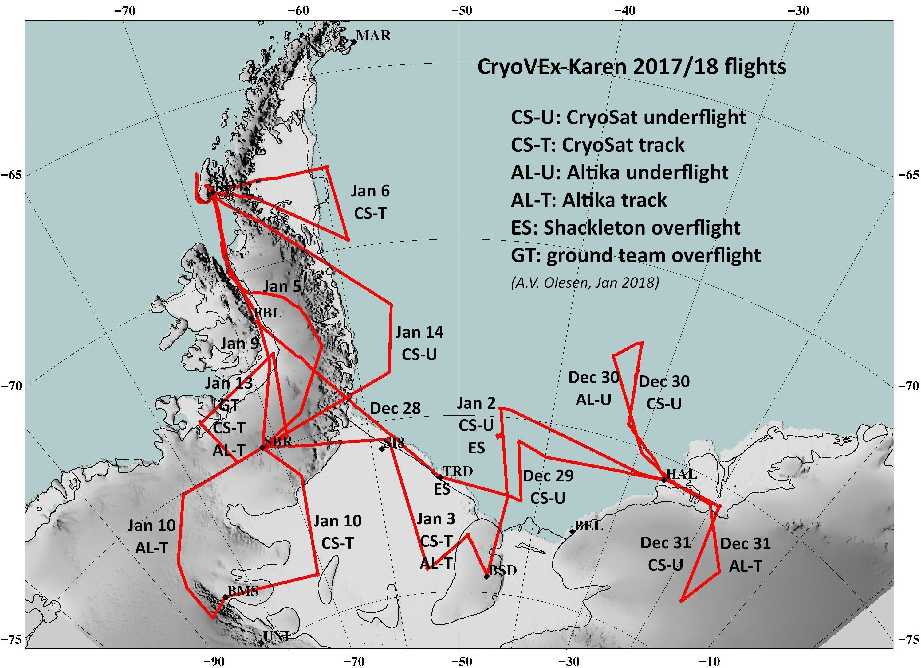
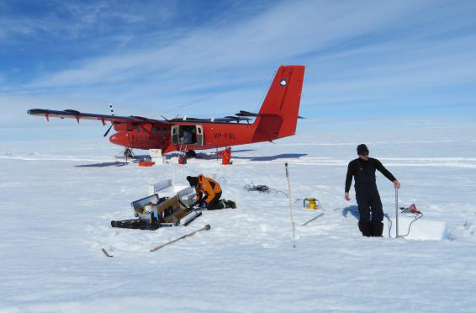
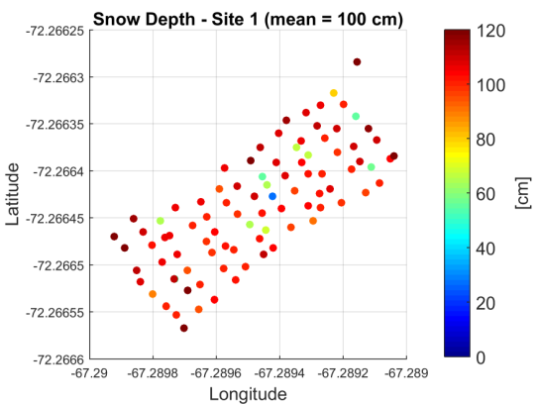
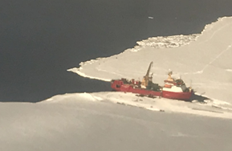
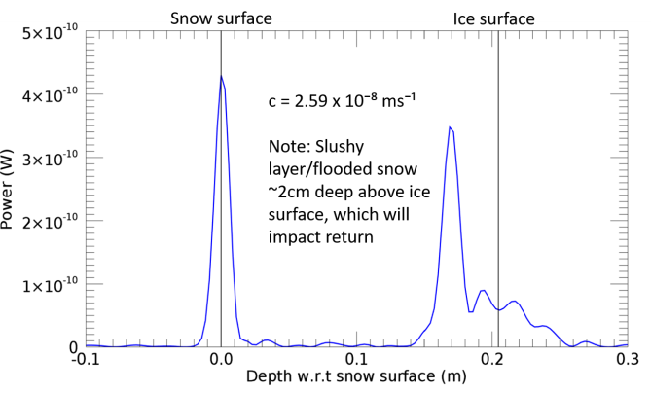
CryoVEx ANT 2017/18
Schackleton

Slide 16

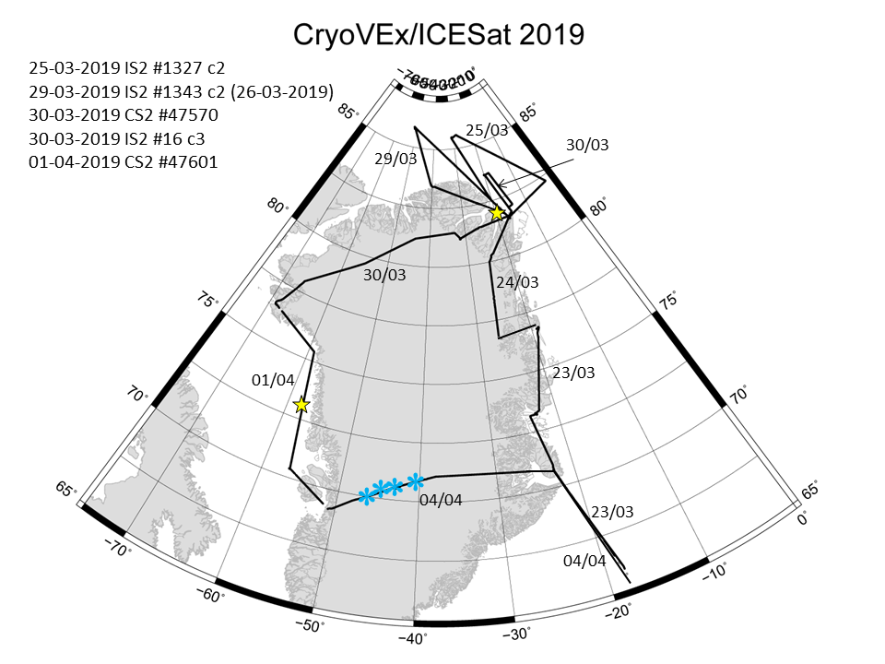
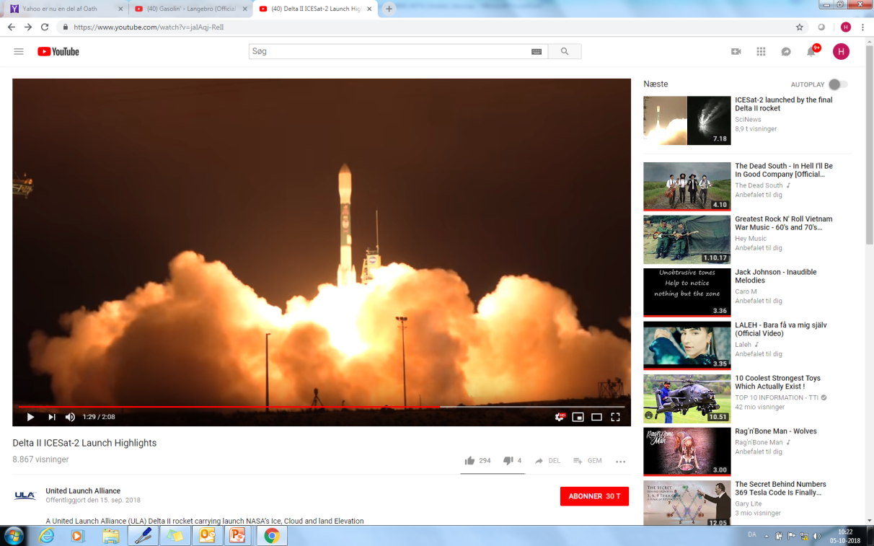
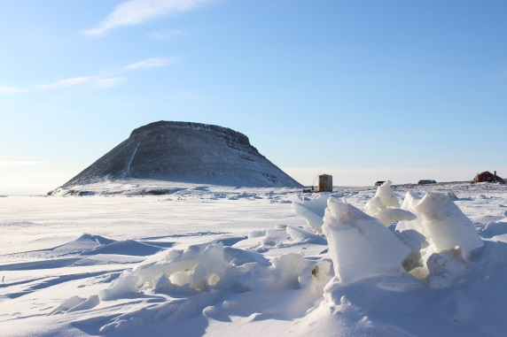
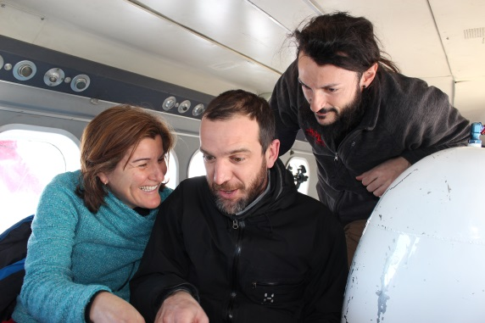
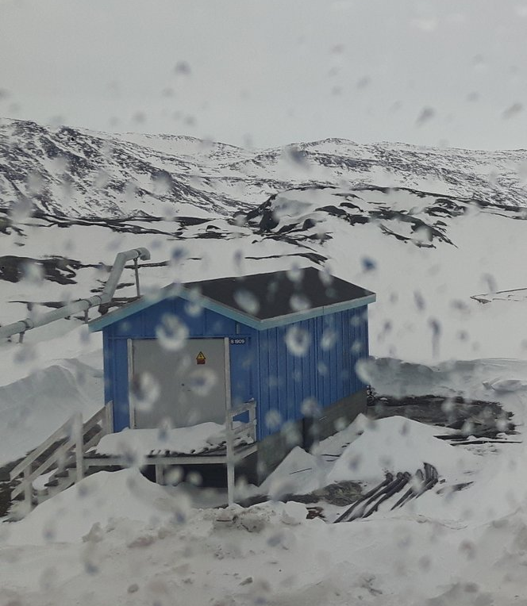
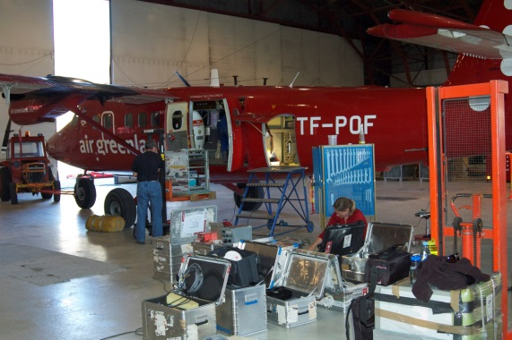
CryoVEx/ICESat-2 2019
15-09-18

Slide 17
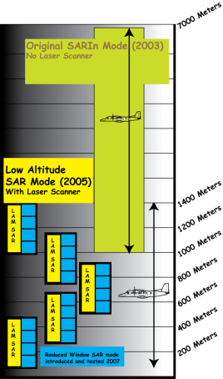

Radar operation modes (SAR/SARIn)
LASER
ASIRAS
KAREN
2500m
1000m
600m
0m

Slide 18
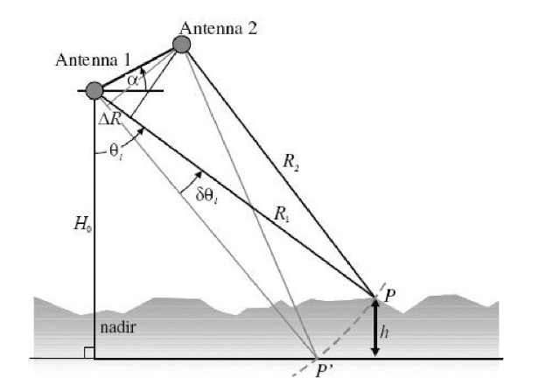
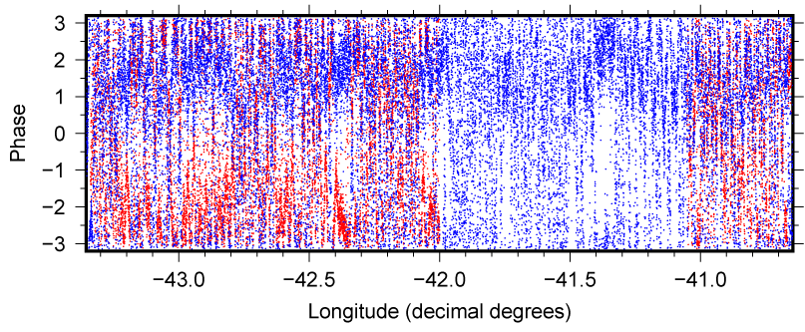

ASIRAS and KAREN - SARIn
October 2016
ASIRAS blue KAREN red

Slide 19
ASIRAS and KAREN - SARIn
Phase (rad) Blue: KAREN, Cyan: ASIRAS
Roll (degrees)
Time(seconds)
Phase depent on:
1st order... roll (motion of platform)
2nd order... surface tilt
3rd order... ????

Slide 20


Thank you !
AGU, Washington DC, DEC 10-14, 2018
Notes:
We also have to bear in mind that it is a very complex enviroment that we are trying to observe

Slide 21






Future Campaigns
2019 Summer: combination of fixed wing and drone North Greenland, test of new dual-frequency instrument (University of Kansas)
2020 Coordination with MOSAiC drift experiment Arctic Ocean
MOSAiC, AWI
The GreenLAnd Circumnavigation Expedition
(GLACE)

