Slide 1
Geomagnetic Field Modelling Using Multi-Mission Data Sets
Nils Olsen (DTU Space) with contributions from Tiku Ravat, Chris Finlay, Lars Tøffner-Clausen, Mike Purucker
Update on LCS-1 Lithospheric Field Model
Towards interpretation of LCS-1: estimation of depth-integrated magnetic susceptibility

Slide 2
LCS-1 Lithospheric Field Model Lithospheric Model from CHAMP and Swarm – Version 1
Swarm data (only Alpha and Charlie), Nov 2013 – Dec 2016 (3 years) CHAMP data, Oct 2006 – Sept 2010 (4 years)
Only “gradient” data (finite spatial differences)
NS-gradient approximated by along-track first differences of 15 sec data, CHAMP + Swarm
EW-gradient approximated by difference Swarm Alpha – Swarm Charlie (at same latitude)
Removal of CHAOS-6 core field (n=1-15) and large-scale magnetospheric field
Data misfit regularization: Robust (Tukey) weighting
Model regularization: Minimization of |Z | averaged over Earth’s surface (ellipsoid)
Model parameterization: 35 000 point sources at 100 km depth transformation to spherical harmonic expansion, formally up to degree n=185
Olsen et al, GJI, 2017

Slide 3
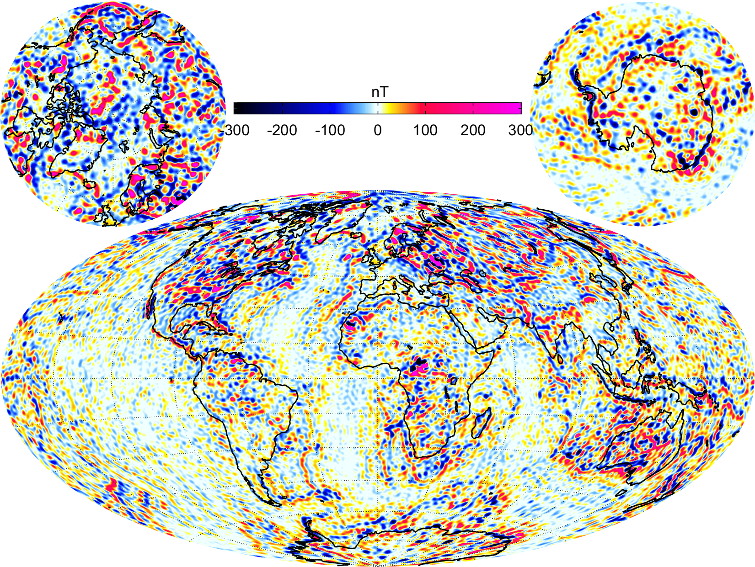
Z at Earth’s surface (ellipsoid)
Model regularization parameter α² = 3

Slide 4
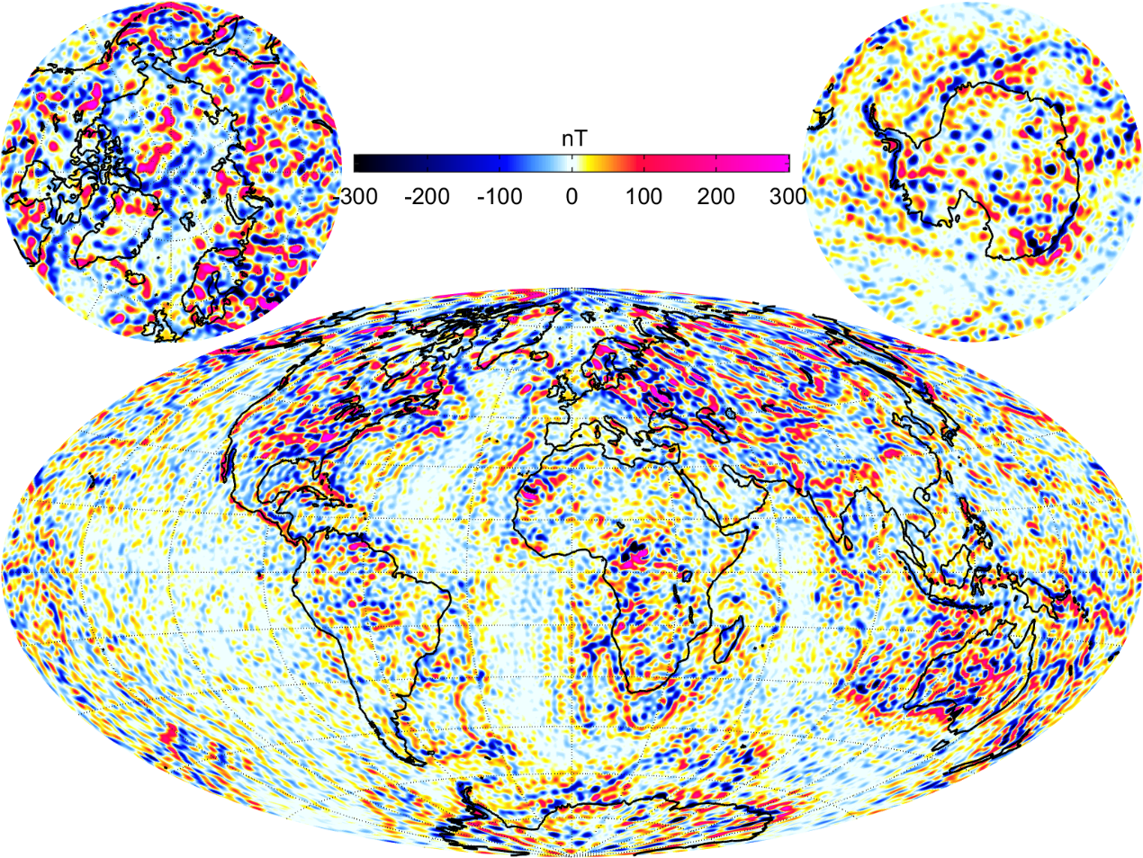
Adding 8 months Swarm data (Jan – Aug 2017)
α² = 3 (should be larger since more data are added)

Slide 5
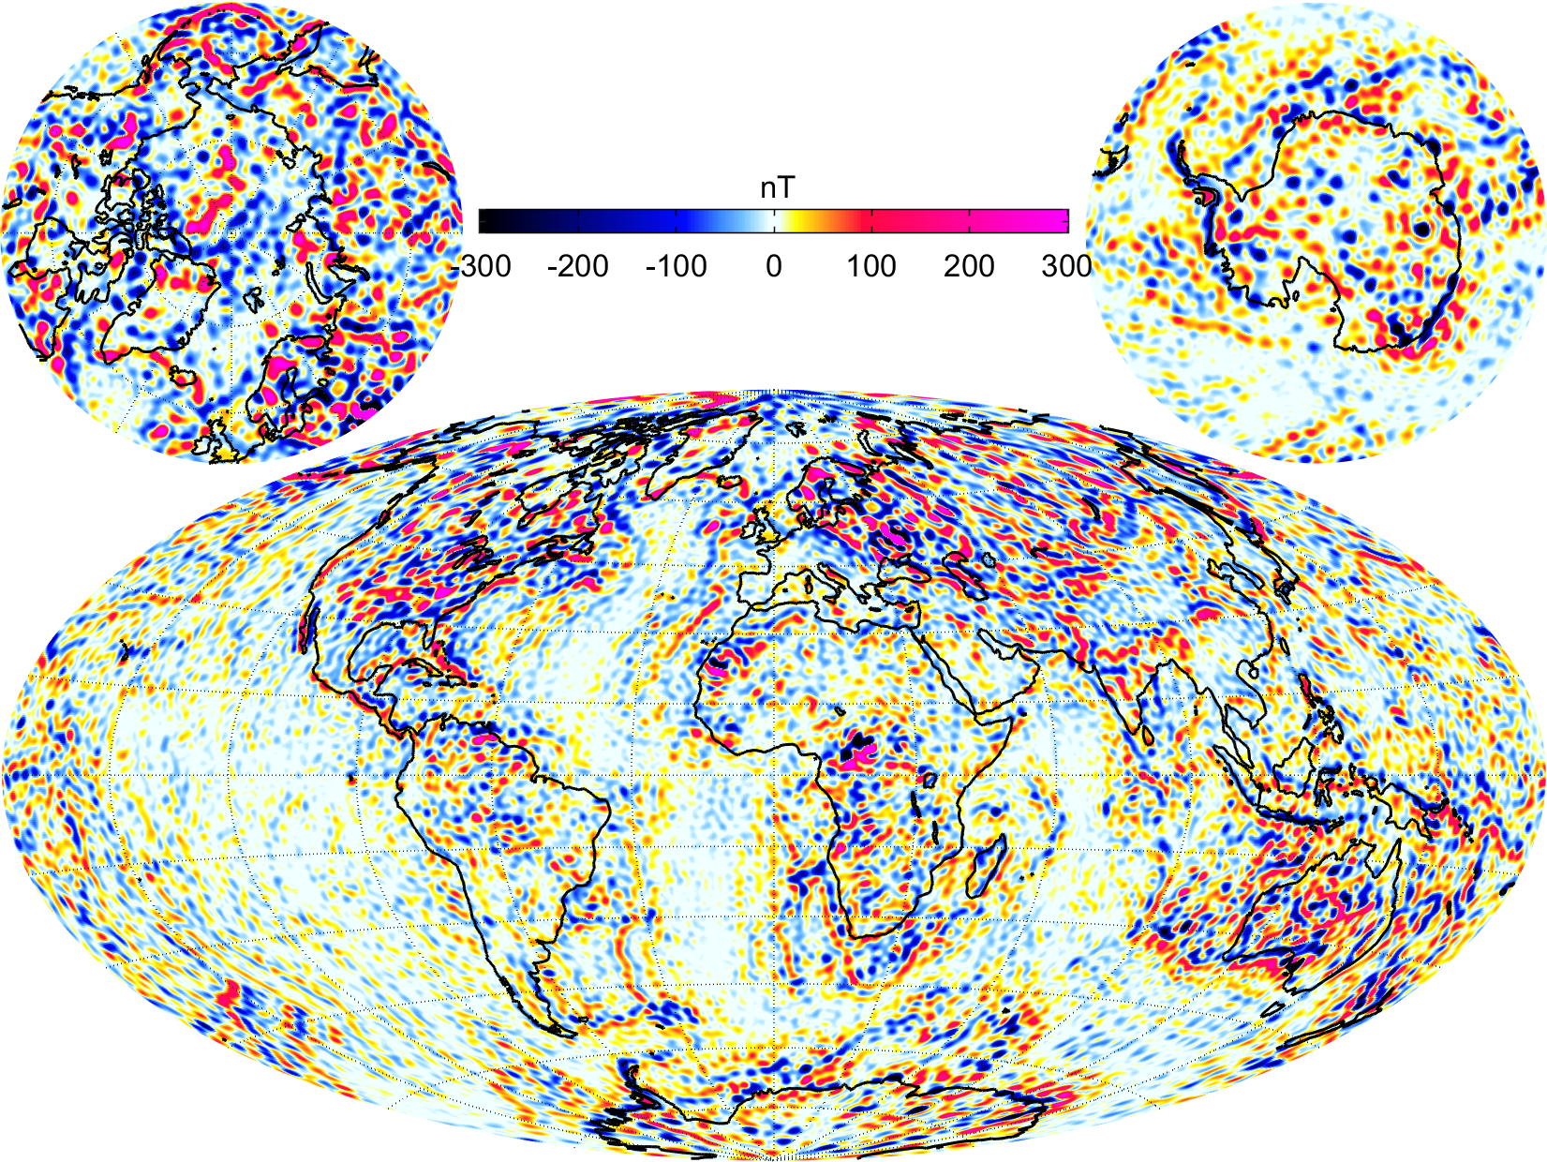
Adding 8 months Swarm data (Jan – Aug 2017)
Waiting for more Swarm data …
… obtained at lower altitudes
α² = 4

Slide 6
LCS-1 Lithospheric Field Model
Swarm data (only Alpha and Charlie), Nov 2013 – Dec 2016 (3 years) CHAMP data, Oct 2006 – Sept 2010 (4 years)
Only “gradient” data (finite spatial differences)
NS-gradient approximated by along-track first differences of 15 sec data, CHAMP + Swarm
EW-gradient approximated by difference Swarm Alpha – Swarm Charlie (at same latitude)
Removal of CHAOS-6 core field (n=1-15) and large-scale magnetospheric field
Data misfit regularization: Robust (Tukey) weighting
Model regularization: Minimization of |Z | averaged over Earth’s surface (ellipsoid)
Model parameterization: 35 000 point sources at 100 km depth transformation to spherical harmonic expansion, formally up to degree n=185
Alternative Model parameterization: spherical harmonics up to n=185, using same data set and model regularization
Olsen et al, GJI, 2017

Slide 7
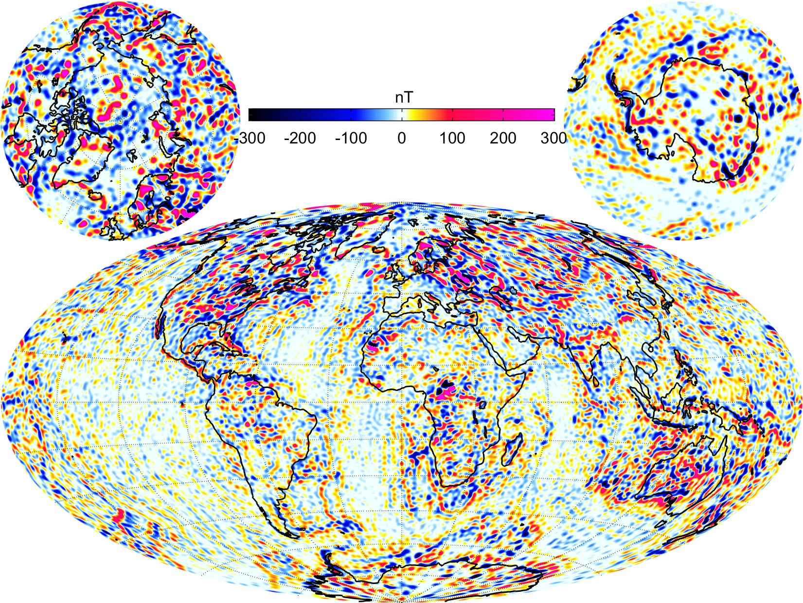
Z at Earth’s surface (ellipsoid)
Based on SH expansion α² = 3

Slide 8
Z at Earth’s surface (ellipsoid)
Based on point source expansion α² = 3

Slide 9
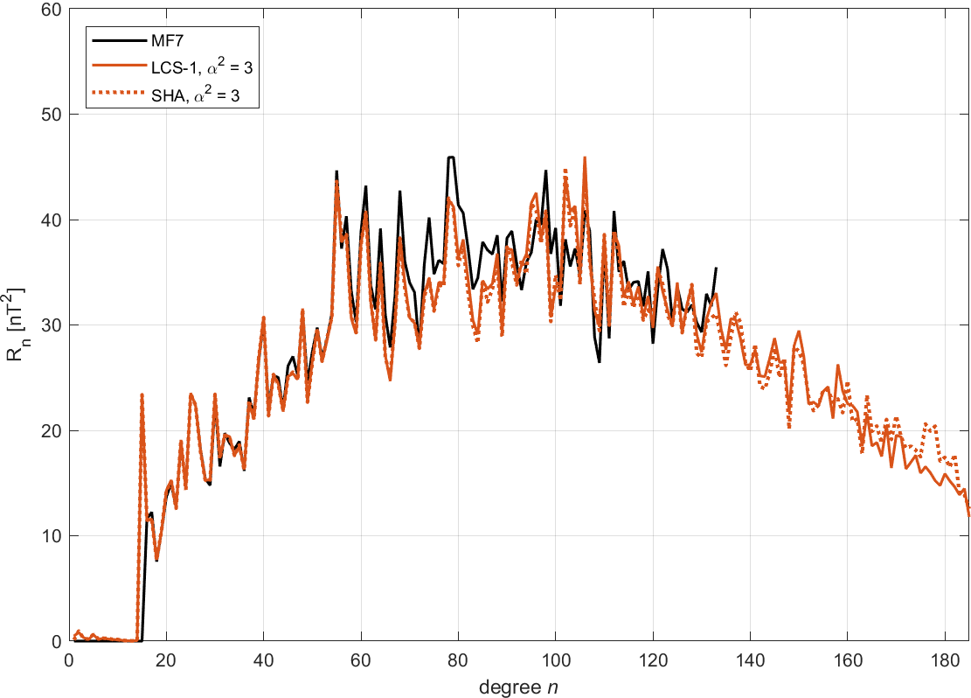
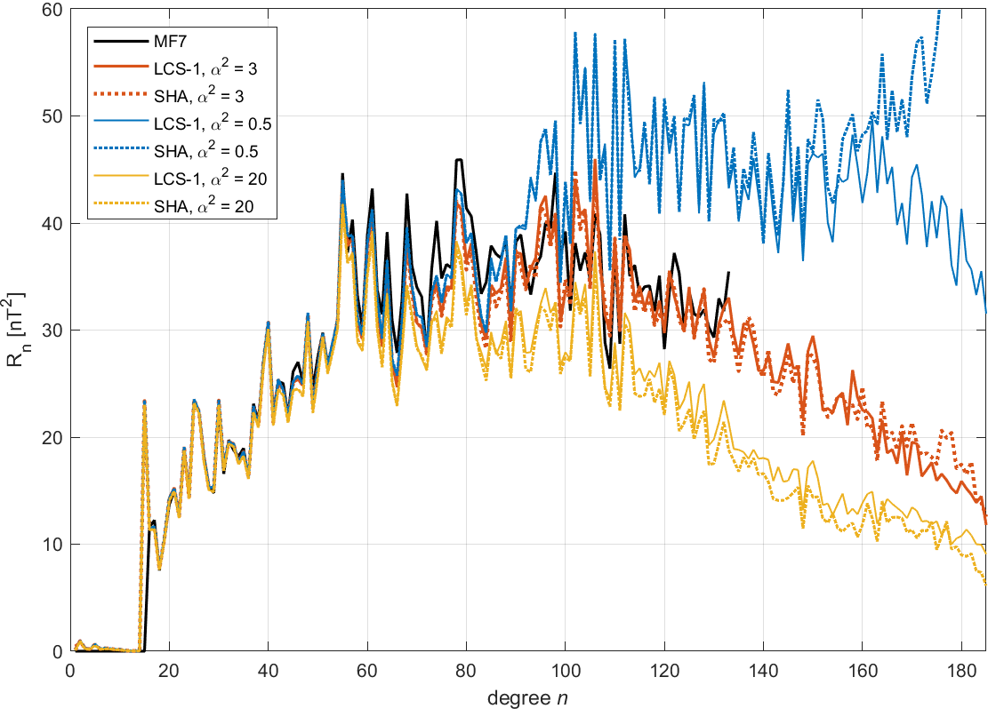
Spatial Powerspectra
Shape of spectra is determined by model regularization, not by choice of basis functions (point sources vs. spherical harmonics) - for “reasonable” values of regularization

Slide 10
Conclusions 1
LCS-1 lithospheric maps and powerspectra are determined by
Data selection (only “gradient data”) and robust data processing
model regularization (L1 regularisation of |Z |)
… but not by choice of basis functions (point sources vs. spherical harmonics)
Advantage of point source representation:
Faster accumulation of normal matrices for point sources (code optimization?)
Point sources allow for higher spatial resolution in regions with better data coverage (e.g. joint analysis of satellite and regional aeromagnetic data – not done for LCS-1 model)

Slide 11
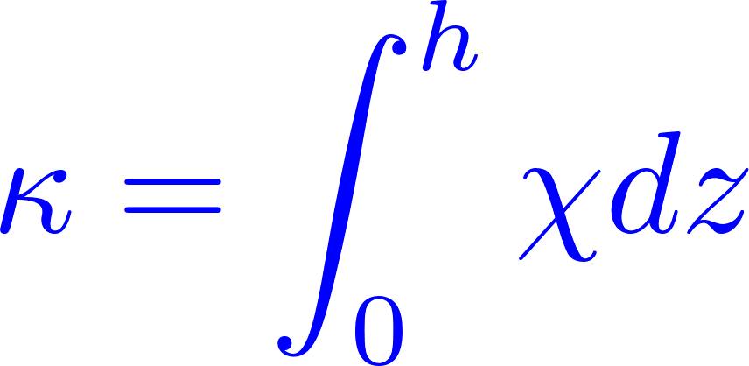
Outlook: Depth-integrated susceptibility (crustal thickness) constrained by LCS-1
Depth integrated susceptibility
Inducing magnetic field B₀ (given by CHAOS-6 core field model)
Linear relationship between Gauss coefficients g of lithospheric field caused by induced magnetization and depth-integrated susceptibility (at global equal-area grid):
Crustal thickness h from model crust1.0 (Laske et al)
A-priori value of magnetic susceptibility χ = 0.04 SI (assumed to be constant)

Slide 12
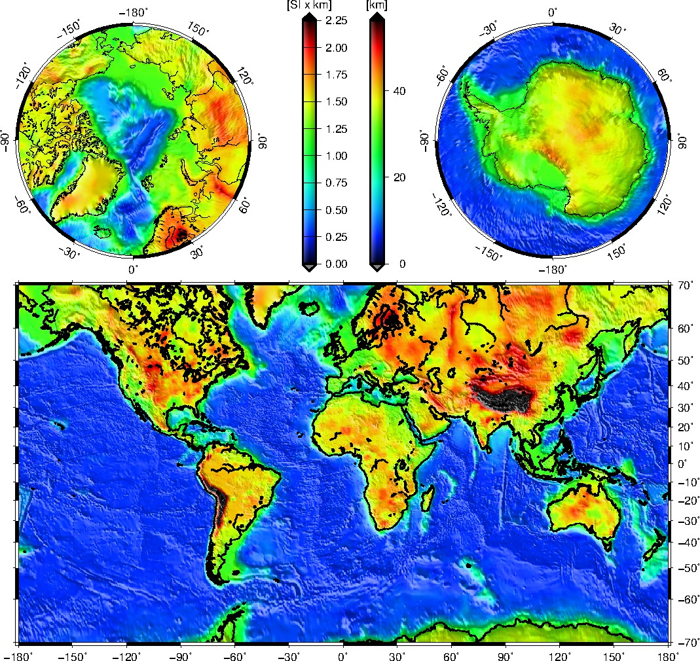
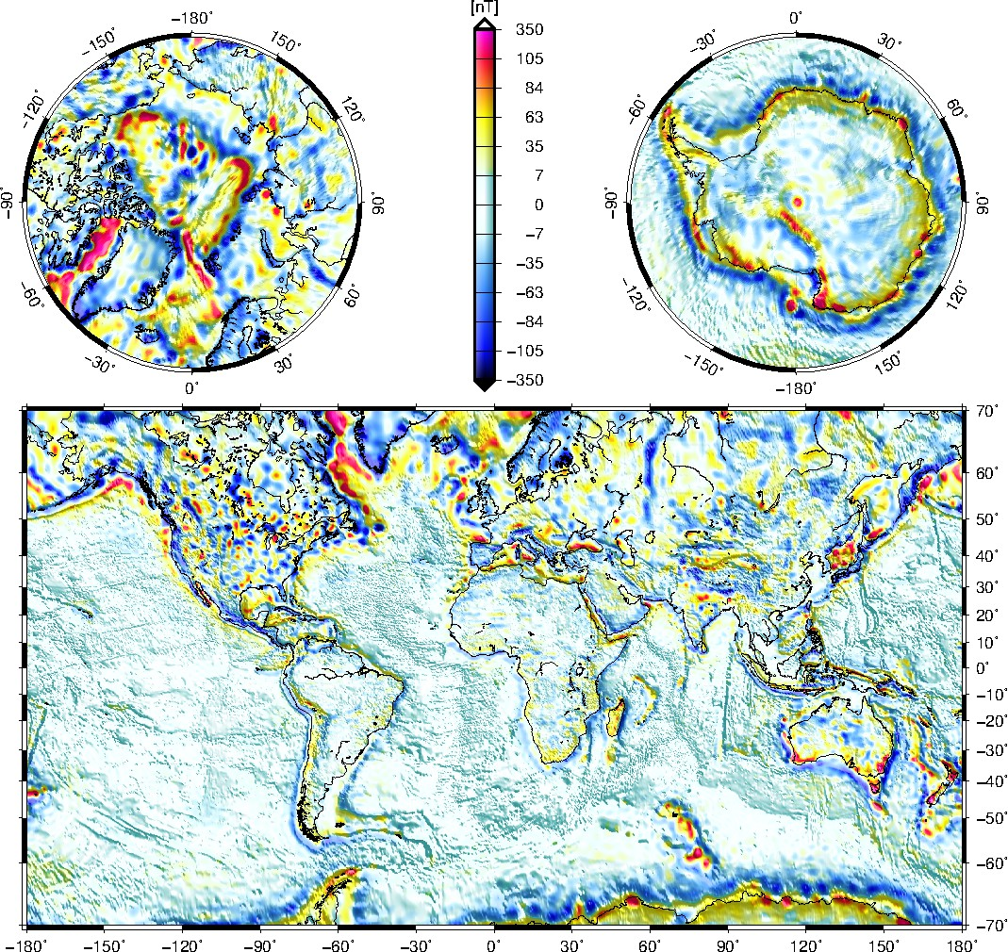
Depth-integrated susceptibility from crust1.0
Resulting magnetic field B_{r} at surface

Slide 13
Solving the inverse problem
Forward problem
Inverse problem with “generalized matrix inverse” G^{–g}
Without additional information this is an unsolvable problem due to existence of “annihilators” (distribution of κ that do not produce any magnetic field) e.g. a spherical shell of constant κ (Runcorn’s theorem)
A-priori information is needed, e.g. from crust1.0
Estimation of depth-integrated susceptibility κ by constrained Least-Squares inversion of LCS-1 Gauss coefficients for SH degrees n = 16 - 160 regularization parameter α², a-priori solution κ₀

Slide 14
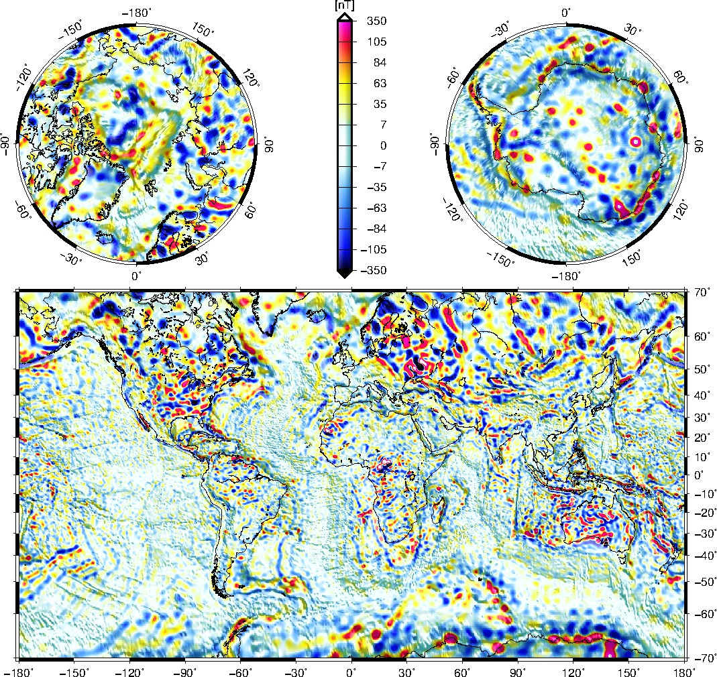
B_{r} at surface (n=16 – 160)
_{r}
LCS-1

Slide 15
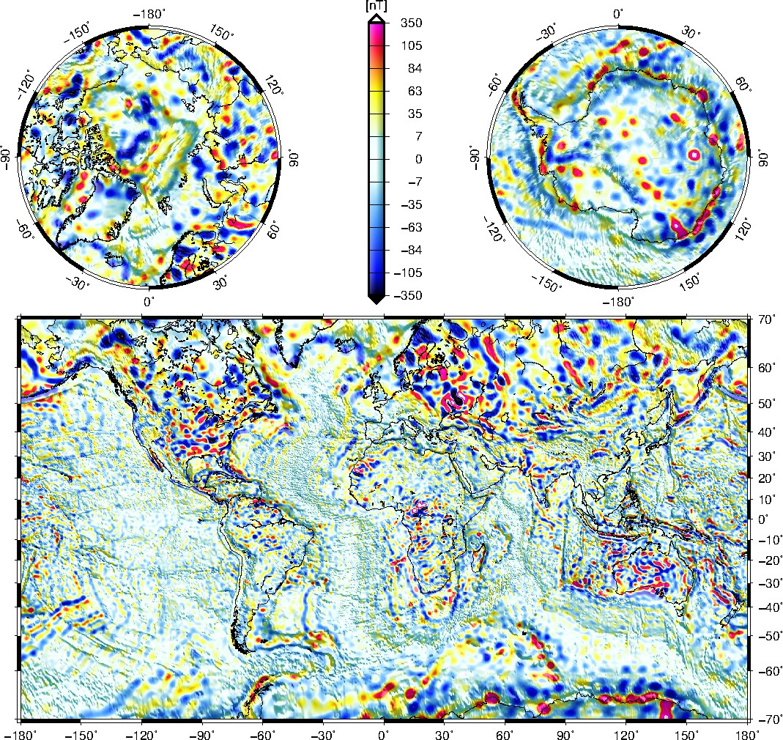
B_{r} at surface (n=16 – 160)
_{r}
… as predicted by “optimized” model of κ

Slide 16
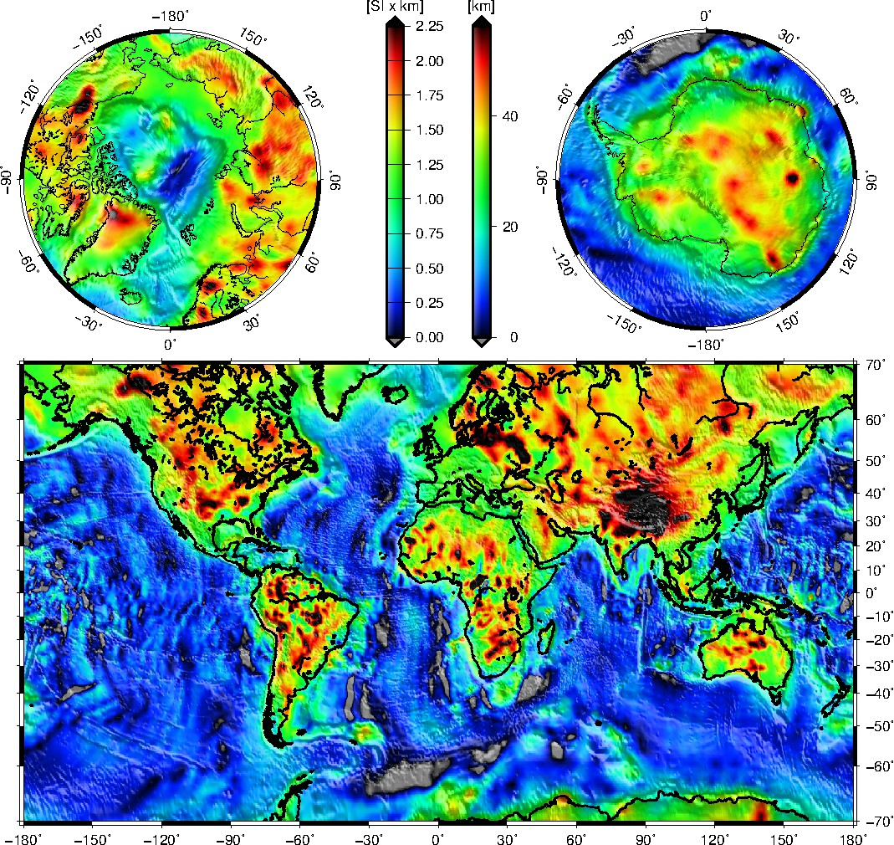
Depth-integrated susceptibility from LCS-1 and crust1.0
- the “optimized” model of κ
Note: this model is only valid in regions where induced magnetization dominates remnant magnetisation

Slide 17
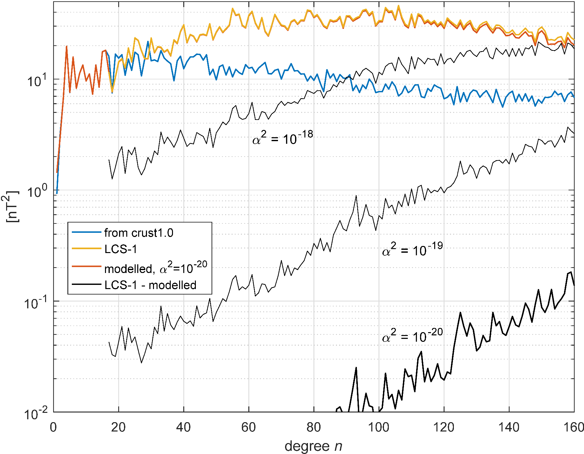
Spectral powerspectra

Slide 18
Conclusions
LCS-1 lithospheric maps and powerspectra are determined by
Data selection (only “gradient data”) and robust data processing
model regularization (L1 regularisation of |Z |)
… but not by choice of basis functions (point sources vs. spherical harmonics)
New method to determine depth-integrated susceptibility from Gauss coefficients of lithospheric field model and a-priori information
Model of depth-integrated susceptibility derived which explains > 99% of LCS-1 spatial power (Note: this model is only valid in regions where induced magnetization dominates)

