Slide 1
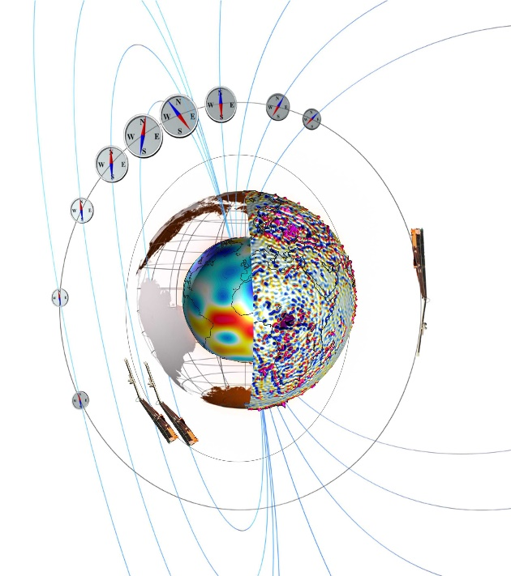
Satellites in support of “Internal Field” Swarm Science GRACE platform magnetometer data and lithospheric field modelling using proposed EOP Daedalus satellite
Nils Olsen (DTU Space, Denmark) with help from many experts
CryoSat-2, GRACE and GRACE-FO
Lithospheric field determination using ultra-low elliptical satellite orbits: the Daedalus mission

Slide 2
“Platform” Magnetometer Data from past and present satellites in support of Swarm
CryoSat-2 (since 2010) 3 magnetometers, 4 sec sampling Olsen et al., Magnetic observations from CryoSat-2: Calibration and processing of satellite platform magnetometer data, Earth Planets Space, 2020, doi:10.1186/s40623-020-01171-9 daily CDF files in “Swarm-like format” available at ftp://swarm-diss.eo.esa.int/#CryoSat-2/
GRACE ( < 2008 – 2017) 2 satellites each with 1 magnetometer, 1 sec sampling (since 2008) Olsen, submitted to Earth Planets Space preliminary daily CDF files available at ftp://ftp.spacecenter.dk/data/magnetic-satellites/GRACE/
GRACE-FO (since 2018) 2 satellites each with 1 magnetometer, 1 sec sampling Stolle et al., submitted to Earth Planets Space daily CDF files available at ftp://isdcftp.gfz-potsdam.de/grace-fo/MAGNETIC_FIELD/

Slide 3
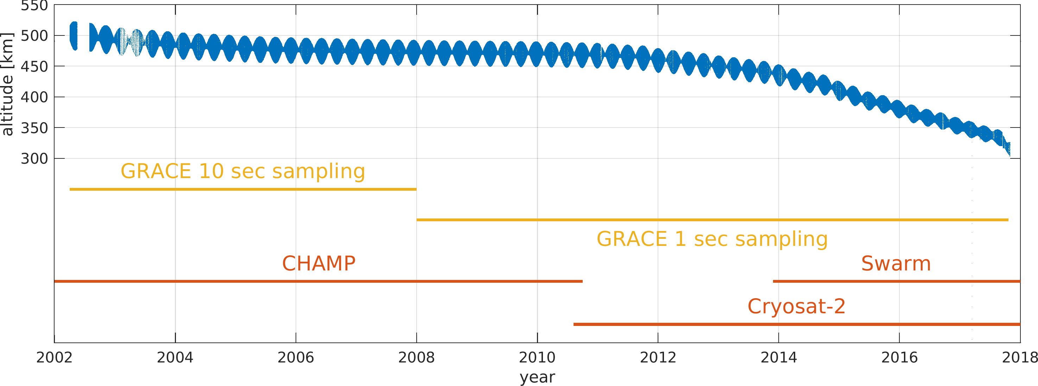
Why GRACE ?
+ 2 years overlap before and after CHAMP/Swarm data gap
12 bit magnetometer, 26 nT quantisation steps (7.5 nT rms quantisation noise)
very large (> 1000 nT) magnetorquer disturbance
presently no HK data (solar array and battery currents, temperatures …) available

Slide 4
Calibration steps
118 months (Jan 2008 – Oct 2017)
12 “classical” calibrations parameters (3 offsets, 3 scale values, 3 non-orthogonalities, 3 Euler angles) estimated in monthly bins 118 x 12 = 1416 parameters
weak regularisation of month-to-month variation
“common parameters” (assumed to be valid for whole mission) 3 x 3 matrix of magnetorquer magnetic signature: 9 parameters magnetometer non-linearities and sensor cross-talk: 48 parameters
Total of 1473 model parameters estimated by robust inversion by minimizing average of where B_{mod,CRF} is given by CHAOS-7 model

Slide 5
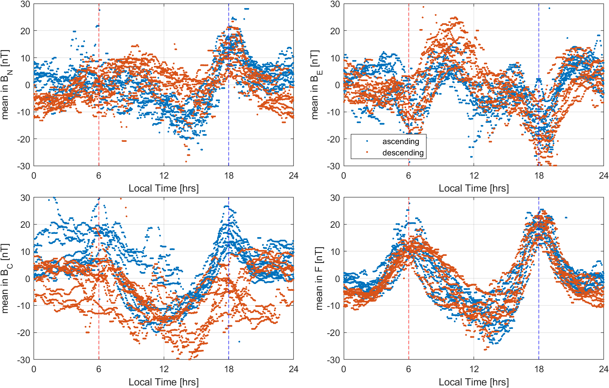
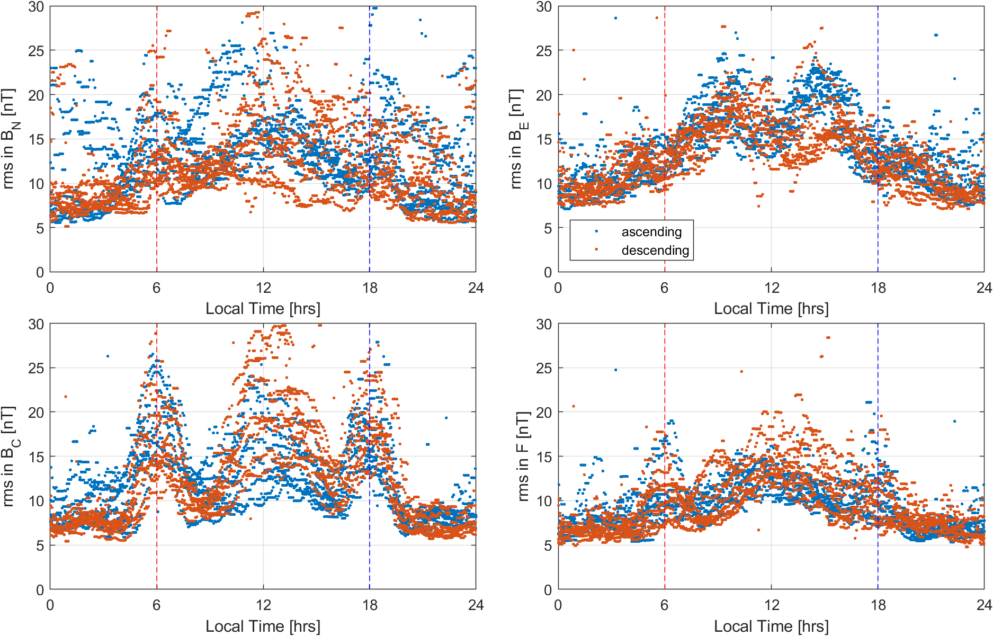
Daily mean and rms misfit in dependence on Local Time
daily mean values
daily rms misfit values
Magnetic disturbance of solar arrays / batteries ? since also in ΔF
Bending of boom since mainly in ΔB but weaker in ΔF

Slide 6
GRACE-A magnetic residuals
10 – 19 August 2010 removal of CHAOS-7 model

Slide 7
Lithospheric field determination using ultra-low elliptical satellite orbits The Daedalus satellite mission

Slide 8
Daedalus – one of 3 ESA EE-10 candidate missions in Phase 0
Main science goal: to investigate physical processes in the lower thermosphere and ionosphere (“ignorosphere”) e.g. “Joule heating” and related space-weather phenomena
In-situ measurements at low altitudes – never done before!
Highly elliptical orbit 140 x 1500 km (threshold), down to 120 km (target)
Suite of instruments including (absolute) magnetometers
Presently in Phase-0, ready for Phase-A (decision at end of November 2020)

Slide 9
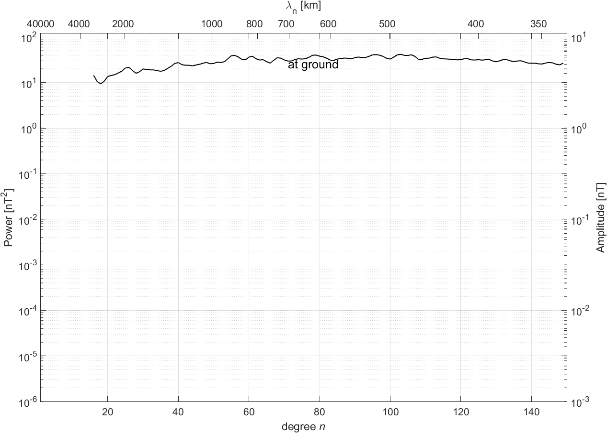
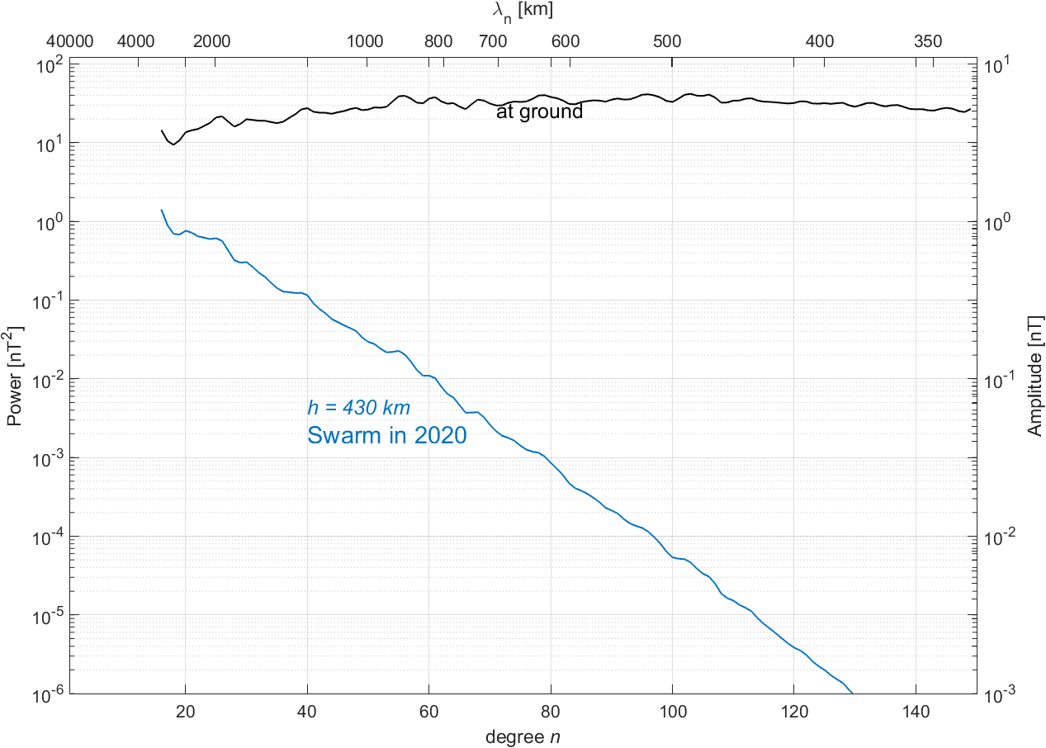
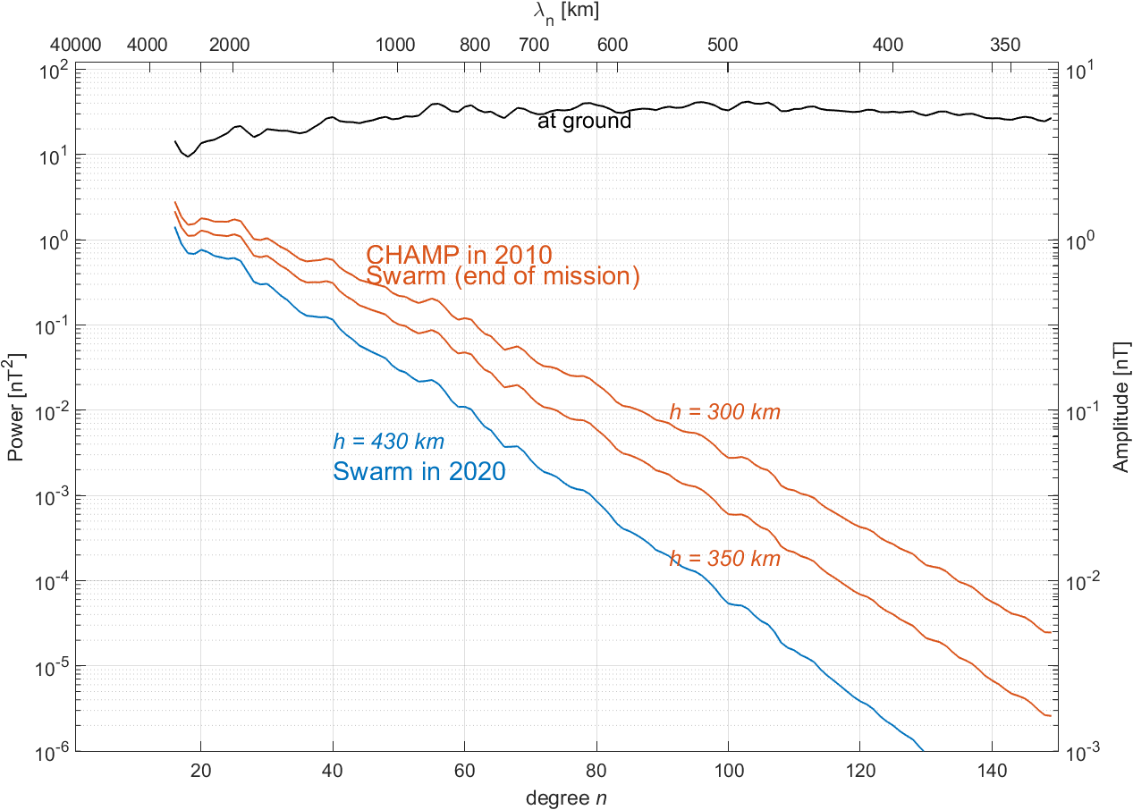
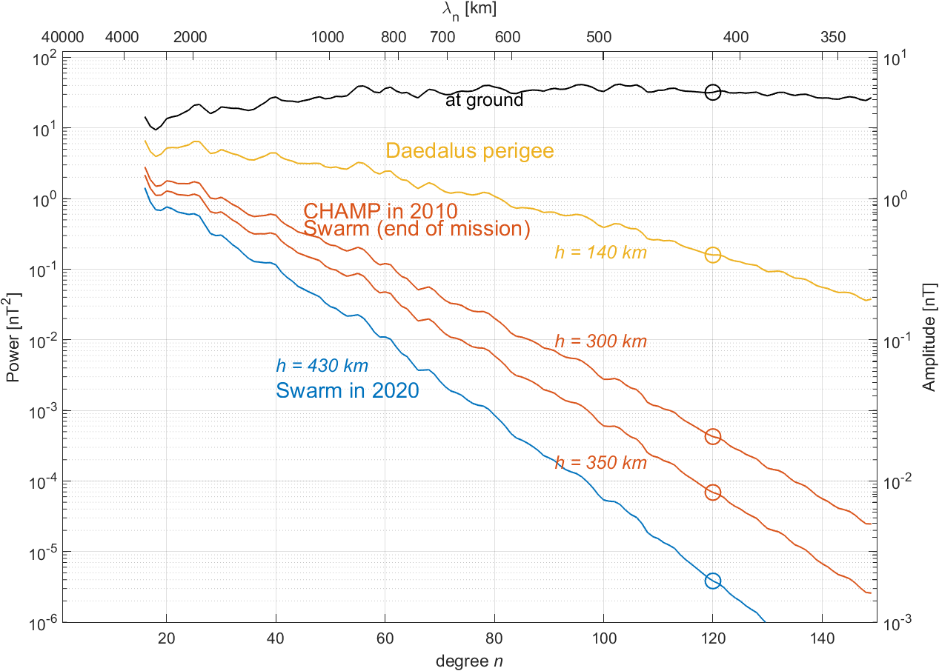
Lithospheric Magnetic Signature at Various Altitudes
Rule of thumb:
Detection of magnetic structure of spatial size h requires observations from distances < h
Lithospheric field power at SH degree n = 120 ( = 420 km horizontal scale) is 500 times stronger at 140 km altitude compared to 300 km altitude (end of Swarm mission), and 10⁵ times stronger as presently seen by Swarm

Slide 10
Daedalus – one of 3 ESA EE-10 candidate missions in Phase 0
Main science goal: to investigate physical processes in the “ignorosphere” e.g. “Joule heating” and related space-weather phenomena
Highly elliptical orbit 140 x 1500 km (threshold), down to 120 km (target)
Suite of instruments including magnetometers
Can low-altitude magnetic data be used for determining the lithospheric field?
Sensitivity Analysis:
Simulated 140 x 1500 km orbits for one year, 15 s sampling rate
Compare 140 x 1500 km elliptical Daedalus orbit with 300 x 350 km “circular” reference orbit
Mission sensitivity analysis: determine error (variance) of Gauss coefficients

Slide 11
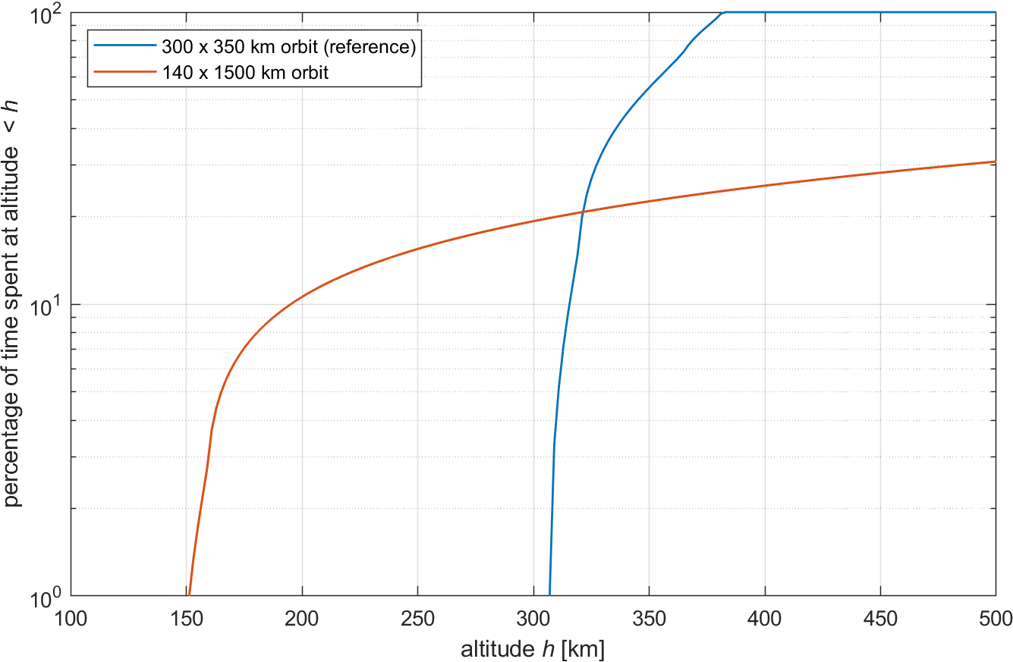
Altitude distribution of simulated Daedalus orbits
15 % of time at altitudes < 250 km
11 % of time at altitudes < 200 km

Slide 12
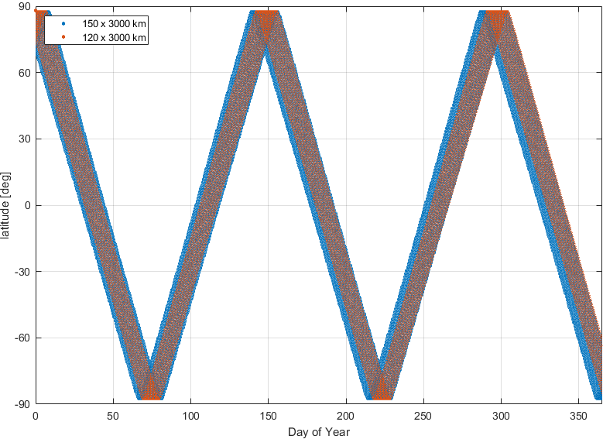
Latitude of perigee
Daedalus will provide low-altitude data of global coverage within its mission lifetime
Allows for lithospheric field modelling (static!)

Slide 13
From magnetic field measurement to global model
Magnetic measurements collected in data vector d (millions of data …)
Gauss coefficients collected in model vector m (a few thousand numbers)
Linear relationship between model and data … allows to estimate model (Gauss coefficients) from magnetic measurements
data vector d model vector m
data kernel matrix G

Slide 14
From magnetic field measurement to global model
Magnetic measurements collected in data vector d (millions of data …)
Gauss coefficients collected in model vector m (a few thousand numbers)
Linear relationship between model and data … allows to estimate model (Gauss coefficients) from magnetic measurements
No data, no model (obviously …)
But: model uncertainty (error) can be estimated without actual data Requires knowledge about data uncertainty (error)
data vector d model vector m
data kernel matrix G

Slide 15
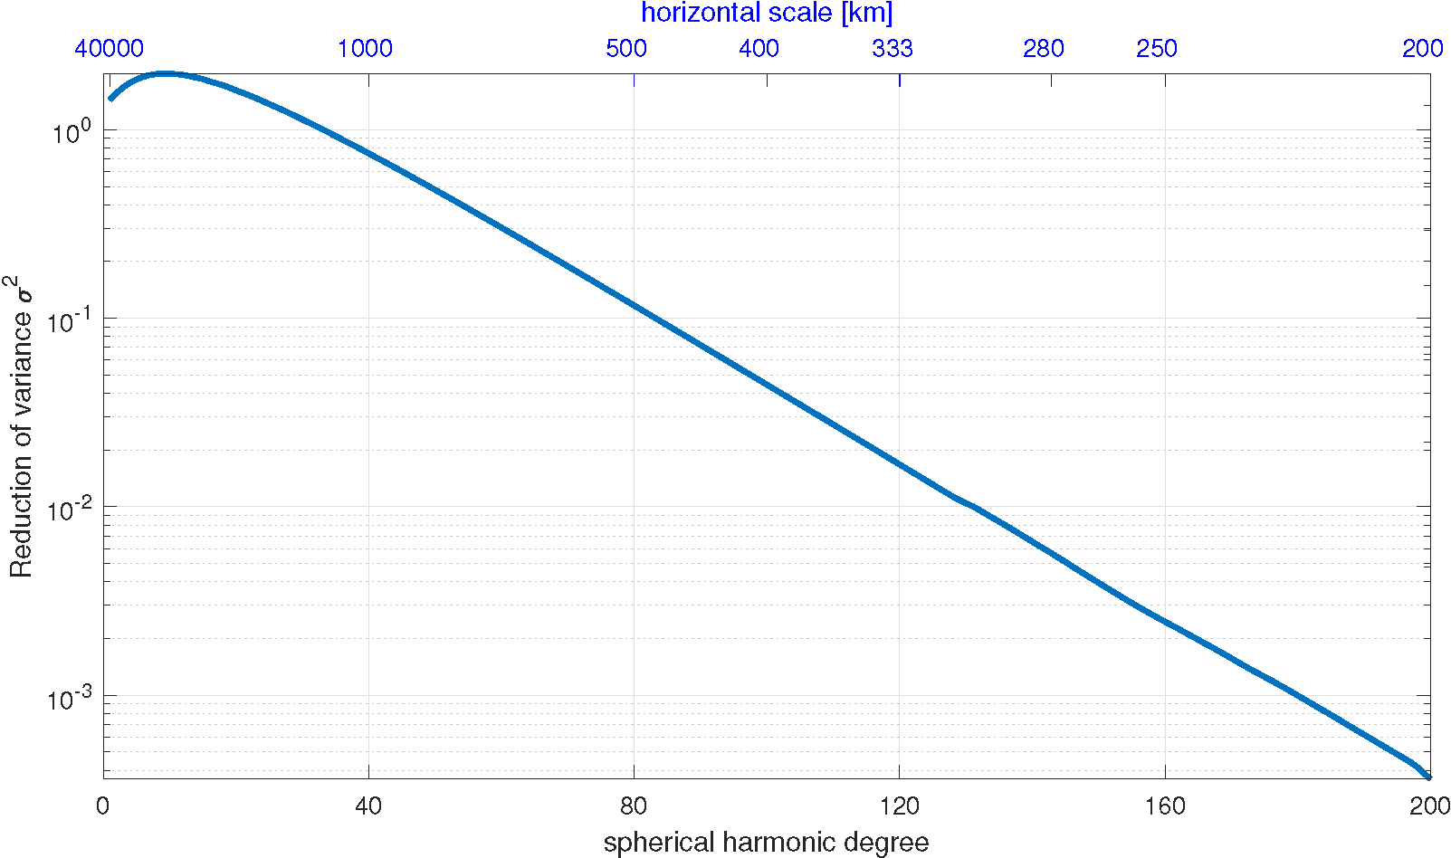
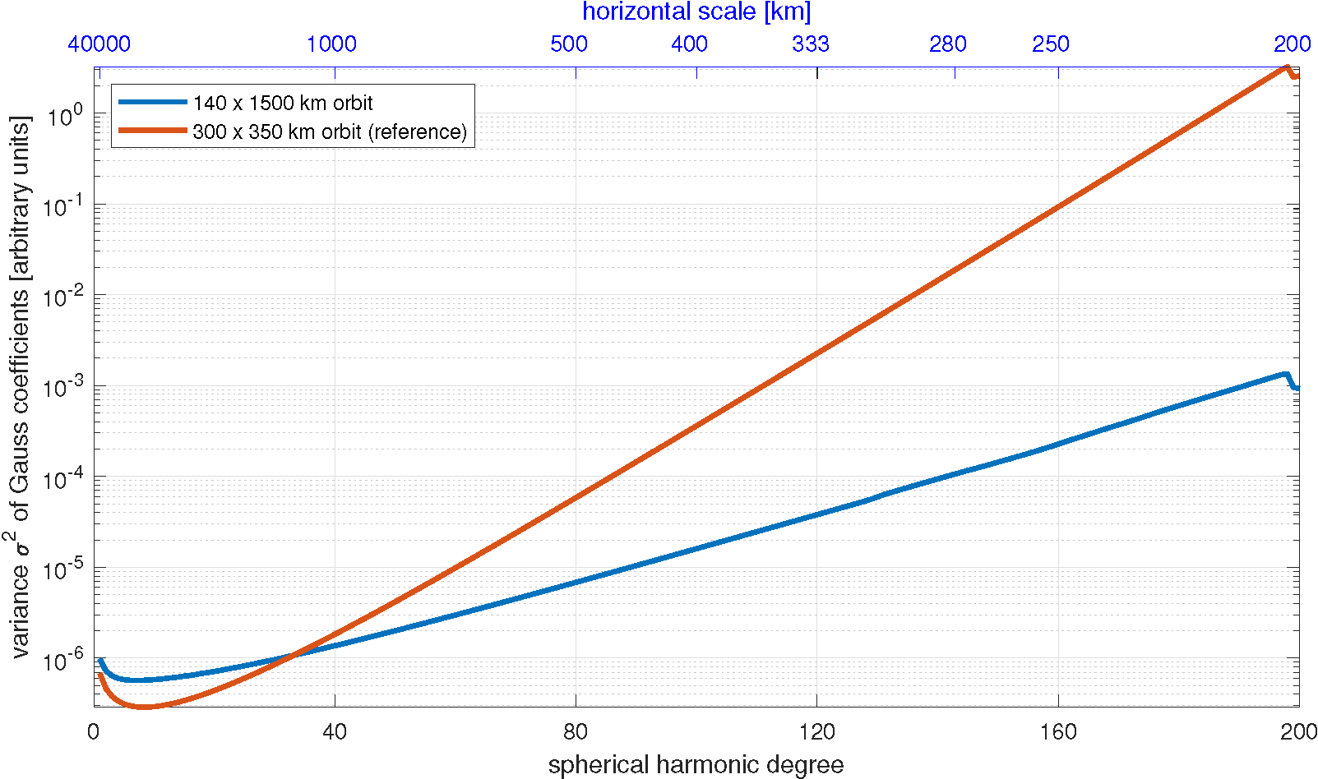
Variances of Gauss coefficients
data vector d model vector m
data kernel matrix G
model covariance matrix
data covariance matrix C_{d} = σ₀² I measurement error σ₀
1000 times smaller variance at n = 180 when using data from elliptical Daedalus orbit compared to circular 350 km reference orbit

Slide 16
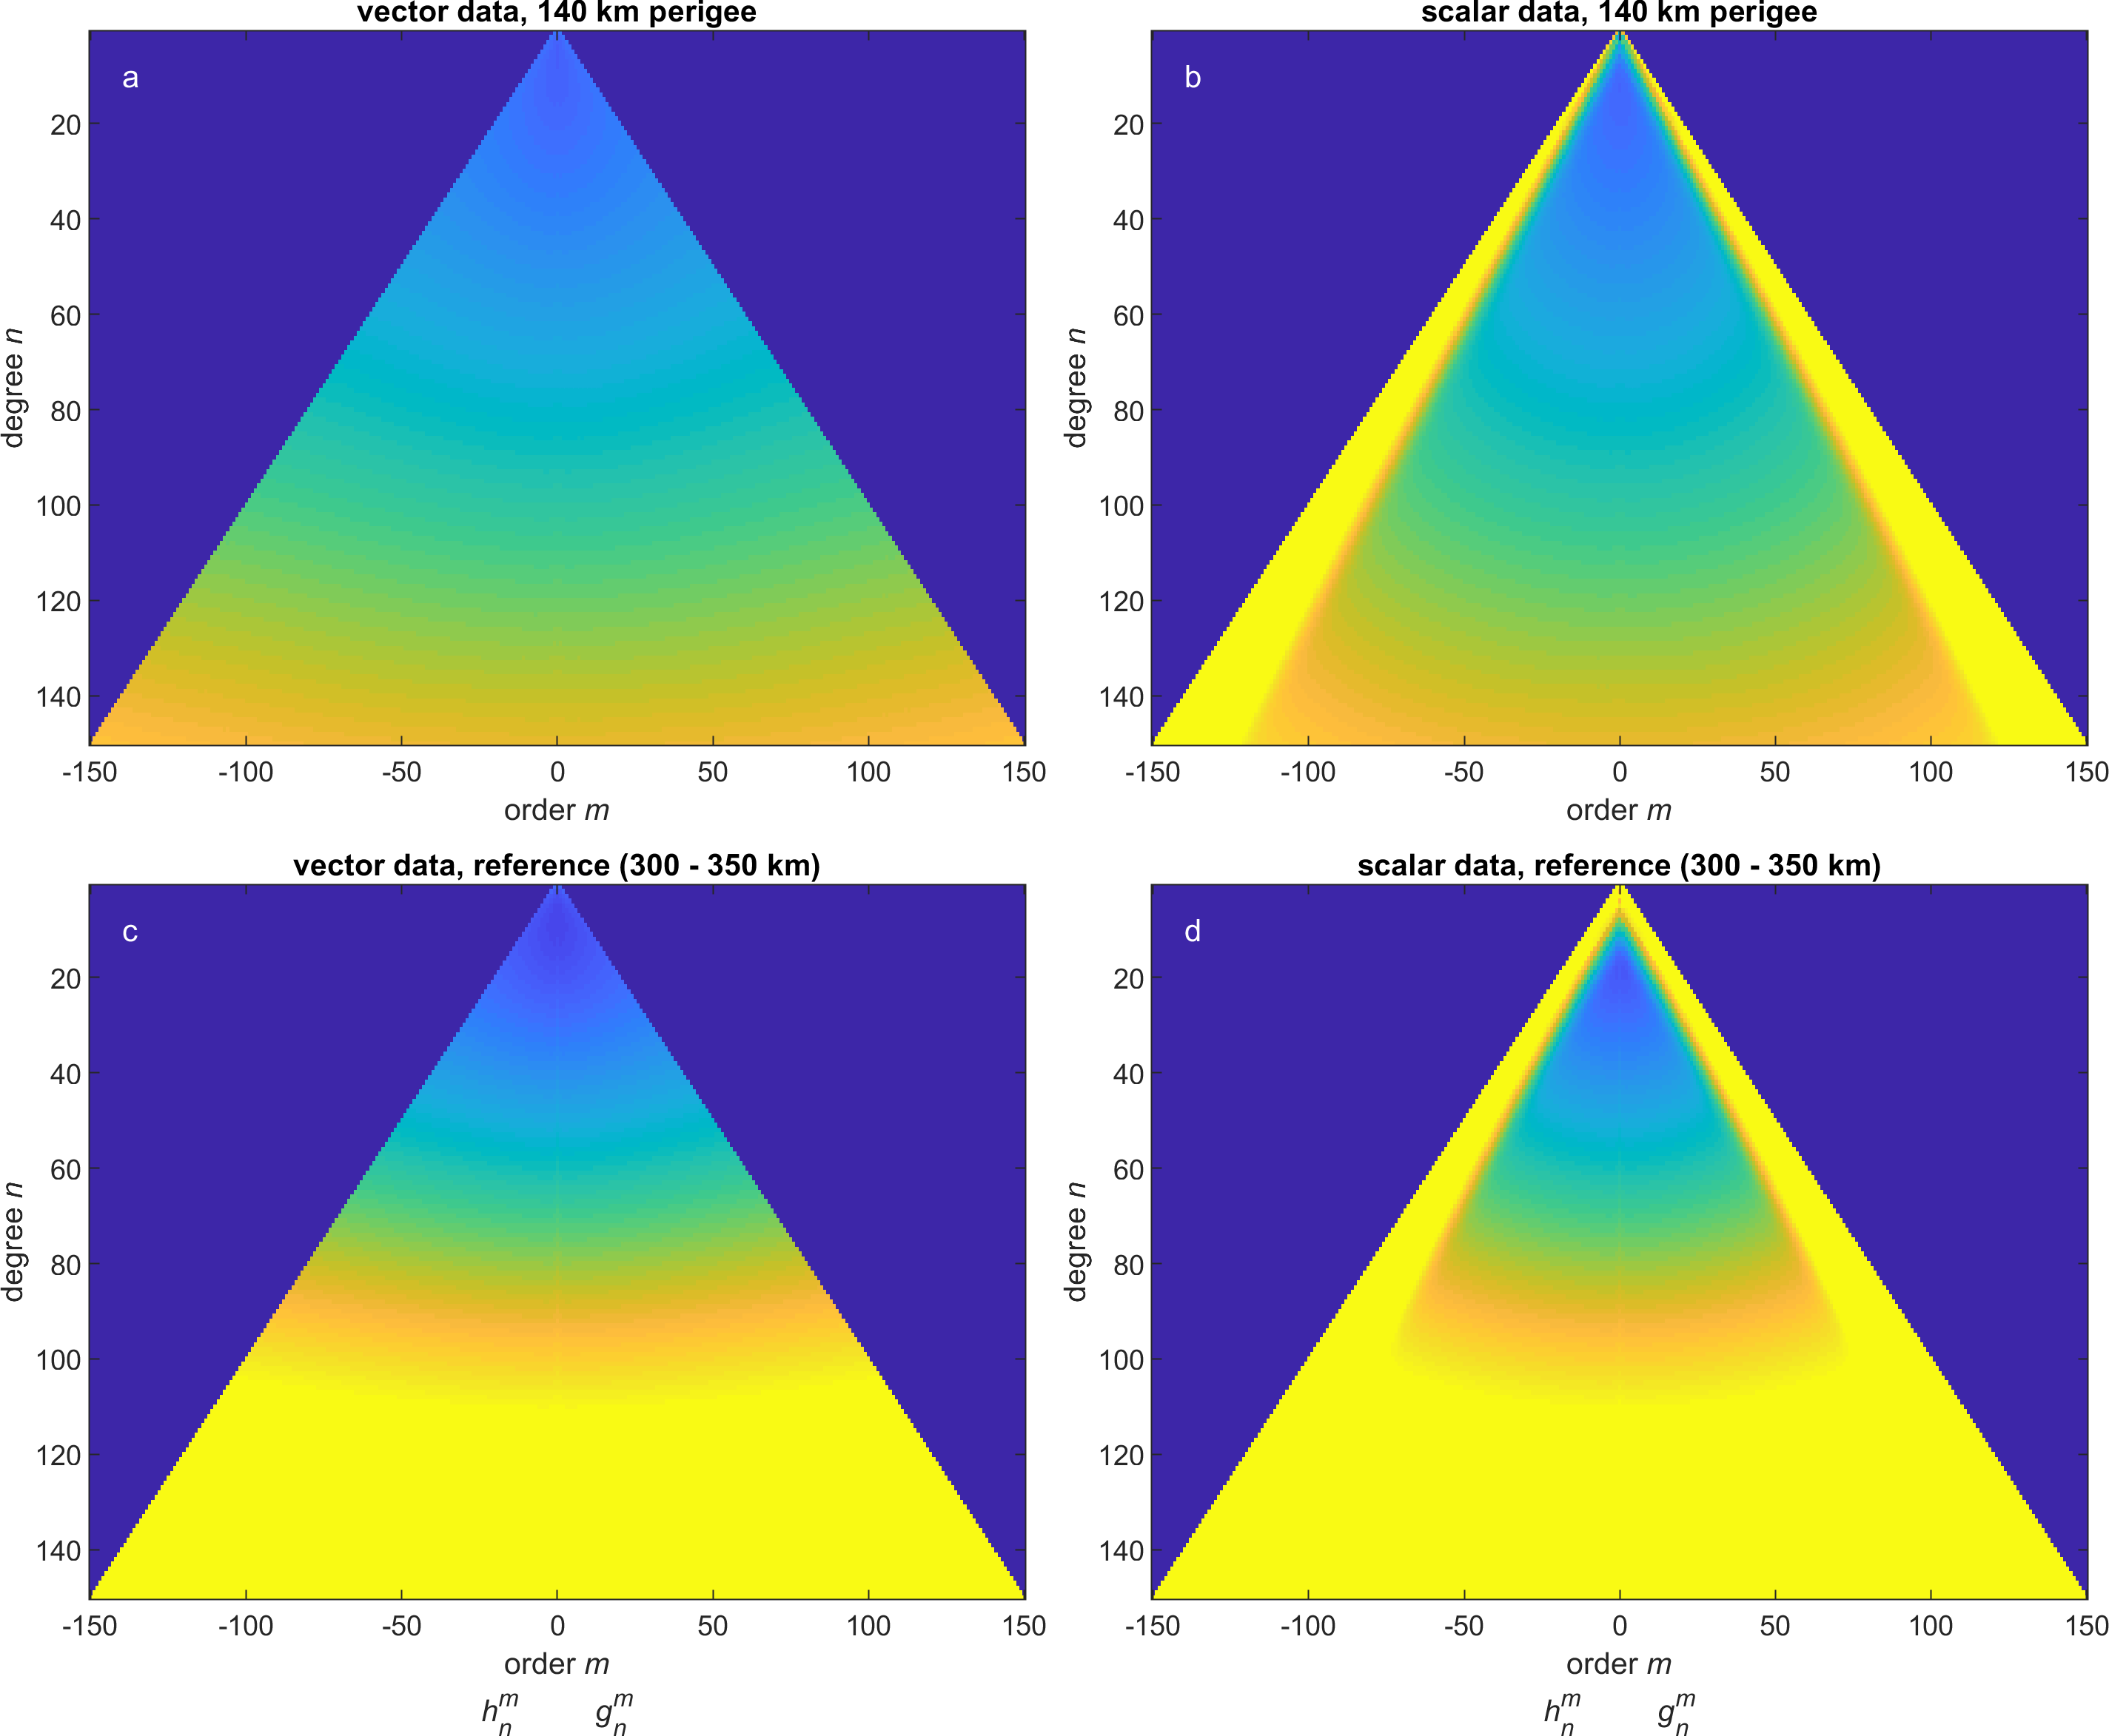
Variances of Gauss coefficients
data vector d model vector m
data kernel matrix G
model covariance matrix C_{m}
data covariance matrix C_{d} = σ₀² I measurement error σ₀

Slide 17
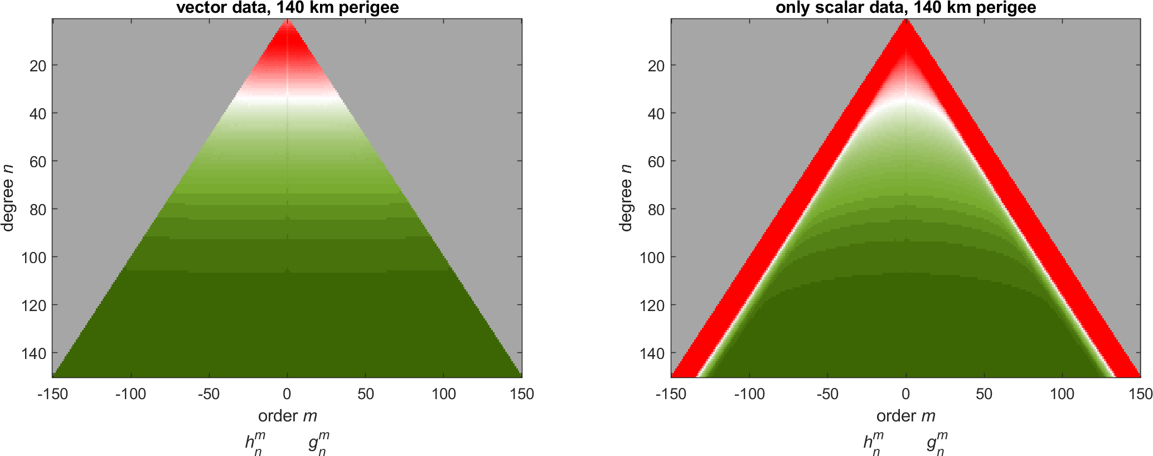
Improvement of elliptical vs reference orbit

Slide 18
Conclusions
What next? After Swarm? Or in parallel with remaining Swarm mission? Macau-satellite NanoMagsat (ESA Scout mission in Phase A)
Daedalus …
Only 10% of time at low altitudes (elliptical orbit) but 1000 better resolution of high-degree crustal field compared to Swarm + CHAMP (provided that Daedalus can provide magnetic data of same quality than Swarm …)

