Slide 1
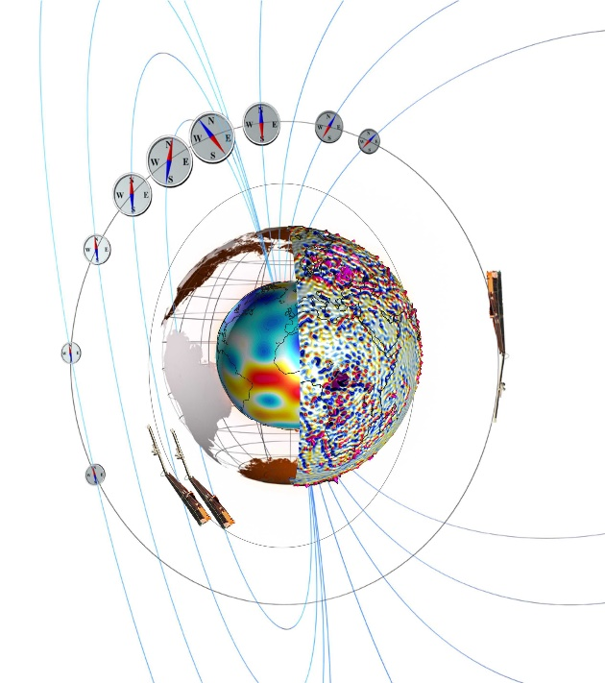
Towards a true Swarm of Magnetic Satellites -
Scientific use of measurements taken by navigational magnetometers onboard Low-Earth orbiting satellites
Nils Olsen
DTU Space – Technical University of Denmark / DK
Satellites for measuring Earth’s magnetic field
On magnetometer data calibration
Successful examples: Cryosat-2, GRACE, GRACE-FO*
Less successful examples: GOCE, Aeolus
Some scientific applications
*GRACE-FO calibration done by GFZ Potsdam

Slide 2
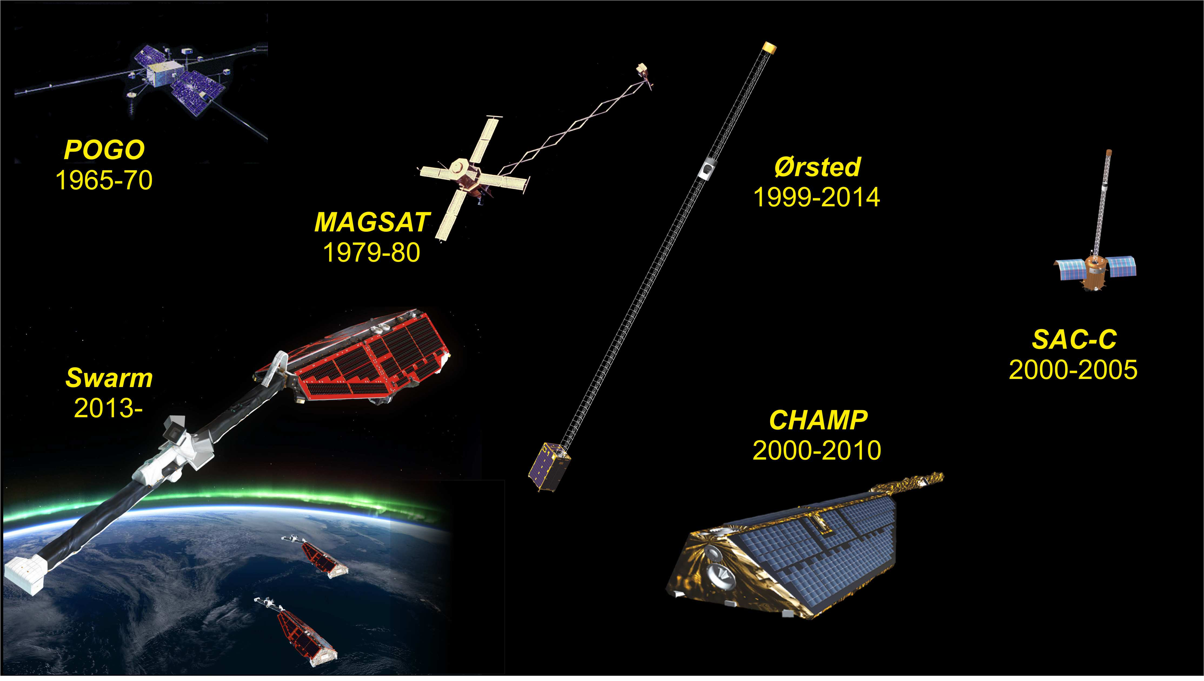
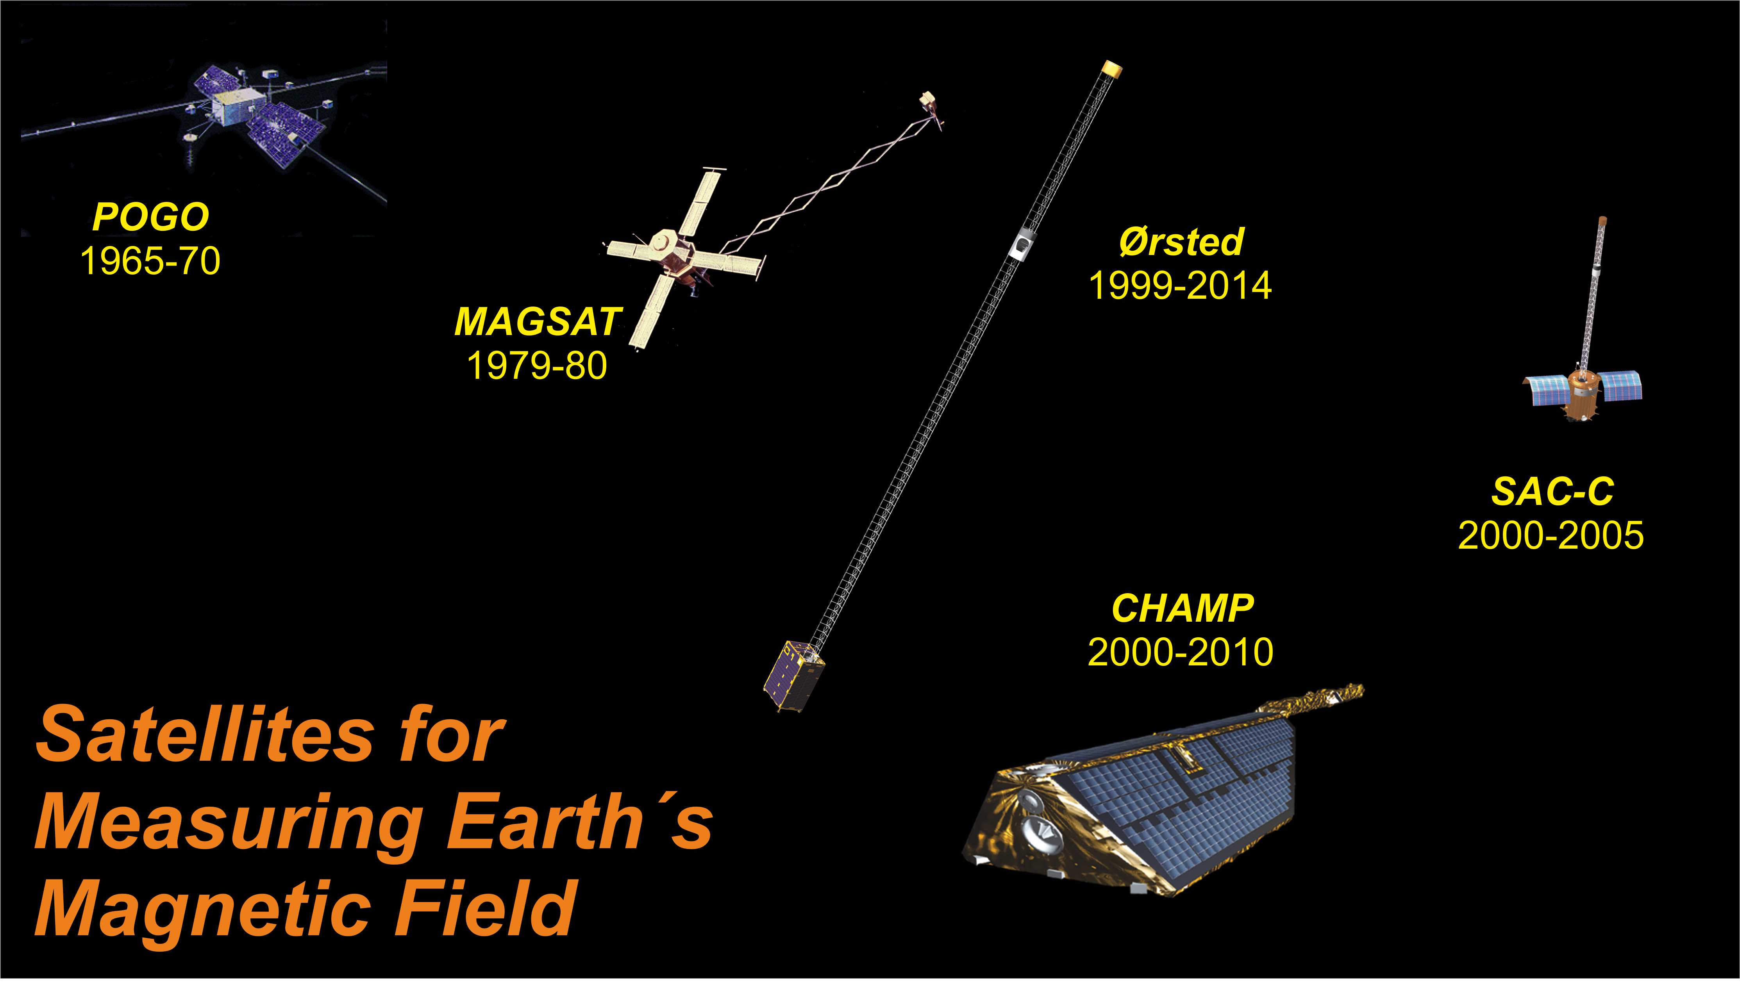
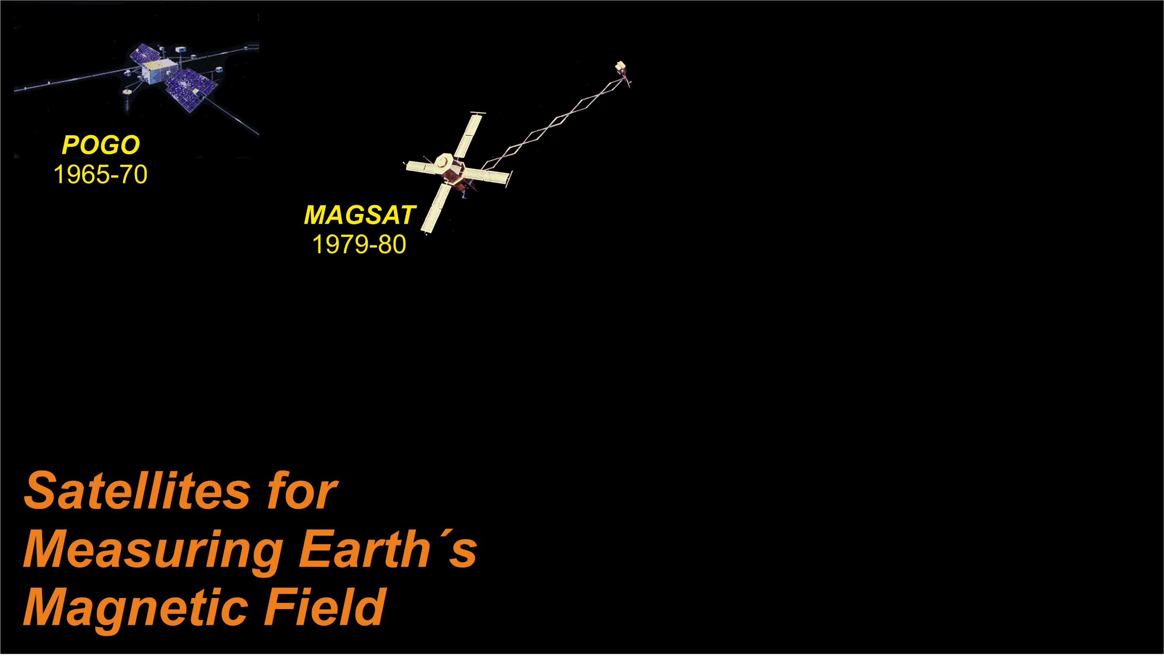

Slide 3
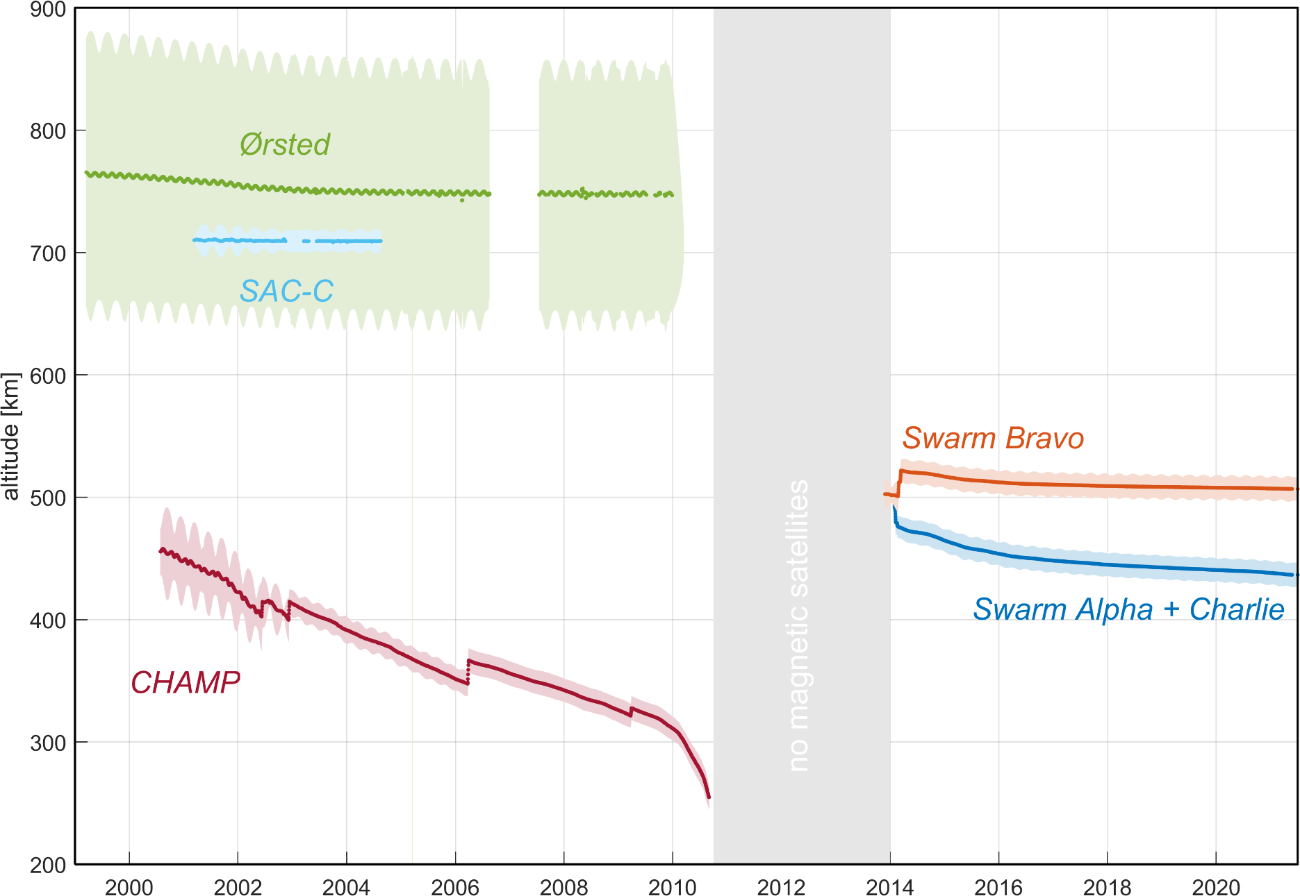
Why more satellites for exploring Earth’s magnetic field?
No high-precision magnetic field data are available in the gap between CHAMP and Swarm
(Oct 2010 and Nov 2013)

Slide 4
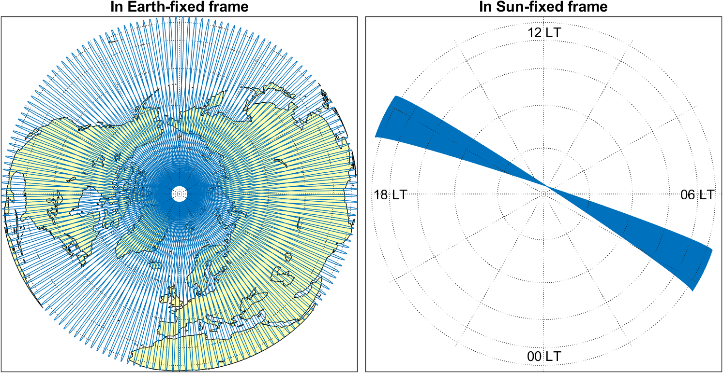
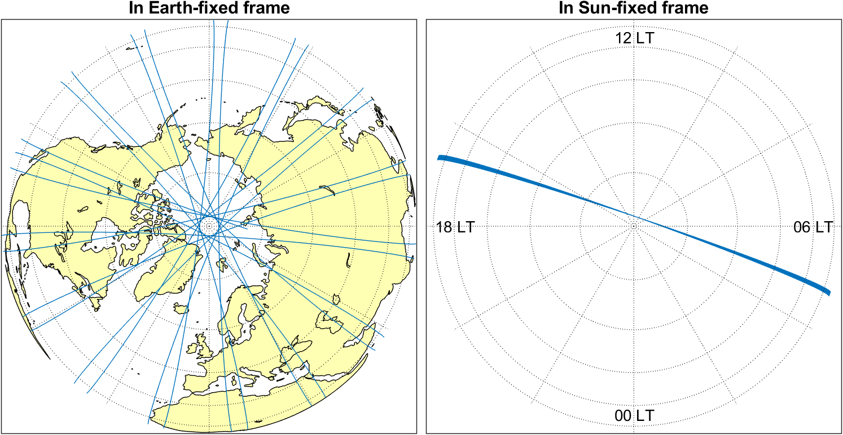
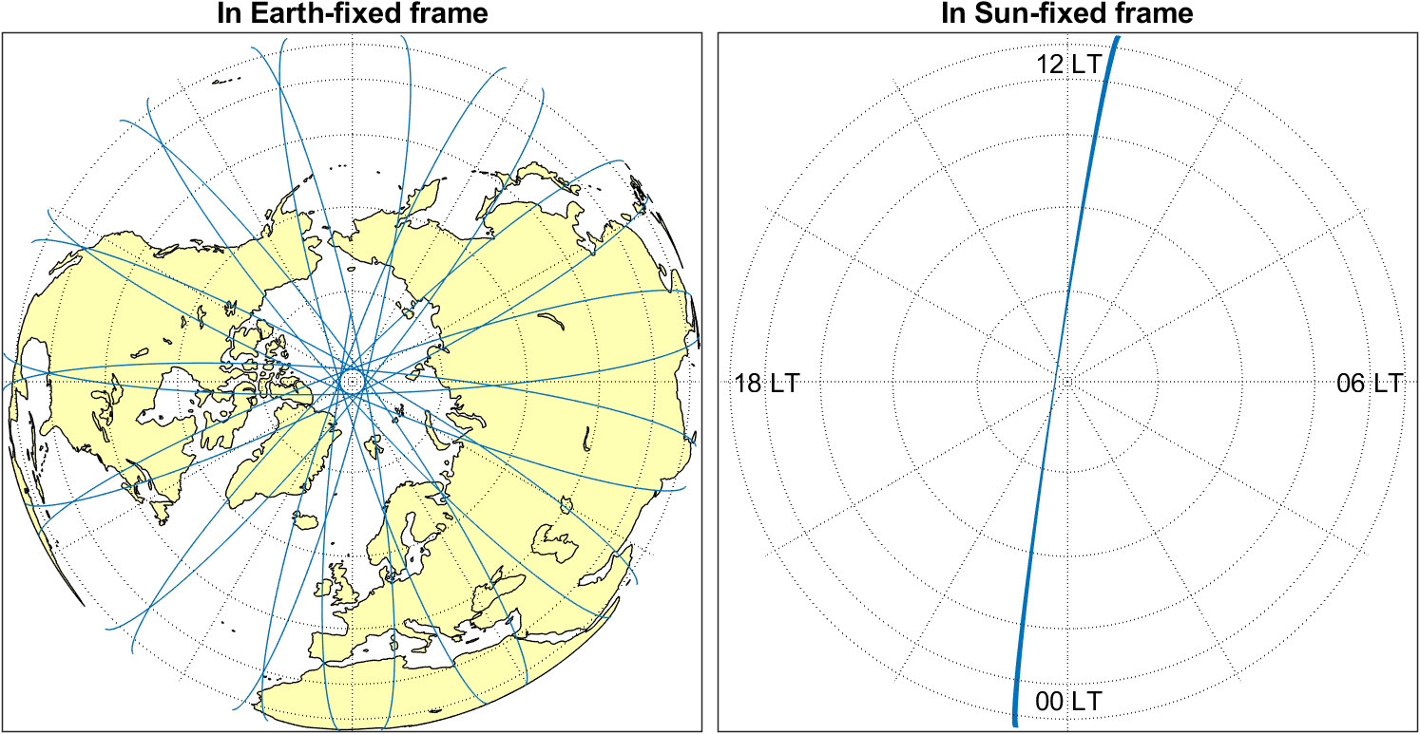
Why more satellites for exploring Earth’s magnetic field?
Ionospheric and magnetospheric electric current systems are oriented wrt Sun
Single satellites only measure at one specific local time (slowly drifting in time)
Simultaneous magnetic data from many satellites allows to detangle time-space structure of external sources
Swarm Alpha, 1 Aug 2018
Swarm Alpha, 1 - 11 Aug 2018

Slide 5
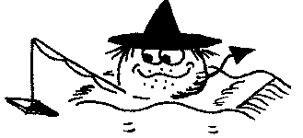
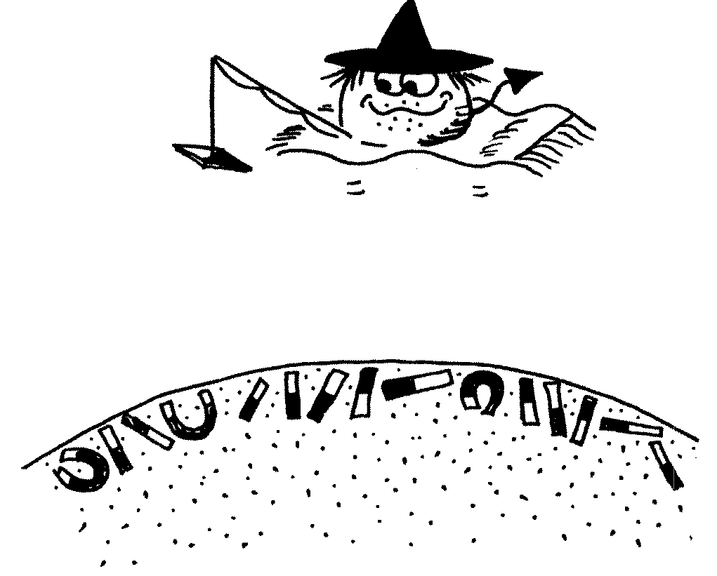
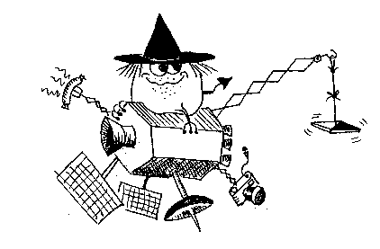



Most satellites carry magnetometer for navigational purposes as part of their AOCS (Attitude and Orbit Control System)
The data of these AOCS magnetometers have scientific value but data calibration is essential
Towards a true swarm of satellites …

Slide 6
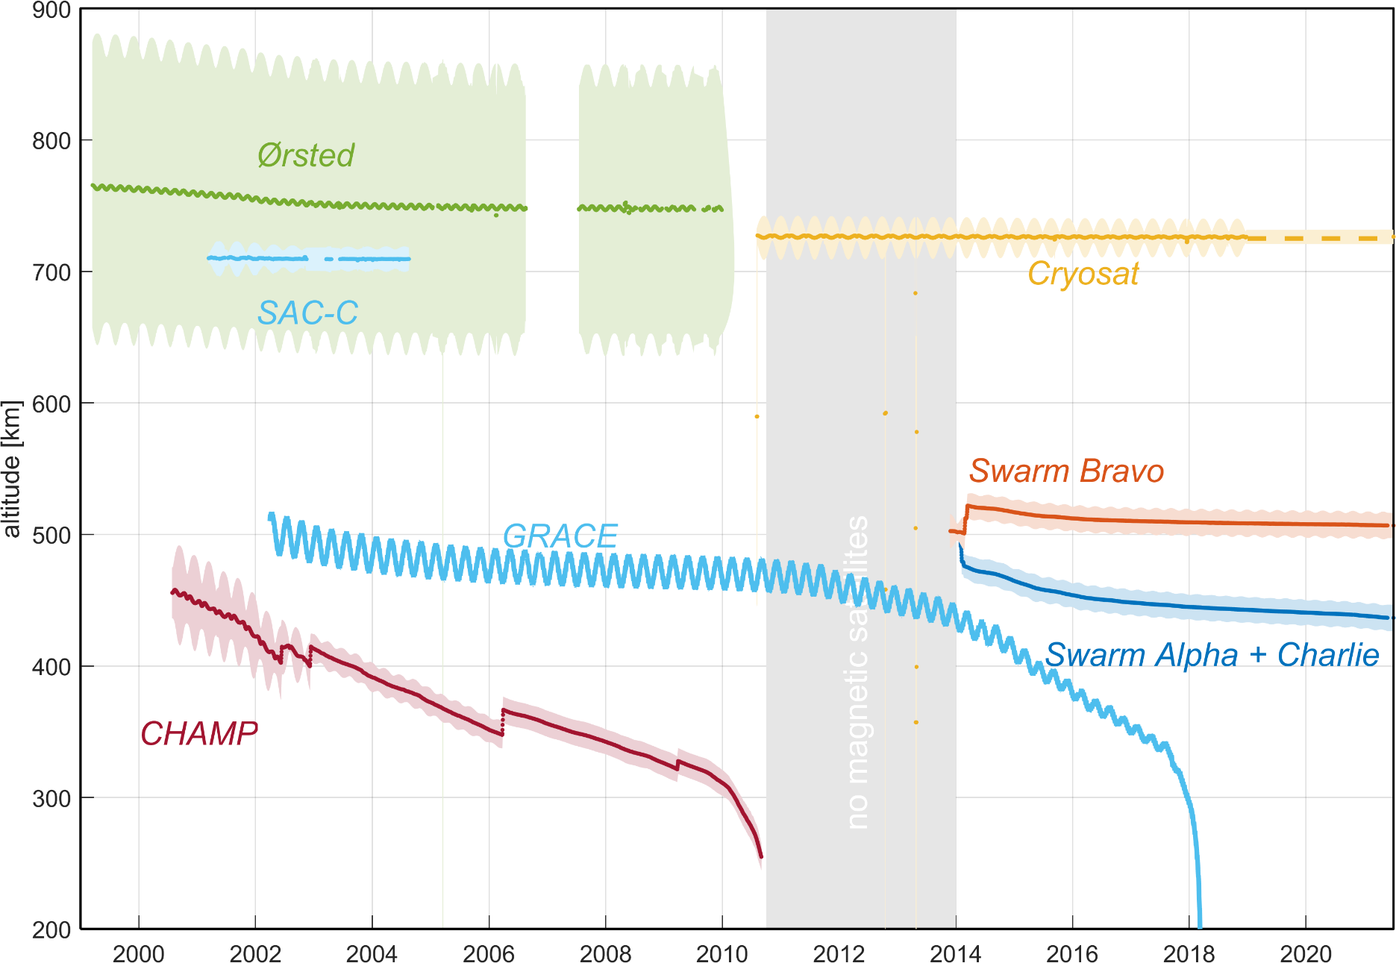
Why more satellites for exploring Earth’s magnetic field?
No high-precision magnetic field data are available in the gap between CHAMP and Swarm
(Oct 2010 and Nov 2013)
CryoSat-2 and GRACE help to fill this gap, for improved study of the dynamics of Earth’s core field

Slide 7
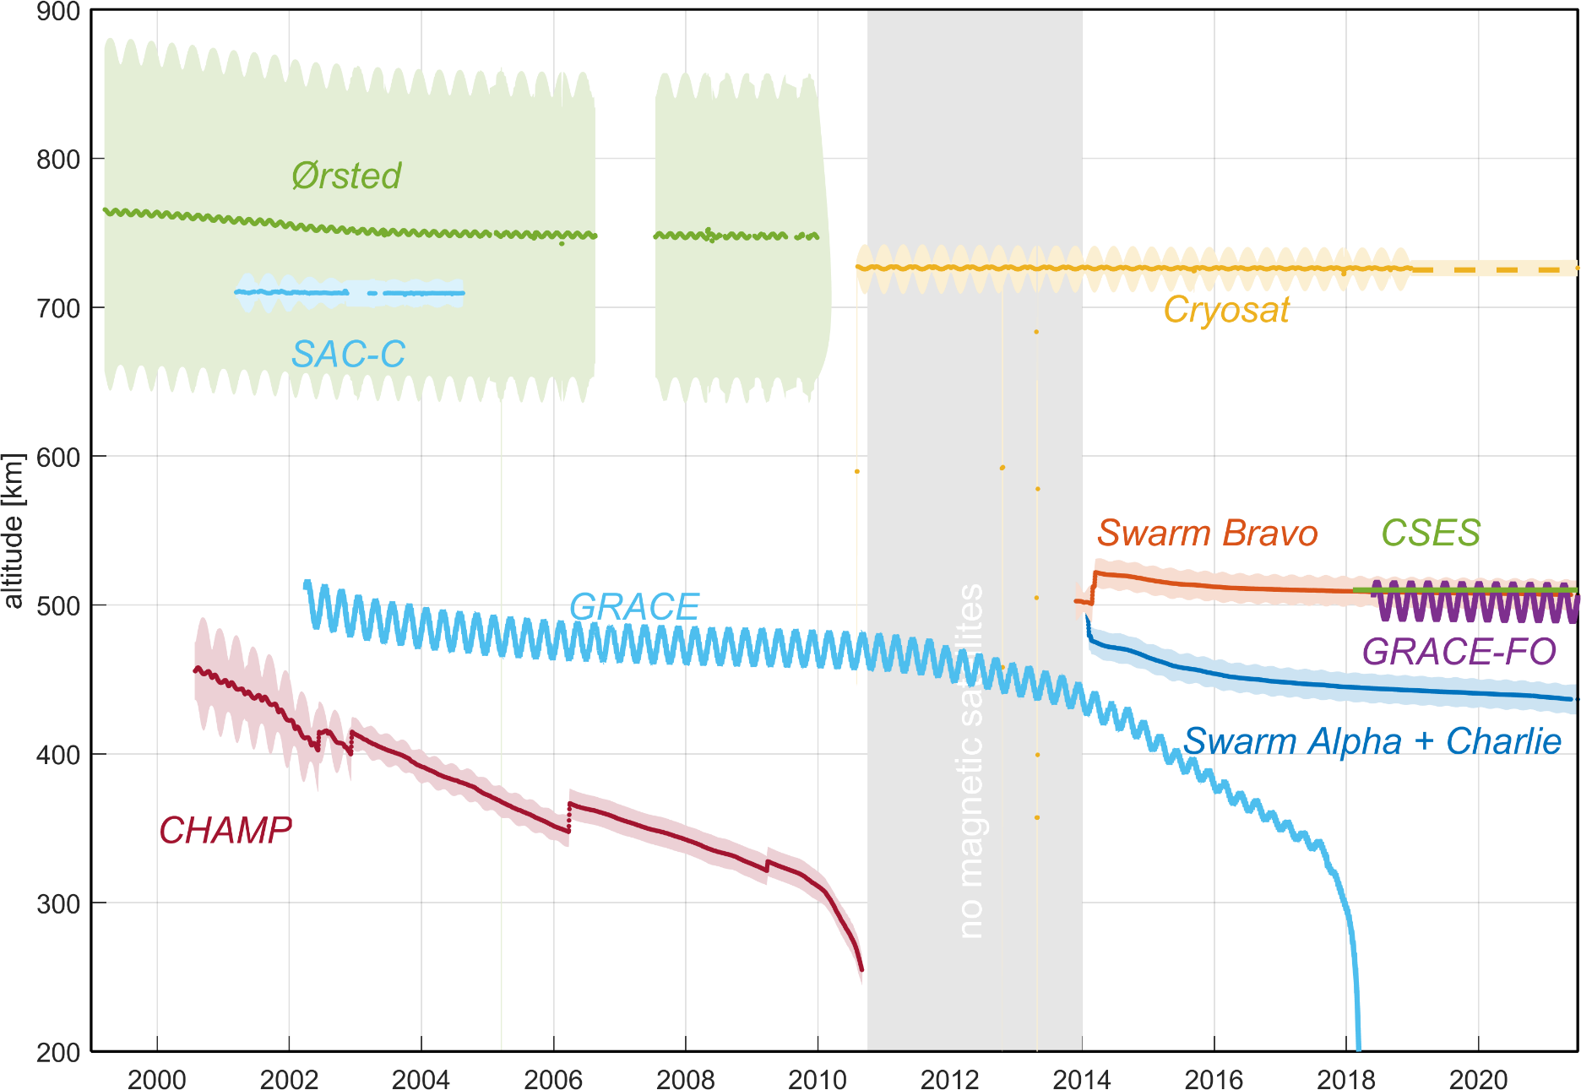
Why more satellites for exploring Earth’s magnetic field?
No high-precision magnetic field data are available in the gap between CHAMP and Swarm
(Oct 2010 and Nov 2013)
CryoSat-2 and GRACE help to fill this gap, for improved study of the dynamics of Earth’s core field
Swarm, GRACE-FO and CSES provide simultaneous data for improved time-space separation of external sources

Slide 8
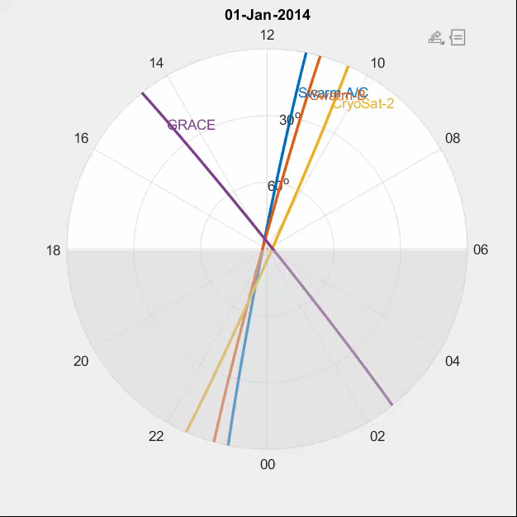
Local Time evolution of Swarm, CryoSat-2 and GRACE
Swarm A/C
change in LT of 2.73 hrs/month
all LT in 4.4 months
Swarm B
change in LT of 2.61 hrs/month
all LT in 4.6 months
CryoSat-2
change in LT of 1.51 hrs/month
all LT in 8.0 months
GRACE A/B
change in LT of 2.24 hrs/month
all LT in 5.3 months

Slide 9
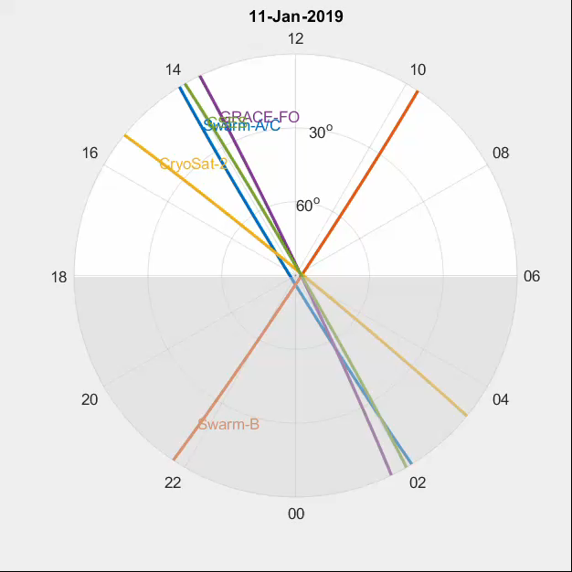
Local Time evolution of Swarm, CryoSat-2, GRACE-FO and CSES
Swarm A/C
change in LT of 2.73 hrs/month
all LT in 4.4 months
Swarm B
change in LT of 2.61 hrs/month
all LT in 4.6 months
CryoSat-2
change in LT of 1.50 hrs/month
all LT in 8.0 months
GRACE-FO A/B
change in LT of 0.59 hrs/month
all LT in 20.2 months
CSES
fixed LT at 02/14

Slide 10
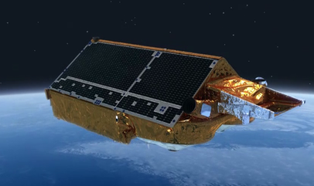
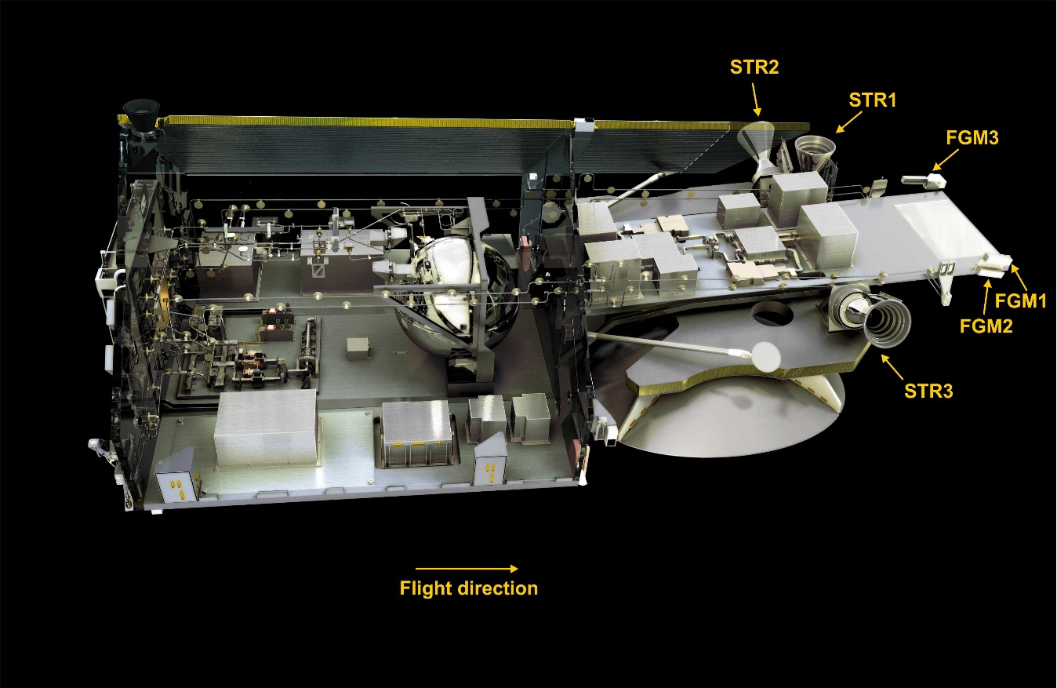
Cryosat-2
Launched in April 2010 – and still in operation
720 – 730 km altitude, 92° orbital inclination
3 platform vector Fluxgate magnetometers (FGMs), 4 sec sampling
3 Star imagers (STRs)
House-Keeping (HK) data available: magnetorquer currents, magnetometer temperature, …

Slide 11
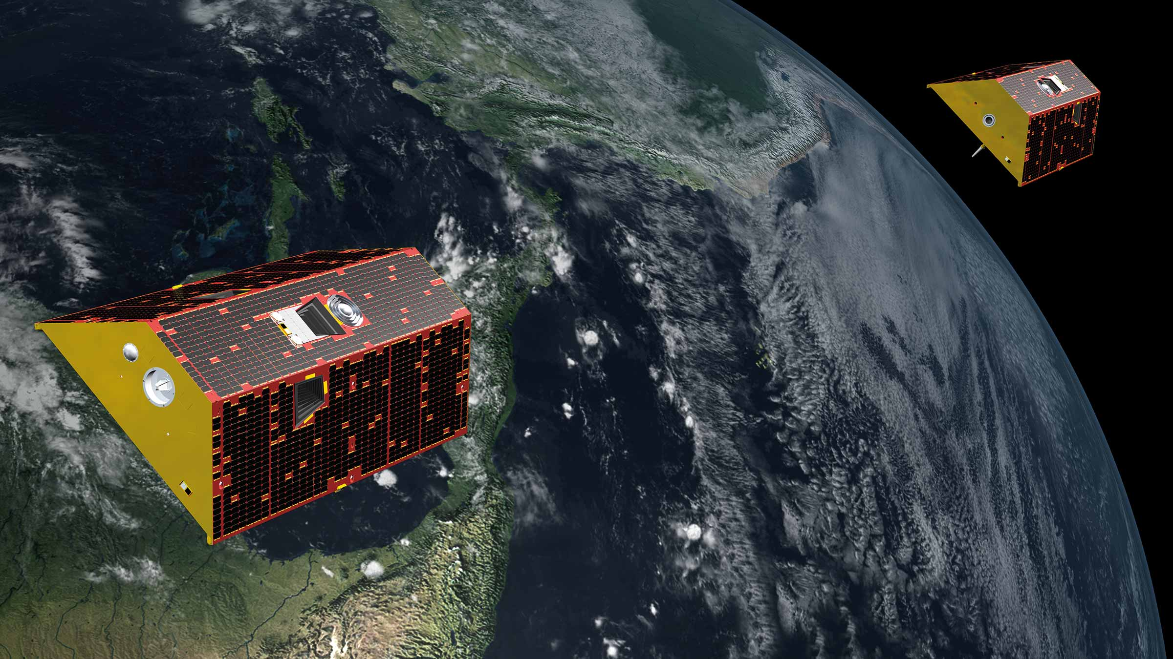
GRACE Satellite Duo
GRACE-A and GRACE-B follow each other with 220 km alongtrack distance
Between March 2002 and October 2017, 92° orbital inclination

Slide 12
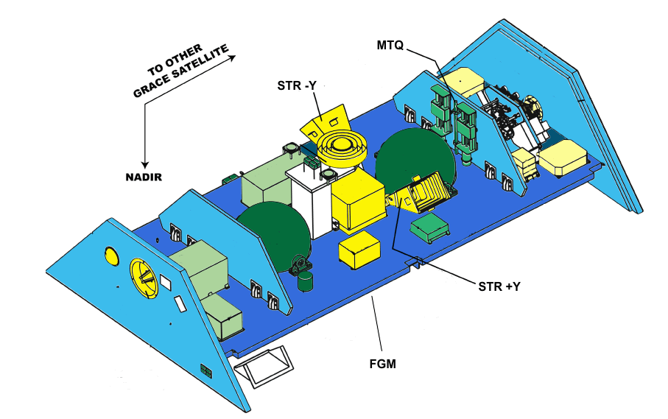
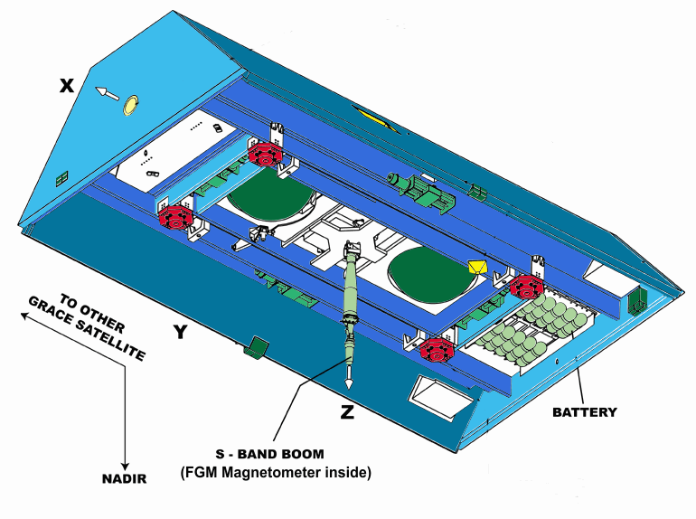
GRACE Satellite Duo
GRACE-A and GRACE-B follow each other with 220 km alongtrack distance
March 2002 and October 2017, 92° orbital inclination
1 Fluxgate magnetometer (FGM) on short boom, 1 sec sampling (since 2008), 26 nT digitisation steps
2 Star imagers (STRs) on satellite body
HK data: magnetorquer currents, battery and solar array currents, but no magnetometer temperature

Slide 13
Terminology …
Calibration: From Vector Fluxgate Magnetometer (FGM) 3-sensor output E
to magnetic field B_{FGM} vector in FGM frame
Estimation of the parameters describing FGM calibration and applying them to sensor output E
in order to get B_{FGM} in physical units (nT) in an orthogonalized instrument frame
Alignment: Rotation of B_{FGM} from FGM frame to Star Imager (STR) frame
and further to B_{NEC} in NEC (North-East-Center) frame
Estimation of rotation parameters (“Euler angles”) and applying them to B_{FGM}
using STR attitude data q in order to get magnetic field vector B_{NEC} in NEC frame
Correction for disturbance magnetic field ΔB:
Accounting for influence from instrument and S/C
e.g. magnetorquer disturbance field
Estimation of disturbance parameters and correction of B_{FGM}
Often done by co-estimation with calibration parameters

Slide 14



Calibration and Alignment of a Vector Magnetometer
E is uncalibrated output of the 3 sensors, B_{FGM} is calibrated magnetic field vector
in FGM frame
Assumption: linear response of each FGM instrument:
3 offsets (biases), 3 scale values (sensitivities), 3 non-orthogonalities
Alignment: rotation from FGM to STR (Common Reference Frame of Star tracker)
3 Euler angles for describing rotation matrix
12 parameters
From STR to NEC frame with attitude information (STR quaternions q)

Slide 15
Scalar Calibration vs Vector Calibration
Scalar Calibration
Estimation of 9 FGM parameters by minimizing < ΔF² = (|B_{FGM}| - |B_{mod}|)² >
or < ΔF² = (|B_{FGM}| - F_{abs})² > (provided availability of absolute scalar measurements F_{abs})
  Preferred solution for satellites that carry an absolute scalar instrument (Ørsted, CHAMP, Swarm)
  Magnetic field intensity F is less influenced by magnetic signature of ionospheric field-algned currents, thus data from polar latitudes can be included in calibration process
  Usually much smaller rms misfit (factor 3 -5) than vector calibration
  Better estimation of F compared to vector calibration
  Less sensitive to calibration parameters: some parameters are poorly resolved, and Euler angles are completely unresolved
Vector Calibration
Estimation of 9 FGM parameters and 3 Euler angles (= 12 paremeters)
by minimizing of < ΔB² = |B_{FGM} – B_{mod}|² >
  Preferred solution provided good model vector field B_{mod} is available and stable mounting of FGM and STR
  Less suitable for boom-mounted FGM mounted and satellite-mounted STR due to boom bending
  ΔF² = (|B_{FGM}| - |B_{mod}|)²
Good model values B_{mod} or F_{mod} = |B_{mod}| are required to calibrate magnetometer on satellites without absolute scalar magnetometer
For that we use CHAOS-7 model predictions (core, crust, magnetosphere + induced) calculated for the time and position of each data point

Slide 16
Scalar Calibration vs Vector Calibration
Scalar Calibration
Estimation of 9 FGM parameters by minimizing < ΔF² = (|B_{FGM}| - |B_{mod}|)² >
or < ΔF² = (|B_{FGM}| - F_{abs})² > (provided availability of absolute scalar measurements F_{abs})
  Preferred solution for satellites that carry an absolute scalar instrument (Ørsted, CHAMP, Swarm)
  Magnetic field intensity F is less influenced by magnetic signature of ionospheric field-algned currents, thus data from polar latitudes can be included in calibration process
  Usually much smaller rms misfit (factor 3 -5) than vector calibration
  Better estimation of F compared to vector calibration
  Less sensitive to calibration parameters: some parameters are poorly resolved, and Euler angles are completely unresolved
Vector Calibration
Estimation of 9 FGM parameters and 3 Euler angles (= 12 paremeters)
by minimizing of < ΔB² = |B_{FGM} – B_{mod}|² >
  Preferred solution provided good model vector field B_{mod} is available and stable mounting of FGM and STR
  Less suitable for boom-mounted FGM mounted and satellite-mounted STR due to boom bending
GRACE: combined scalar and vector calibration
(vector calibration alone would result in larger scatter of FGM calibration parameters due to boom bending)
CryoSat-2: vector calibration
(possible because of body-mounted FGM and STR)

Slide 17


CryoSat-2:
Accounting for temperature, s/c disturbance, and non-linearities
12 “basic” calibration parameters, estimated separately for each of the 100 months
(Aug 2010 – Dec 2018) x 12 = 1200 parameters
The 3 offsets b and 3 scale values S depend on sensor temperature T_{FGM}
Assumed to be constant for whole mission: 2 x 3 = 6 parameters
Magnetic disturbance vector of Magnetorquer currents I_{MTQ}
Assumed to be constant for whole mission: 3 x 3 tensor = 9 parameters
Magnetic disturbances due to solar array and battery current strengths I_{SA1}, I_{SA2}, I_{Batt}
Assumed to be constant for whole mission: 3 x 3 = 9 parameters
Non-linearities (“transverse effect” disturbance of fluxgate sensor x on sensor output y)
B₁ depends on E₃², and B₃ depends on E₂³ and E₃² : 3 parameters
In total 1227 model parameters estimated by robust non-linear Least-Squares
from 13.3 mio observations (= 3 x 4.4 mio data triplets)
Temporal regularisation (smoothing) of month-to-month variation of “basic” 12 parameters
Vector calibration, minimizing average of ΔB² = |B_{FGM} – B_{mod}|²

Slide 18
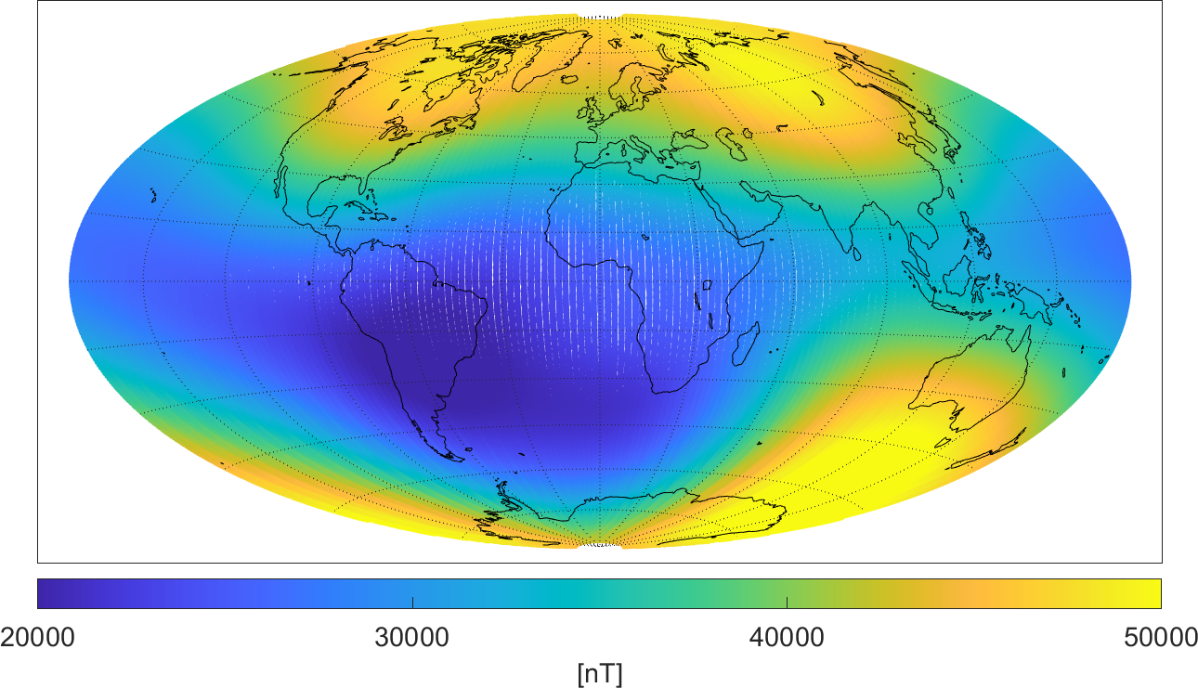
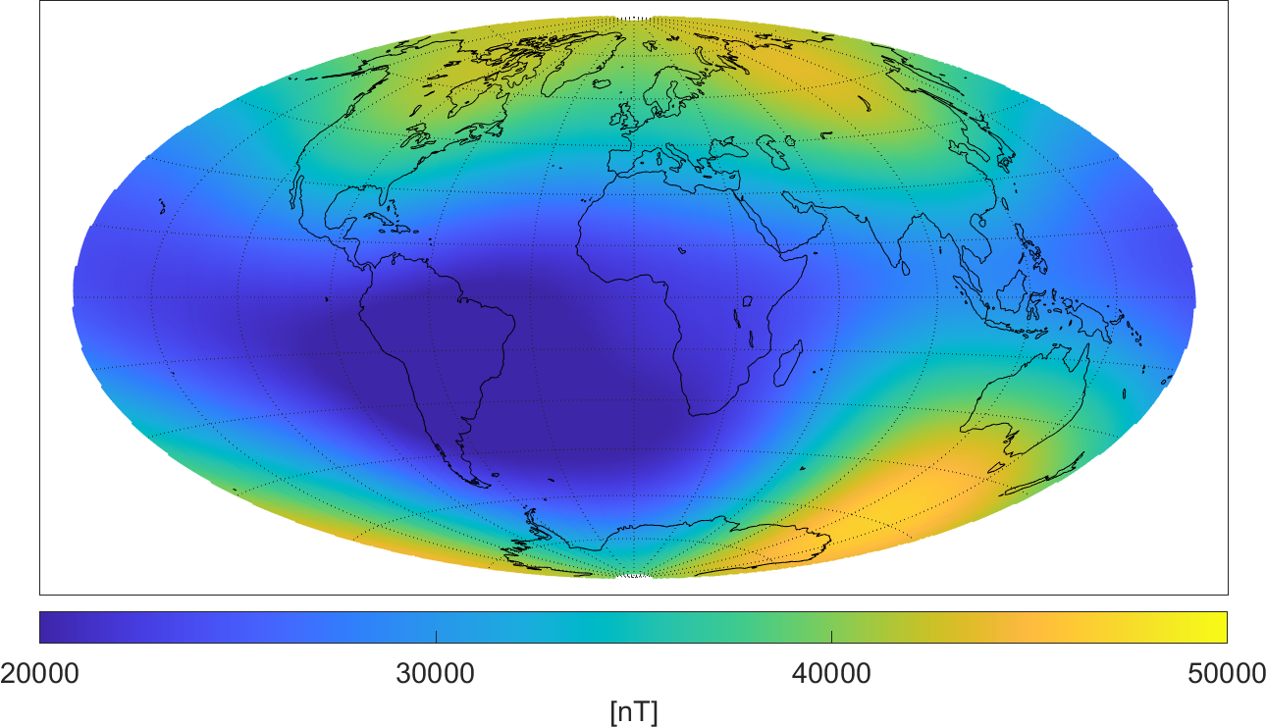

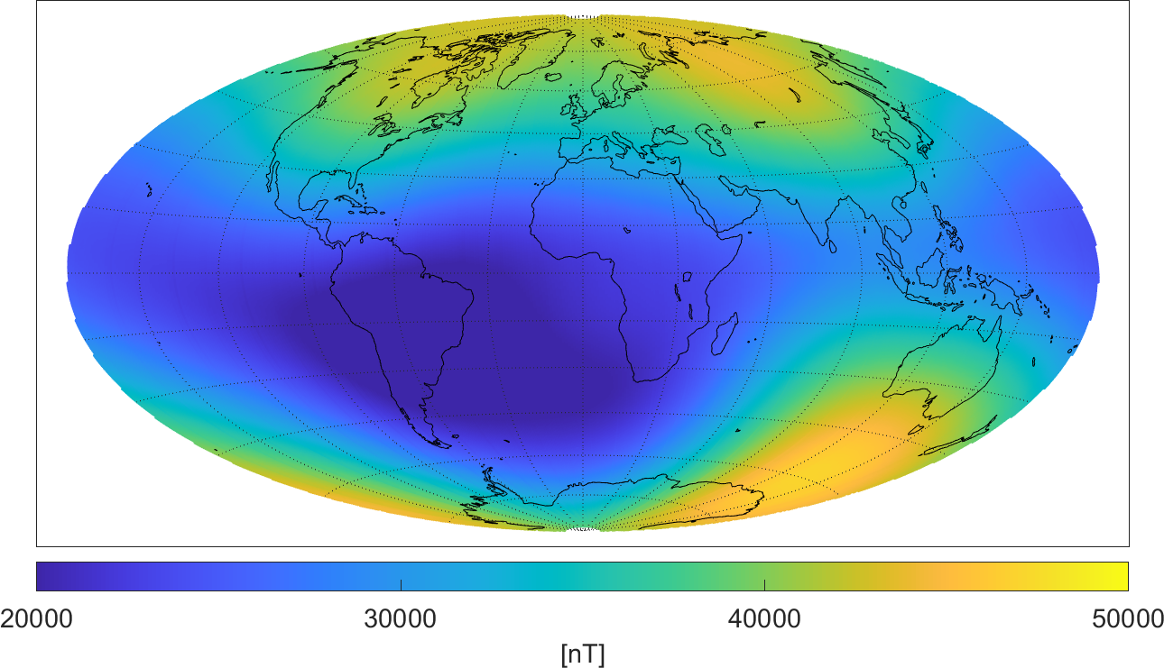
Magnetic field strength F = |B|
August 2018
Swarm A
CryoSat-2
430 km altitude
720 km altitude
observed F_{obs}
model F_{mod}

Slide 19
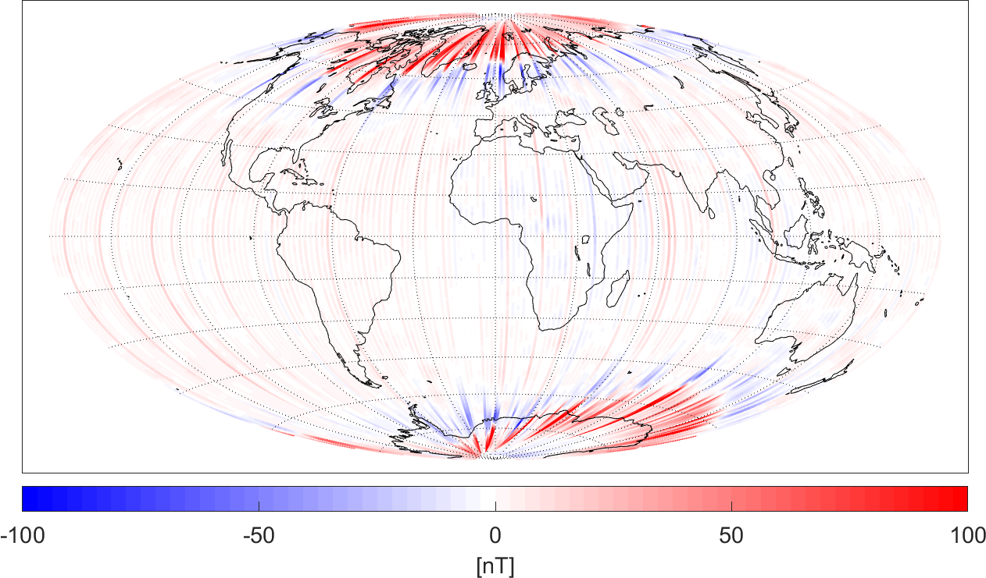
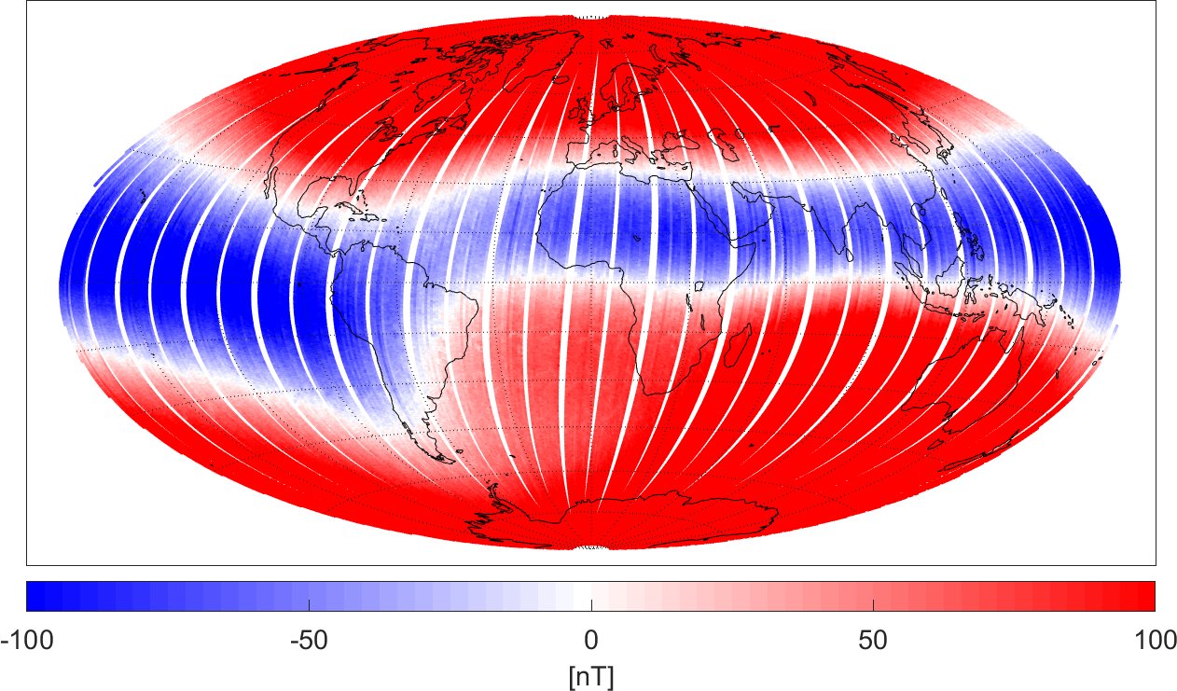
Magnetic field strength F = |B|
August 2018
Swarm A
CryoSat-2, uncalibrated
ΔF = F_{obs} – F_{mod}
Polar ionospheric currents

Slide 20
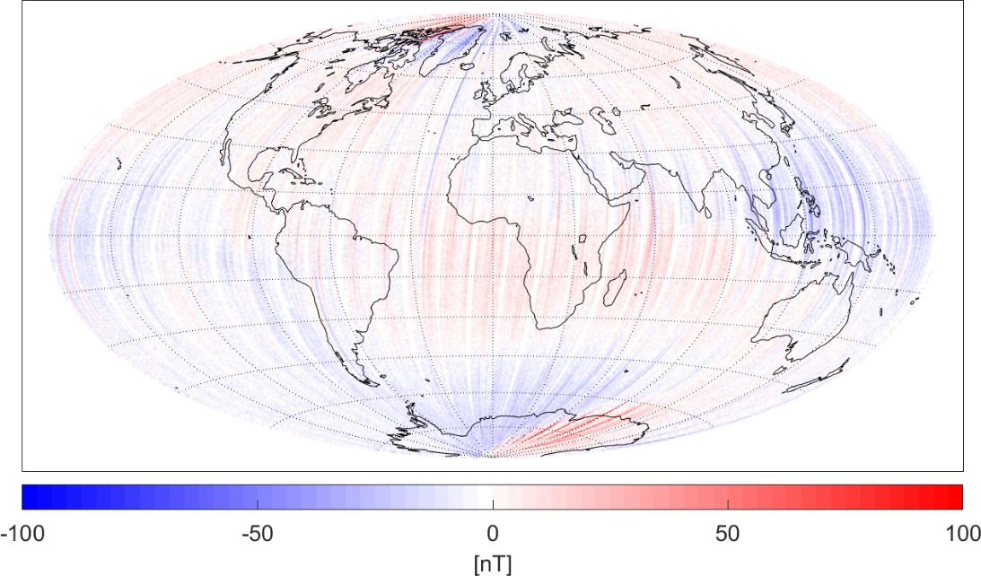
Magnetic field strength F = |B|
August 2018
Swarm A
CryoSat-2, calibrated
ΔF = F_{obs} – F_{mod}
weaker in CryoSat,
due to higher altitude
Polar ionospheric currents

Slide 21
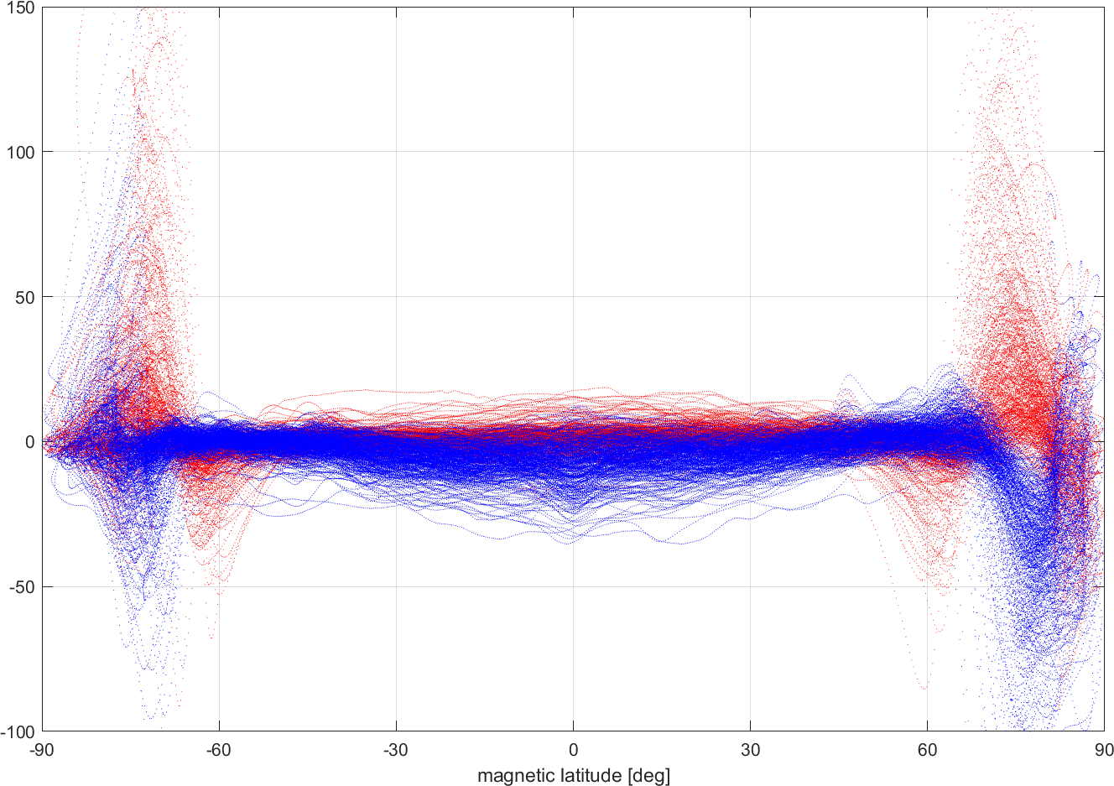
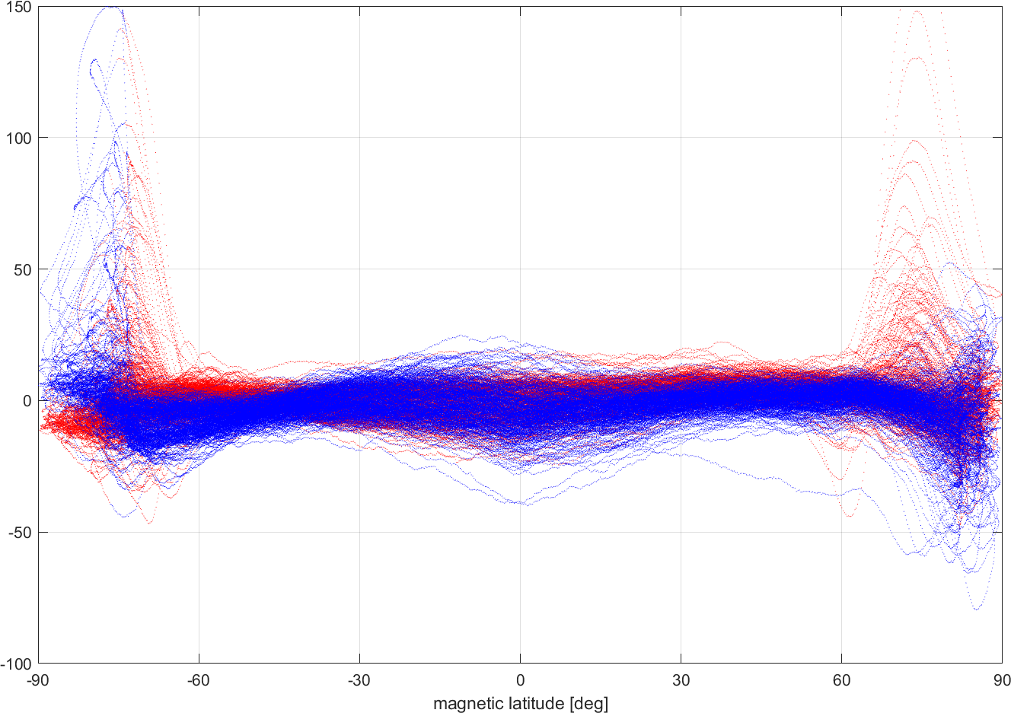
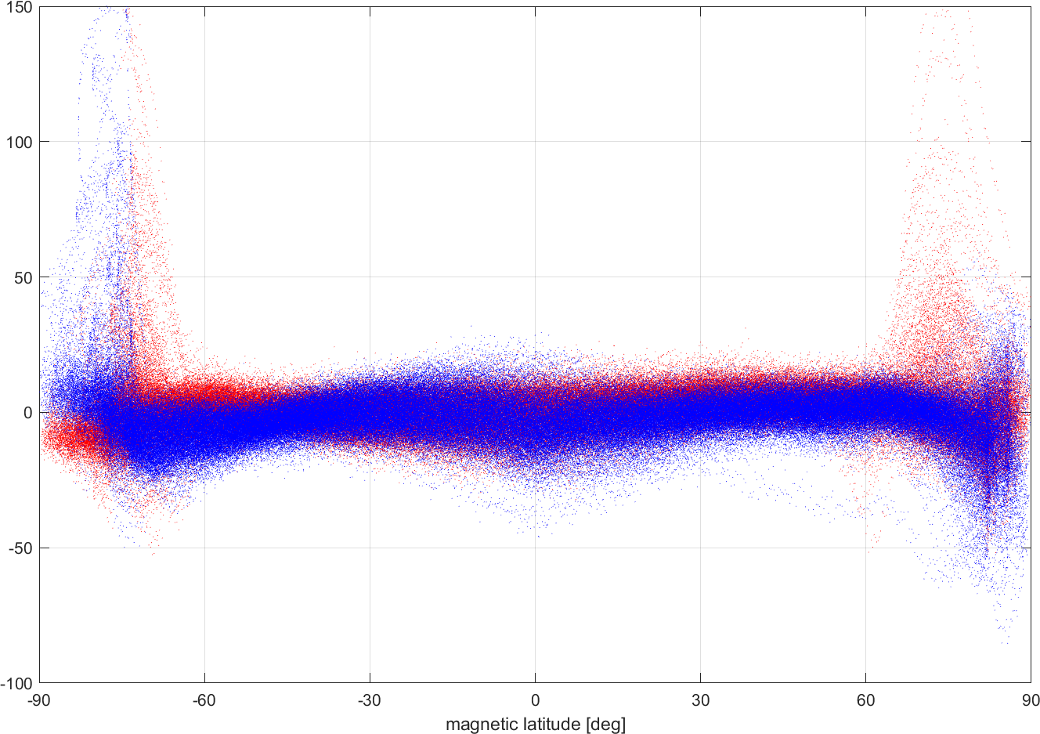
Magnetic field strength F = |B|
August 2018
Swarm A
CryoSat-2, calibrated
1.9 nT rms
measurement error: < 0.5 nT
6 nT rms
ΔF = F_{obs} – F_{mod}
dayside
nightside
1 min (15 values) moving average

Slide 22
CryoSat-2: Temporal Evolution of Calibration and Alignment Parameters
Month-to-month variation:
Offsets: ± 8 nT
Scale values: ± 300 ppm
non-orthononalities and
Euler angles: ±0.02° (±72 arcsecs)
For FGM1

Slide 23
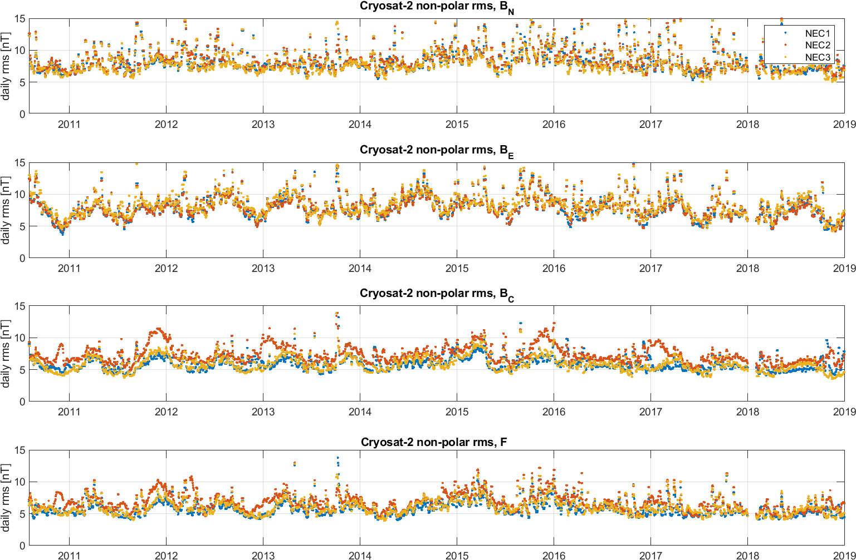
CryoSat-2: Daily rms misfit of 5 – 10 nT

Slide 24
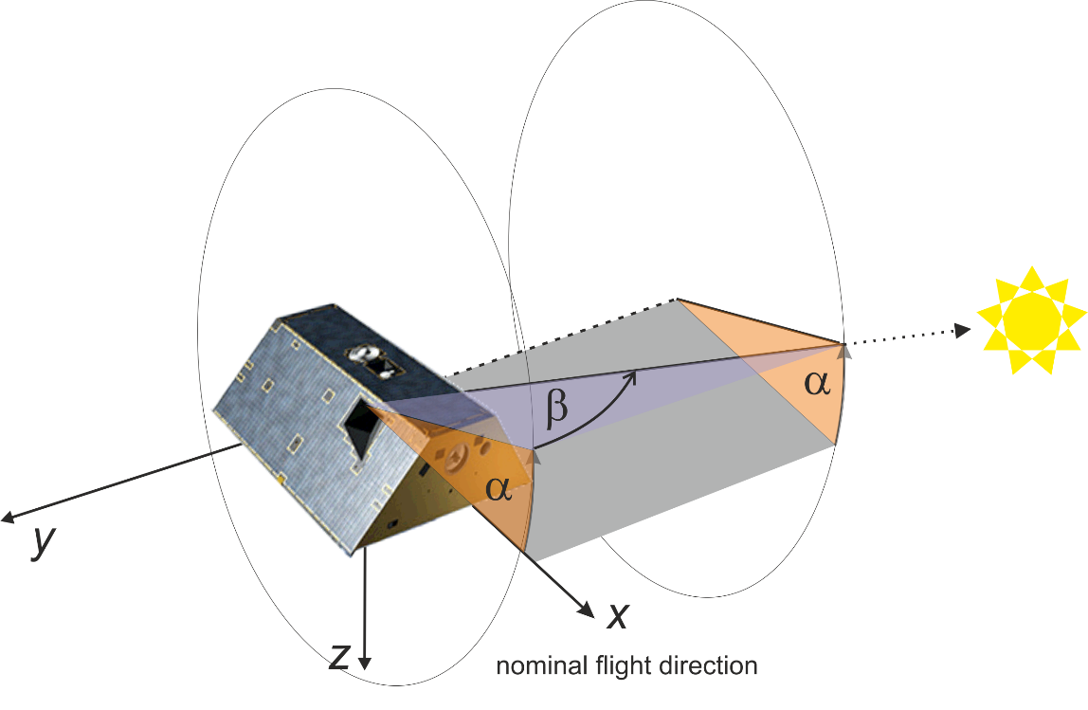
GRACE:
How to account for magnetometer temperature effects?
GRACE magnetometer temperature data are not available (not part of HK data)
Fluxgate magnetometer output depend on sensor temperature
  up to 30 ppm/°C for Swarm scale values,
  up to 100 ppm/°C for CryoSat-2 scale values, measured ΔT of ±6 °C results in ±600 ppm change, corresponding to ±30 nT @ 50 000 nT
Proxy for magnetometer temperature: Sun position angles α,β wrt spacecraft
(same approach as used for correcting dB_{Sun} disturbance on Swarm satellites)
Dependency of FGM offsets and scale values, and of Euler angles (boom bending!) on Sun position

Slide 25
GRACE:
Calibration model parameterization
12 “basic” calibration parameters, estimated separately for each of the 118 months
(Jan 2008 – Oct 2017) x 12 = 1416 parameters
The 3 offsets b, 3 scale values S, and 3 Euler angles depend on Sun position angle α,β
Spherical harmonic expansion, assumed to be constant for whole mission: 342 parameters
Magnetic disturbance vector of Magnetorquer currents I_{MTQ}
Assumed to be constant for whole mission: 3 x 3 tensor = 9 parameters
Magnetic disturbances due to solar array and battery current strengths I_{SA1}, I_{SA2}, I_{Batt}
Assumed to be constant for whole mission: 3 x 3 = 9 parameters
Non-linearities (“transverse effect” disturbance of fluxgate sensor x on sensor output y): 48 parameters
In total 1839 model parameters estimated by robust non-linear Least-Squares
from 10.5 mio observations (= 3 x 2.62 mio vector triplets + 2.62 scalar values) for each satellite
Temporal regularisation (smoothing) of month-to-month variation of “basic” 12 parameters
Combined scalar and vector calibration, minimizing weighted average of
5<ΔF²> + <|ΔB|²> = 5< (|B_{FGM}| - |B_{mod}|)² > + < |B_{FGM} – B_{mod}|² >
scalar residuals are upweighted by factor 5

Slide 26
GRACE: Temporal Evolution of Calibration and Alignment Parameters
Month-to-month variation:
Offsets: ± 10 nT
Scale values: ± 200 ppm
non-orthononalities and
Euler angles: ±0.01° (±36 arcsecs)
For GRACE-A

Slide 27
GRACE-A: ΔB = B_{obs} – B_{CHAOS-7} for 10 to 19 August 2010
FACs in horizontal components B_{N}, B_{E}
in auroral regions
Polar Electrojets in vertical component B_{C} and scalar field F
in auroral regions

Slide 28
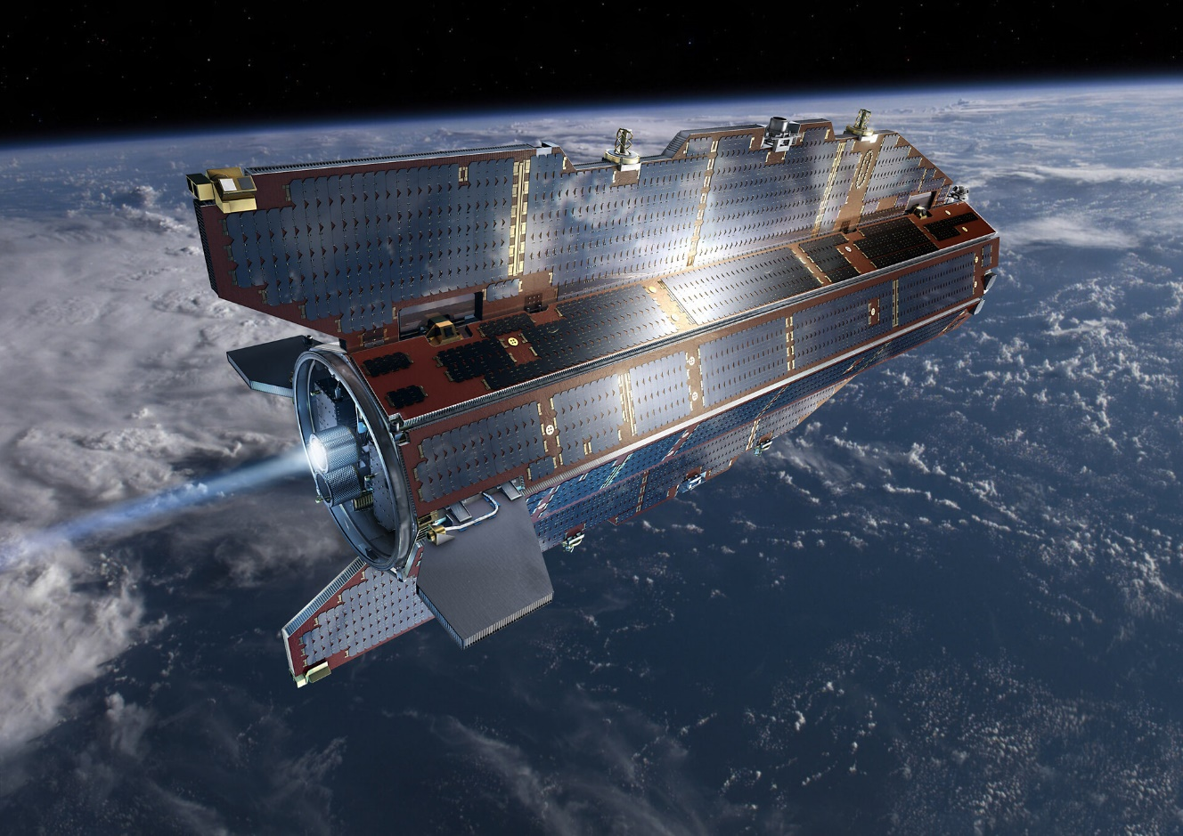
Less successful calibrations: GOCE and Aeolus
March 2009 – November 2013
255 km altitude, lowered to 235 km in November 2012
3 platform vector Fluxgate magnetometers (FGMs), 16 sec sampling
2 Star imagers (STRs)
House-Keeping (HK) data available: magnetorquer currents, magnetometer temperature, …

Slide 29
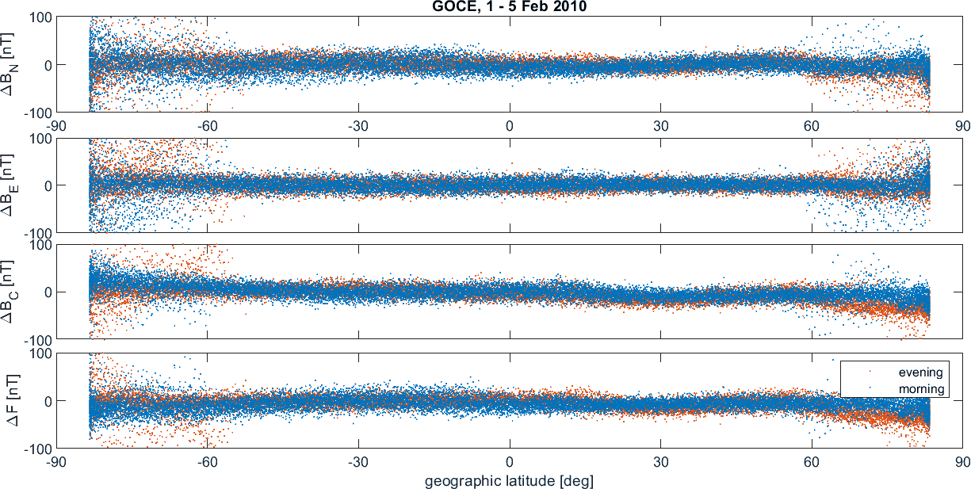
Less successful calibrations: GOCE and Aeolus
March 2009 – November 2013
255 km altitude, lowered to 235 km in November 2012
3 platform vector Fluxgate magnetometers (FGMs), 16 sec sampling
2 Star imagers (STRs)
House-Keeping (HK) data available: magnetorquer currents, magnetometer temperature, …
Large scatter in all components and scalar field F, no clear geophysical signal visible

Slide 30
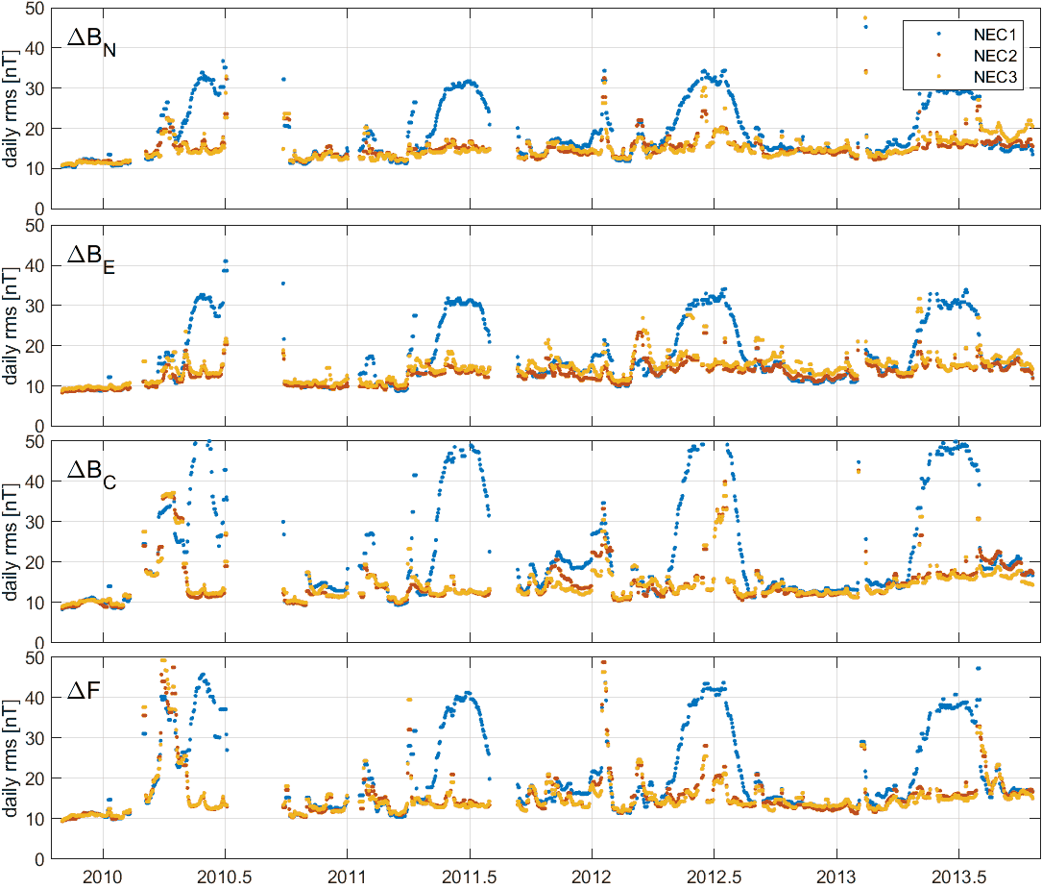
Less successful calibrations: GOCE and Aeolus
Daily rms: 10 nT at best, increased
to > 30 nT during (northern) summer (?)
Orbit-to-orbit variation of
calibration parameters
(see next talk by Rekowski et al)
Note: GOCE magnetic data can still be used for determination of e.g. FACs in polar regions after high-pass filtering on orbit-by-orbit basis.
However, the coarse 16 sec sampling rate make GOCE data less interesting for external field investigations

Slide 31
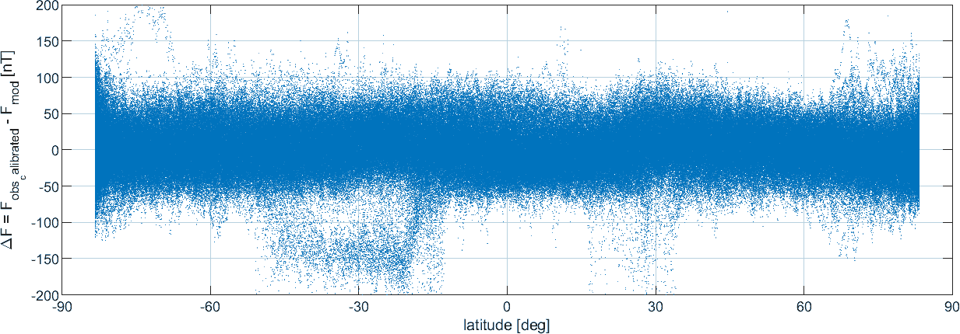
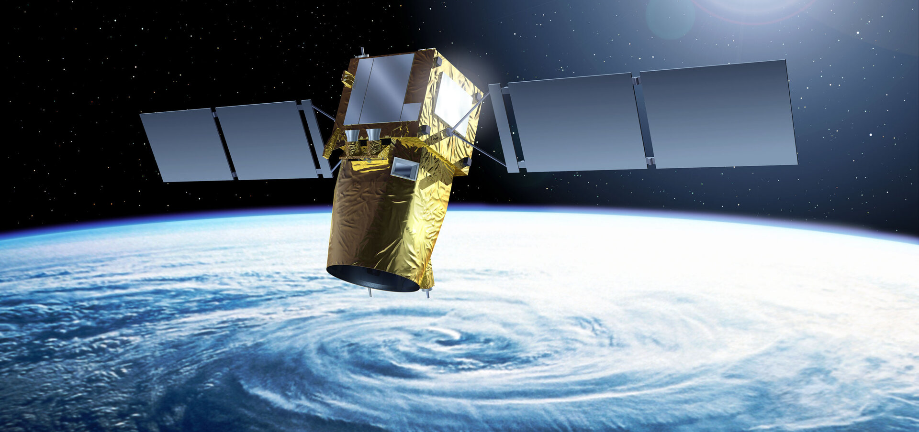
Less successful calibrations: GOCE and Aeolus
Launched in August 2018
320 km altitude
1 platform vector AMR (Anisotropic Magneto Resistive) magnetometer, 10 sec sampling
14 – 21 Oct 2018, 26 nT rms in ΔF

Slide 32
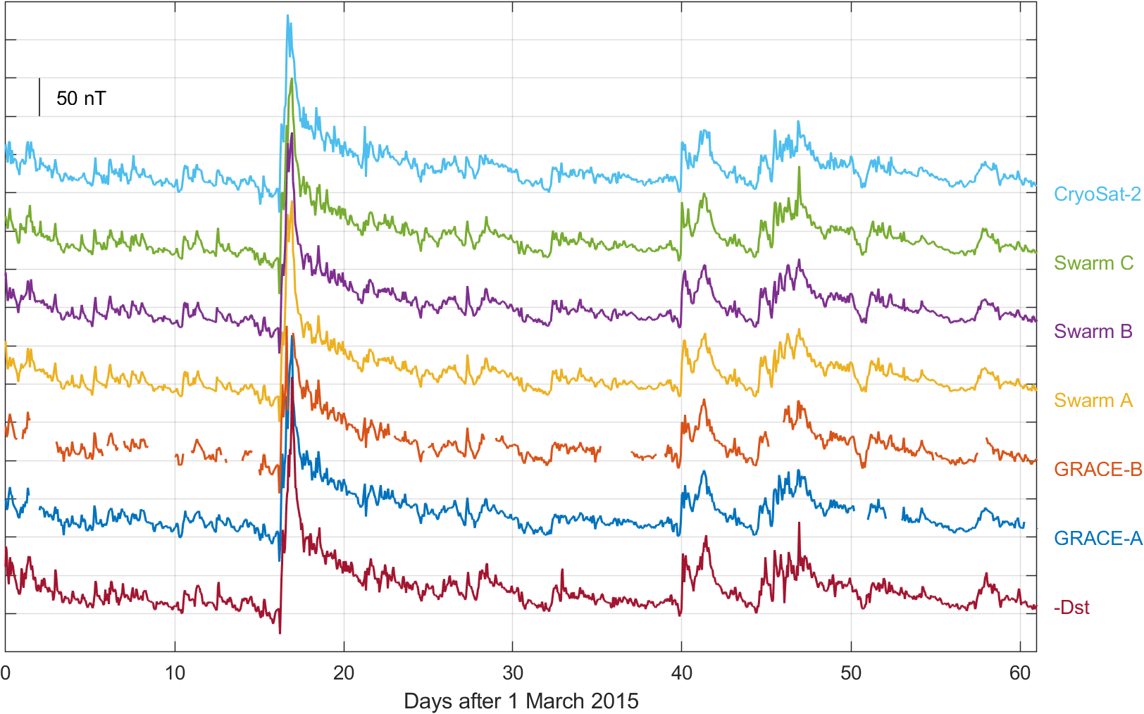
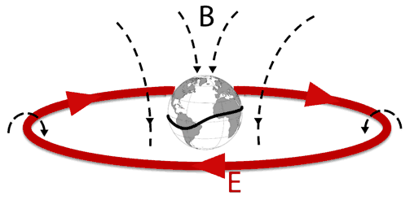
Application:
Monitoring of Magnetospheric Ring-current activity
Independent observation of time-evolution of magnetospheric ring-current with magnetic data
from 6 satellites …
… and comparison with Dst-index derived from ground magnetic data

Slide 33
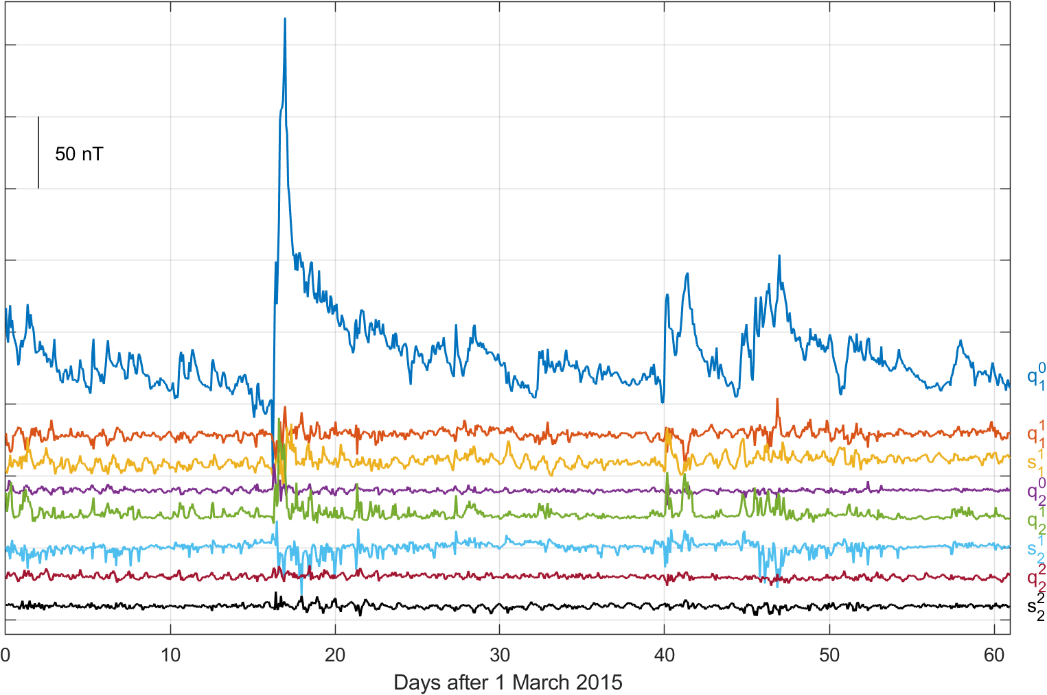
Space-time structure of magnetospheric field
q₁⁰ is main ring-current term
describes symmetric ring-current in equatorial plane
Joint spherical harmonic analysis using magnetic data from 6 satellites
Strong asymmetric ring current during storm expansion phase
contributions from terms with m = 1, faster decay compared to main term
Terms describing asymmetric ring-current

Slide 34
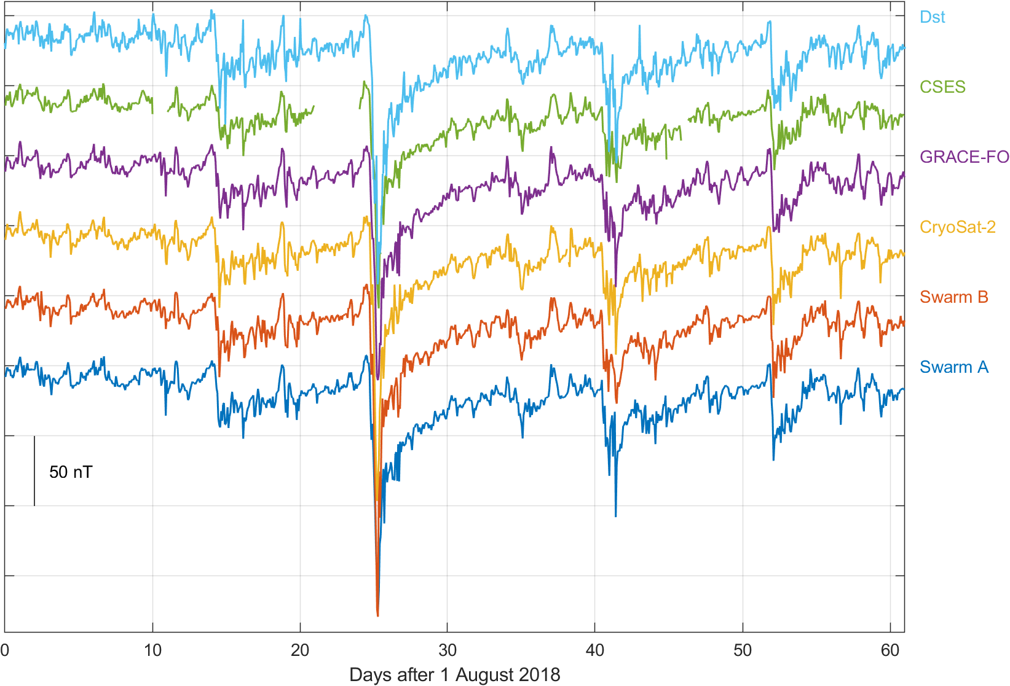
Application:
Monitoring of Magnetospheric Ring-current activity
Independent observation of time-evolution of magnetospheric ring-current with magnetic data
from 5 satellites …
… and comparison with Dst-index derived from ground magnetic data
50 nT
Swarm A
Swarm B
CryoSat-2
GRACE-FO
CSES
Dst

Slide 35
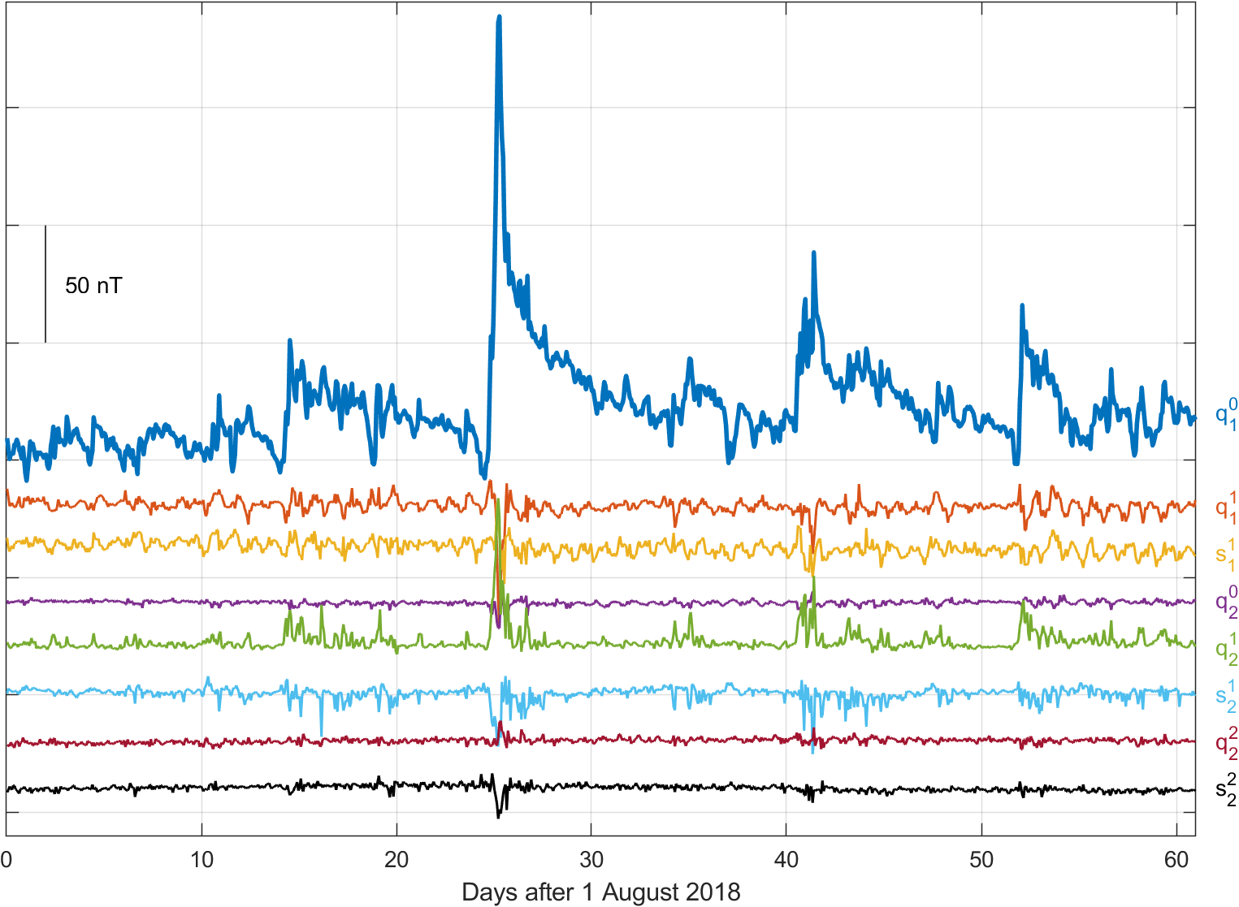
Space-time structure of magnetospheric field
q₁⁰ is main ring-current term
describes symmetric ring-current in equatorial plane
Joint spherical harmonic analysis using magnetic data from 5 satellites
Strong asymmetric ring current during storm expansion phase
contributions from terms with m = 1, faster decay compared to main term
Terms describing asymmetric ring-current

Slide 36
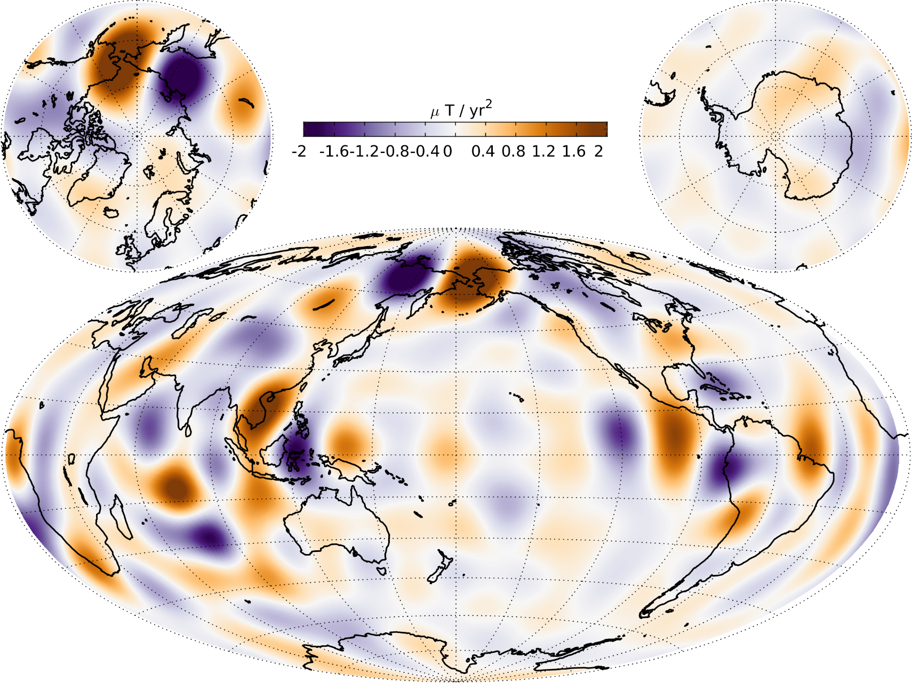
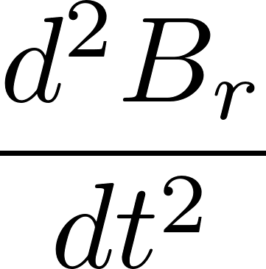
Application: Core surface field secular acceleration
in 2015 at surface of Earth’s core
(r = 3485 km)
CHAOS-7 model of Earth’s magnetic field
up to spherical harmonic degree n = 19

Slide 37
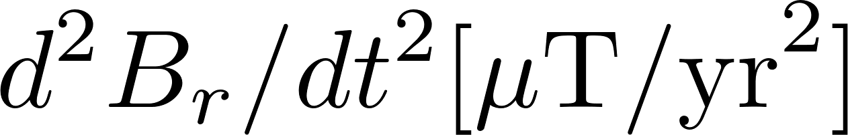
Application: Core surface field secular acceleration
CHAOS-7
Swarm
Only ground observatories
CHAMP

Slide 38
Application: Core surface field secular acceleration
CHAOS-7
SOLA: Local Inversion of CHAMP,
Cryosat and Swarm data (Hammer & Finlay 2019)
Swarm
Cryosat
CHAMP

Slide 39
Summary and Conclusion
Almost every satellite carries magnetometers for navigational purposes
Their data can be used for scientific investigations – after calibration
Quality of magnetometer data and s/c disturbances is very different
from satellite to satellite – be prepared for surprises!
Data can be used for core field studies and for investigating ionospheric and magnetospheric current systems - Space-weather applications
Enormous potential for science and application
Magnetic data for CryoSat-2 (GRACE and GRACE-FO will follow soon)
are available as daily files in CDF (similar to Swarm L1b data)
at ftp://swarm-diss.eo.esa.int/
and at Swarm ViRES/VRE online service https://vires.services
We are working towards calibration and
distribution of platform magnetometer data
from other ESA satellite missions (e.g. Sentinel-3, …)

Slide 40
