Slide 1
New "quite time" concept: application to Champ lithospheric field modelling Nils Olsen, Jesper Gjerløv & Co.

Slide 2
”Quiet Times” and Internal Field Modeling
”Quiet times” means reduced external (ionospheric and magnetospheric) contributions
Does not necessarily mean absence of external contributions
Important for field modeling: the remaining external “noise” should have “zero mean” …
… and thus hopefully averages out and leads to an unbiased internal field model, although it will increase the rms misfit.

Slide 3
Test of SMDL indices with Lithospheric Field Modeling
CHAOS-4h: Field model derived from 2 years of low-altitude CHAMP data (Sept 2008 – Sept 2010), 30 sec sampling rate
Non-polar regions (|QD lat| < 55°):
|dDst/dt| < 2 nT/hr Kp ≤2⁰
Fulfilled for 57 % of time
Polar regions (|QD lat| > 55°):
|dDst/dt| < 2 nT/hr E_{m} ≤ 0.8 mV/m
Fulfilled for 42 % of time
Only data from ”dark regions” (sun at least 10° below horizon)
Model parameterization
Crustal (static) field up to SH degree N = 100
Quadratic Secular Variation up to N = 16
Co-estimation of large-scale magnetospheric field parameterized by RC index and of Euler angles (of VFM – STR rotation) in bins of 10 days
Replace these selection criteria with SMDL criteria, with thresholds such that 57% of non-polar and 42% of polar data are chosen

Slide 4
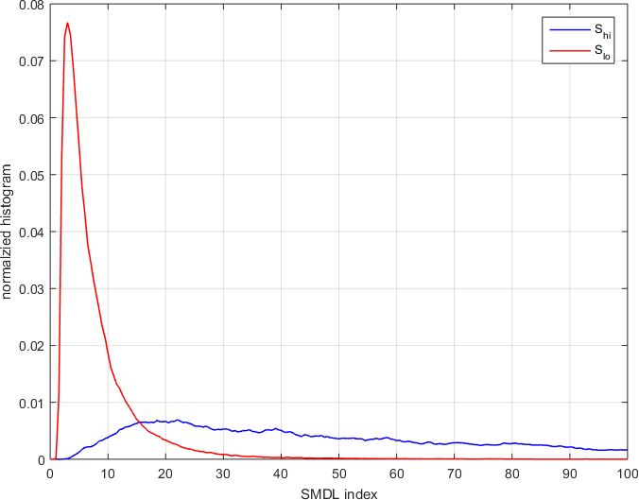
Histogram of SMDL indices (2008-2010)

Slide 5
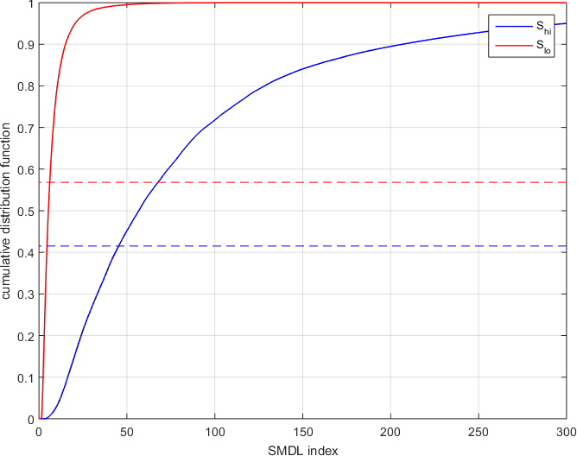
Cumulative Distribution
0.57
S_{lo} < 6.2 for 57% of time
S_{hi} < 48 for 42% of time
0.42
”SMDL field model”

Slide 6
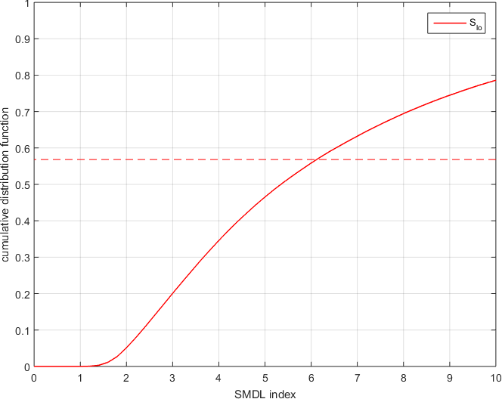
Cumulative Distribution
0.57
S_{lo} < 6.2 for 57% of time
S_{hi} < 48 for 42% of time
”SMDL field model”

Slide 7
Cumulative Distribution Modified Threshold values
0.57 + 10%
0.57
similar threshold modifications for S_{hi}
0.57 - 10%
”SMDL”
”SMDL-10%”
”SMDL+10%”
… and compare with CHAOS-4

Slide 8
Model Misfit
 | Non-polar rms [nT] |  |  |  | Polar rms [nT
 | # data | B_{r} | B_{θ} | B_{φ} | # data | F
CHAOS-4 | 275311 | 1.95 | 2.93 | 2.26 | 103463 | 3.72
SMDL | 274376 | 1.93 | 2.64 | 2.03 | 102887 | 3.72
SMDL-10% | 247317 | 1.90 | 2.56 | 1.99 | 95295 | 3.63
SMDL+10% | 305537 | 1.96 | 2.74 | 2.10 | 115810 | 3.91
Lower rms misfit with equal amount of data points

Slide 9
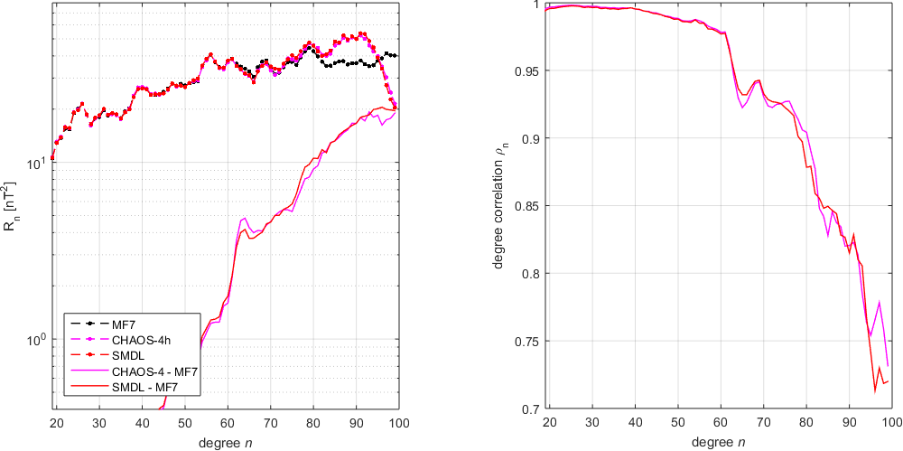
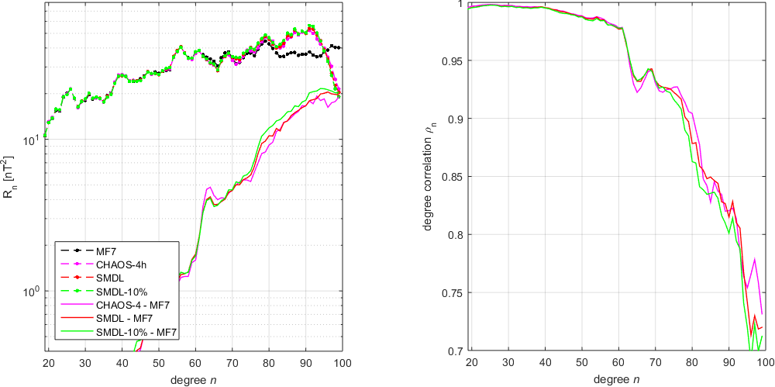
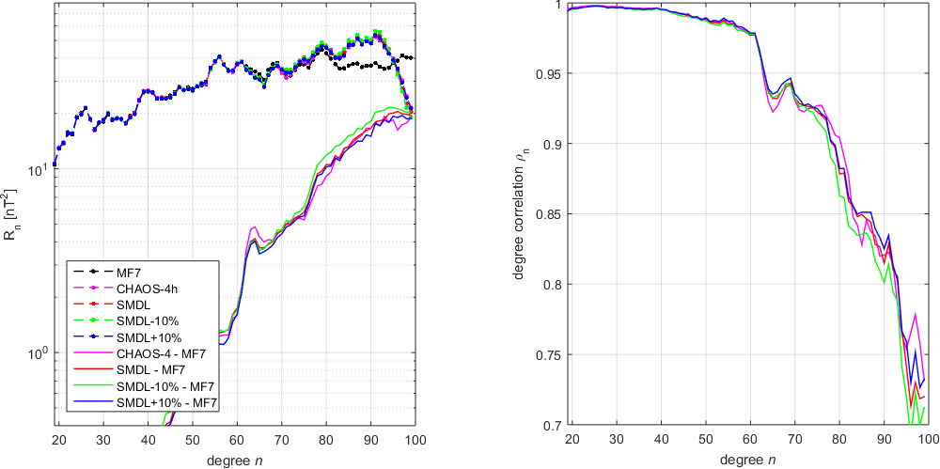
Crustal Field Spectra
But only very small change of field model

Slide 10
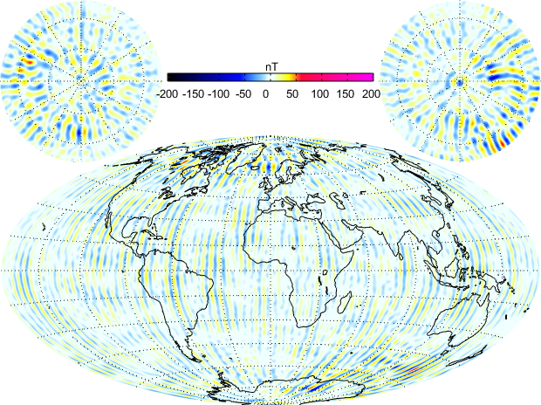
Maps of ΔBr at ground MF7 – CHAOS-4

Slide 11
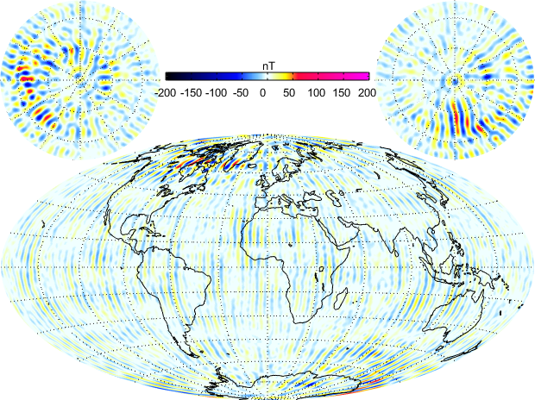
Maps of ΔBr at ground MF7 - SMDL

Slide 12
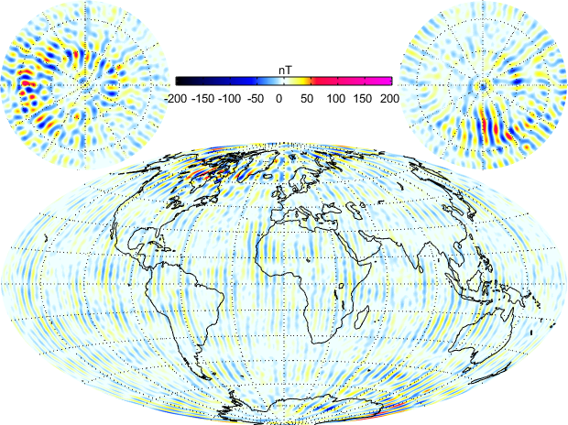
Maps of ΔBr at ground MF7 – SMDL-10%

Slide 13
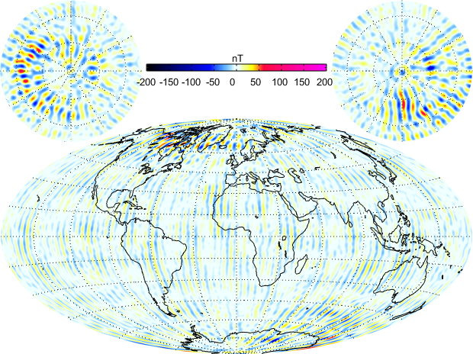
Maps of ΔBr at ground MF7 – SMDL+10%

Slide 14
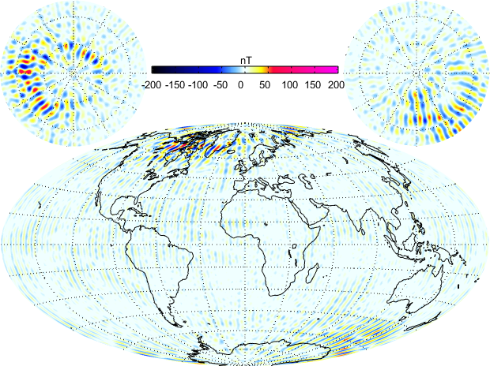
Maps of ΔBr at ground CHAOS-4 - SMDL

Slide 15
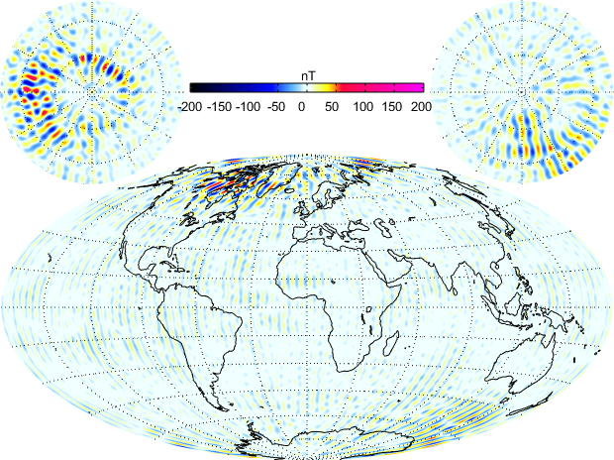
Maps of ΔBr at ground CHAOS-4 – SMDL-10%

Slide 16
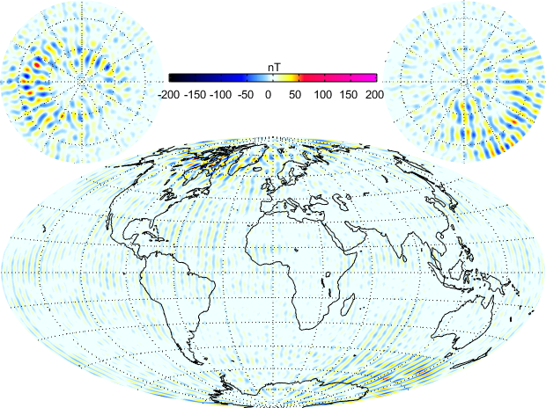
Maps of ΔBr at ground CHAOS-4 – SMDL+10%

Slide 17
Conclusions
SMDL selection criteria work – somehow!
Same amount of data selected using SMDL rather than dDst/dt and Kp leads to smaller model misfit, in particular at non-polar latitudes (10% reduction in B_{θ}, B_{φ})
Difference maps of Br (wrt MF7) indicate larger differences at polar latitudes but smaller differences at non-polar latitudes

Slide 18
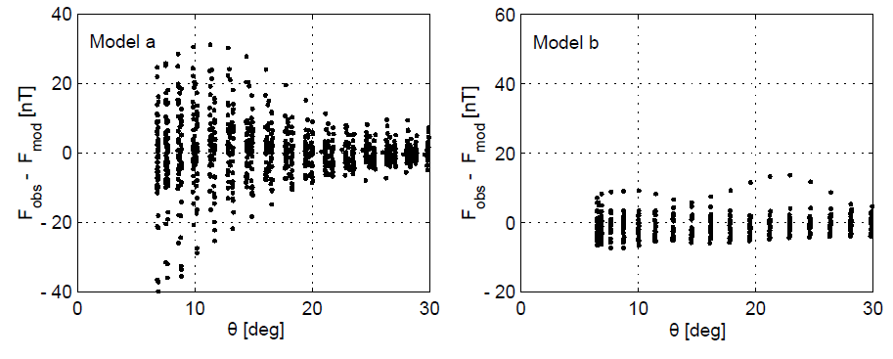
Bias vs misfit: Contamination of Magnetic Field Model due to Polar-Cap Currents
In Summer 1999: Determination of IGRF 2000 from Ørsted satellite data.
Only few geomagnetic quiet days with vector data available (May and Sept 1999)
Determination of two models:
Model a: 6 quiet days in May (10 May - 22 May)
Model b: 3 quiet days in Sept (23 Sept - 25 Sept)
Zero mean residuals in Northern polar cap for both models
Smaller misfit for Model b (Sept data) - better model?

Slide 19
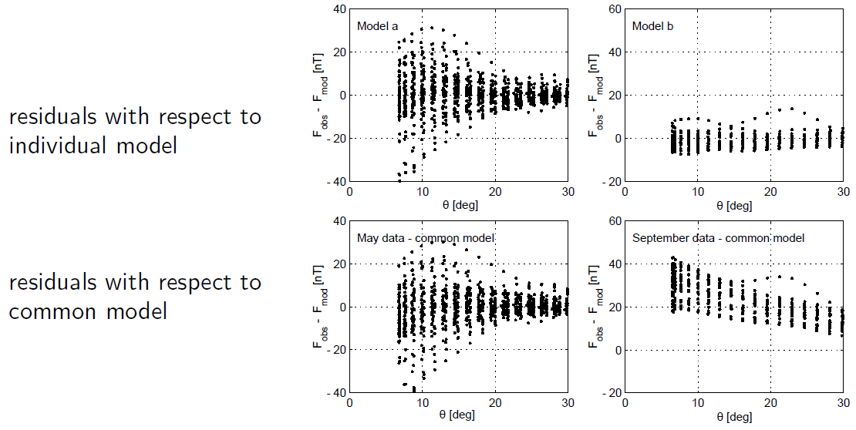
Bias vs misfit: Contamination of Magnetic Field Model due to Polar-Cap Currents

Slide 20
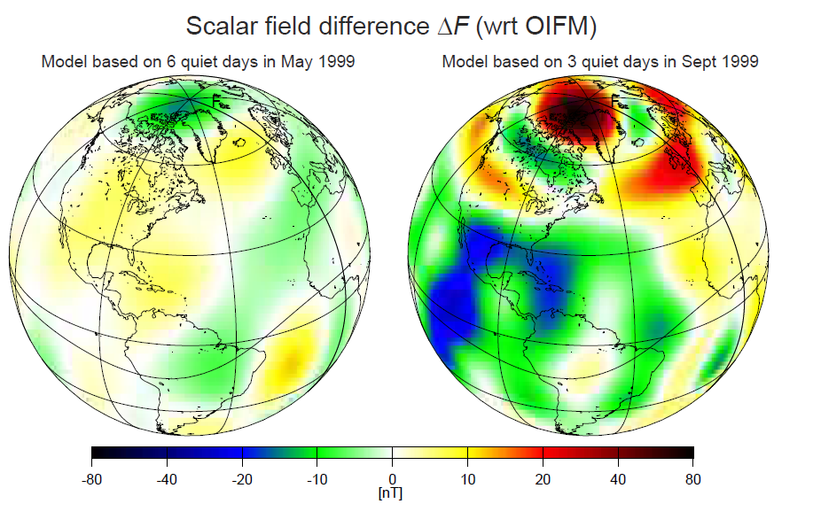
Bias vs misfit: Contamination of Magnetic Field Model due to Polar-Cap Currents

Slide 21
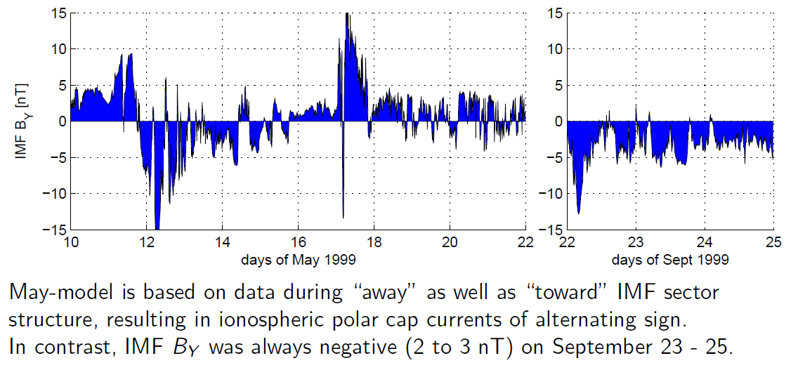
Bias vs misfit: Contamination of Magnetic Field Model due to Polar-Cap Currents

Slide 22
”Quiet Times” and Internal Field Modeling
”Quiet times” means reduced external (ionospheric and magnetospheric) contributions
Does not necessarily mean absence of external contributions
Important for field modeling: the remaining external “noise” should have “zero mean” …
… and thus hopefully averages out and leads to an unbiased internal field model, although it will increase the rms misfit.
Perhaps SMDL selection results in ”reduced” external contributions, but of preferred (i.e. biased) magnetic field direction of the remaining part?

