Slide 1
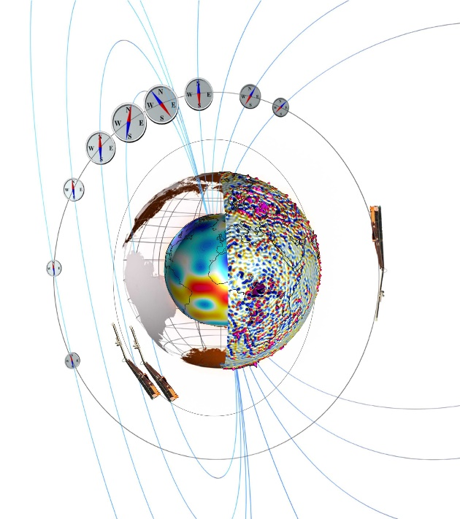
Swarm and beyond - exploring Earth's magnetic field from Space using ESA's satellite trio and other data
Nils Olsen (DTU Space, Denmark) with help from many experts
Data Quality Monitoring
Evolution of the Swarm Constellation
Swarm combined with other data sets
Take-home message:
Excellent data quality – still! Swarm is ready for the next few years
New science opportunities due to present close conjunction of satellites
Combination of Swarm with other data where is Swarm unique, and when do other satellites / data sources help?

Slide 2
Swarm Objectives for the Mission Extension Recommendations by ESA ACEO, October 2017
Capturing and understanding the Earth’s core dynamics
Mapping and understanding the near-Earth environment response to the solar cycle
Distinguishing spatial and temporal variation in the near-Earth environment
Mapping ocean tides and the electrical conductivity of the mantle
Versatile opportunities at the cutting edge of Earth and space physics and the understanding of physical coupling between terrestrial and space weather

Slide 3
Swarm Objectives for the Mission Extension Recommendations by ESA ACEO, October 2017
Capturing and understanding the Earth’s core dynamics
Mapping and understanding the near-Earth environment response to the solar cycle
Distinguishing spatial and temporal variation in the near-Earth environment
Mapping ocean tides and the electrical conductivity of the mantle
Versatile opportunities at the cutting edge of Earth and space physics and the understanding of physical coupling between terrestrial and space weather

Slide 5
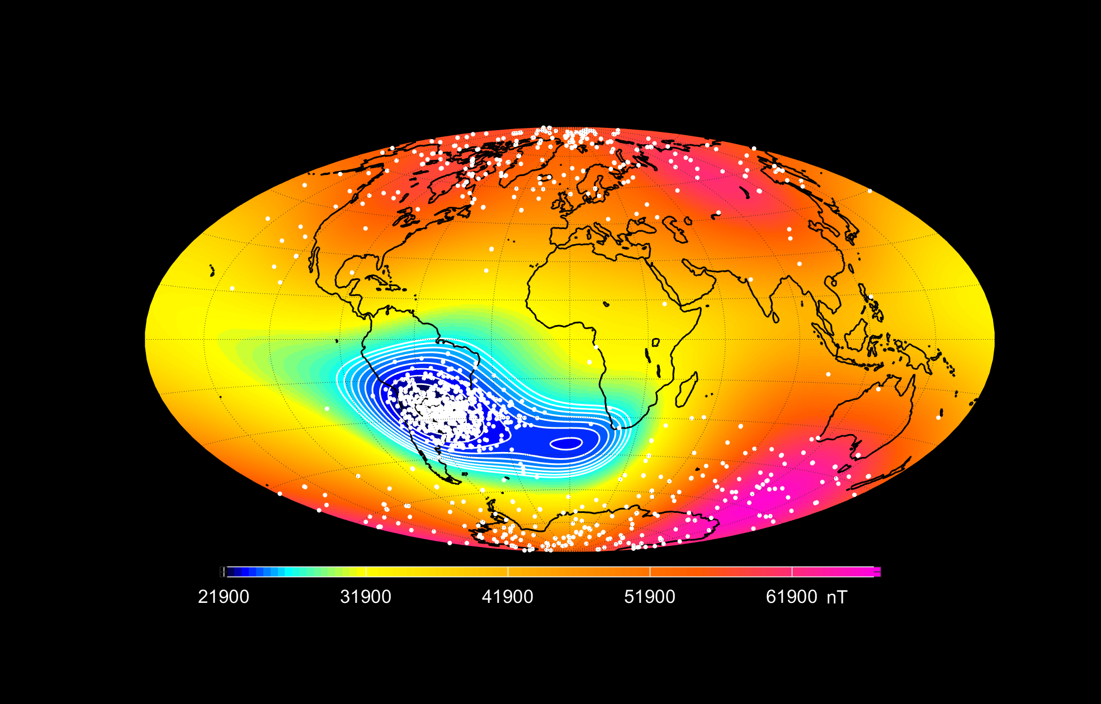
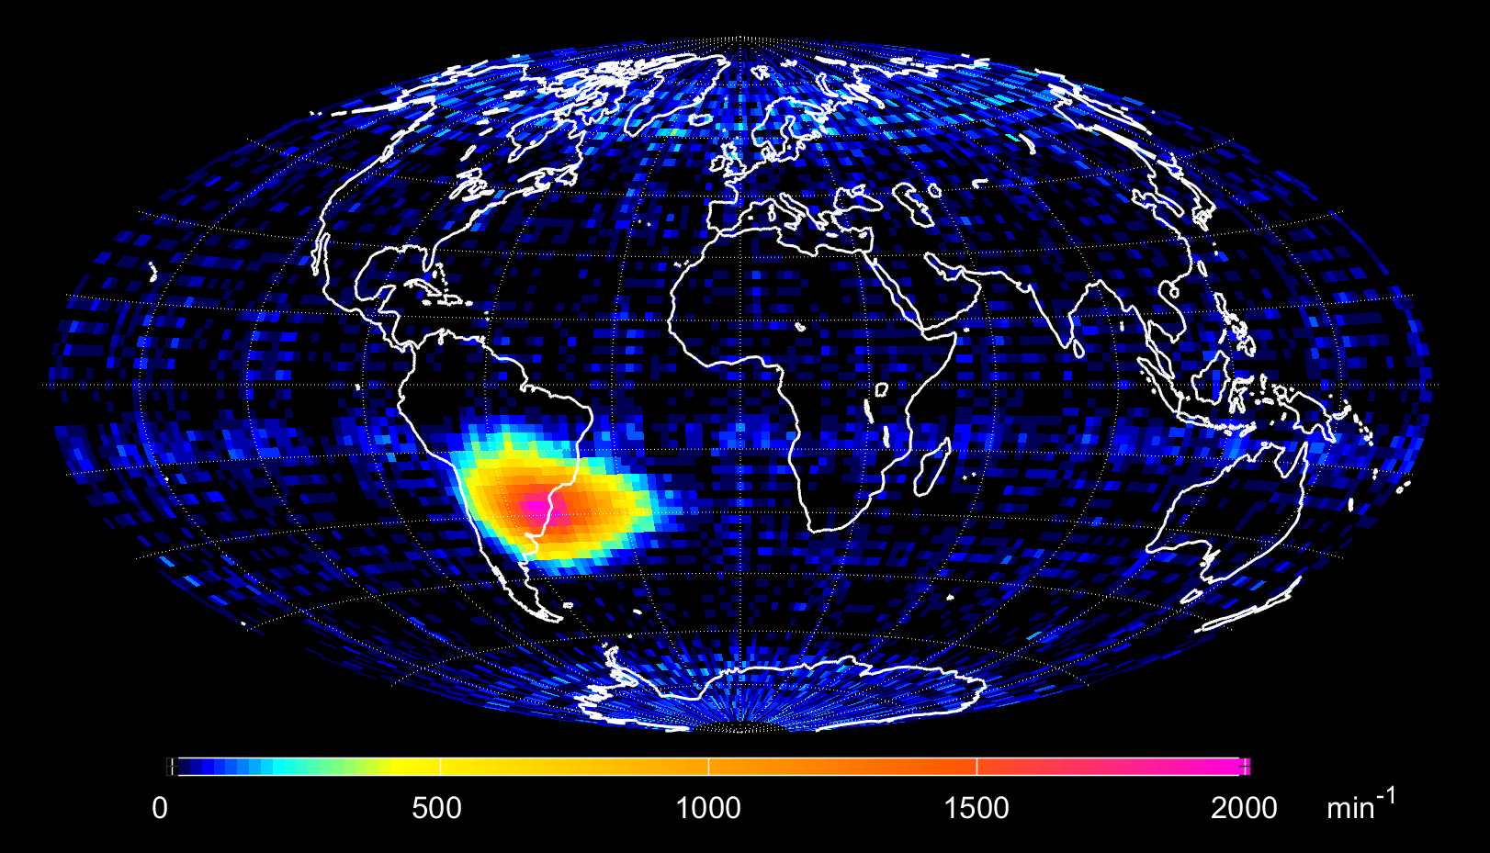
Swarm Star Tracker “Hotspot” count rate monitors high energy (> 20 MeV) particle radiation since 2018
April 2018
courtesy Christina Toldbo session #7, Thursday afternoon

Slide 6
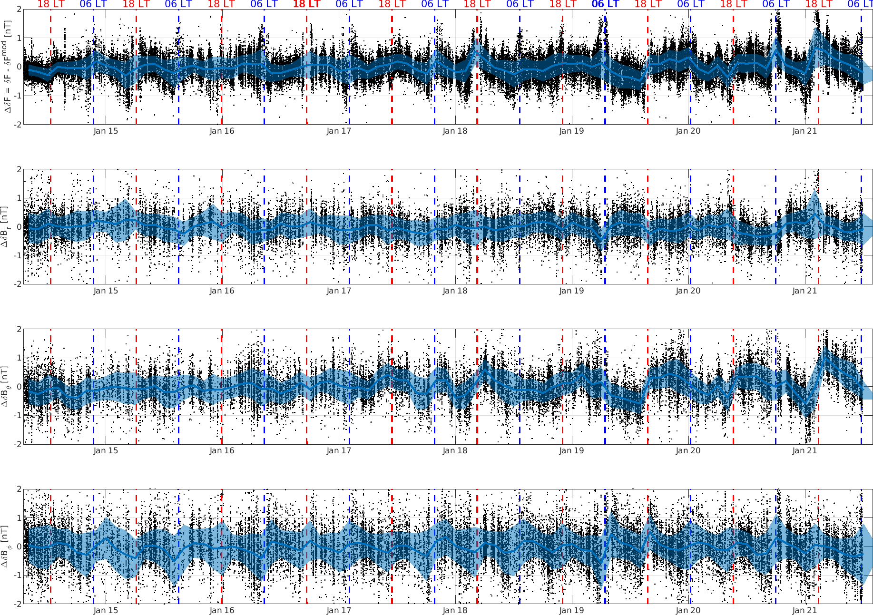
Data Quality Monitoring: Magnetic Residual Difference between Swarm-A and Swarm-C
Difference in magnetic vector components between Alpha and Charlie (after subtraction of CHAOS-7.8 model) provides independent check of
VFM calibration
dB_{Sun} disturbance correction
VFM – STR alignment (Euler angles)
Less than 0.5 nT rms difference – well within mission specifications
These are maximum data error estimates since geophysical signals not captured by CHAOS-7.8 contribute to observed scatter.
No sign of data quality degradation

Slide 7
Evolution of longitudinal separation Swarm Charlie - Alpha
Smaller East-West separation allows for improved calibration/validation …
… and is great for some science
Mission baseline: 1.4°
155 km @ equator
Separation decreases since Oct 2019
Oct 2020: 0.74°
82 km @ equator
zero longitudinal separation in Oct 2021
courtesy Detlef Sieg

Slide 8
Just in time for DQW#11: Small distance between Alpha and Charlie
August 2021: Alpha follows Charlie after 4 s 0.1° separation in longitude
1 October 2021: Alpha follows Charlie after 2 s 0.0° separation in longitude

Slide 9
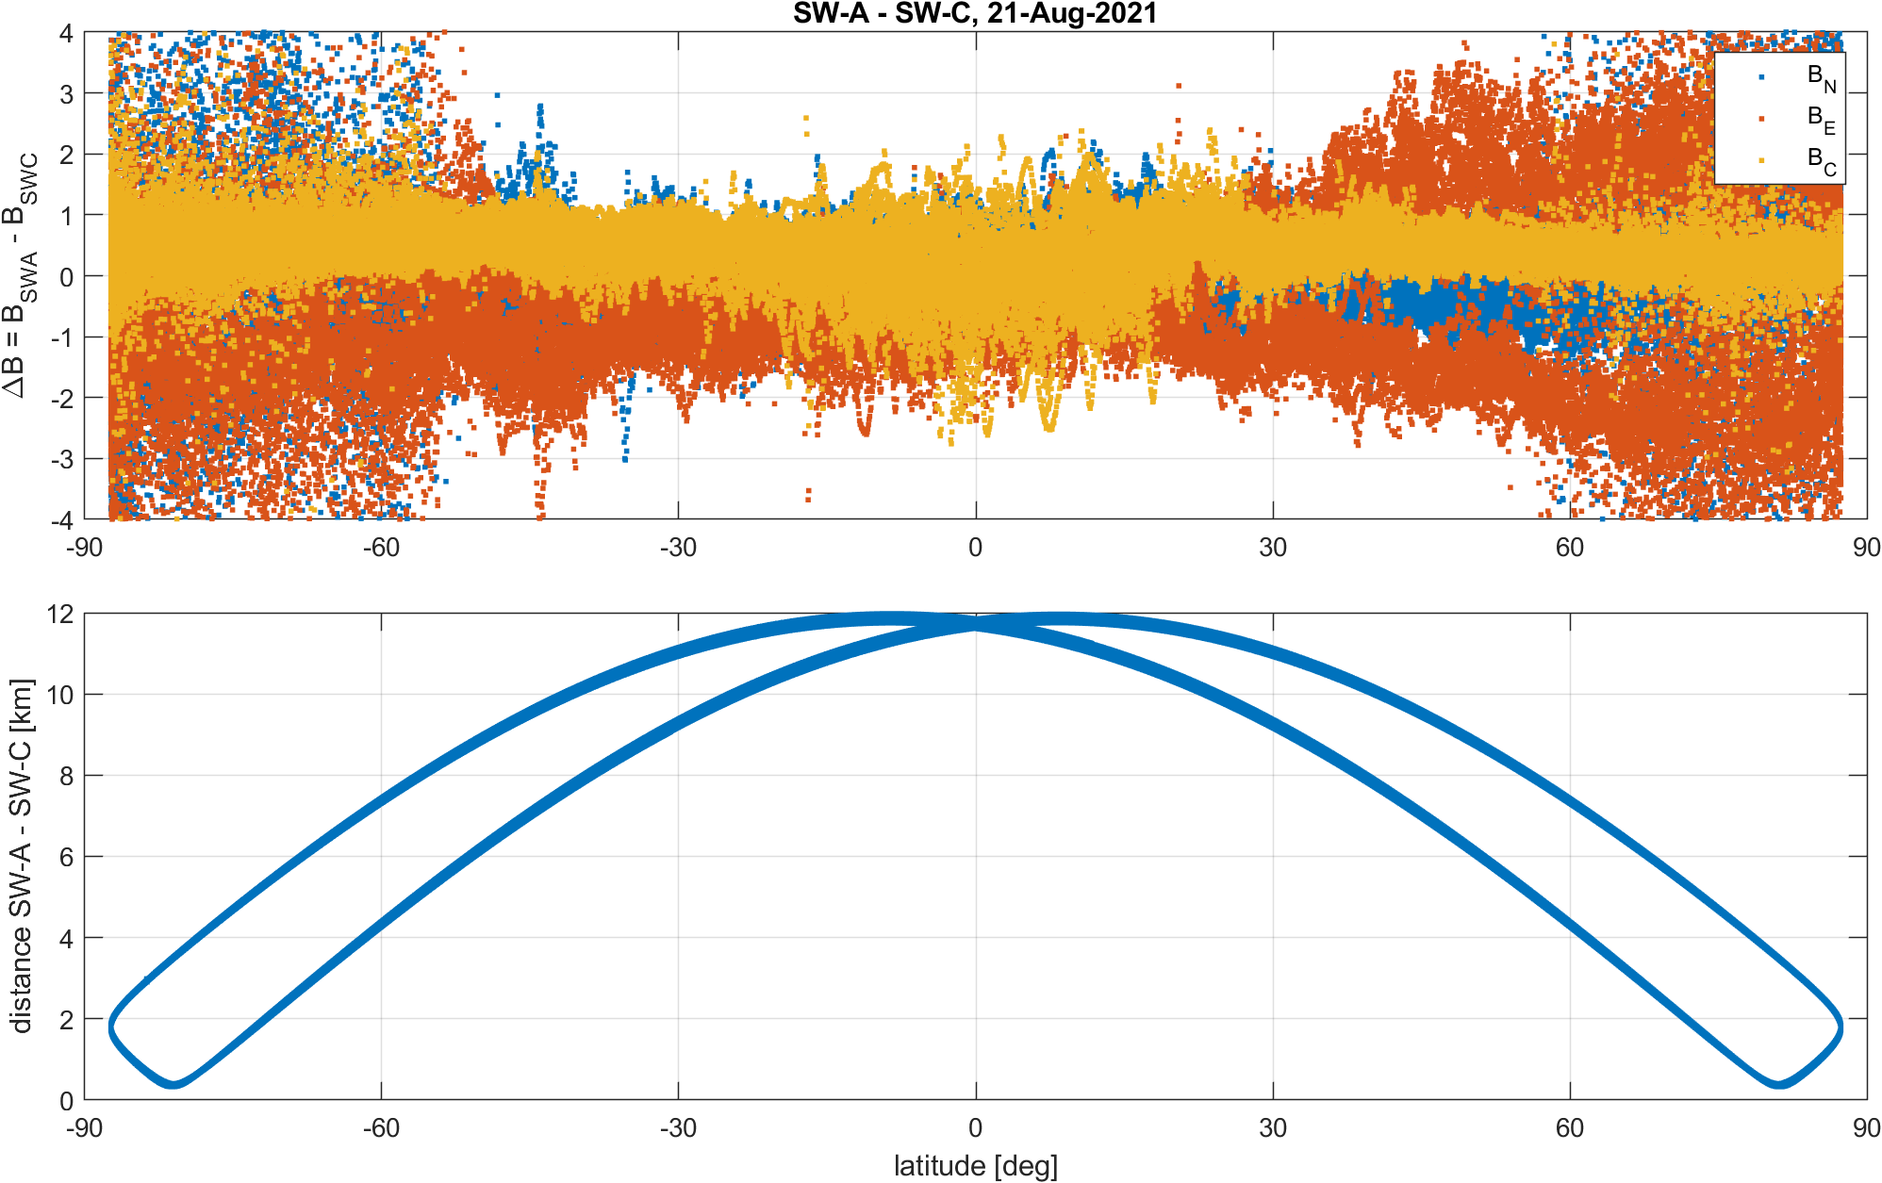
Just in time for DQW#11: Small distance between Alpha and Charlie
Magnetic vector difference Alpha – Charlie after removal of CHAOS 7.8 model
21 Aug 2021, Ap = 3 nT (Kp = 0 – 1o)
0.10° separation in longitude
Distance between satellites <12 km after correcting for time shift of 4 s
baseline 06 data

Slide 10
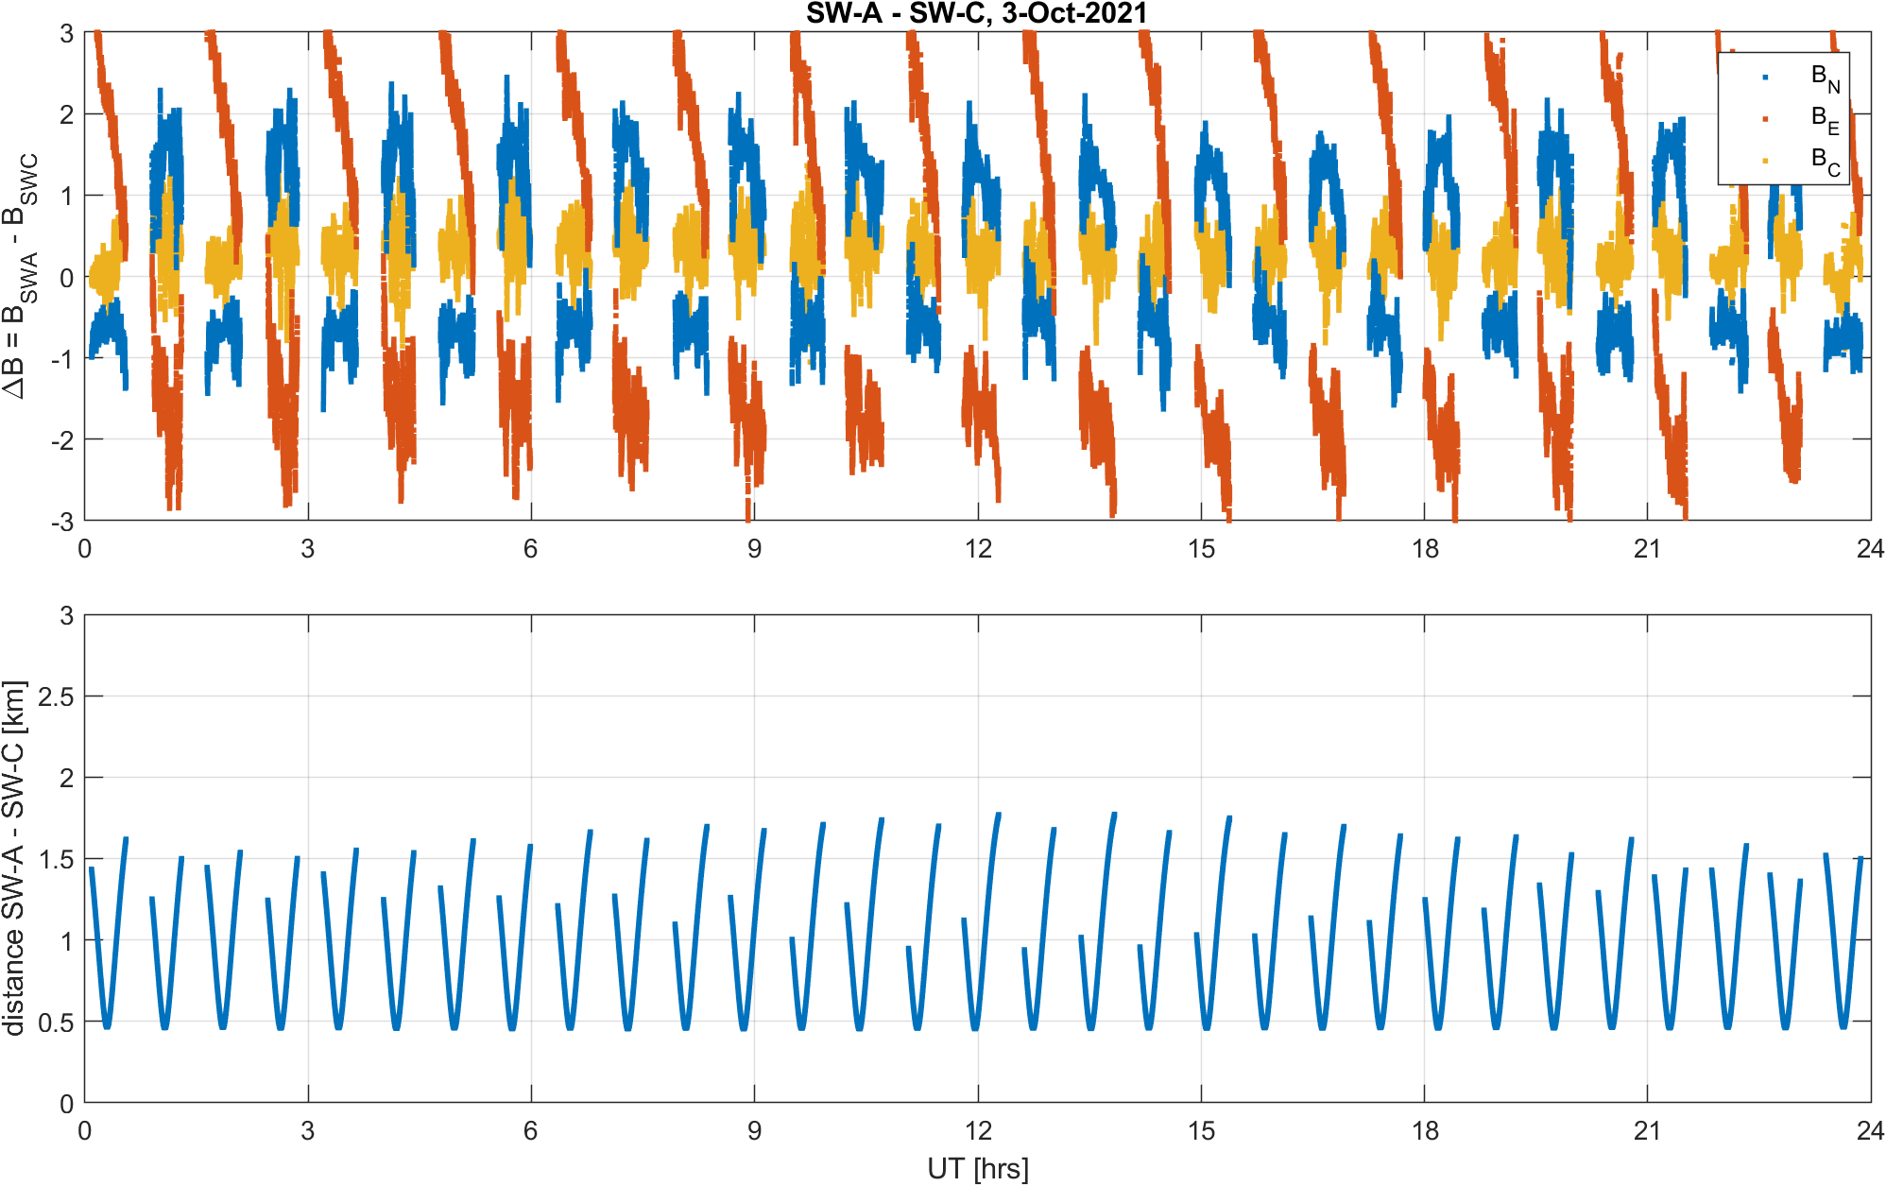
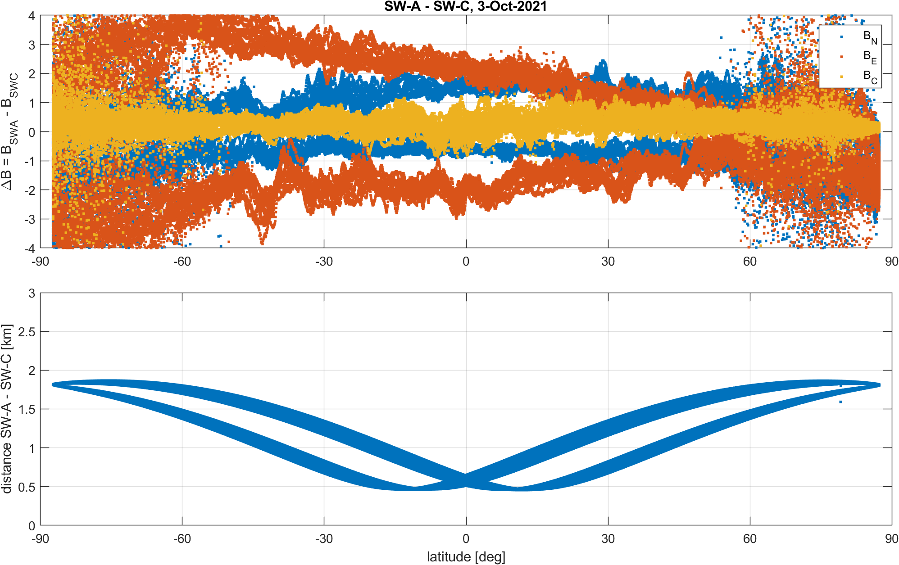
Just in time for DQW#11: Small distance between Alpha and Charlie
Magnetic vector difference Alpha – Charlie after removal of CHAOS 7.8 model
3 Oct 2021, Ap = 5 nT (Kp = 0 – 2o)
0.00° separation in longitude
Distance between satellites < 2 km after correcting for time shift of 2 s
This is baseline 05 data (not properly corrected for dB_Sun disturbance) Baseline 06 for Sept + Oct 2021 not yet available

Slide 11
Swarm Objectives for the Mission Extension Recommendations by ESA ACEO, October 2017
Capturing and understanding the Earth’s core dynamics
Mapping and understanding the near-Earth environment response to the solar cycle
Distinguishing spatial and temporal variation in the near-Earth environment
Mapping ocean tides and the electrical conductivity of the mantle
Versatile opportunities at the cutting edge of Earth and space physics and the understanding of physical coupling between terrestrial and space weather

Slide 12
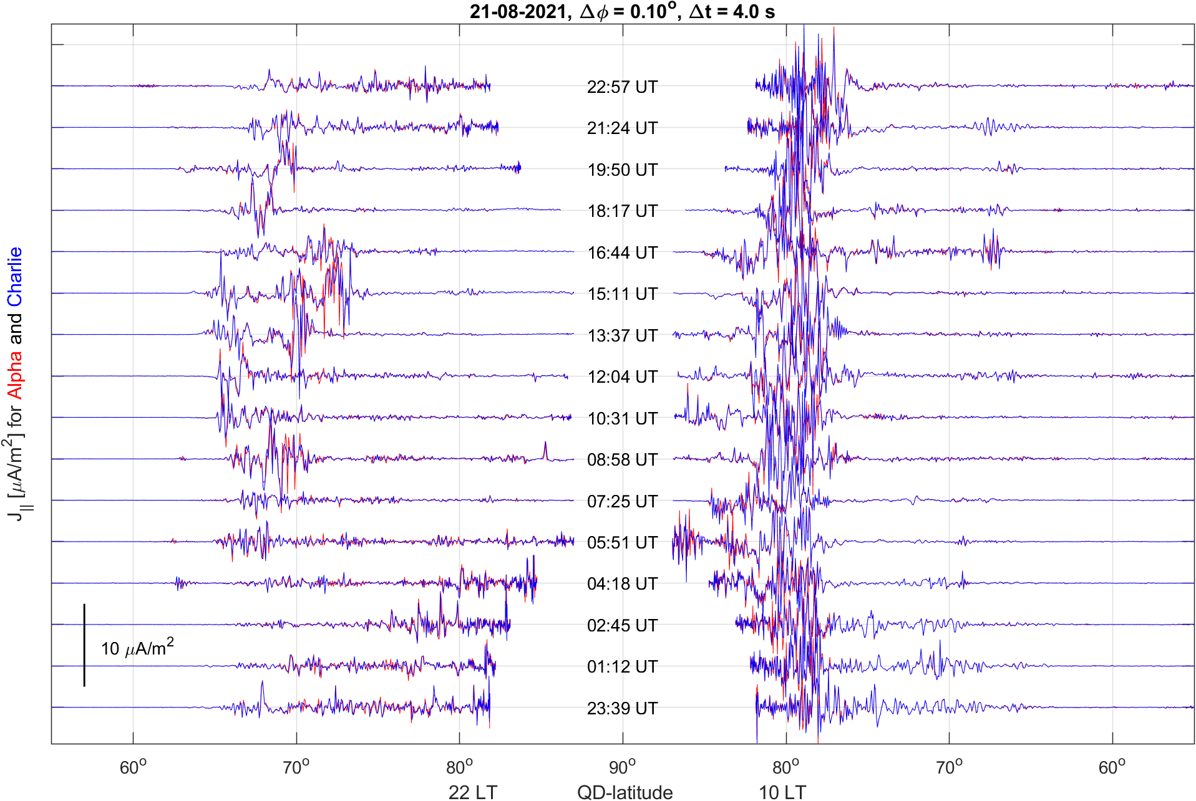
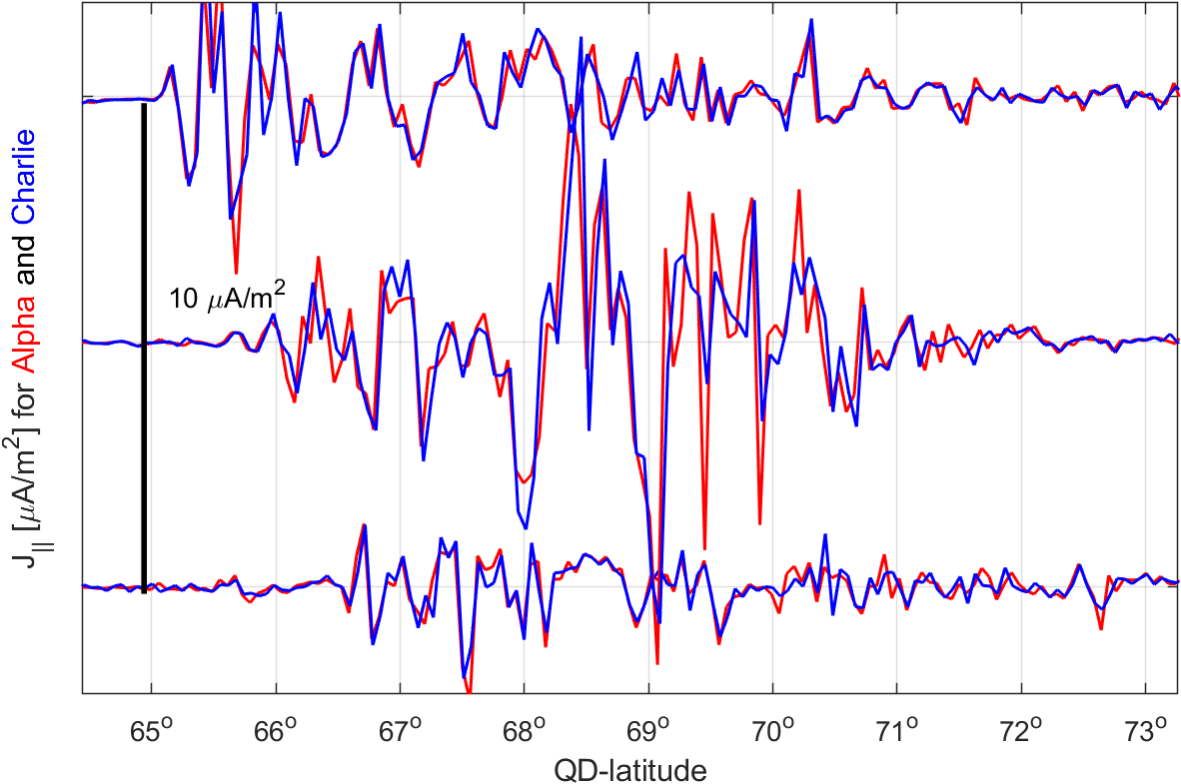
Field-Aligned Currents
Level2 product Alpha and Charlie
21 Aug 2021, Ap = 3 nT (Kp = 0 – 1o)
0.10° separation in longitude
Distance between satellites < 4 km after correcting for time shift of 4 s

Slide 13
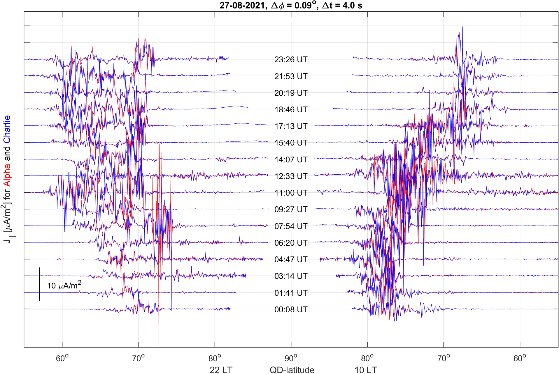
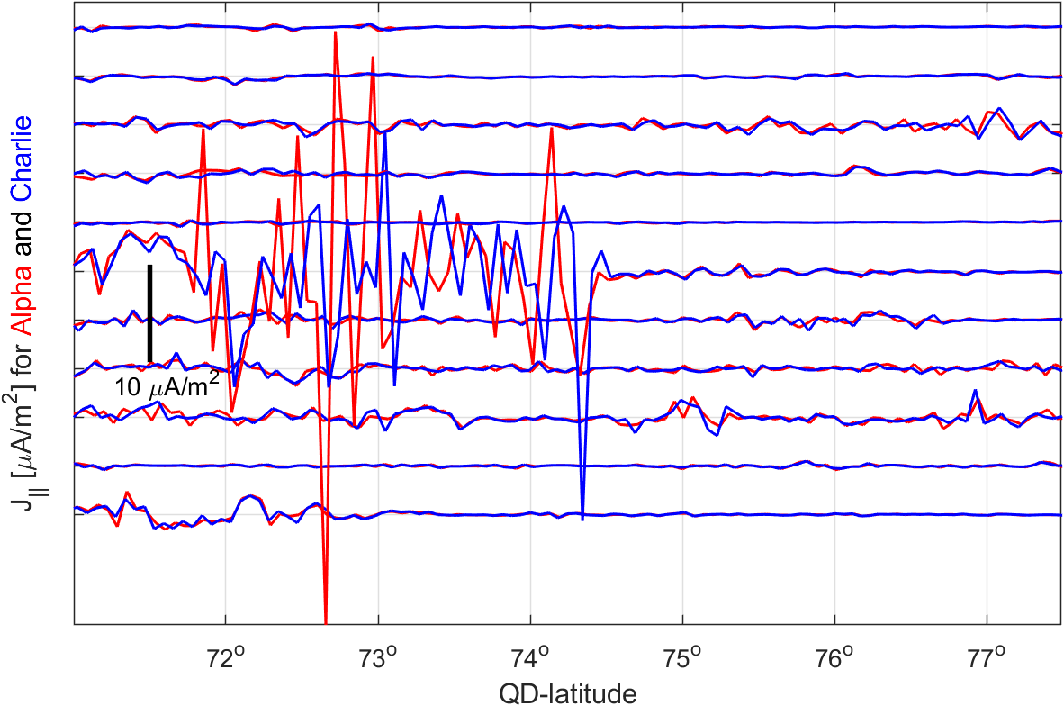
Field-Aligned Currents
Level2 product Alpha and Charlie
27 Aug 2021, Ap = 21 nT (Kp about 4)
0.09° separation in longitude
Distance between satellites < 4 km after correcting for time shift of 4 s

Slide 14
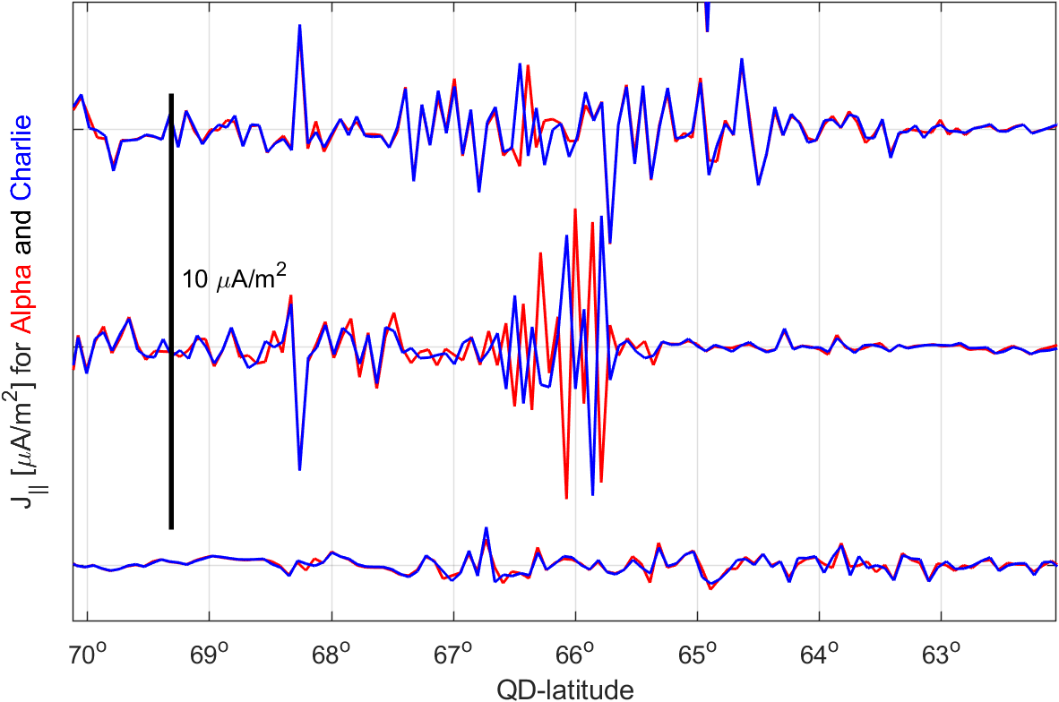
Field-Aligned Currents
Level2 product Alpha and Charlie
3 Oct 2021, Ap = 5 nT (Kp = 0 – 2o)
0.00° separation in longitude
Distance between satellites < 2 km after correcting for time shift of 2 s

Slide 15
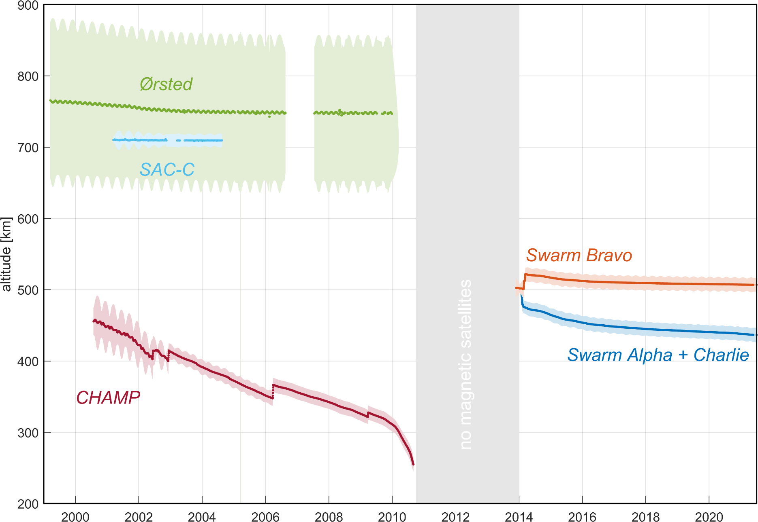
Why more satellites for exploring Earth’s magnetic field?
No high-precision magnetic field data are available in the gap between CHAMP and Swarm (Oct 2010 and Nov 2013)

Slide 16
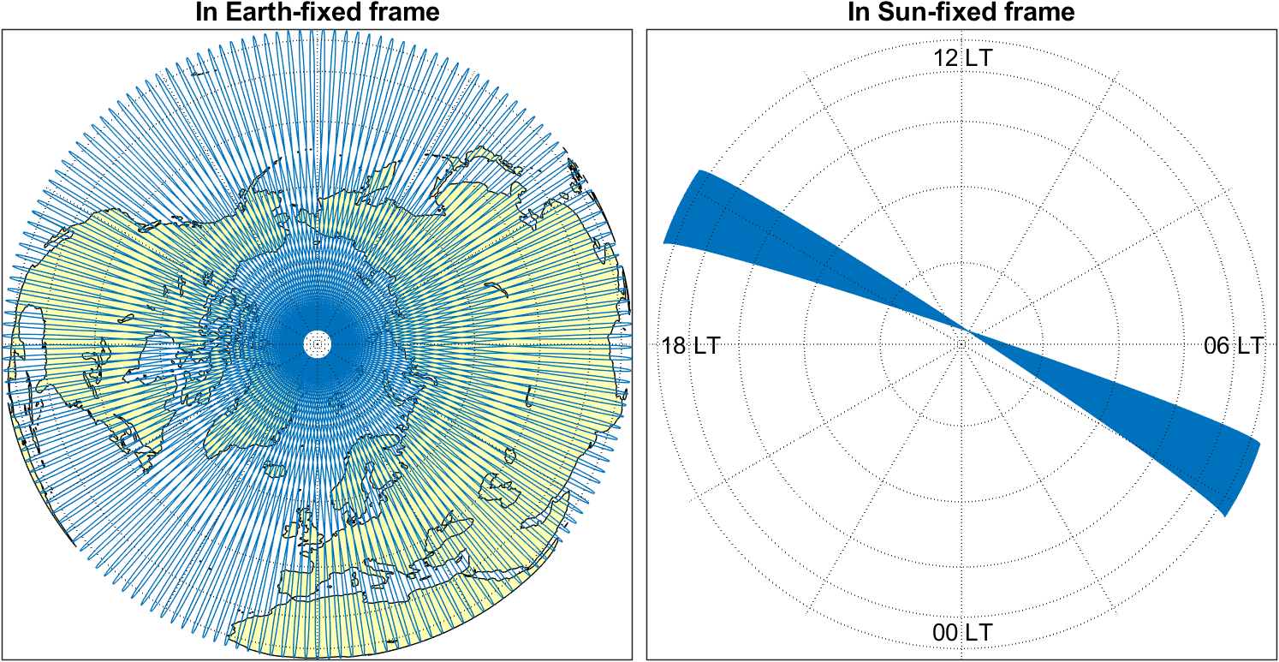
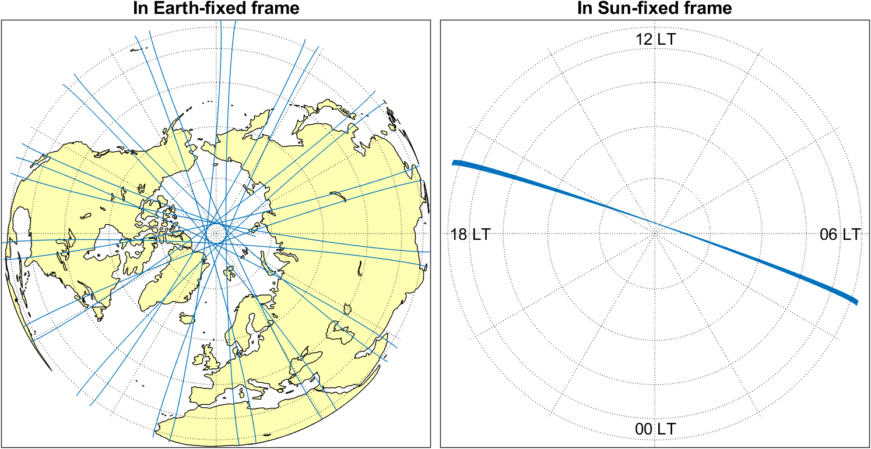
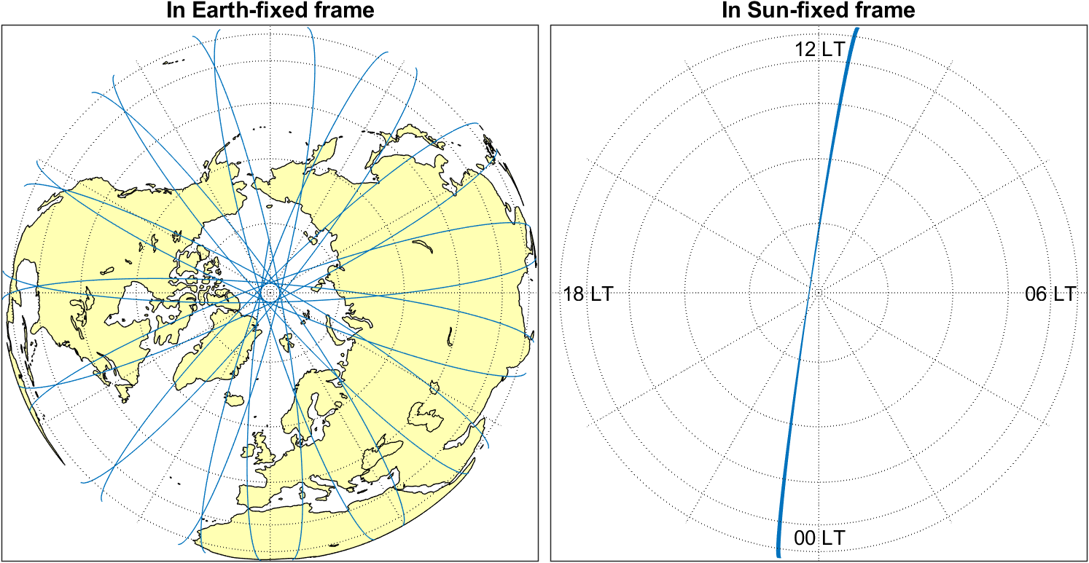
Why more satellites for exploring Earth’s magnetic field?
Ionospheric and magnetospheric electric current systems are oriented wrt Sun
Single satellites only measure at one specific local time (slowly drifting in time)
Simultaneous magnetic data from many satellites allows to detangle time-space structure of external sources
Swarm Alpha, 1 Aug 2018
Swarm Alpha, 1 - 11 Aug 2018

Slide 17
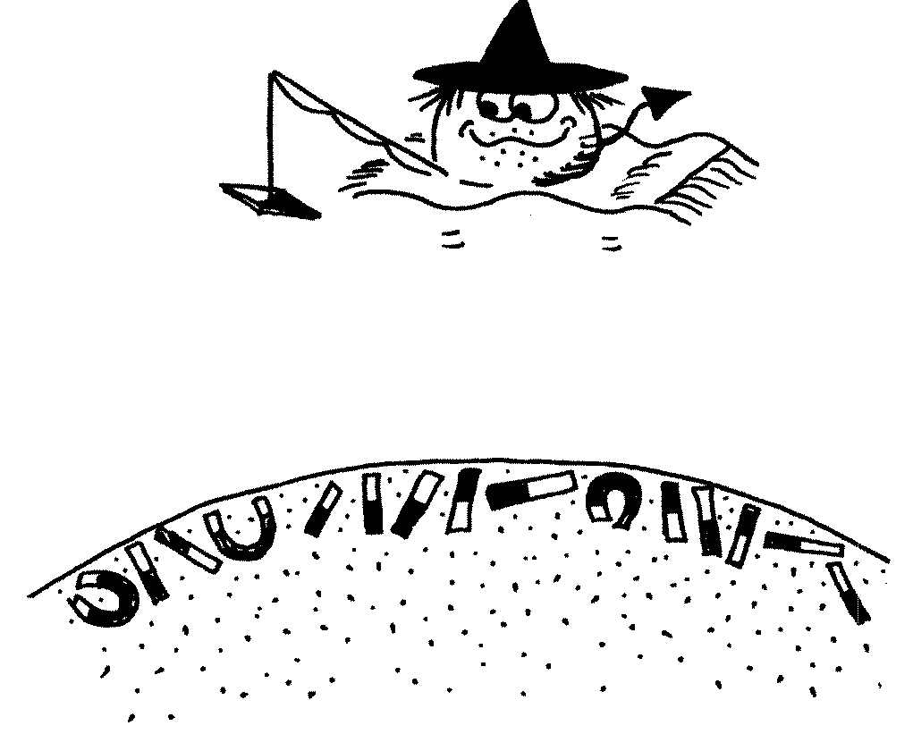
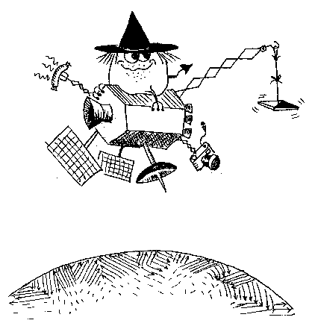
While waiting for dedicated satellite for mapping Earth’s magnetic field like MacauSat and NanoMagSat (see session Thursday this week): Most satellites carry magnetometer for navigational purposes as part of their AOCS (Attitude and Orbit Control System) The data of these AOCS magnetometers have scientific value but data calibration is essential Towards a true swarm of satellites …
Daily files of calibrated magnetic data for CryoSat-2, GRACE, GRACE-FO available through www.vires.services and at ftp.swarm-diss.eo.esa.int

Slide 18
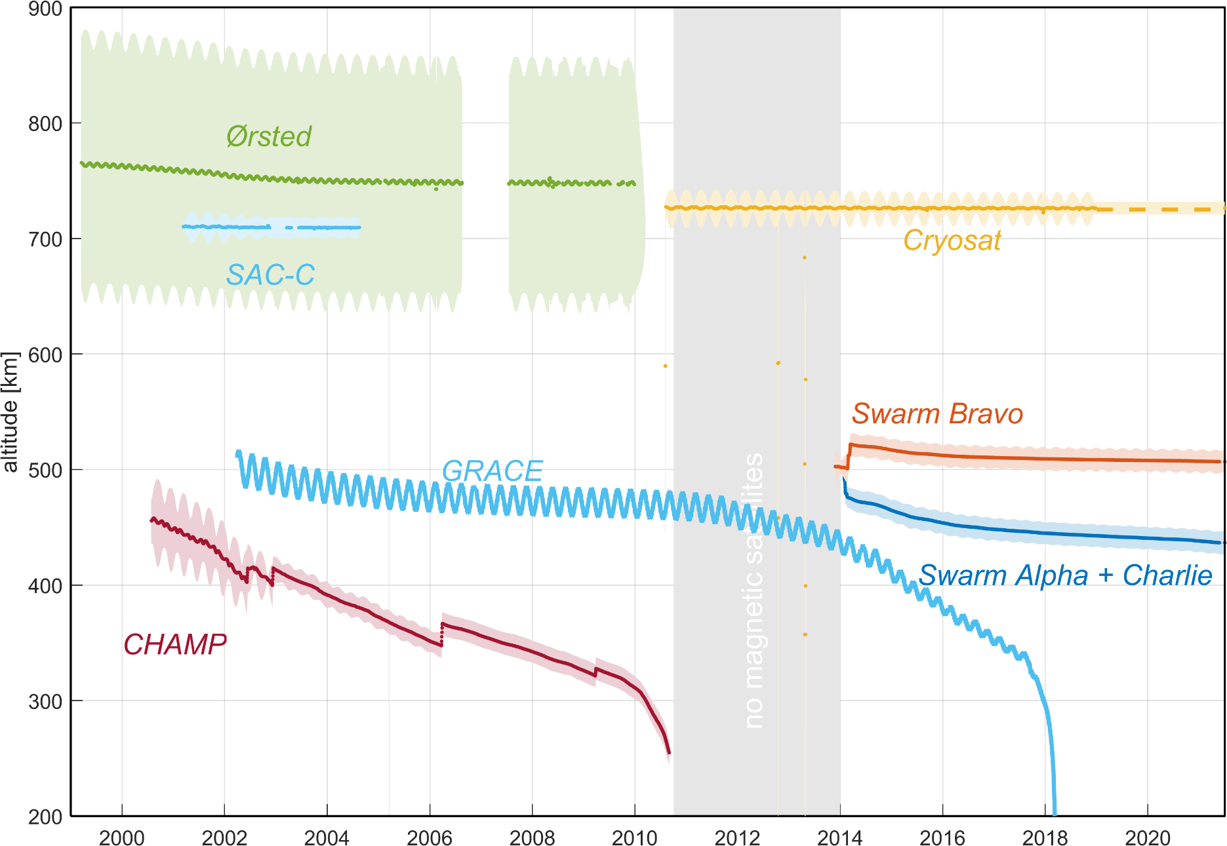
Why more satellites for exploring Earth’s magnetic field?
No high-precision magnetic field data are available in the gap between CHAMP and Swarm (Oct 2010 and Nov 2013)
CryoSat-2 and GRACE help to fill this gap, for improved study of the dynamics of Earth’s core field

Slide 19
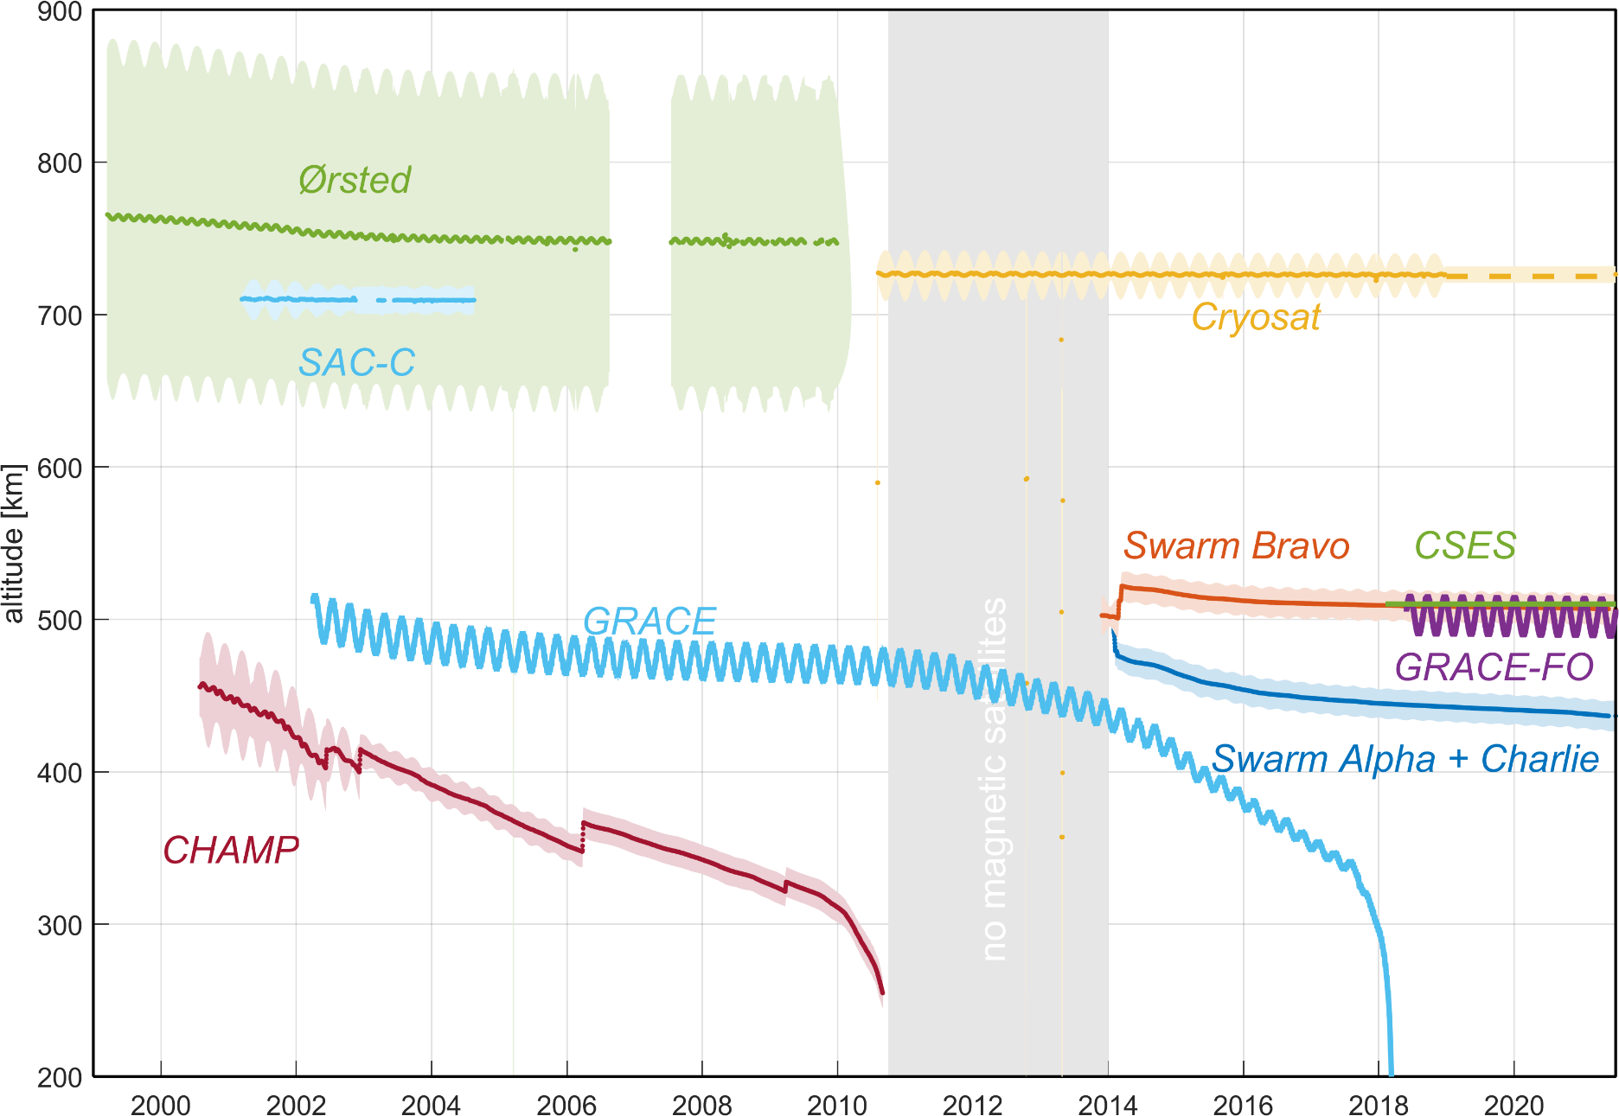
Why more satellites for exploring Earth’s magnetic field?
No high-precision magnetic field data are available in the gap between CHAMP and Swarm (Oct 2010 and Nov 2013)
CryoSat-2 and GRACE help to fill this gap, for improved study of the dynamics of Earth’s core field
Swarm, GRACE-FO and CSES provide simultaneous data for improved time-space separation of external sources

Slide 20
Local Time evolution of Swarm, CryoSat-2 and GRACE
Swarm A/C change in LT of 2.73 hrs/month all LT in 4.4 months
Swarm B change in LT of 2.61 hrs/month all LT in 4.6 months
CryoSat-2 change in LT of 1.51 hrs/month all LT in 8.0 months
GRACE A/B change in LT of 2.24 hrs/month all LT in 5.3 months

Slide 21
Local Time evolution of Swarm, CryoSat-2, GRACE-FO and CSES
Swarm A/C change in LT of 2.73 hrs/month all LT in 4.4 months
Swarm B change in LT of 2.61 hrs/month all LT in 4.6 months
CryoSat-2 change in LT of 1.50 hrs/month all LT in 8.0 months
GRACE-FO A/B change in LT of 0.59 hrs/month all LT in 20.2 months
CSES fixed LT at 02/14

Slide 22
Conclusions
Swarm is prepared for the next few years until next solar minimum in 2031 ?
Combination of Swarm with other data sources where is Swarm unique, and when do other satellites / data sources help?
New science opportunities and applications – new Swarm data users e.g. space science / space weather
Towards System Science

